Slide 1
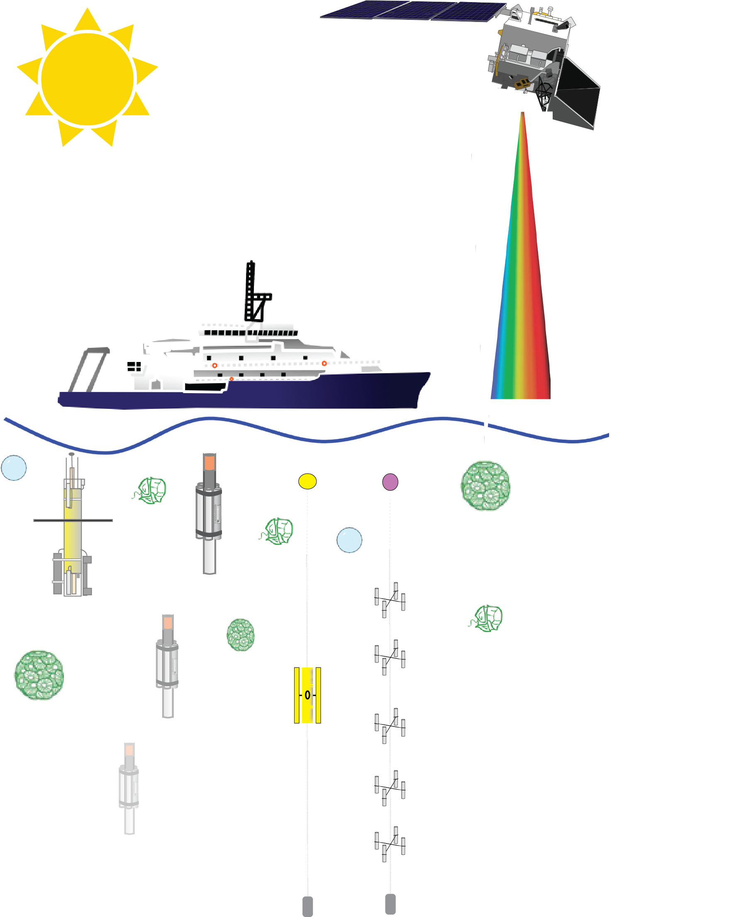

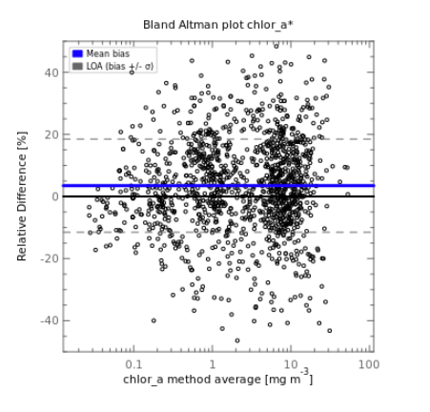





SeaBASS Discussion
UWG Meeting
June 10, 2025
SeaBASS
Data Archive
Data Format (.sb)
Services & Tools
Satellite Validation
Data Publicly Available
Notes:
1

Slide 2
Outline
  Brief updates and upcoming plans
  Data Archival
  QA/QC
  System Updates (Database)
  What’s on the horizon
    Validation updates
    Further NASA Earthdata integration
Conversation and discussion very much welcomed; please ask questions during or after.
Notes:
Presentation covers with news, recent updates, and plans relevant to familiar users. My hope is to facilitate conversation - almost all the time is for conversation.

Slide 3
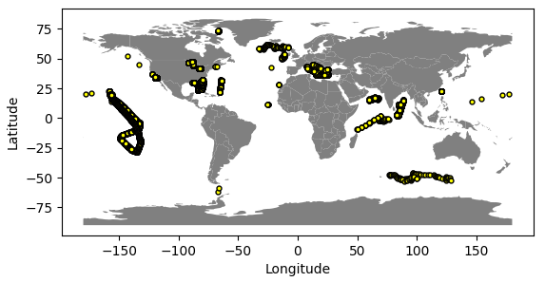
Recently Archived Data Summary
19,500 data files from 190 cruises archived May 2024-2025
Further enriched by resubmissions (More on this later)
Notes:
18,000 data files from 400+ cruises archived April 2023-2024
6,600 data files from 60 cruises archived April 2022-2023

Slide 4
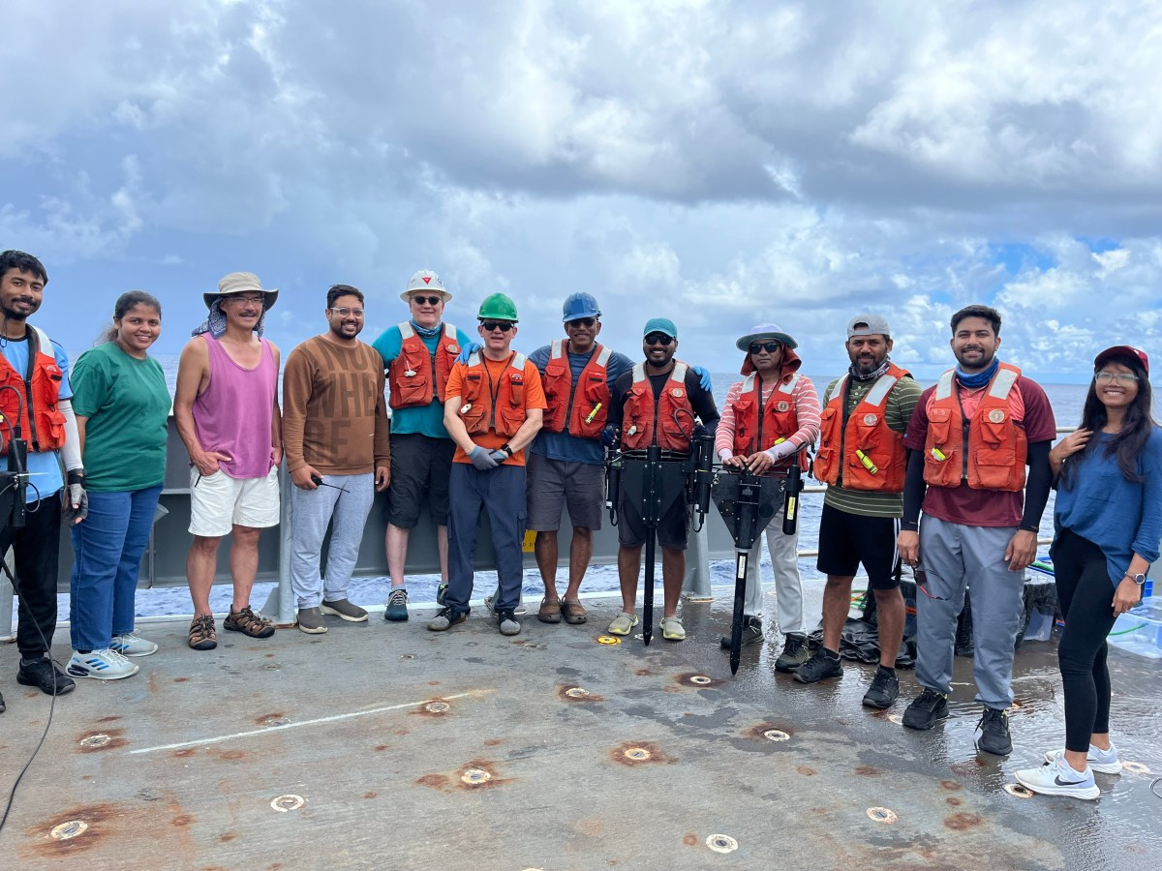
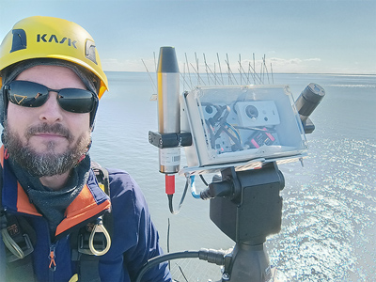
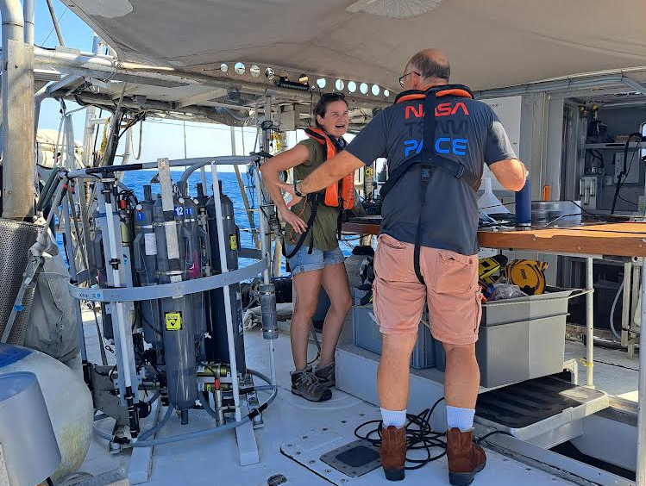
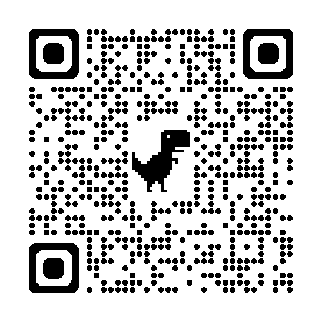
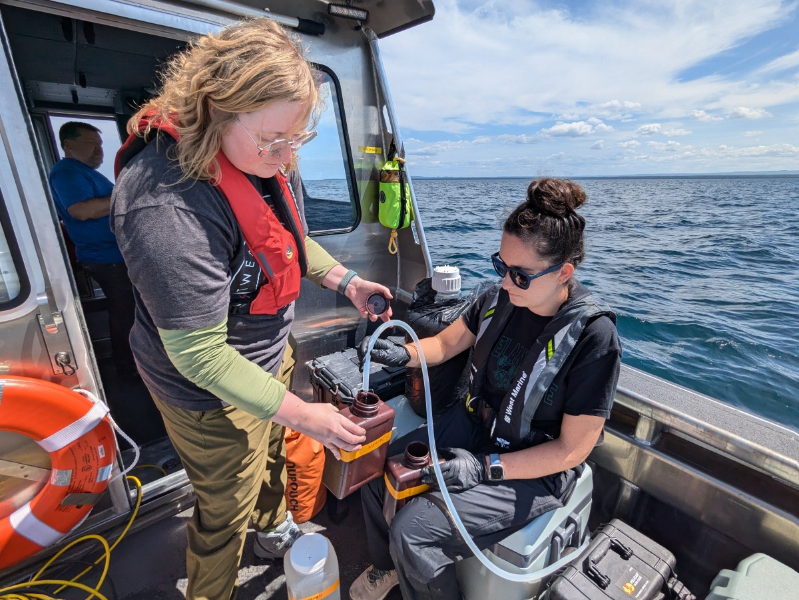
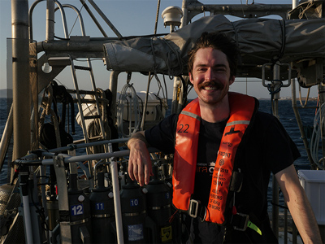
PVST: Biggest source of recent submissions
NASA-funded Teams devoted to PACE Validation
Main PI name | SeaBASS experiment name
B. K. Grunert | PVST_PRINGLS
A. Chase | PVST_SOPACE, TARA_EUROPA
R. Foster | PVST_POL
F. Henderikx-Freitas | PVST_HOTPACE
S. Maritorena | PVST_SBCR
M. Ondrusek | VIIRS_VALIDATION, PACE-PAX
K. Turpie | PVST_WATERHYPERNET*
J. Goes | PVST_NORTHERN_INDIAN_OCEAN
L. S. Guild | PVST_AIRSHARP
N. Haentjens | PVST_VOSDIUP
X. Zhang | PVST_AUV_GOM
O. Torres | PVST_UVAAP
S. Tsay | PVST_SMART
E. J. Hochberg | PVST_PSST
C. Anderson | PVST_CALCOFI
S. P. Broccardo | PVST_SEASTAR
J. R. Graff | PVST_PBR
C. Mitchell | GNATS
C. Mouw | PVST_NCS
A. E. Maas | PVST_BATS_PLANKTON
N. Poulton | BIOGOSHIP
M. Sayers | PVST_GLOC
J. Hair | PVST-HSRL_RSP
K. Sinclair | PVST_CLOUDS_VAL
SeaBASS
https://pace.oceansciences.org/pvstdoi.htm
Notes:
24 NASA-funded Team devoted to PACE Validation

Slide 5

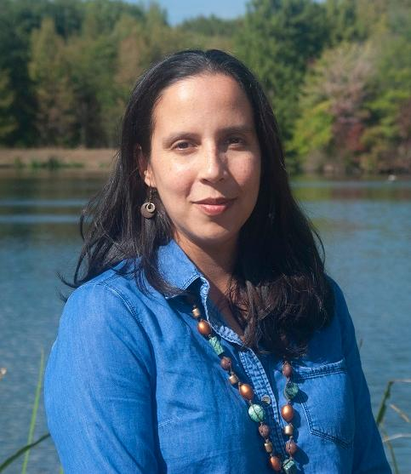
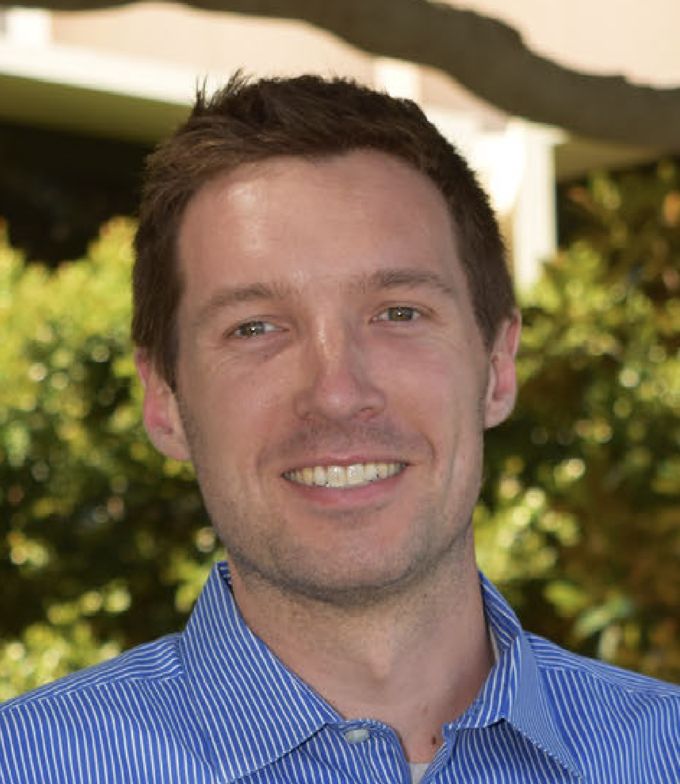
SeaBASS Staff
Chris Proctor
SeaBASS Manager
Inia Soto Ramos
Validation Data Flow Lead
Mike Maniscalco
Data Manager
Extended SeaBASS team includes many other contributors
OB.DAAC software and web developers
Field Support Group Subject Matter Experts (SMEs)
PACE Validation Leads

Slide 6

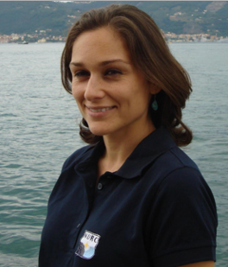
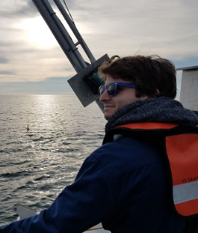
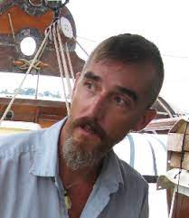
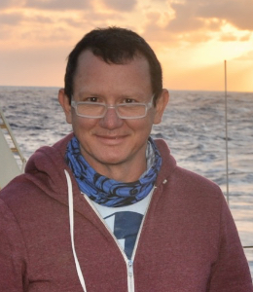
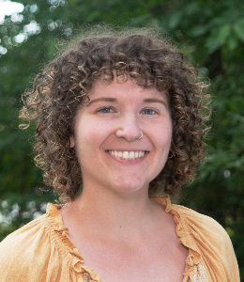

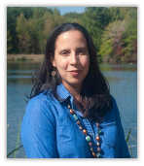
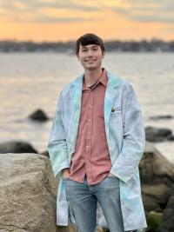


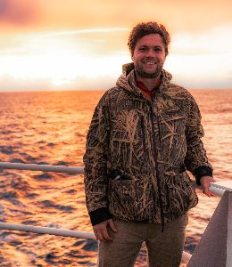
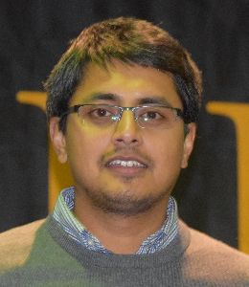
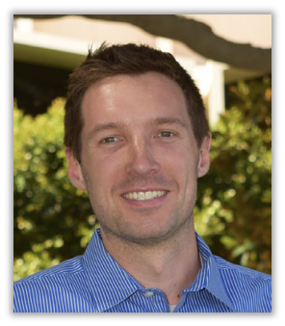

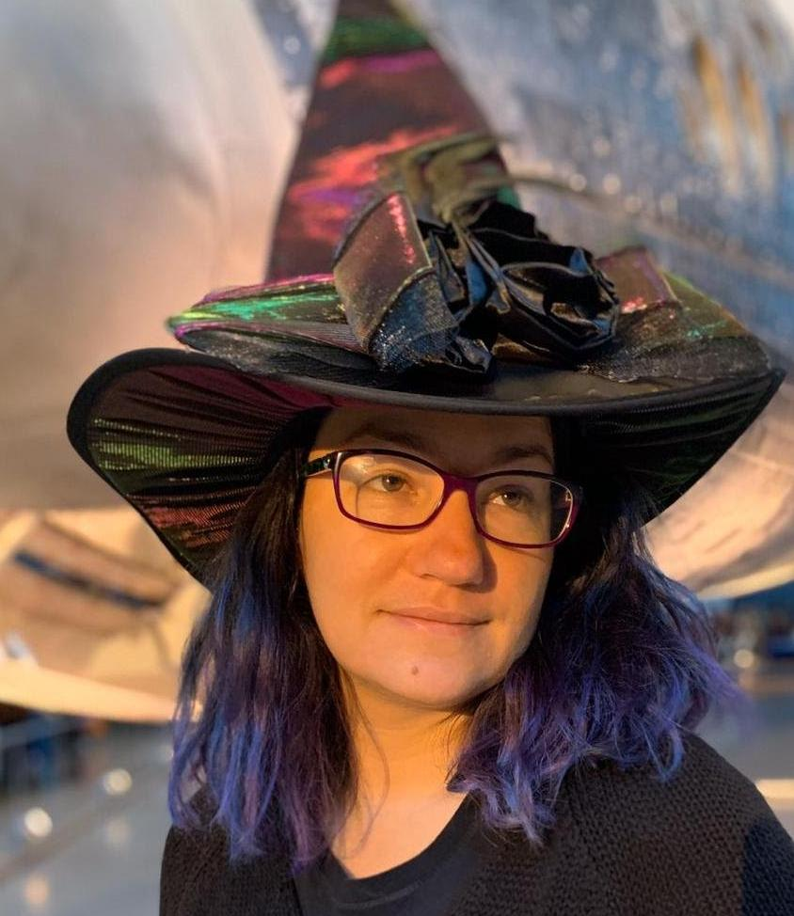
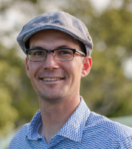

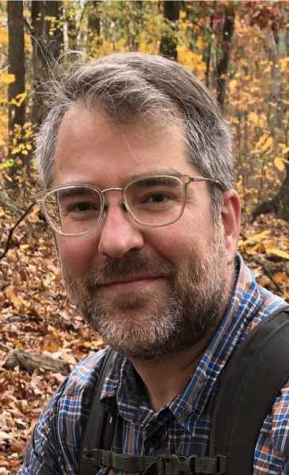
Staff Continued. Other OEL contributors to QA/QC + Validation workflows
Subject Matter Experts (SMEs)
SeaBASS Team
Chris Proctor
SeaBASS Manager
Violeta Sanjuan Calzado (AOP)
Harrison Smith
(AOP & PSD)
Dirk Aurin
(AOP)
Joaquin Chaves
(BGC & IOP)
Vanessa Strohm
(IFCB/FCM)
Kelsey Allen
(FCM/IOP)
Inia Soto Ramos
Validation Data Flow Lead
Ethan Taylor
(BGC & NPP)
James Allen
(AOP & IOP)
Meng Gao
(Aerosols)
Riley Blocker
(Polarimetry)
Chamara Rajapakshe
(Clouds)
Ocean (AOP, BGC, IOP), Aerosols, Clouds, and Polarimetry Team Leads
Michael Maniscalco
SeaBASS Data manager
Amir Ibrahim
Ivona Cetinić
Lachlan McKinna
Andrew Sayer
Kirk Knobelspiesse

Slide 7
Submission QA/QC Feedback Cycles
Data submissions go through at least two levels of review
      Data Manager
      2) SME
Submitters
SeaBASS Data Manager
Subject Matter Experts (SMEs)
Validation Leads
SeaBASS Archive
(OB.DAAC)
+
EarthData Search
Notes:
Dataset submissions go through multiple review cycles, and I wanted to share some of how that works so that data submitters are informed. There’s the upfront back and forth between submitters and the SeaBASS data manager. That’s where the majority of format issues are solved.
After submission, we recheck the data formats, make sure the submission and types of documentation appear complete, and perform basic checks (mainly locations), then dataset is archived and available to the public.
Submissions are then divided by measurement types and assigned to a relevant subject matter experts (field support group). They internally reviews submissions, taking a deeper look at data and documentation. QA/QC is performed for types of measurements that can be used standard ocean color satellite validation.
Those are labeled for their suitability in further validation processing. However, if there are questions about datasets, anything major is missing or flagged, they pass that info back to our data manager, who might reach out to you to ask for clarification, or to discuss if any portions of the dataset might need to be resubmitted for an update
Data are then passed to analysts for validation processing. We’ve spent a lot of time this past year building up the software and workflows for these processes

Slide 8
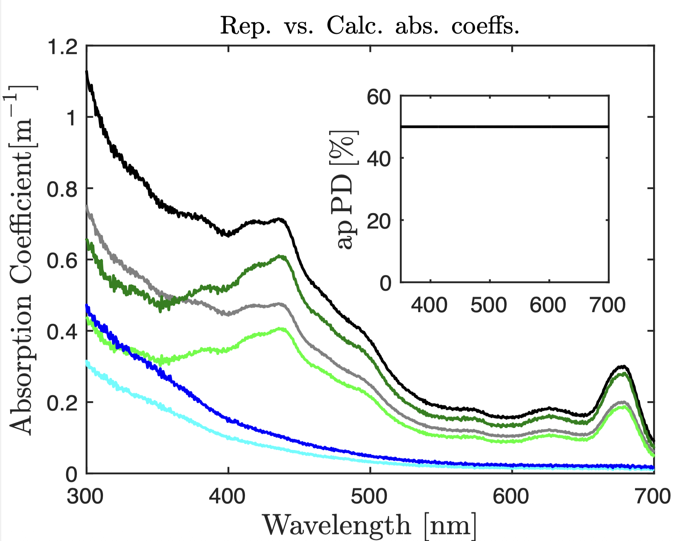
Enhanced QA/QC Successes
Feedback cycles make good data great. Approximately 31% of files archived in the past year resulted in resubmission improvements.
SeaBASS Data Manager
Subject Matter Experts (SMEs)
SeaBASS Archive
(OB.DAAC)
+
EarthData Search
Proud of our enhanced SME reviews and feedback cycles!
Deeper QA/QC helps detect and fix subtle issues:
  Systemic issues
  One-off issues
  Gaps in documentation or provenance
Notes:
More rapid turn-around for PVST
The 31% statistic has a few caveats. I expect the percentage will increase in the coming months as there are datasets archived recently that are still in the queue.
These enhanced feedback cycles have also benifitted submissions by detecting and requesting fixes for Better tracking documentation and provenance
They have fed into our review process, and led to updates to our specialized submission requirements

Slide 9

Other recent updates:
Database transition
SeaBASS completed a major database upgrade in the second half of 2024
  Necessary for performance and maintainability
New submissions were paused for several weeks, but no interruptions in public data access
By February 2025, all archival services were transitioned

Slide 10
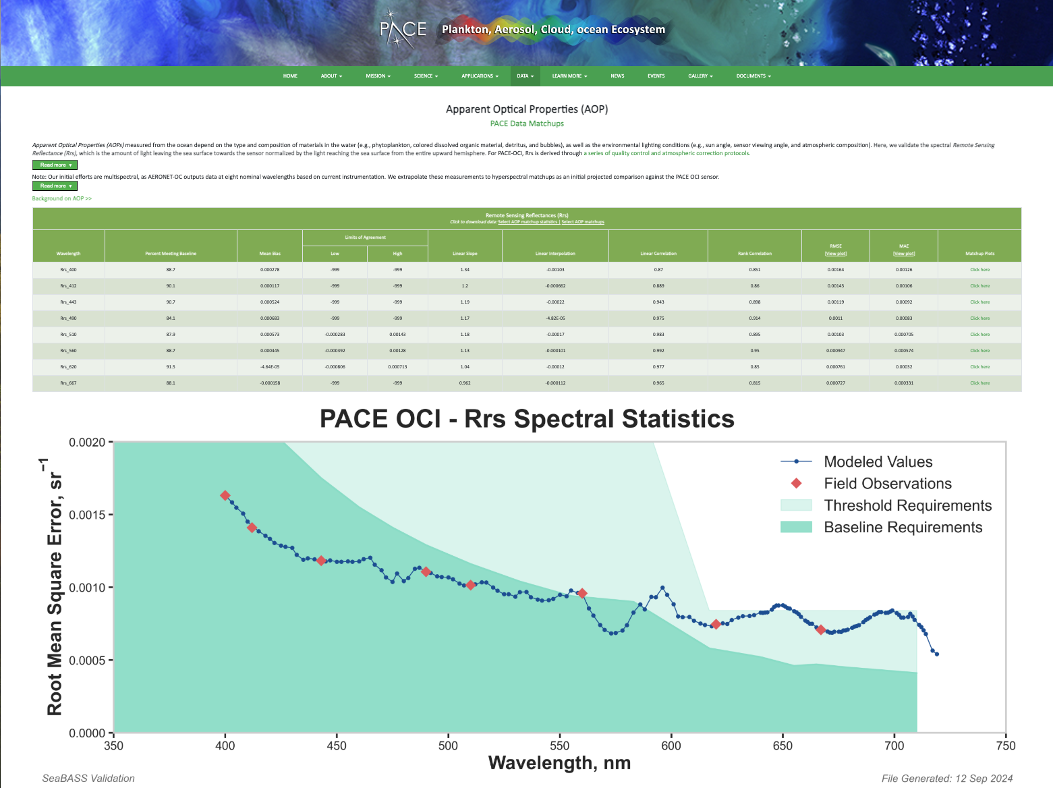
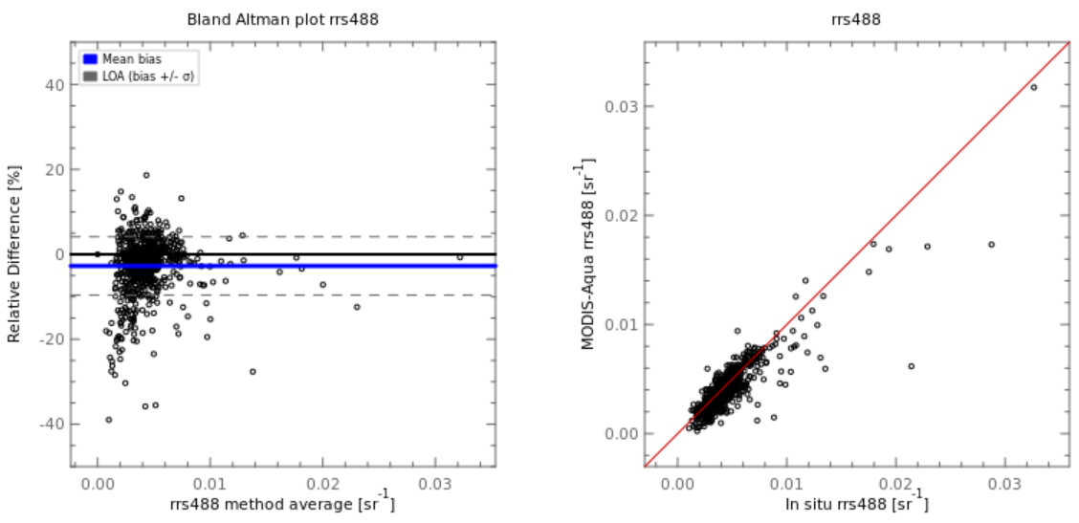
What’s on the horizon?
Further Validation Updates
With PACE workflows maturing or being finalized, update hosting validation results
Support more advanced products
Continue incorporating uncertainties (esp. for PACE)
Redesign dataset versioning and hosting
Better incorporate other external sources (e.g., WATERHYPERNET)
SST Validation (J1VIIRS)

Slide 11
What’s on the horizon? Continued
Transition from SFTP Data Submissions
  Earthdata tools under development:
    Cloud Upload Environment (CUE) & EDPub
Enhance discoverability in Earthdata Search
Prepare for NASA Earthdata Web Unification
SeaBASS Dataset Cloud Transition
Develop an improved SeaBASS lexicon/namespace for variables

Slide 12
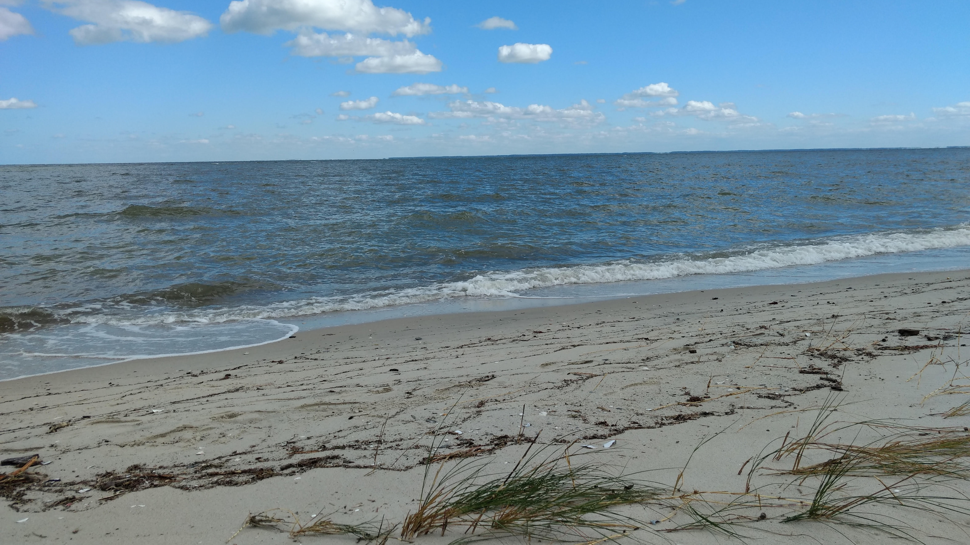
Questions, Requests, Suggestions?
Notes:
What do you like? What could we do better?

Slide 13
Extra / Optional Slides

Slide 14
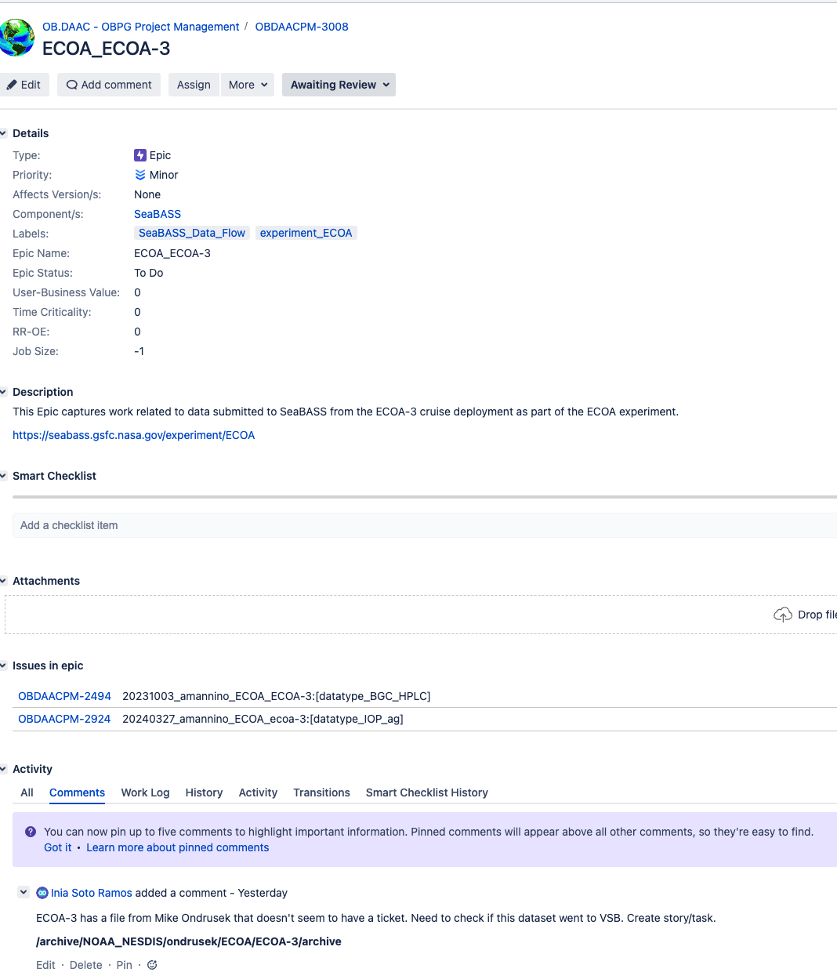
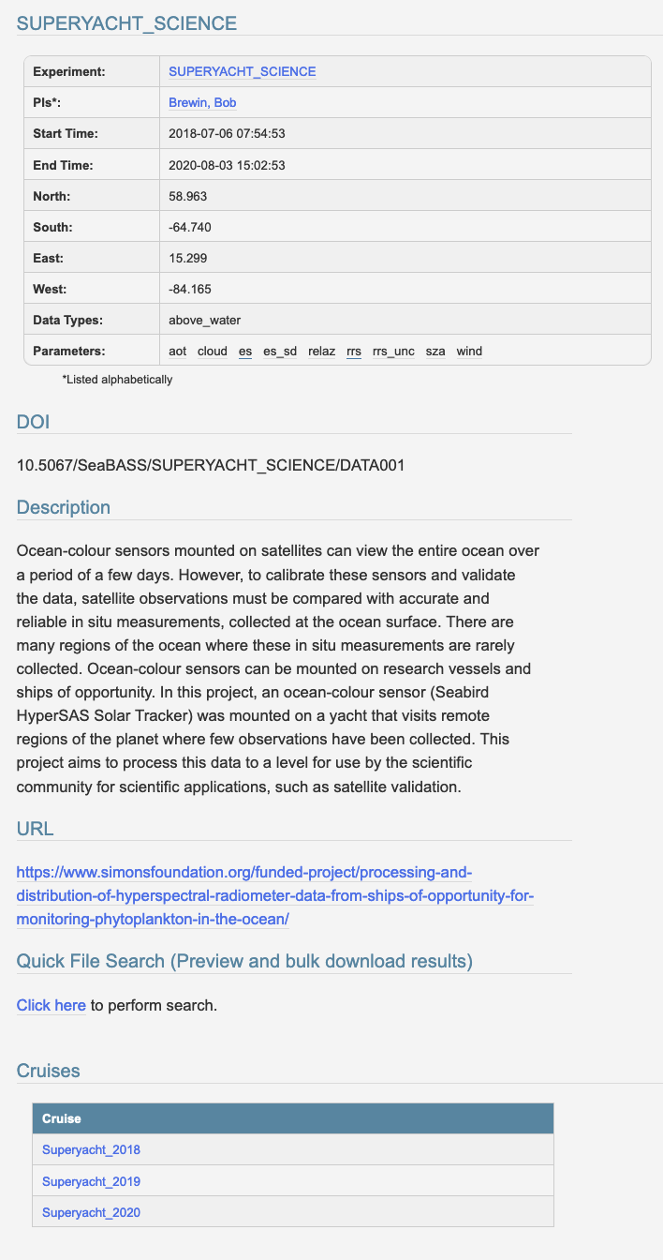

SeaBASS Systems & Web Tools Include:
Data Systems
Data Archive (over 149,000 files plus supporting documentation; over 350 Experiment DOIs)
Relational database: metadata catalogue, facilitates web-services, tools, validation, etc.
ODPS-integrated validation system for satellite data match-ups
SFTP user submission system (~200 submitter accounts)
DOI Experiment landing pages (~400)
Project management tracking for dataset QA/QC + submission feedback loops

Slide 15
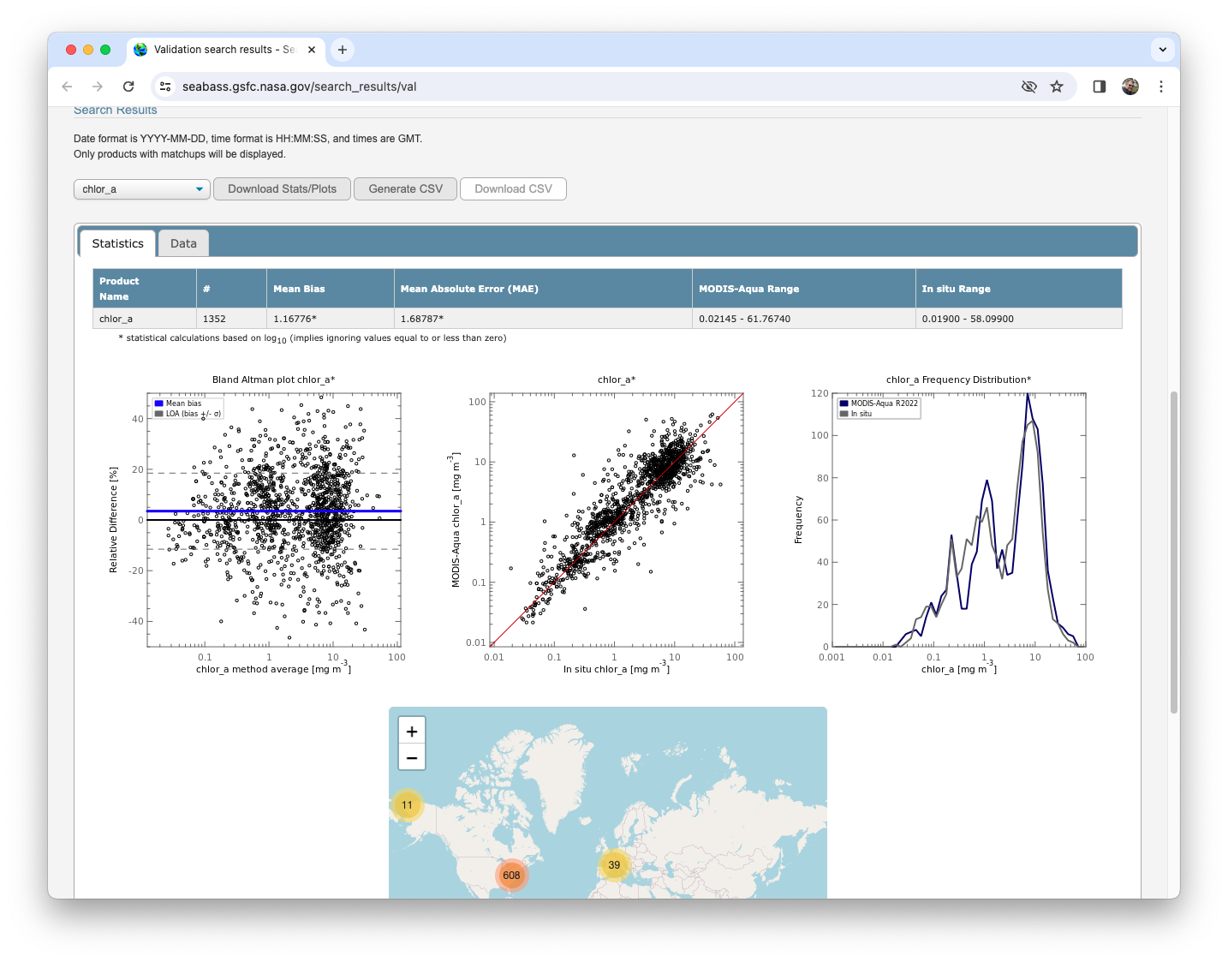
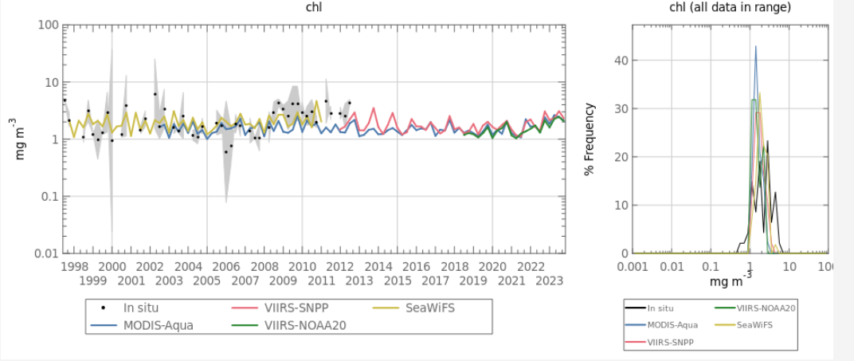
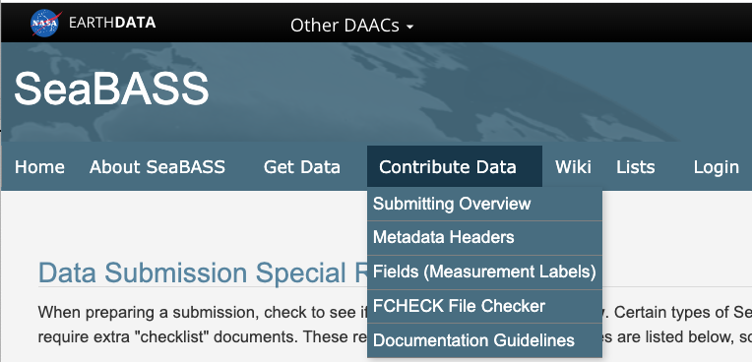



SeaBASS Systems & Web Tools Include:
Web-based tools
File Search
Enhanced data access pages: Recent data updates, Browse Archive, Lists, etc.
Validation Search (Match-ups with 12 OC Sensors)
Time Series Tool
Extensive web pages with documentation, technical information, and examples for users and submitters
NOMAD, legacy V2 & future V3
SST Validation (over 90 million validation match-ups across 4 satellite sensors)

