Slide 1
First Forays into the Cloud
Experiences from NASA Openscapes in 2023
Aronne Merrelli
Climate and Space Sciences and Engineering, U. Michigan
merrelli@umich.edu

Slide 2
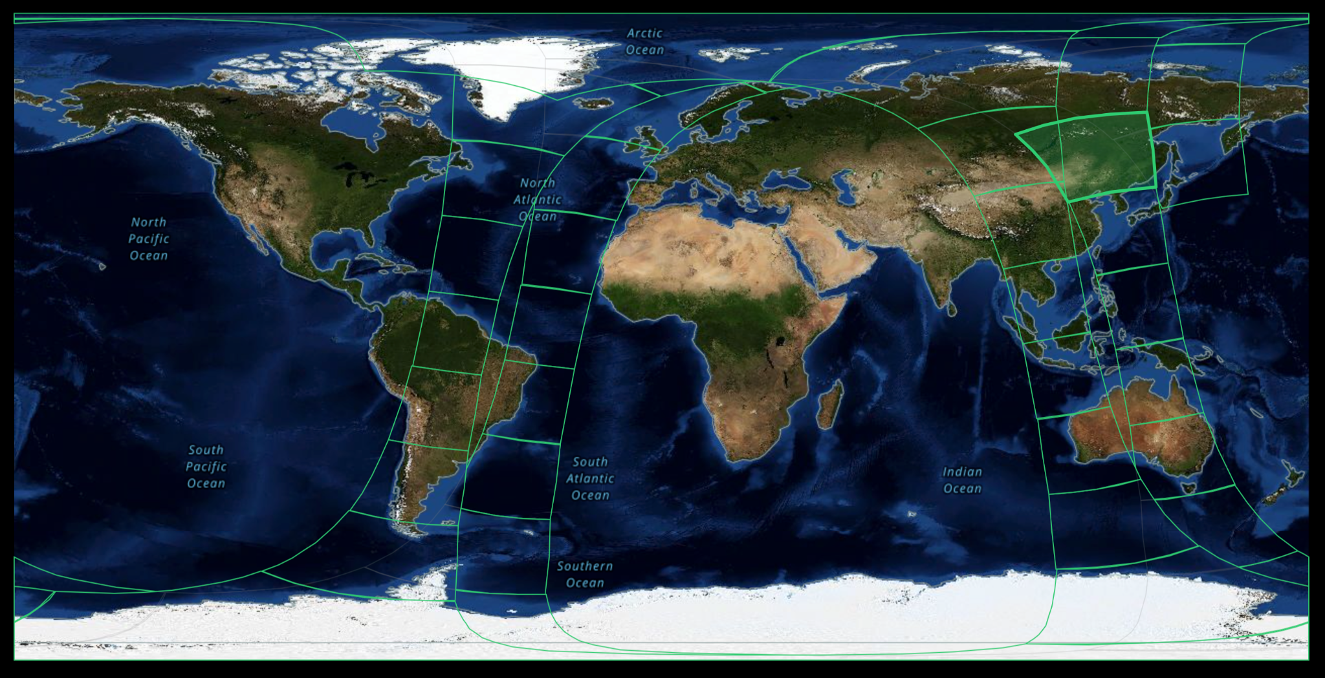
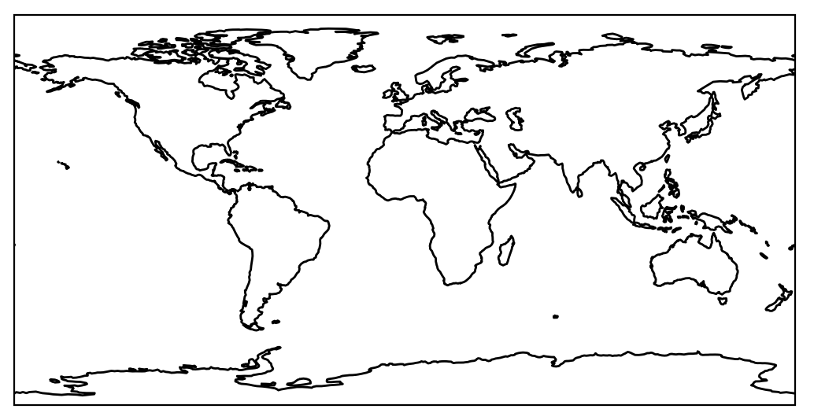
A brief summary of my research…
I am primarily a “L1 and L2 algorithm” scientist, and work with data from many satellite instruments (NASA, NOAA, ESA, …)
L1/L2 data comes in “sensor swaths”...
… not in N-D data “cubes”
(e.g., L3 or model data)

Slide 3

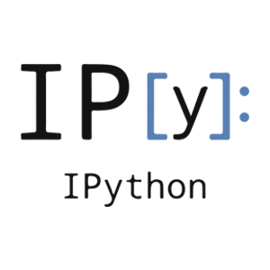

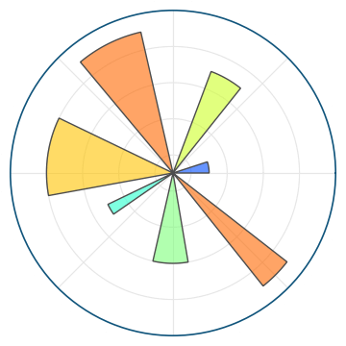
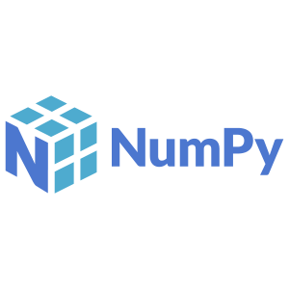
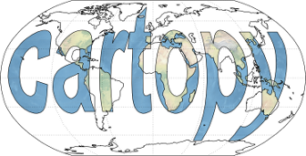
A brief summary of my research…
I work mainly in the python ecosystem (with a little MATLAB and fortran)

Slide 4
… and where I have worked
Now at the University of Michigan, previously at the University of Wisconsin
Both are large, well-resourced research institutions
Have access to a lot of shared computing resources
(and, an institutional AWS account)

Slide 5
Workflow Scales
Calc time
(CPU-hours)
10,000
For my own workflows:
Cloud computing will unlikely replace any current computing environments (share server or compute cluster)
What it will do instead is facilitate processing of large datasets, via NASA Earthdata cloud.
Univ. Shared compute cluster
1,000
Cloud computing
Research
Group Server
100
10
Laptop/ Desktop
1
0.1 1 10 100 1000 Data size (TB)

Slide 6
Cloud experiences…
A year ago I had effectively zero useful experience with “the cloud”!
and some negative, or at least, not helpful experiences:
Talking to cloud engineers/IT support at my institution
Attending webinars offered by Amazon Web Services staff engineers
How to estimate costs… doesn’t seem that inexpensive
A lot of material is geared towards model analyses (e.g. CMIP, L3, …) …
… and seems to require specialized python packages/data formats
Most discussions revolved around the administration of cloud services
Made it seem like there was a large overhead to using the cloud
Specialized packages seemed hard to use, or inefficient on datasets I use

Slide 7
Cloud experiences…
Today, after NASA Openscapes, and learning to use coiled:
Easy to run code in the cloud with little extra overhead
Don’t need to learn specialized python packages
Doesn’t require “cloud-optimized” data formats
Don’t need to modify my workflow, just deploy to cloud when needed!

Slide 8
NASA Openscapes opportunities
Jupyterhubs:
Extremely easy to use (especially if you already use jupyter)
gets your ‘toes in the water’ running code in the cloud
Very useful to prototype code & do efficiency testing on cloud hardware
Not a straightforward way to transition this back to my own institution (I am not aware of anyone administering a similar setup in my own institution)
Coiled:
Very easy to use
Very easy transition to my workflow (UM’s institutional AWS account is a big help here)
Essentially zero administrative overhead

Slide 9
How to proceed?
My recommendation: Identify a near term task that you can shift to cloud processing.
Ideally this task should be…
something you were going to do anyway
requires use of a dataset in the cloud (NASA Earthdata cloud, NOAA open data)
Is “largeish”, so you will get some immediate benefit (meaning, that you will potentially save yourself some time by doing it in the cloud)
I chose to do the analysis for my AGU poster through coiled, which fit all of those criteria

Slide 10
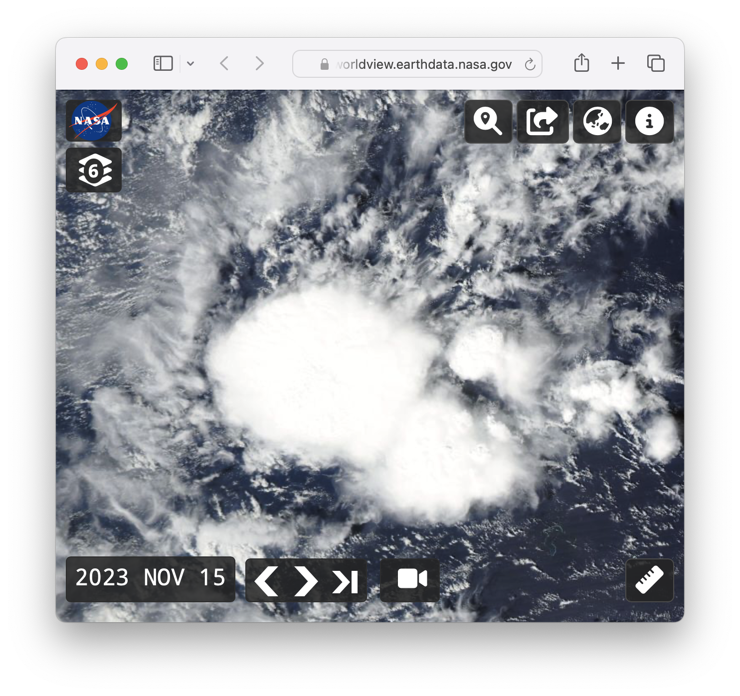
Specific example: L1 data analysis for my AGU poster
Background:
Satellite instruments often use sensor arrays, with many different physical detector elements
This presents a calibration challenge:
How can we ensure all array elements are calibrated consistently?
How do we track this on-orbit?
Vicarious calibration: use “standard” Earth-view scenes.
In Visible and Near - IR,
Deep Convective Clouds work well!

Slide 11
A specific example: an L1 data analysis task
The problem: apply the Deep Convective Cloud “DCC” technique to data from the NASA Orbiting Carbon Observatory (OCO)
We don’t know apriori when and where DCC will occur (cannot use simple subsetting criteria like lat/lon/time), but we can identify DCC through variables in other L2 retrieval products
The data record is approx 12 TB/year, ~ 13 years of data = ~ 150 TB total
Output data will be small, order of 4 GB total
In the “old workflow”: would need to download all of these files:
doesn’t fit on group server; could do the process in stages (e.g., process year 1, delete; process year 2, ….)
Assuming 50 MB/s download this is about 36 days of downloading

Slide 12
A specific example: an L1 data analysis task
“New option”: Use coiled to run this on AWS!
The algorithm is simple, we don’t need big, expensive Amazon EC2 hardware
Matt Rocklin’s “Rule of Thumb”: $0.10 per TB
This assumes:
The code is reasonably optimized, so that data transfer is most of the time
Using ARM CPUs and the Spot market (trivial to do with coiled)
So, processing 150 TB would be roughly $15

Slide 13
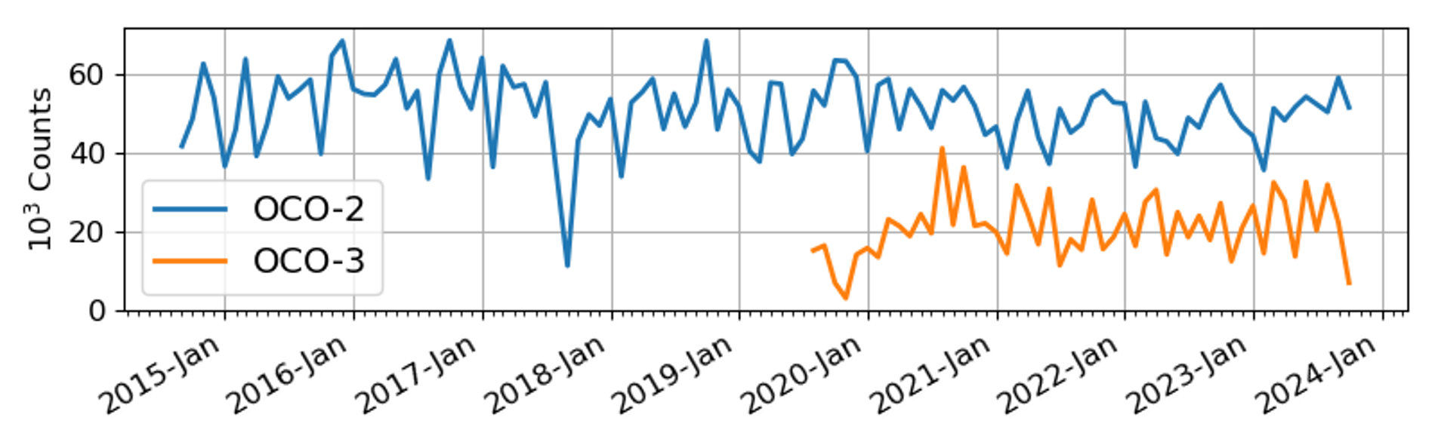
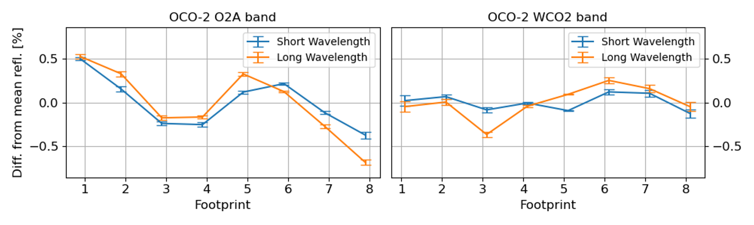
How did it go? Very smoothly!
Number of identified DCC observations in each data record
Inferred radiometric offsets between the 8 OCO-2 detectors

Slide 14
Key points & Lessons Learned
Develop the code on a small sample dataset which you can download on your local machine (e.g. download 1 day of the 13 years, develop/test with that small dataset)
When you are done debugging and testing, a few simple modifications with coiled will essentially deploy the code to AWS for the “production run”
Found it easy to process 1 year of data at a time:
  With 100 EC2 instances, each year takes ~ 30 minutes to process, costs < $1.00

Slide 15
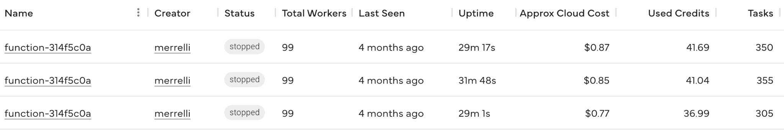
Coiled dashboard - immediate feedback, granularity
AWS Cost explorer -
Aggregate cost
Service | Service total | 11/1/23 | 12/1/23 | 1/1/24
S3($) | $8.49 | $0.01 | $0.59 | $6.40
EC2-Instances($) | $8.46 | $1.38 | $6.21 | $0.87
EC2-Other($) | $2.48 | $0.37 | $1.84 | $0.27

Slide 16
Final thoughts on Coiled & AWS
Costs can still be opaque:
You don’t know the “actual” cost until later, in the AWS console
BUT: real cost is much lower than expected, so I no longer worry much about cost. Should be easy to add funding on grant proposals (~$100s/yr will go a long way)
Coiled makes this much easier than I realized:
no admin overhead
Very easy to test locally, and deploy to a “production run” when ready
AWS/EC2 processing on big data is VERY fast, once you leverage parallel workers
Feels like a super power for processing large satellite datasets!
Opens door to new analyses, and importantly allows for fusion of multiple sensors & reanalysis data.

