Slide 1

Joint Communications Efforts: ESDIS/OB.DAAC
April 7, 2023– May 27, 2024
Data User Profiles and Data Chats
Data Tool in Focus
Feature Articles & Dataset Announcements
Earthdata Webinars/Workshops
Social Media

Slide 2

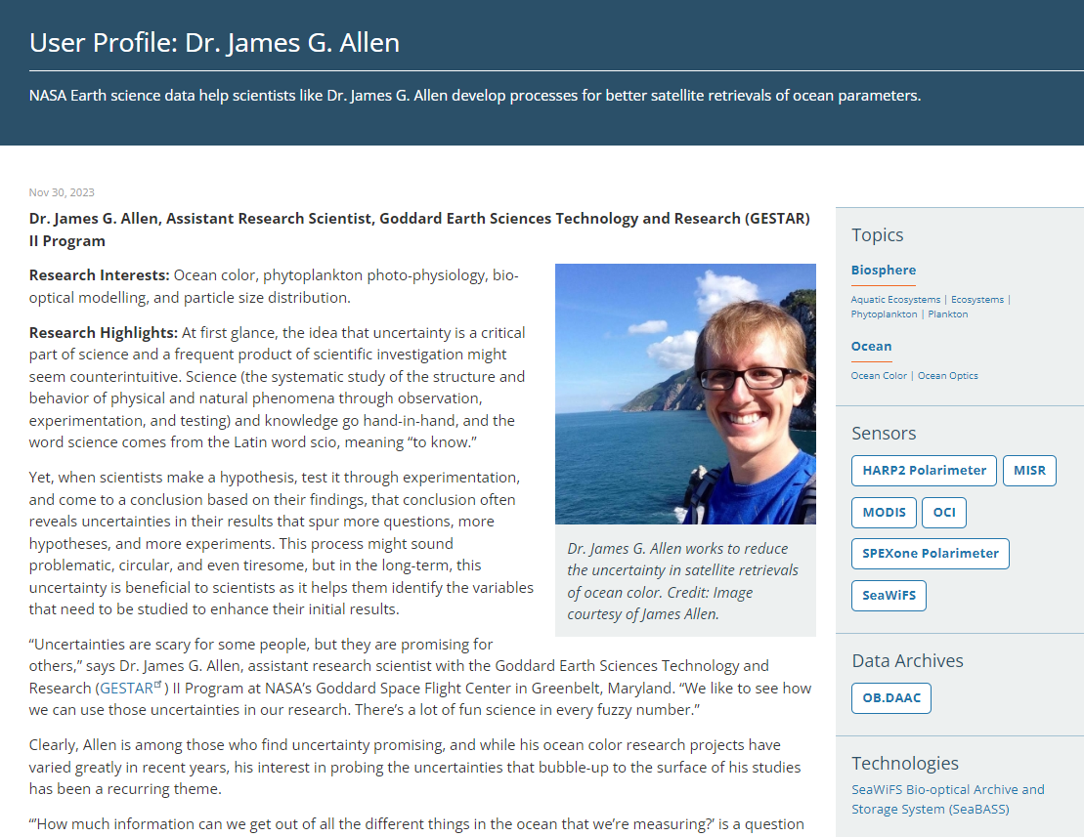
Data User Profiles
About the Profiles
Between 2015-2023 Published 4th Thursday of each month.
Each monthly profile featured a different DAAC UWG member and his/her research
Promoted via NASA Earthdata social media
Note: To allow for more flexibility regarding topics and profile subjects, beginning in January 2024 we have switched to monthly Data Chats.
Data User Profiles: https://earthdata.nasa.gov/profiles
Data Chats: https://www.earthdata.nasa.gov/learn/data-chats
Published 11/30/23

Slide 3
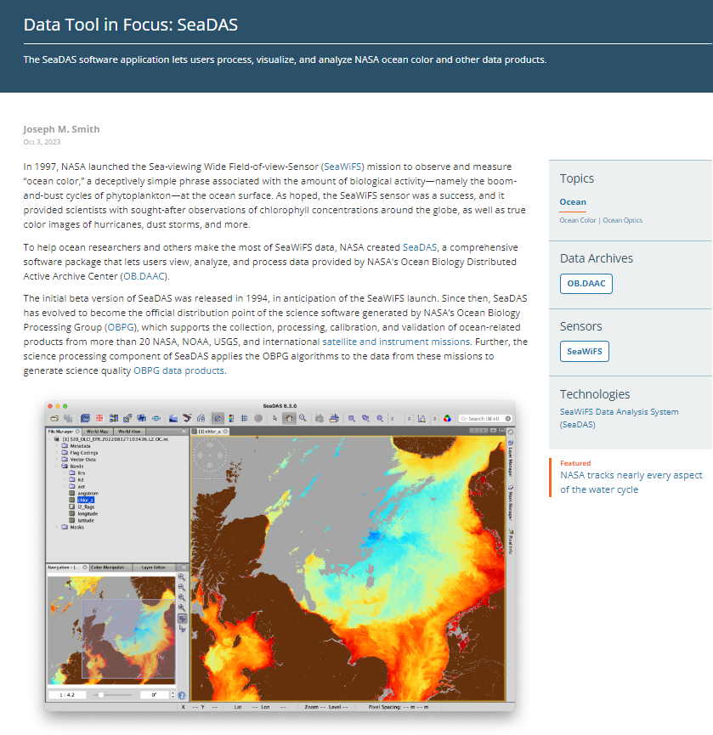
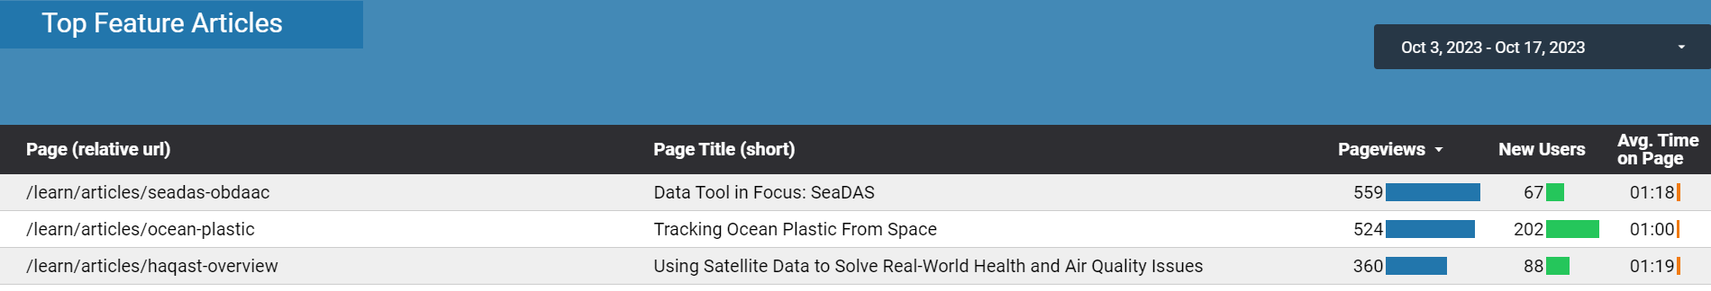
October 2023 Data Tool in Focus: SeaDAS
NASA Earthdata Site Report
#1 Top Feature Article on NASA Earthdata
10/3/23 (Publication date) through 10/17/23.
Published 10/23/23
https://go.nasa.gov/45fpApw

Slide 4
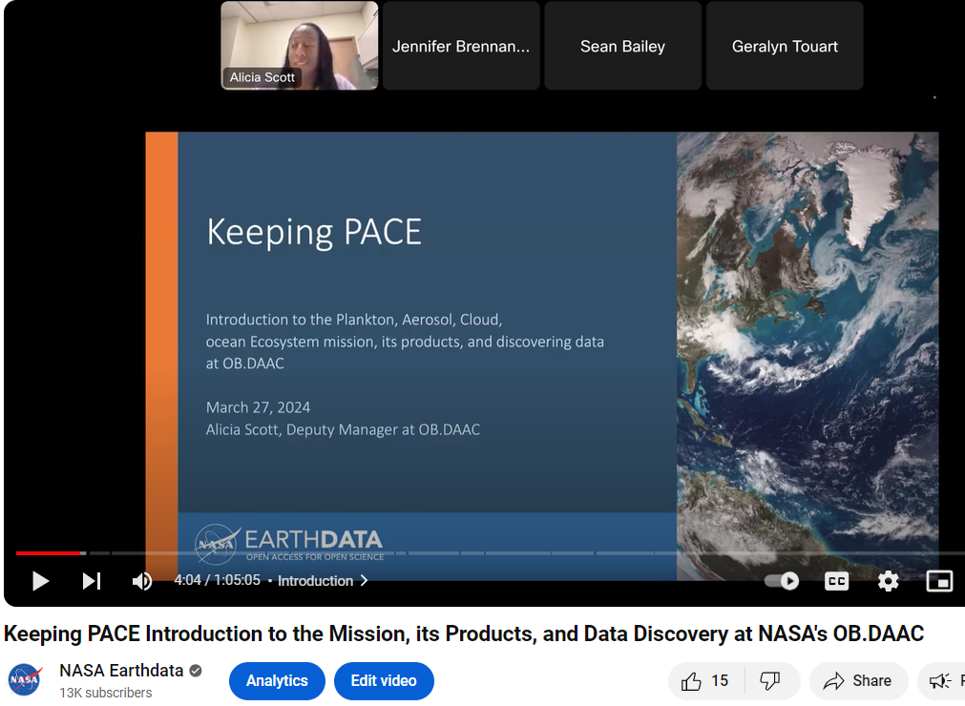

Earthdata Webinars
Keeping PACE: Introduction to PACE Mission, Products, and Data Discovery
YouTube Webinar Metrics:
372 Views (since published 4/1/24), 31 Hours of Watch Time (Metrics pulled 5/28, 5:37 PM EDT)
NASA Earthdata YouTube Channel
www.youtube.com/c/NASAEarthdata
13,041 subscribers (+129 in the last 28 days)
434 total videos to include data discovery and access webinars, short data tutorials, special feature videos, applications workshop videos and more housed within 34 unique playlists.
Metrics/Live Webinar Event held 3/27/24
Total Participants: 139, Affiliation: Education 56.11%, Government 26.62%, Commercial 5.76%, Non-Profit 11.51%; Country: 64.75% U.S. and 35.25% International from 28 other countries

Slide 5
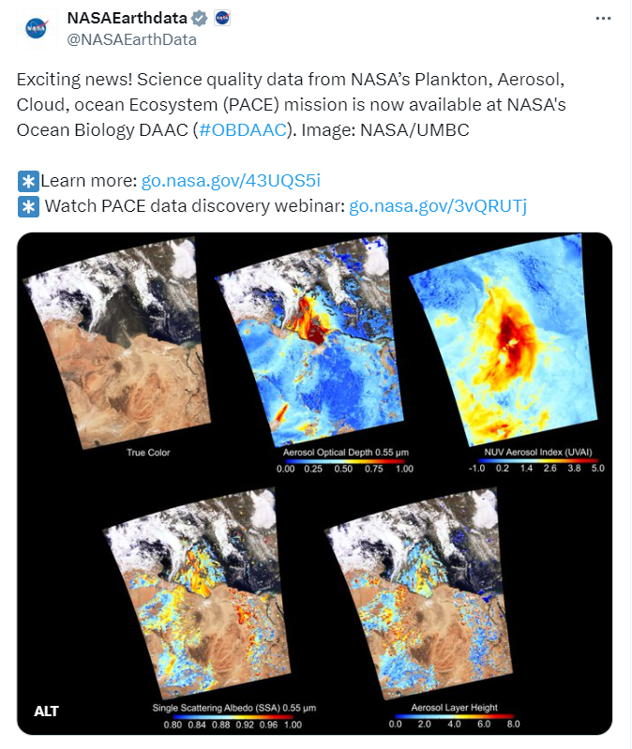
Social Media- Twitter (@NASAEarthdata)
Time period: 4/7/23 - 5/28/24
13 OB.DAAC-specific or- related tweets announcing new data products, data tools, data service updates and webinars.
81,463 Impressions
2,128 Engagements
NASA Earthdata Twitter Account
40,657 Followers on 5/28/24 (pulled at 6:29 PM EDT)
The most popular content on our Twitter account are data recipes, data scripts, Jupyter Notebooks, etc.
We welcome more of it!
Highest Impressions and Highest Number of Engagements
24,040 Impressions, 508 Engagements
2.1 % Engagement Rate
https://twitter.com/NASAEarthData/status/1778523686242509099

Slide 6
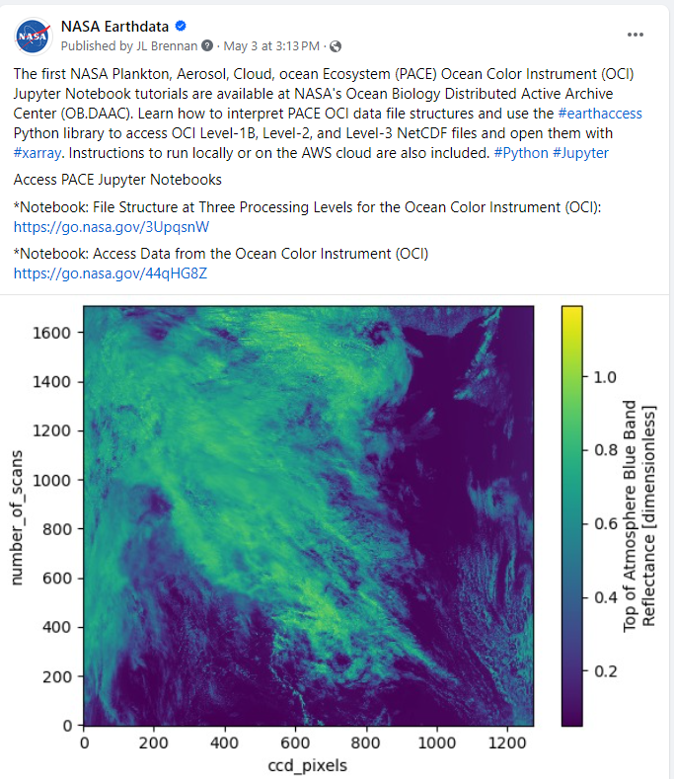
Social Media- Earthdata Facebook
Time period: 4/7/23 -5/28/24
OB.DAAC specific posts announcing new data products, data tool or data service updates and webinars.
13 Posts
Total Impressions 35,419, People Reached 34,268, and Engagements 1,760
NASA Earthdata Facebook
www.facebook.com/NASAEarthdata
59,113 Followers on 5/28/24
(Pulled at 6:40 PM EDT)
Most Engaging Post
4,087 Impressions
3,982 Post Reach, 179 Engagements
https://www.facebook.com/NASAEarthData/posts/736319185337917

Slide 7
Contact Us!
The ESDIS Team is here to help! Have a data story idea? Would you like us to address a data product, service, or tool on social media? Would you like to hold a webinar? Have some new Jupyter Notebook tutorials or other data recipes you want to promote? We’d love to hear from you!
Please reach out to Jennifer Brennan at:
Email: Jennifer.L.Brennan@nasa.gov
Connect with us on Social Media
X (Twitter): @NASAEarthdata
Facebook: www.facebook.com/NASAEarthdata
YouTube: www.youtube.com/NASAEarthdata

Slide 8
OB.DAAC Data Access

Slide 9
Data Access Tool Overview
Earthdata Tools
Earthdata Search Client
Worldview
OBDAAC Tools
Direct Data Access
File Search
Level 3 and 4 browser
Earthaccess

Slide 10
Earthdata Tools

Slide 11
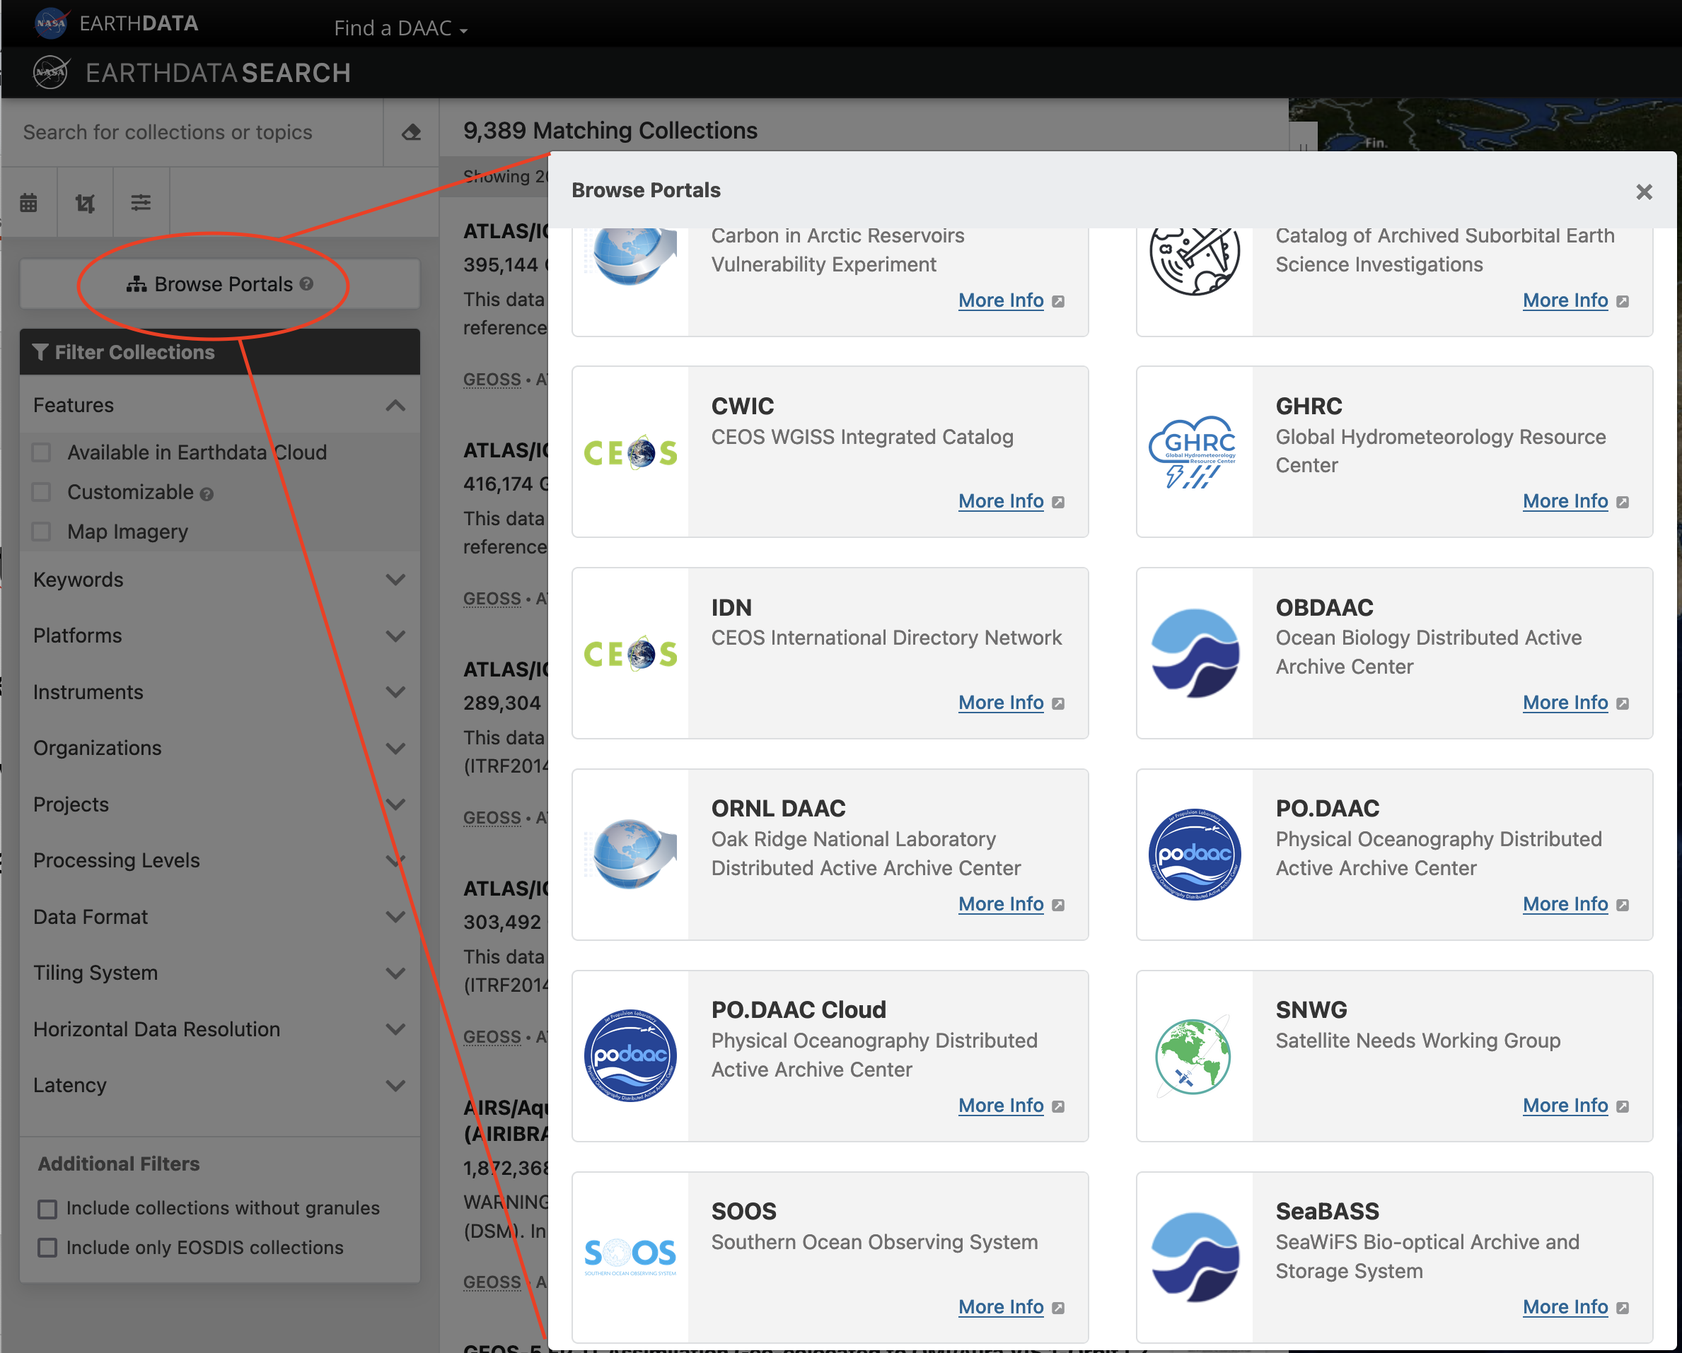
Earthdata
Search Client
Data Provider names: OB_DAAC and OB_CLOUD
Cloud Datasets: PACE
Search Methods:
  Search Bar
  Spatial (including Shapefiles), Temporal, Feature
  Data Portals
  Filters

Slide 12
Earthdata Search Client
News:
  Adding browse imagery to metadata
  Ordering capability is being tested, which will enable subsetting

Slide 13
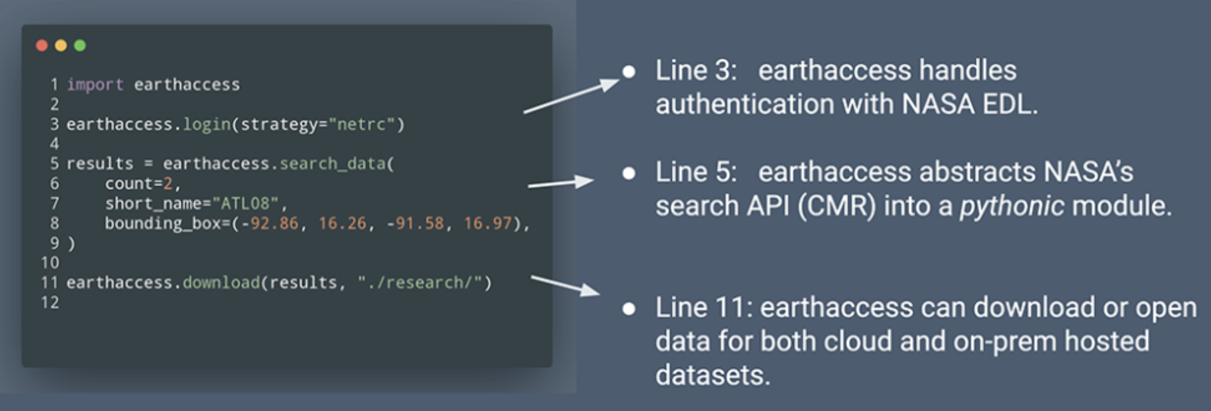
Community-developed Scripts
Python API Library: earthaccess
https://www.earthdata.nasa.gov/learn/blog/earthaccess

Slide 14
Worldview/GIBS
PACE orbit view
  https://worldview.nasa.gov/pace-orbit-track
PACE OCI data layers (CHL, True Color)
  https://worldview.nasa.gov/pace-data-layers
https://worldview.earthdata.nasa.gov/

Slide 15
OB.DAAC Tools

Slide 16
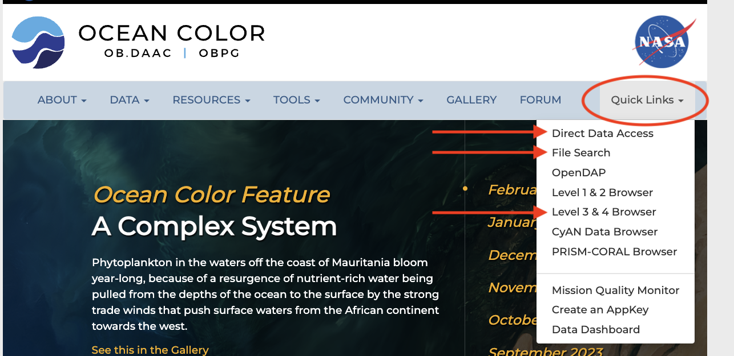

Slide 17
Direct Data Access
All OB.DAAC data holdings: all mission, project, ancillary, browse imagery and data
Generate and append your appkey to wget statements to avoid logging in each time and for hidden data access
  https://oceandata.sci.gsfc.nasa.gov/appkey/
https://oceandata.sci.gsfc.nasa.gov/directdataaccess/

Slide 18
File Search
Web Form
  Returns results in HTML or text format
  Help page describes usage and options
Query API
  wget and curl commands provided based on selections
https://oceandata.sci.gsfc.nasa.gov/api/file_search

Slide 19
File Search
Recent updates
  Choose date range or find data going backward starting from today
  Improved messaging on Results page
https://oceandata.sci.gsfc.nasa.gov/api/file_search

Slide 20
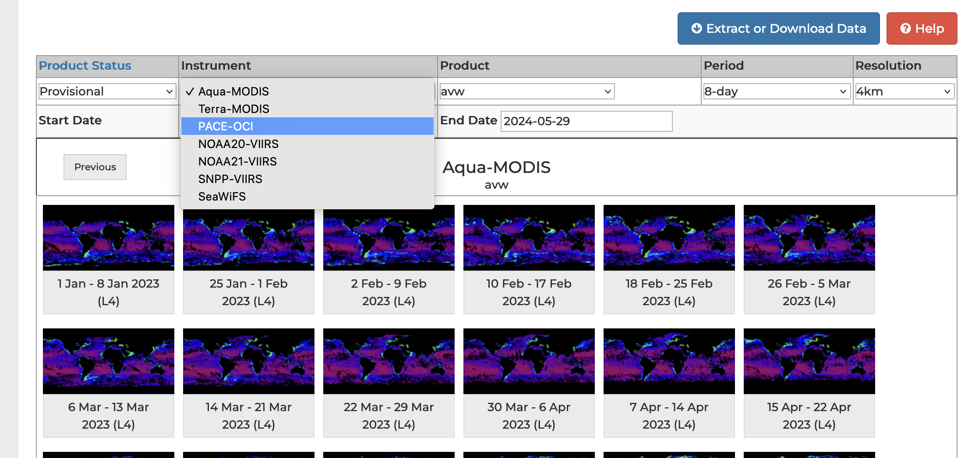
Visual Browser – Level 3 & 4
https://oceancolor.gsfc.nasa.gov/l3/

Slide 21
Next Steps (for OB.DAAC)
Once data ordering capability is completed, additional customizations will be considered
On-premise data migration to Earthdata cloud will begin in June 2024
We are exploring Earthdata resources that would enable processing OB.DAAC data in the cloud

Slide 22
Next Steps (for Users)
Utilize cloud resources:
  Earthdata Cloud Primer: https://www.earthdata.nasa.gov/learn/webinars-and-tutorials/cloud-primer-amazon-web-services
  NASA Openscapes Earthdata Cloud Cookbook: https://www.youtube.com/watch?v=FcATnW5KJJo
Access OB.DAAC Data Tutorials:
  https://oceancolor.gsfc.nasa.gov/resources/docs/tutorials/

Slide 23
Discussion

