Slide 1
SeaDAS Updates for UWG
Aynur Abdurazik
May 30, 2024

Slide 2
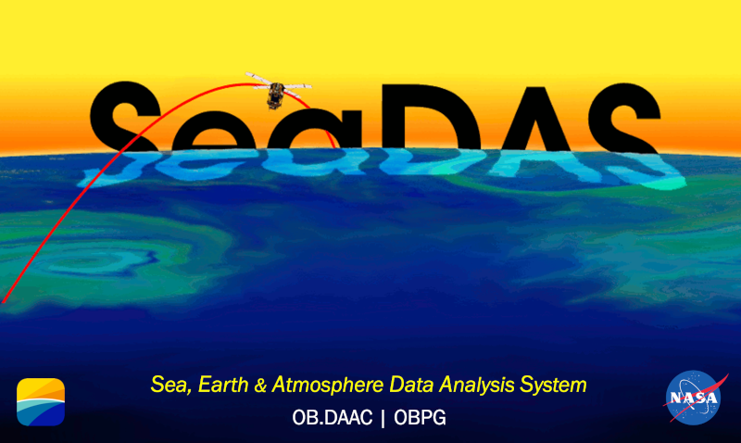

Slide 3
Agenda
SeaDAS overview and updates since last UWG meeting
Future Plans and Upcoming workshops
Q&A

Slide 4
SeaDAS Overview
SeaDAS Supported Missions
SeaDAS
AVHRR
CZCS
ETM+ Landsat7
GOCI
HawkEye
HICO
MERIS
MODIS Aqua
MODIS Terra
MOS
MSI Sentinel 2A
MSI Sentinel 2B
OCI PACE**
OCM1
OCM2
OCTS
OLCI Sentinel 3A
OLCI Sentinel 3B
OLI Landsat 8
OLI Landsat 9
OSMI
SeaWiFS
TM Landsat 5
VIIRS Suomi NPP
VIIRS NOAA20
VIIRS NOAA21
Polarimeters:
HARP2 PACE*
MISR
SPEXone PACE*
Airborne Sensors:
AVIRIS
PRISM
(Sea, earth and atmosphere Data Analysis System)
NASA Software for the processing, visualization and analysis of Earth science data
developed by NASA's Ocean Biology Processing Group (OBPG)
OB.DAAC (Ocean Biology Distributed Active Archive Center) is a NASA EOSDIS DAAC
https://seadas.gsfc.nasa.gov
https://oceancolor.gsfc.nasa.gov
https://www.earthdata.nasa.gov/eosdis/daacs/obdaac
EOSDIS - Earth Observing System Data and Information System
* Limited support
* Planned (limited support)
** Planned full support

Slide 5
SeaDAS Architecture
SeaDAS Application Platform
Analysis and Visualization Tools
Sentinel 3 Toolbox
SeaDAS Toolbox
GPT Processing
Tools
GPT Processors
GUI
SeaDAS Processors GUI
SeaDAS Science Processors
User Terminal
User Terminal

Slide 6
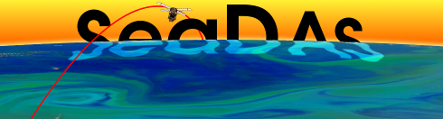
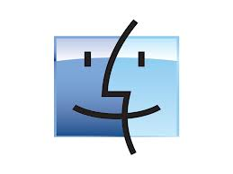


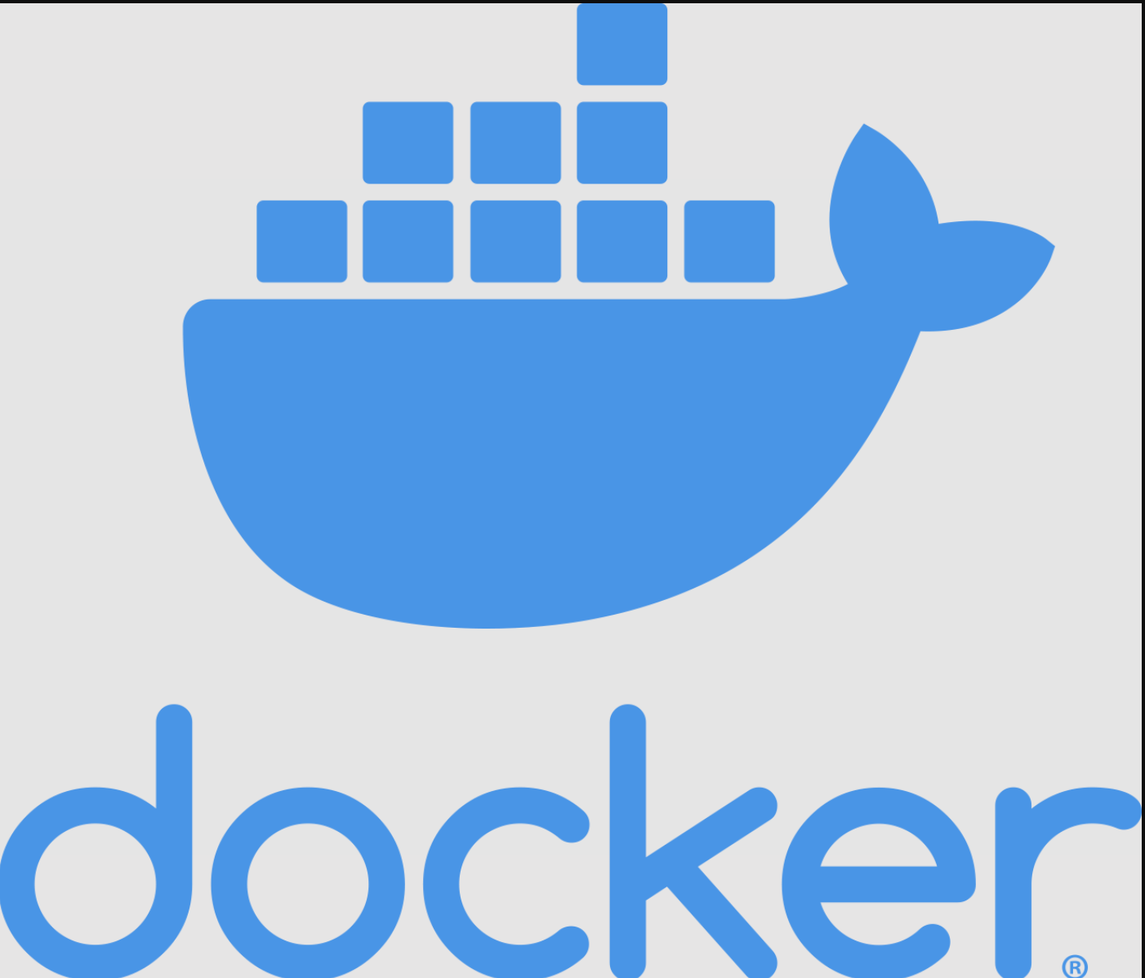
SeaDAS Toolbox and SeaDAS Science Processors
Client-Server Architecture
Java Process
API
Client
Resource
SeaDAS Science Processors
SeaDAS Science Processors
Java Process
API
File System
RESTful API
SeaDAS Science Processors Web Services
Server
Use HTTPS protocol
Use ClientID and JobID to manage server side processing
Client
A client is identified using its self-defined clientID stored in a config file on the client side

Slide 7
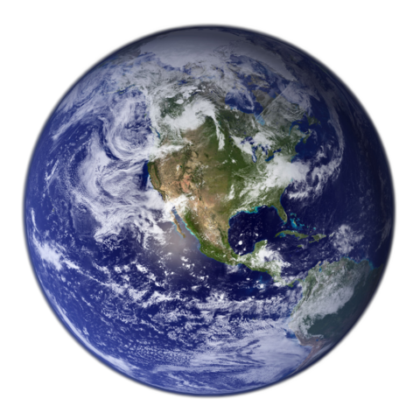

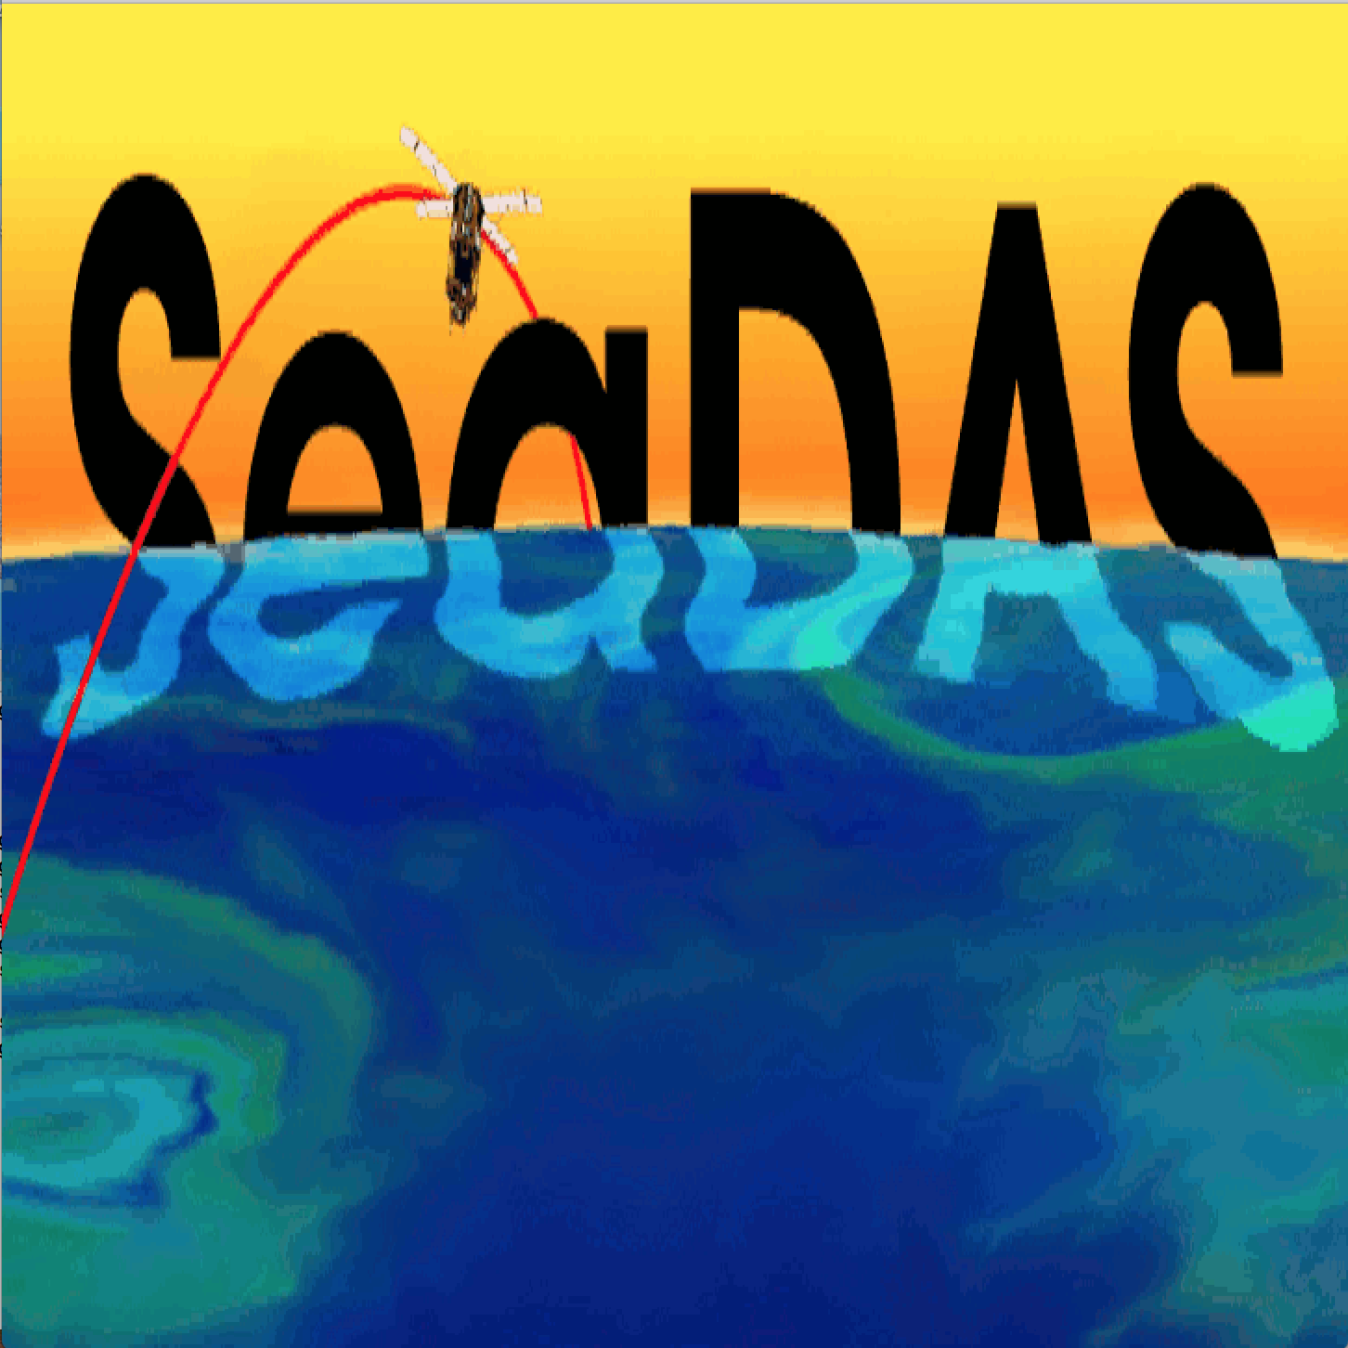
SeaDAS-OCSSW OB.DAAC: Software Data Flow and Tools
Satellite
SeaDAS
General Image
Analysis Tools
Imagery
Masking
Mapping
Aggregation
Algorithms
Analysis
Statistics
SeaDAS Science
Processing Tools
Level-0 Files*
Level-1A Files*
Level-1B Files*
Receiving Station
Data Provider
Geo Files*
Geo Files*
Level-1B Files*
Level-0 Files*
Level-1A Files*
Level-1B Files*
Level-2 Files*
Level-2 Files*
ESA SNAP Processing Tools
Level-3 Binned Files
Level-3 Binned Files
Level-3 Mapped Files
Level-3 Mapped Files
OB.DAAC
User
ODPS
Ancillary Files
Ancillary Files
Ancillary Sources
SeaBASS Files
* Mission dependent

Slide 8
SeaDAS Updates Overview
Visualization and analysis of PACE data (OCI, SPEXone, and HARP2) is now supported.
  PACE OCI files are now supported.
  PACE SPEXOne L1C files are now supported (L1B files are viewable but as generic NetCDF files).
  PACE HARP2 L1C files are now supported (L1B files are viewable but as generic NetCDF files).
Science processing of PACE OCI Data is now supported.
New tools added are: Angular View, Image Animator, Annotation Metadata, Spectrum View and the Soft Button user assignable feature.
Preferences pages and new fields have been added for many of the science processing tools.
GUI support for several new science processing tools have been added.
Mac OS Ventura and the Mac M1/M2 chip is supported.
Docker image is available to support science processing on Windows.

Slide 9
General Tools
Angular View Tool: This tool enables a plot of values across data at different angles (view angle, sensor zenith angle, sensor azimuth angle and scattering angle).
Annotation Metadata Tool: This tool enables adding metadata and custom annotations to a scene image.
Bathymetry Mask Tool: This tool create a bathymetry band and mask in a file.
Color Bar Legend Tool: This tool creates a legend of the color palette and it's corresponding data values.
Color Manager Tool: This tool controls the color palette, along with its range and scaling, being applied to an image.
Image Animator Tool: This tool can create an animation of: scene images, Angular View plots and Spectrum View plots.
Image Export: This tool exports scene view images to a file.
Image View: This tool creates a scene image view window of a band.

Slide 10
General Tools
Land Mask Tool: This tool creates a land band and mask in a file.
No-Data Layer Tool: This tool adds a color to pixels which have a value equal to the No-Data value.
RGB Image Tool: __This tools creates "true color" and "false color" images derived from red, green and blue channels.
Soft Button Tool: This feature enables multiple tools to be assigned to a single one-click button.
Spectrum View Tool: This tool enables a plot of values across data at different wavelengths.
Statistics Tool: This tool computes statistical information, including histogram plots, for any bands in a file.

Slide 11
Updated GUI support of the SeaDAS science processors (OCSSW)
Science processor support:
  PACE OCI is now fully supported.
Georegion_gen: This tool creates a raster region mask file based on either a Shapefile or WKT file.
  GUI support has been added.
L2merge: This tool merges multiple level-2 files into a single level-2 file.
  GUI support has been added.
L2bin: This tool creates a level-3 binned file from an input level-2 file or list of input level-2 files.
  Fields added: "area_weighting", "composite_scheme", "composite_prod" and geographic boundary fields.
  Text entry fields made wider for applicable parameters (including "flaguse").
  Parameter "flaguse" now interacts correctly with its checkbox selector popup user interface.
  Preferences page added.
L3bin: This tool creates a level-3 binned file from an input level-3 file or list of input level-3 files.
  Fields added: "reduce_fac", "composite_scheme" and "composite_prod".
L3binmerge: This tool merges multiple level-3 binned files into a single level-3 binned file.
  GUI support has been added.
L3mapgen: This tool creates a mapped file from an input level-3 file.
  Text entry fields made wider for applicable parameters.
  Parameter added: "num_cache".
  Preferences page added.
L2Gen: This tool creates a level-2 file from an input level-1 file.
  Issue fixed where product selector only functioned for OC suite.
  Supports PACE OCI.

Slide 12
Future Plans and Upcoming Workshops
Enable SeaDAS to access data in the Cloud
Levarage Harmony services
SeaDAS workshop at Ocean Optics XXVI on October 5, 2024

Slide 13
SeaDAS Support
Website: https://seadas.gsfc.nasa.gov
Forum: https://forum.earthdata.nasa.gov/app.php/tag/SeaDAS
OB.DAAC : https://forum.earthdata.nasa.gov/eosdis/daacs/obdaac
Tutorials: https://www.youtube.com/@NASAOceanColor

Slide 14
            Questions and Feedback

