Slide 1
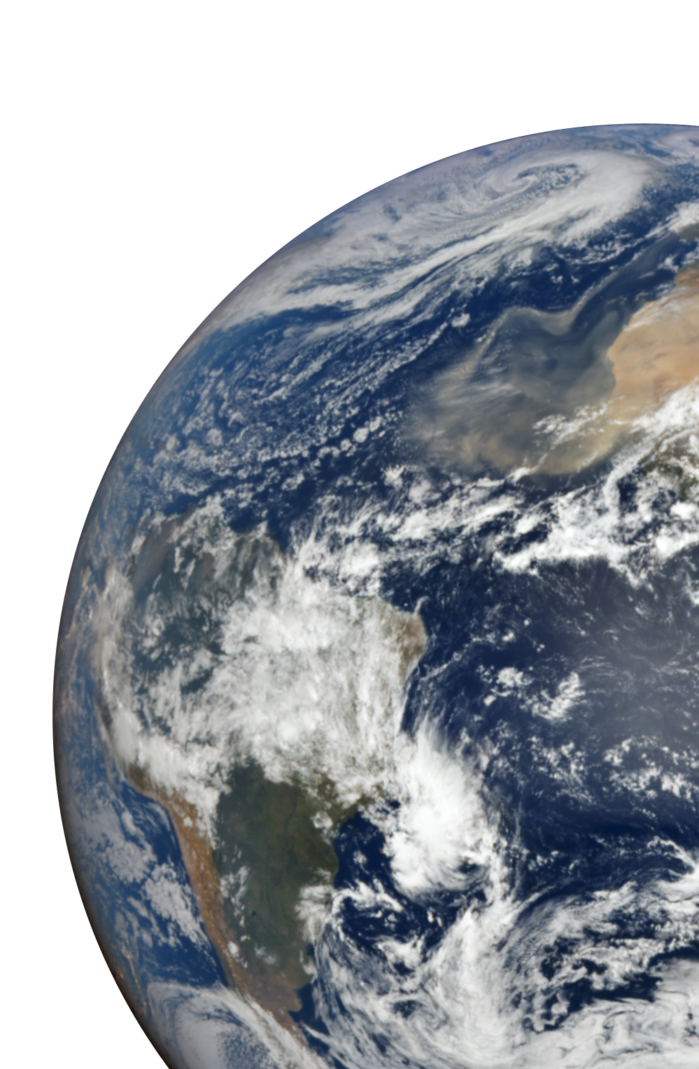

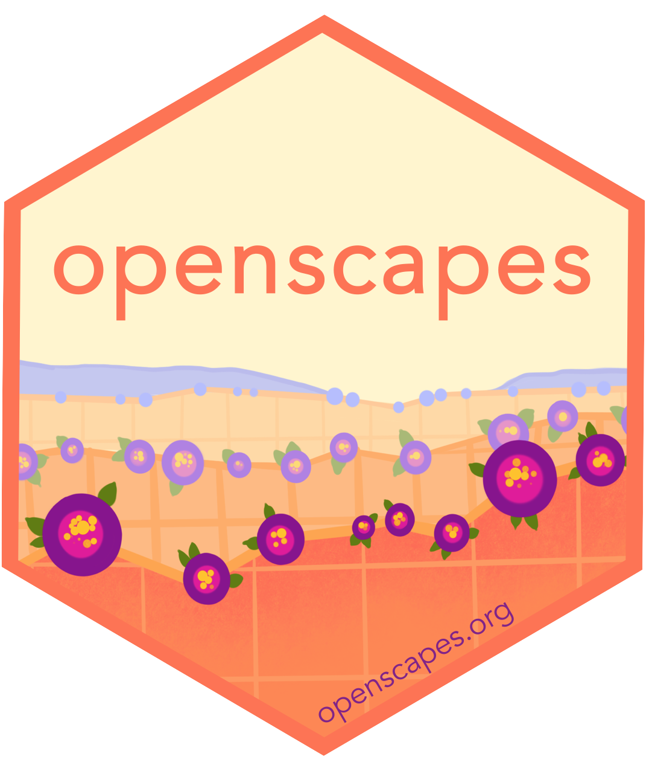
How the NASA Openscapes community supports Earthdata users migrating workflows to the Cloud
NASA Openscapes Mentors and the Openscapes Community
Julia Lowndes • Bri Lind • Catalina Taglialatela • Cassandra Nickles • Aaron Friesz • Michele Thornton • Daniel Kaufman • Alexis Hunzinger • Rupesh Shrestha • Mahsa Jami • Luis Lopez • Celia Ou • Alex Lewandowski • Chris Battisto • Jess Welch • Brianna Pagán • Sargent Shriver • Amy Steiker • Makhan Virdi • Ian Carroll • Guoqing Wang • Nikki Tebaldi • Toni Robinson • Stefanie Butland • Erin Robinson & more!
May 30, 2024
Slides: https://nasa-openscapes.github.io
Notes:
Good morning!
CDDIS User Working Group - NASA Crustal Dynamics Data Information System (CDDIS)
NOAA 2024 Enterprise Data Management Workshop (EDMW)

Slide 2
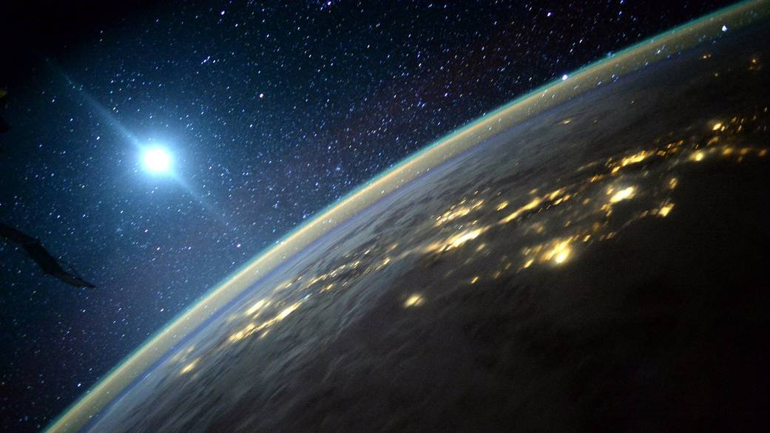
What if we connected our skills & values as a daily practice, for climate?
data science + open science
mentorship + teamwork + community
“To address our climate emergency, we must rapidly, radically reshape society. We need every solution and every solver”. - Ayana Elizabeth Johnson & Katharine Wilkinson, All We Can Save
Notes:
What if we connected our skills & values in our daily work, for climate solutions and justice? Connecting our values to our daily workflows with technical skills and leadership skills.
In our work we’ve seen that when we combine Data science <> Open science <> Teamwork & community is a way for us all to help address our climate emergency. As Ayana Elizabeth Johnson and Katharine Wilkinson say in the book all we can save: “To address our climate emergency, we must rapidly, radically reshape society. We need every solution and every solver”.
I’m going to spend this talk telling two stories of what this looks like and invite you to join us
But first I wanted to tell a bit about me and what drives me to this work. I am often asked why a marine scientist would need data science, so I want to make sure you leave here knowing that marine scientists, as scientists more broadly, work with data every single day to do our science, and it is critical that we are supported to work with data responsibly and to code collaboratively.
So let me start off when a peek at my PhD work, which was here at Stanford University.

Slide 3
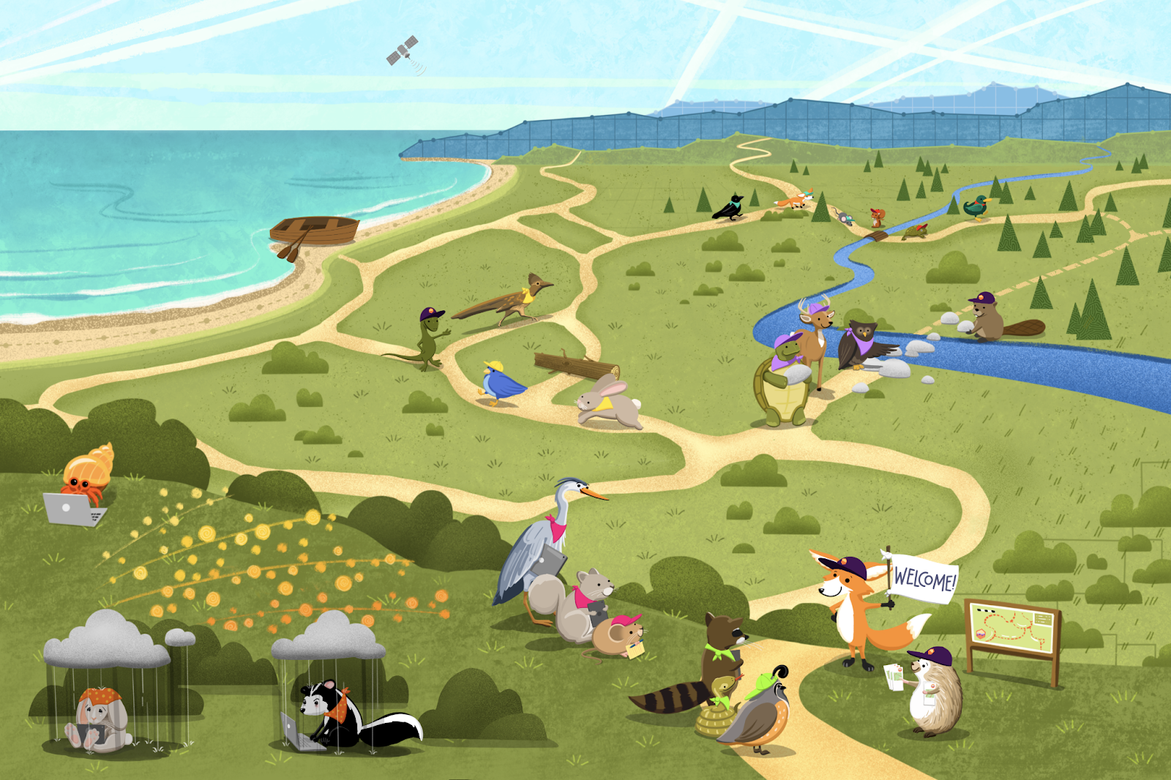

What Openscapes brings
Focused on research teams, connecting to leadership
Centering climate
Kinder science, inclusion
Openscapes helps shift culture by helping people move from lonely science to teamwork as they explore and navigate the open data science landscape safely with their teams.
Kinder science for future us
Notes:
Julie presents
Openscapes is an approach and a community that helps shift culture. We help groups that are feeling stuck or want to make some change, like the bottom left of this graphic, find others with common needs or goals so that they can navigate the open science landscape together, safely with their teams and help build new paths as needed. We talk about this as kinder science for future us.
We work with professional research teams from fed agencies NASA Earth science, NOAA Fisheries, EPA, state agencies like CA Water Boards, academic groups, and nonprofits like the Fred Hutch Cancer Center.

Slide 4
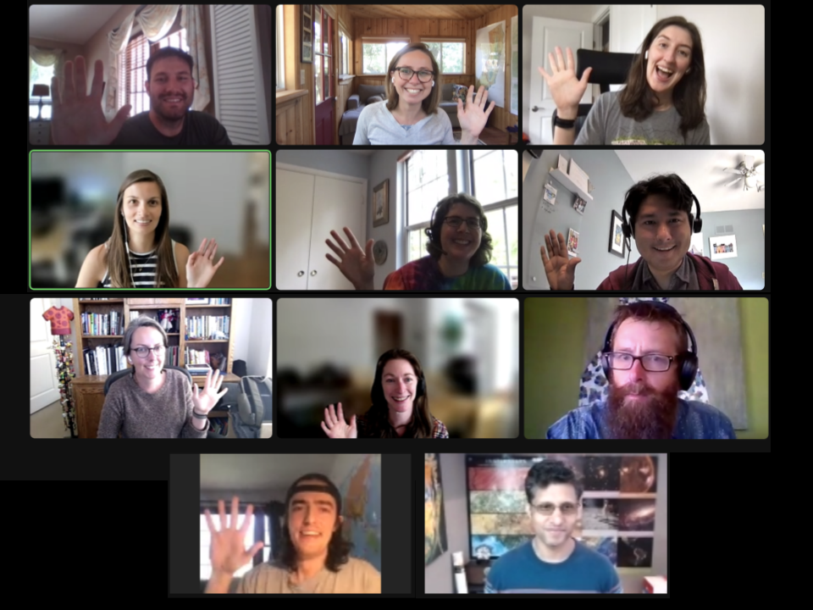
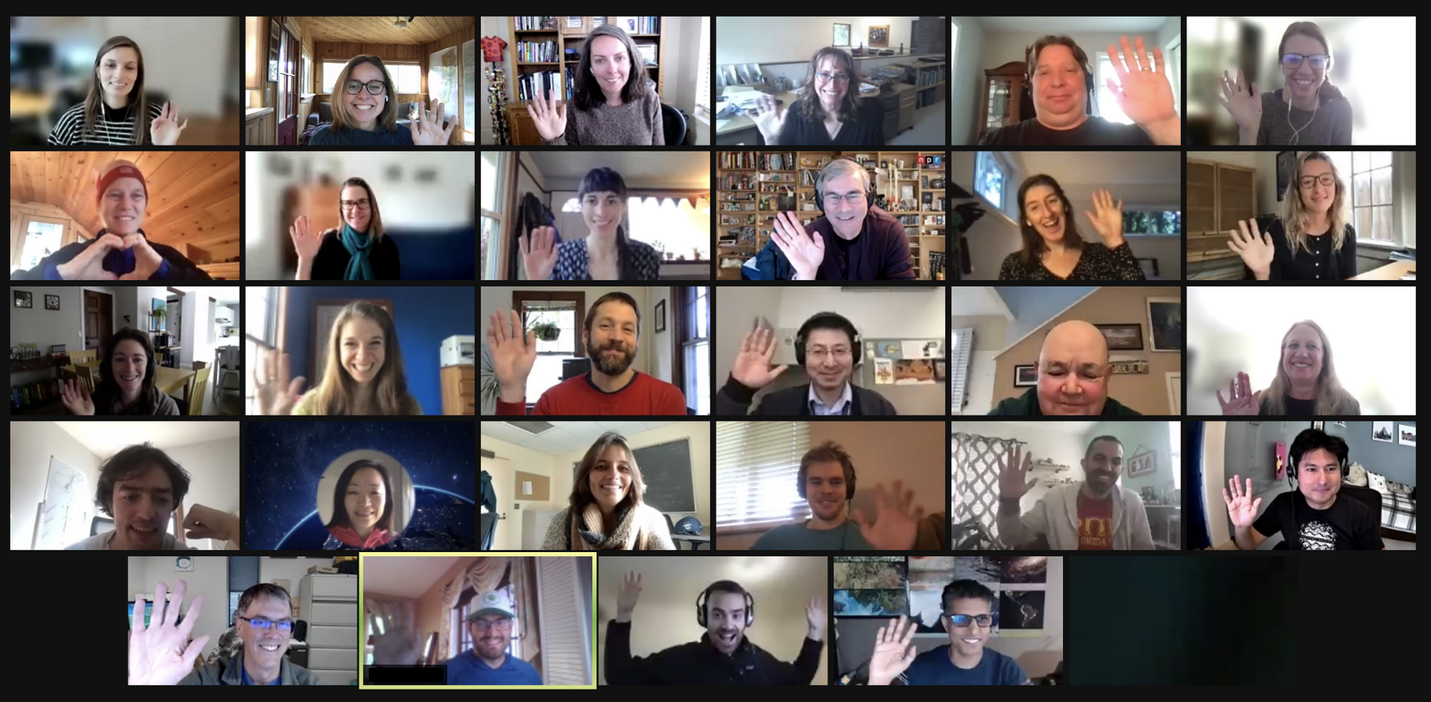

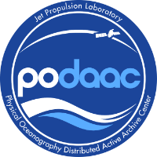

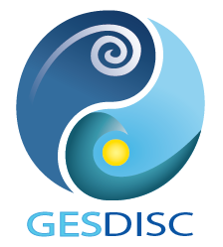
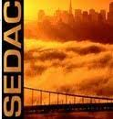

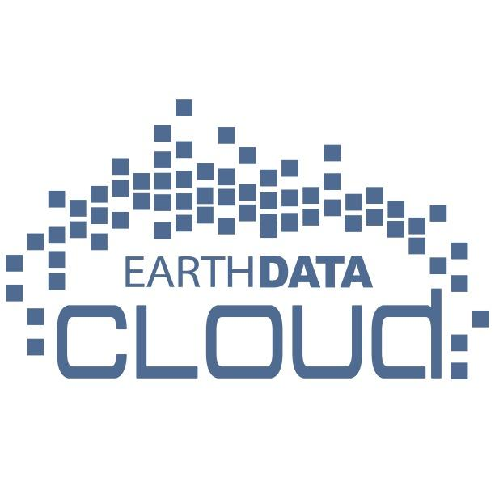





NASA Openscapes:
Supporting Open NASA Earth Science in the Cloud
A mentor community across NASA Earth science data centers that helps support users though:
Co-creating common tutorials
Hosting cloud training events
Practicing open science ourselves!
Proving ground for open source and Cloud community development within orgs
https://nasa-openscapes.github.io
NASA Award# 20-TWSC20-2-0003 Leads: Julia Stewart Lowndes & Erin Robinson
Notes:
The NASA Openscapes mentor community is an amazing group of people
We are a mentor community across NASA Earth science data centers (DAACs). There is top-level support for open science at NASA, and our community is co-creating and teaching common tutorials to support researchers as they migrate analytical workflows to the Cloud.

Slide 5




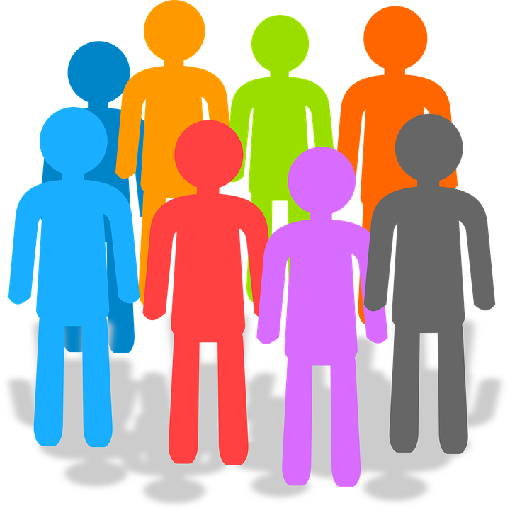

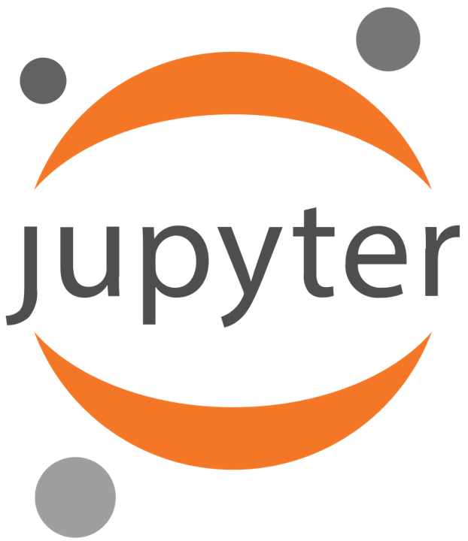
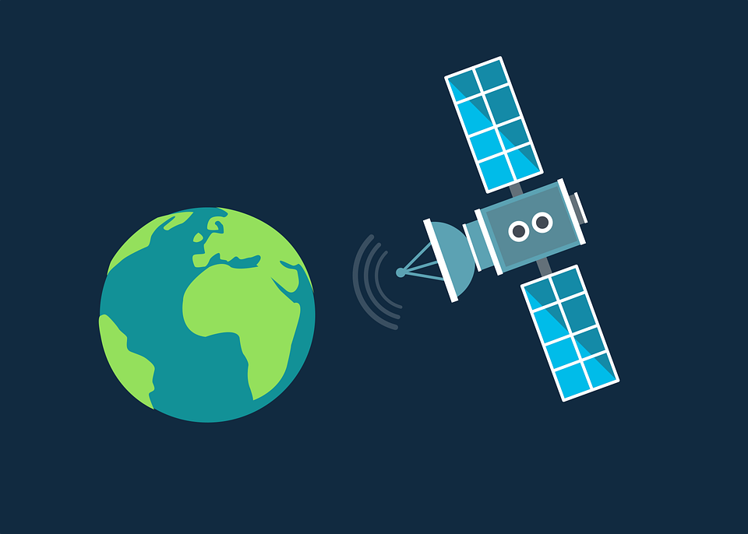

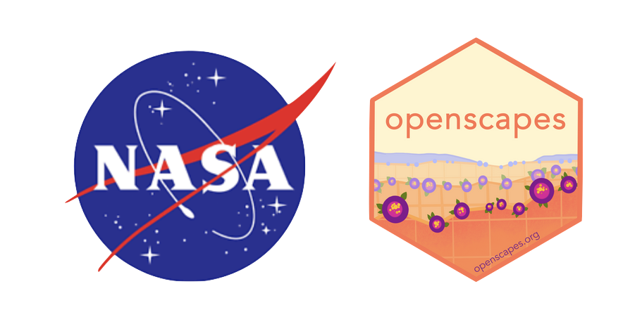
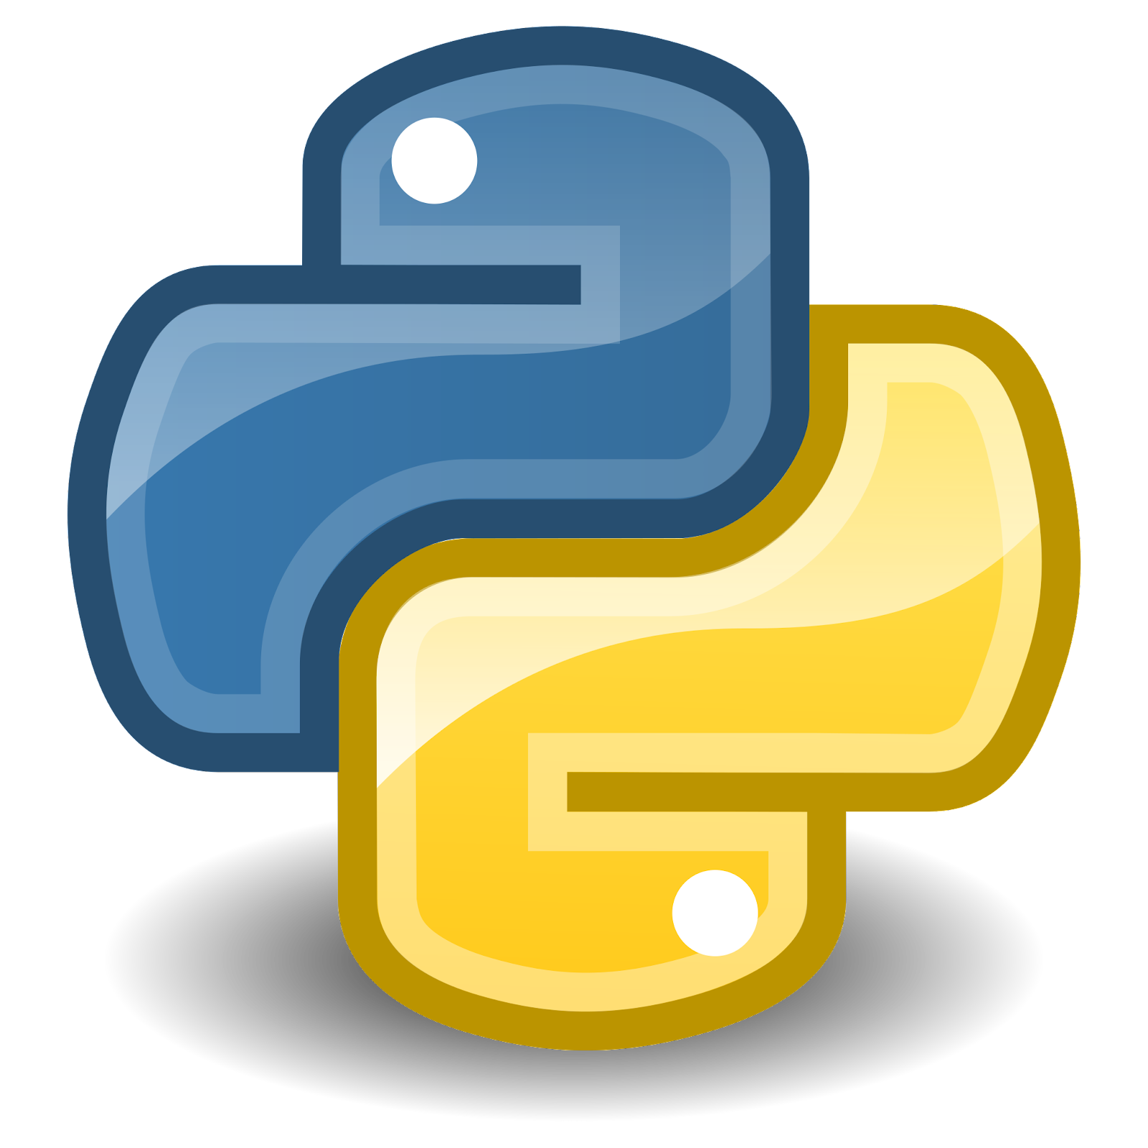





Consistent trust, feedback, & iteration has shaped tools & approaches
NASA Openscapes Mentor Community Values
>> Learn together first
>> Peer-teach, document, and onboard
>> Teach scientists/users (Openscapes Champions is one format where we get to know users deeply)
>> Connect with the broader open source community, collaborate & give back
NASA Data Center Staff
End-Users
Open Science Community
Notes:
Co-developed across different teams of people that work with NASA earthdata
And the way this plays out for us —--
We as a small mentor community (in gray at the top) are able bring our deep expertise from our data centers together and then
Share back and incorporate with our colleagues at each of our data centers (blue)
This means more people and time focussing real-life users (yellow)
And we incorporate what we learn back into the open science community (orange)
We’ve done this with consistent feedback and iteration has shaped development of migration tools and support mechanisms (purple)
I want to emphasize purple?

Slide 6

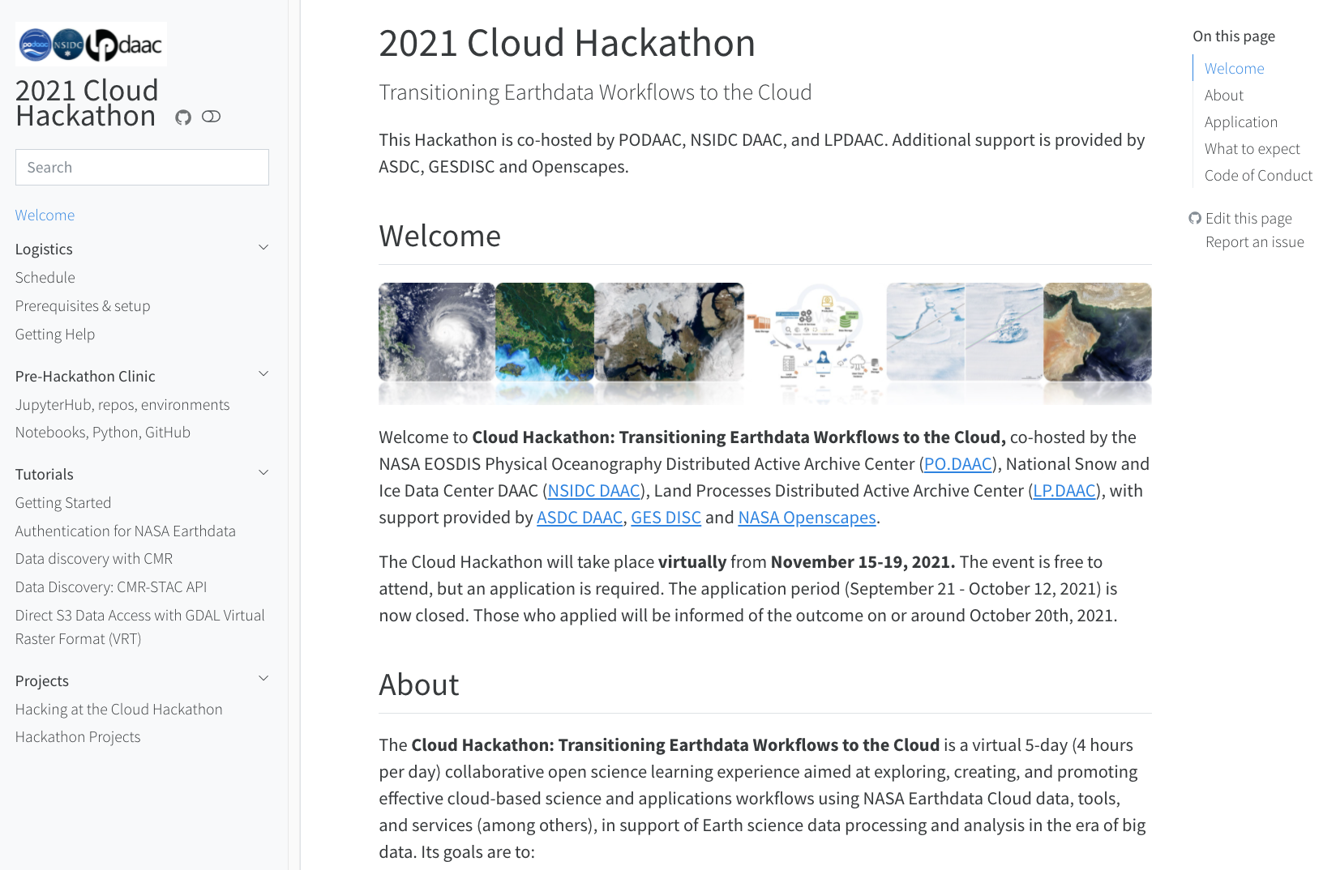
2021 Cloud Hackathon - teaching researchers early on
https://nasa-openscapes.github.io/2021-Cloud-Hackathon/
Preparation:
9 co-created tutorials for data access
User-friendly book with Quarto
Notebook review, teaching dry runs
Shared facilitation & teaching practices
The event:
65 2i2c JupyterHub AWS instances
50 forks of the GitHub repo
8 hack-team projects presented on Day 5
“It was a really great week. The tutorials were AMAZING. Everyone did a great job, and everyone was very nice. I really appreciated welcoming environment. I don't have a strong python background. But i was supported in learning all around”
On Day 1, Mentors stepping in to teach due to an emergency: trust + teamwork + familiarity with the material
Blog summaries:
earthdata.nasa.gov/learn/articles/2021-cloud-hackathon
podaac.jpl.nasa.gov/announcements/2021-12-15-The-2021-Cloud-Hackathon
Notes:
We used that infrastructure for events like this one

Slide 7

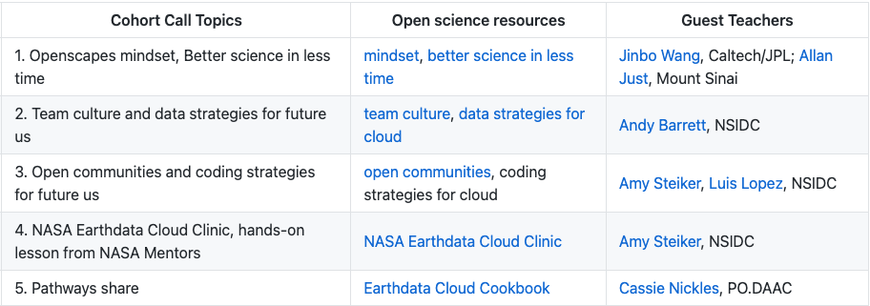
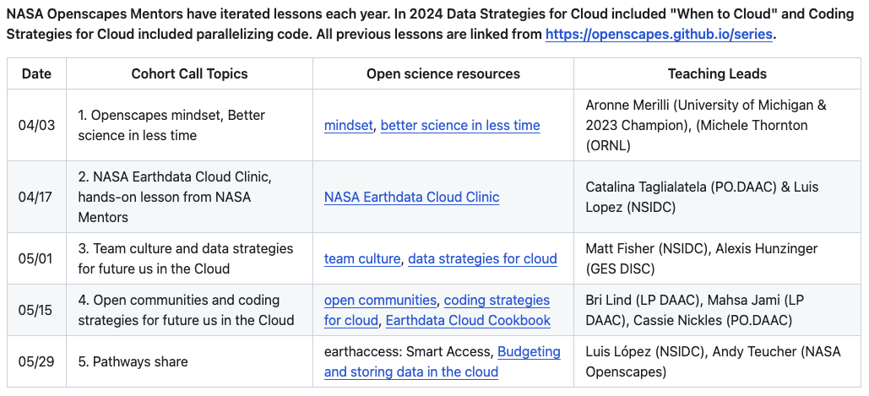
NASA Openscapes Champions
NASA Openscapes Champions is a mentorship and professional development opportunity for research teams using data from NASA Distributed Active Archive Centers (DAACs) and interested in open science and migrating their analytical workflows to the cloud.
To date we have supported 25 teams plan/test/ move their workflows to the cloud.
Benefits to the Champions:
Access to the 2i2c Hub for 1-year
More direct support from the DAACs
Pathway toward cloud migration
Benefits to NASA DAACs
Clear identification of user needs
Success stories to showcase
2023
2024
https://nasa-openscapes.github.io/2024-nasa-champions
Notes:
The mentors are learning how to work in the Cloud together using a 2i2c JupyterHub, where they are supporting researchers to work there in Python, R, and Matlab. They are leading learning events using tutorials they created and reuse and iterate for different audiences and events for researchers and other NASA staff, They are also identifying user needs and developing where they see needs including the earthaccess python library; cheatsheets and guides. They describe how they are now working openly with each other across their silos, feel braver speaking up in other places, and that they are comfortable sharing imperfect work with each other and getting and receiving feedback.
2i2c
Work of the Mentor Community
How to grow it - working on real researchers in the science teams
Luis showing this real example of work the Mentor community has done
We are really grateful for our NASA Mentors, and to NASA who is supporting their time so that open science can be a paid part of their jobs.
We’re supporting Support Mentors towards establishing a common set of NASA Earthdata tutorials that they can then build off their DAAC-specific and science examples
Again, these recurring themes. Wanted to reuse existing so needed to identify what is unique to NASA earthdata and what’s not, tease that apart to reuse existing. Only contribute to combine and fill gaps rather than reinventing
We center researchers, and we focus on this feedback loop between tooling and people
---

Slide 8
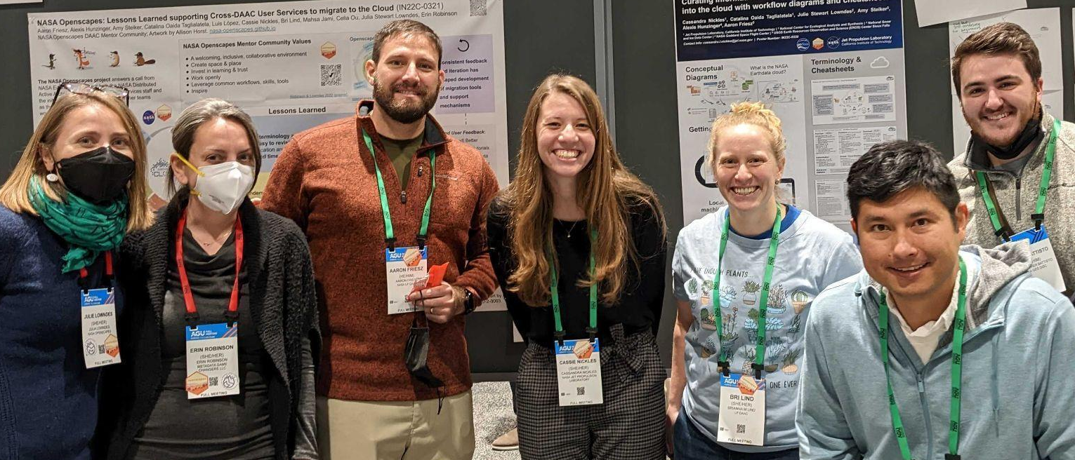
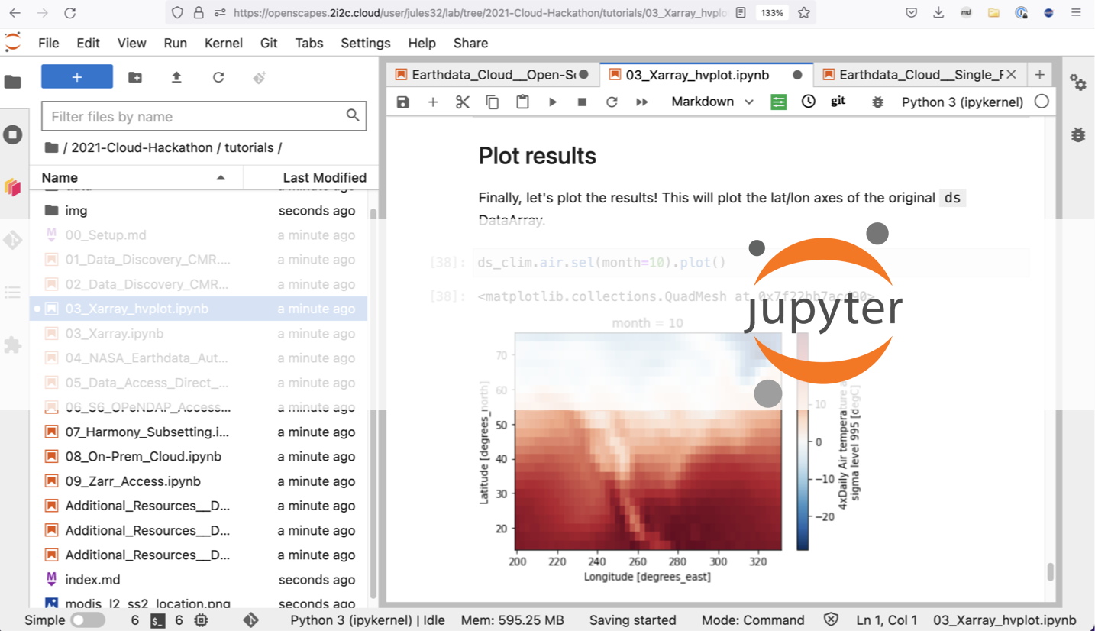
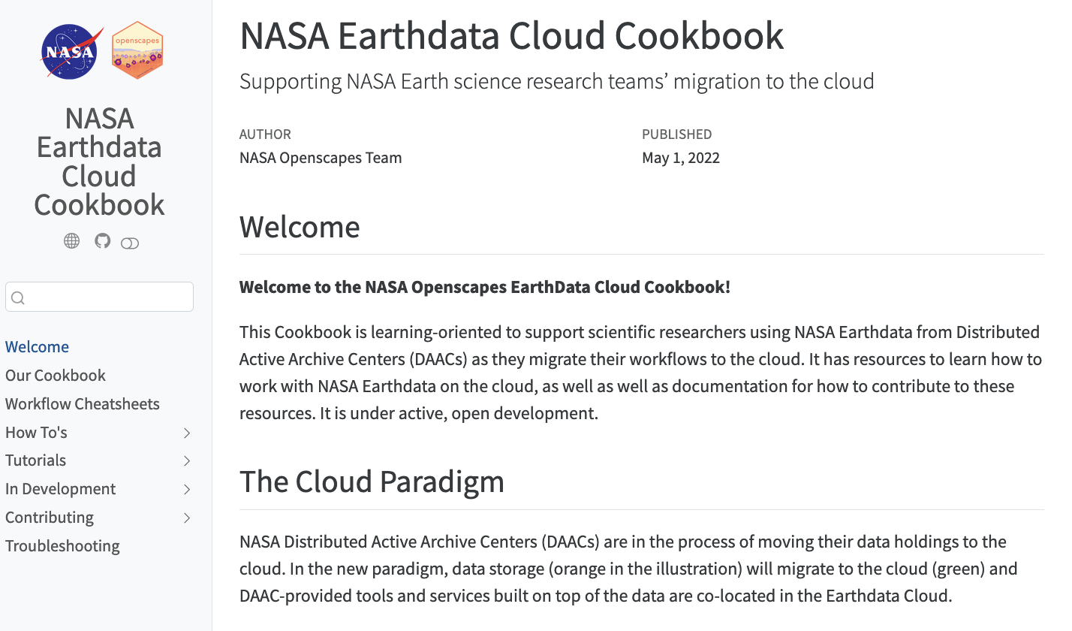

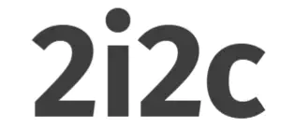
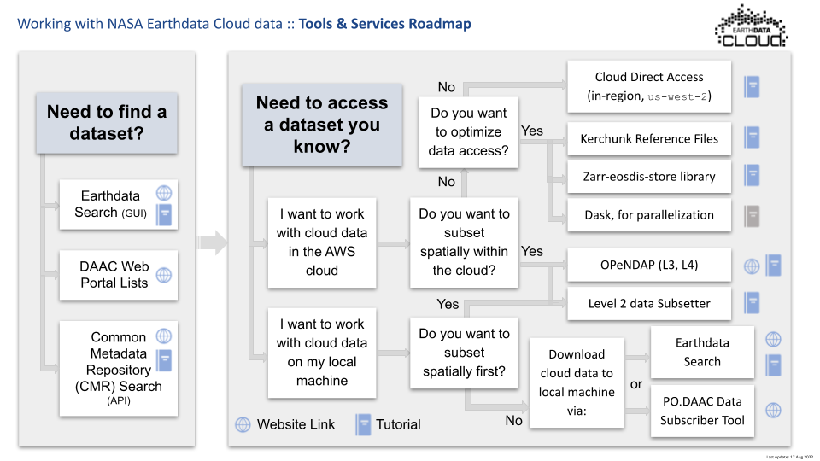
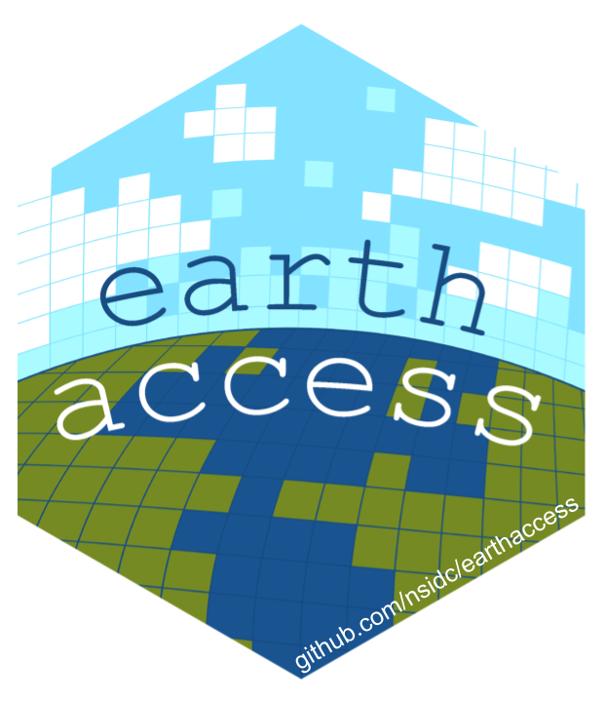
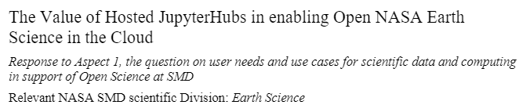
Identifying & responding to user needs
15+ workshops & talks led by Mentors since: reusing & extending tutorials with software & conceptual solutions
2i2c JupyterHub: Python, R, Matlab,
corn base image: built on Pangeo stack
Cookbook: current tutorials & onboarding
Value of Hosted JupyterHubs White paper / RFI
earthaccess Python library
Cheatsheets & guides
Notes:
The mentors are learning how to work in the Cloud together using a 2i2c JupyterHub, where they are supporting researchers to work there in Python, R, and Matlab. They are leading learning events using tutorials they created and reuse and iterate for different audiences and events for researchers and other NASA staff, They are also identifying user needs and developing where they see needs including the earthaccess python library; cheatsheets and guides. They describe how they are now working openly with each other across their silos, feel braver speaking up in other places, and that they are comfortable sharing imperfect work with each other and getting and receiving feedback.
2i2c
Work of the Mentor Community
How to grow it - working on real researchers in the science teams
Luis showing this real example of work the Mentor community has done
We are really grateful for our NASA Mentors, and to NASA who is supporting their time so that open science can be a paid part of their jobs.
We’re supporting Support Mentors towards establishing a common set of NASA Earthdata tutorials that they can then build off their DAAC-specific and science examples
Again, these recurring themes. Wanted to reuse existing so needed to identify what is unique to NASA earthdata and what’s not, tease that apart to reuse existing. Only contribute to combine and fill gaps rather than reinventing
We center researchers, and we focus on this feedback loop between tooling and people
---

Slide 9

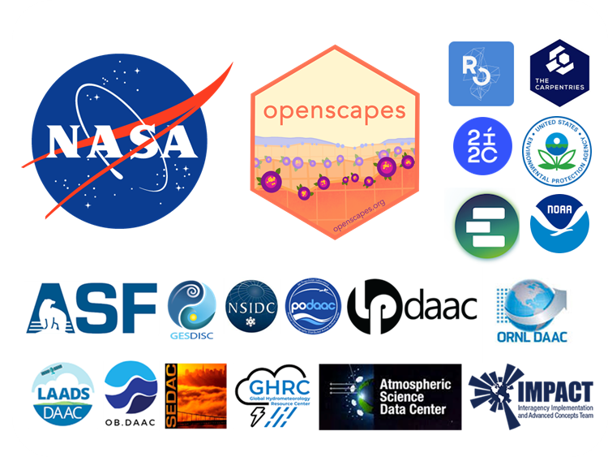
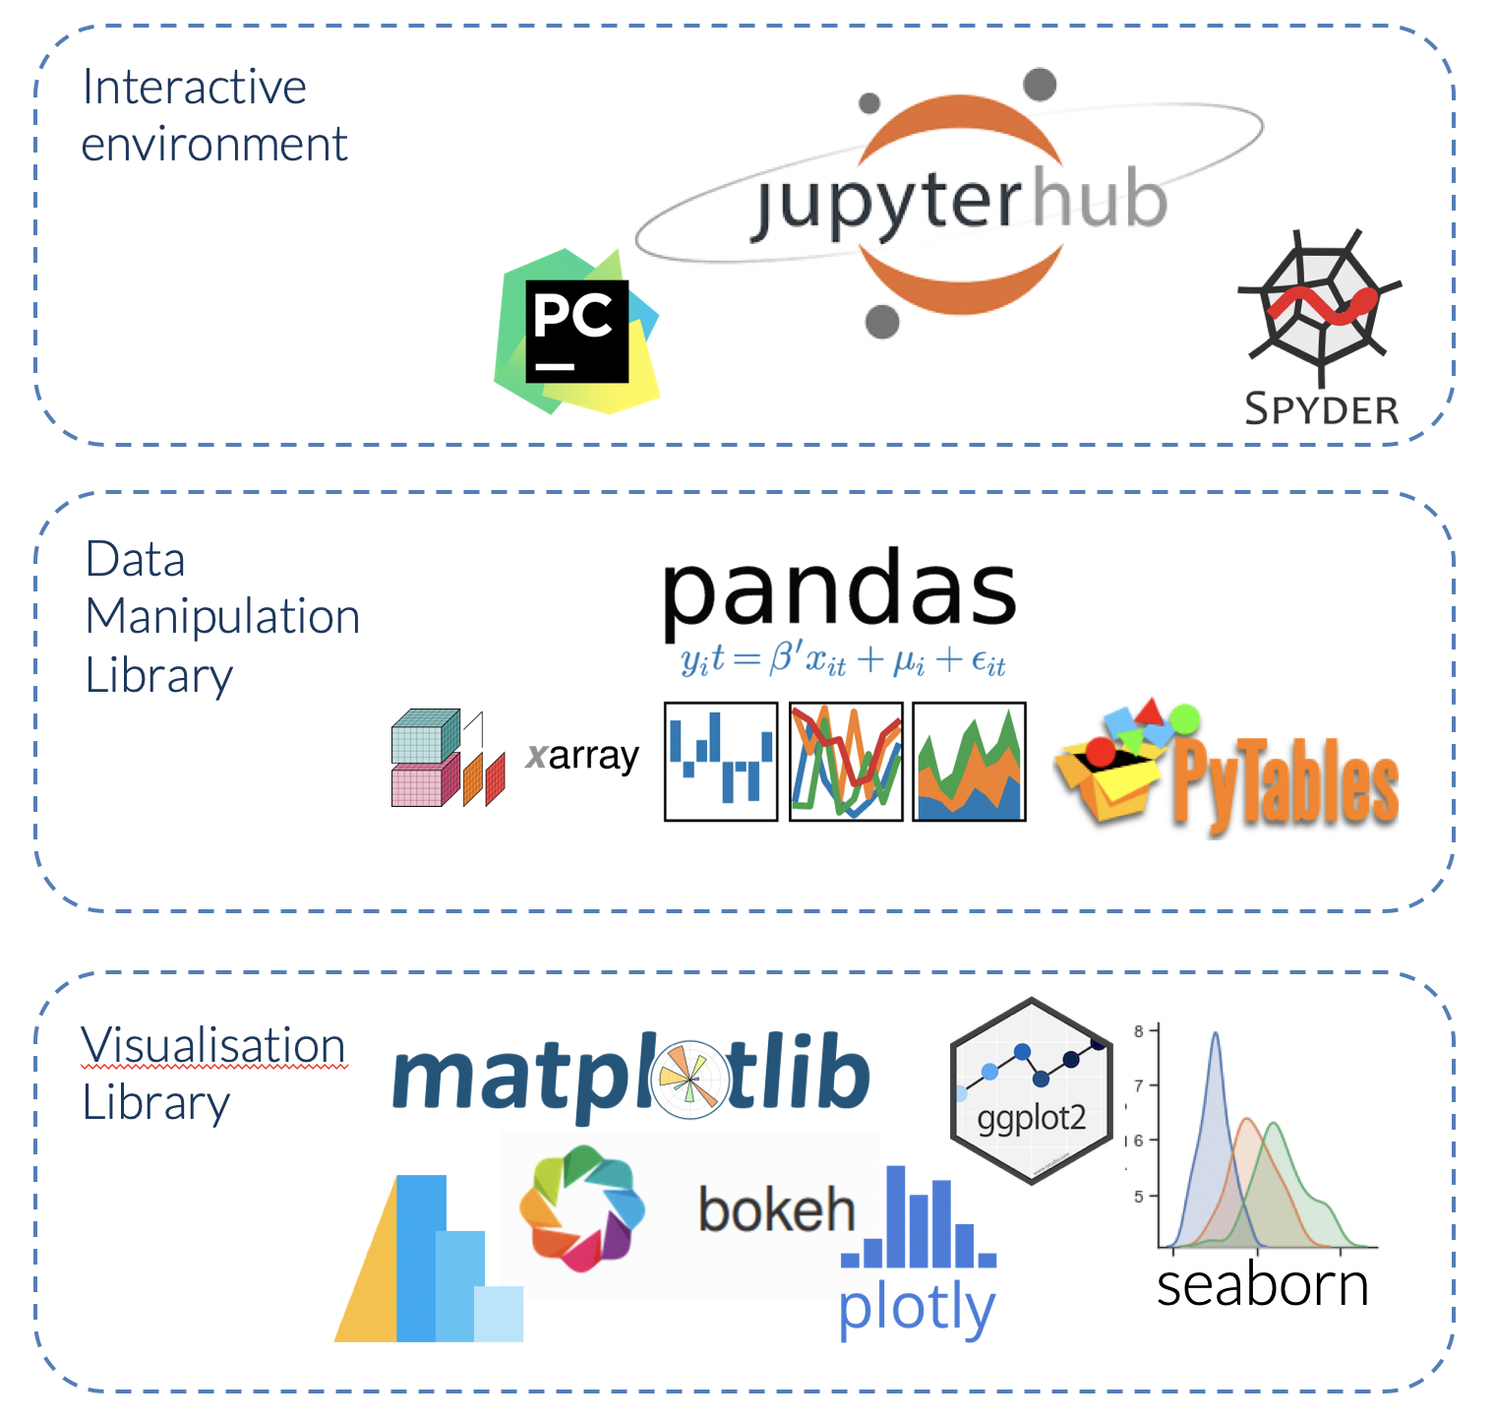



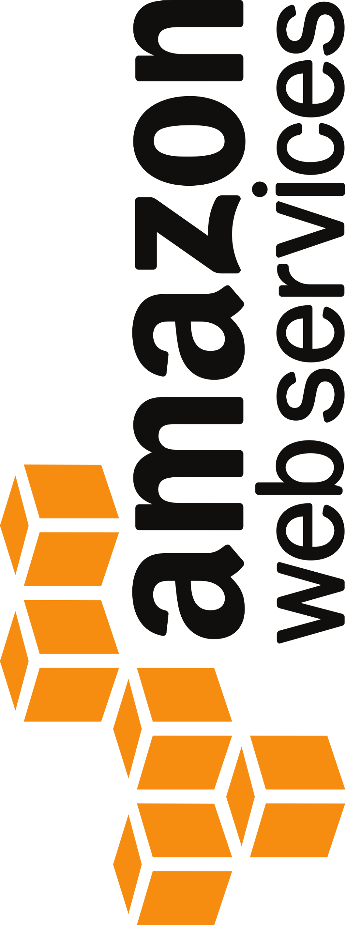
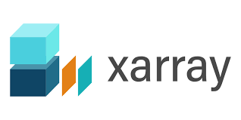
earthaccess aims to be a technical and social bridge between NASA Earthdata and scientific research.
Reproducibility with less code makes open science more accessible.
https://nasa-openscapes.github.io/news/2024-03-04-earthaccess-tech-spotlight

Slide 10
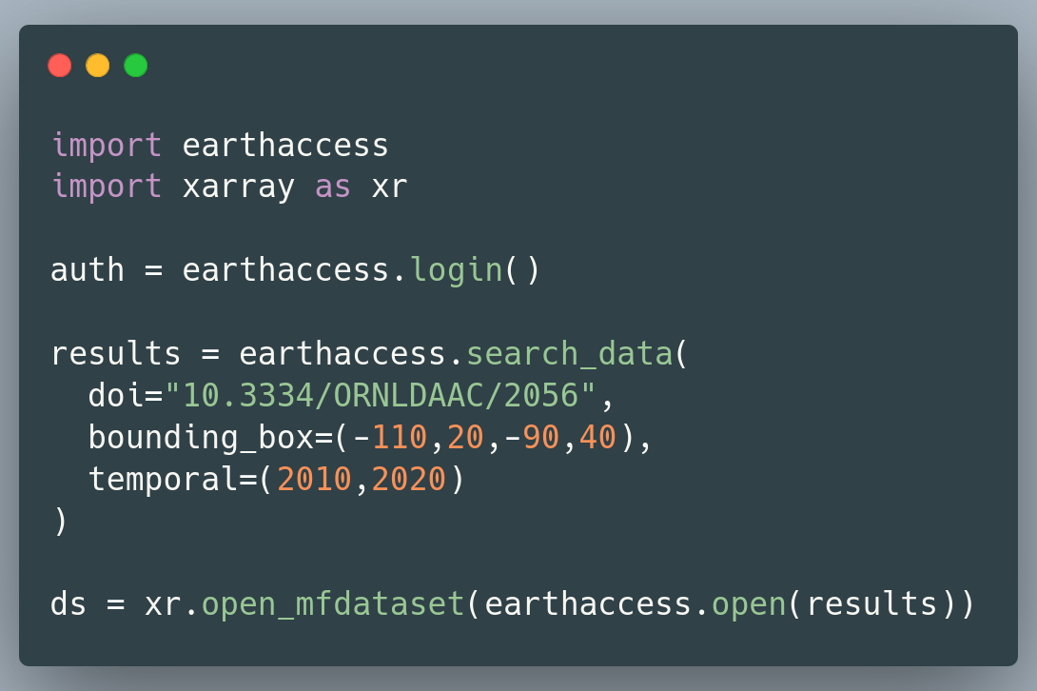
earthacess: making things simpler
earthaccess is a Python library that simplifies data discovery and access to NASA Earthdata by providing an easy to use library to interface with NASA’s authentication and search APIs so that science can be done using less code.
Auth: earthaccess handles authentication with NASA EDL.
Search: earthaccess abstracts NASA’s search API (CMR) into a pythonic module.
Access: earthaccess can download or open data for both cloud and on-prem hosted datasets with the same code.

Slide 11
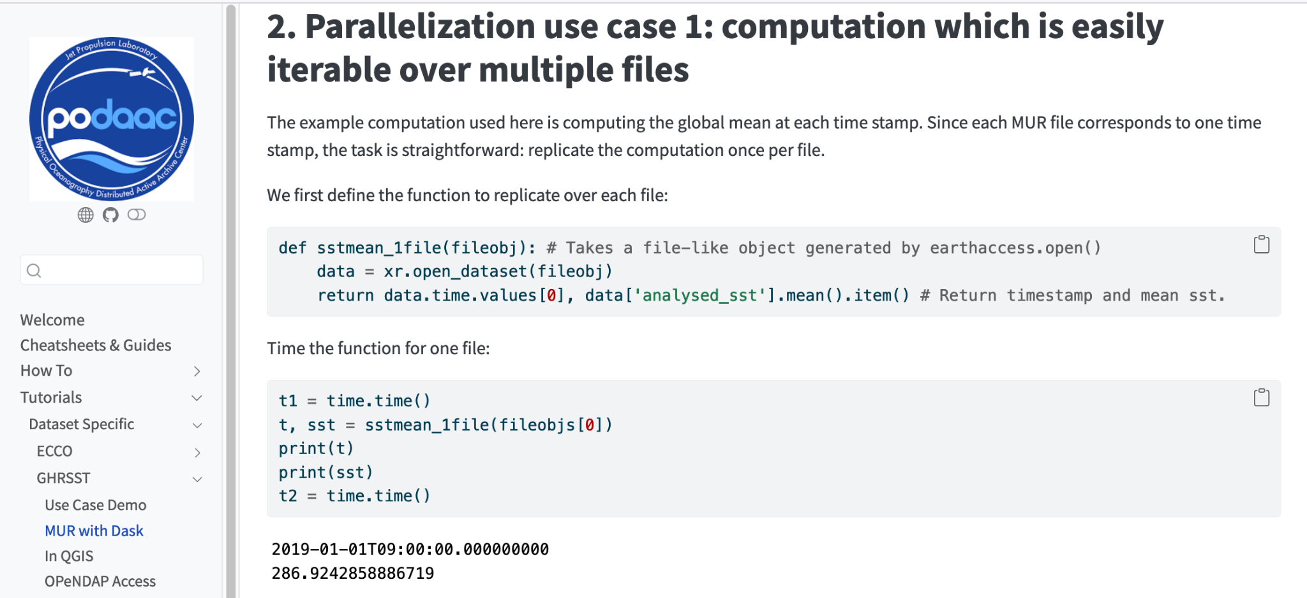
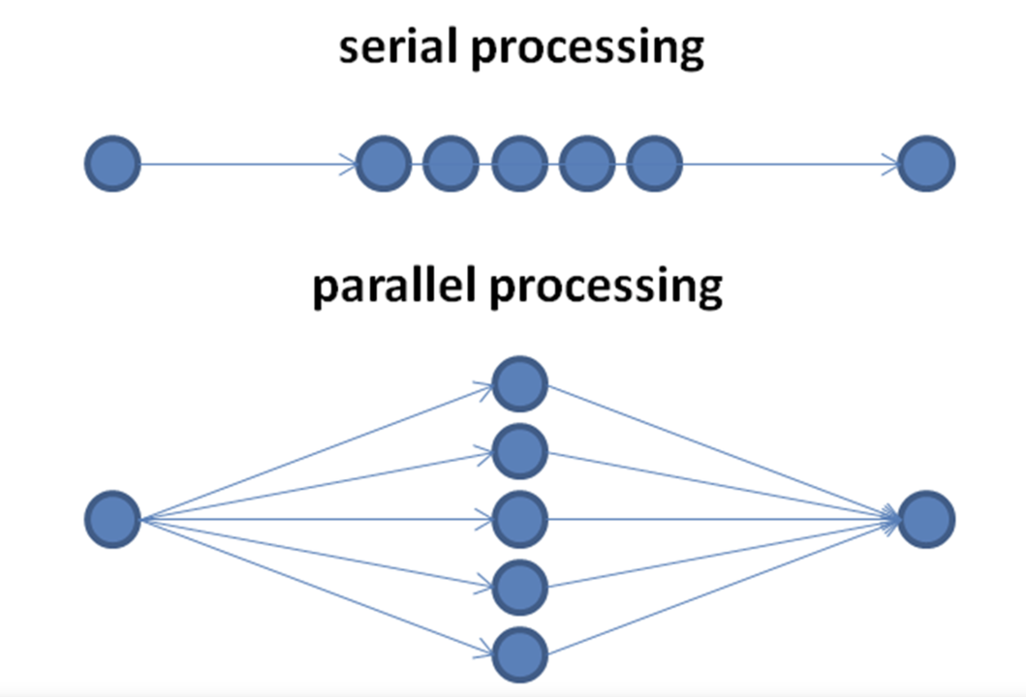
“Daskifying” code: from serial to parallel
PO.DAAC tutorials…
…are used in Mentors’ coworking…
Mahsa Jami (LP DAAC) brings a GEDI notebook to our biweekly Mentor Calls. Screenshares with Luis López (NSIDC) while we all watch & learn.
https://podaac.github.io/tutorials/notebooks/Advanced_cloud/basic_dask
…and then amplified to teach others
Mahsa Jami (LP DAAC) and Luis López (NSIDC) develop & teach coding strategies for parallelization to Champions Teams, May 17 (slides)
Notes:
1) simplest way without using Dask, you don’t open files as a full fileset, then you’re only working on a file that was recently opened so won’t run out. Processing would still be serial. Loop through “for granule in results”...
You’ll see a lot of progress bars. You’re creating a session within the loop
earthaccess.login() doesn’t expire after an hour - could do this at the top.
earthaccess.open() this would expire after an hour - but now since within a for loop it should be ok
2) To make it faster, we can extract the gedi_to_dataframe we could make it parallel. Let’s do it!

Slide 12
Parallelized science in the Cloud - first “fledging” story from 2i2c JupyterHub!
“In Champions Cohort we got a teaser of how to work in the Cloud. With Coiled and I did some simple things and now I’ve moved into my own workflow to Cloud. I have an Amazon account now ‘paying my own way’.”
- Aronne Merelli, University of Wisconsin
Aronne shared his story with the 2024 Champions Cohort science teams in April!
First Forays into the Cloud - Youtube
“It’s like a super power”: I did the analysis on my AGU poster: 150 TB of L1 and L2, and I needed some tiny fraction that were of interest to me - in the old way I would need to find a way to download, don’t have a machine big enough. But with Coiled, I can subset. Now once I realize that, I realize there are bigger datasets that just seem unworkable before.”
Notes:
2021 Kevin Murphy call - what if this doesn’t work. We’ve iterated on Champions, and on teaching opps that Mentors have presented, to 4 workshops at AGU, to Tech Spotlight, Webinar, UWGs. They don’t have any hesitation, they’re not starting from scratch every time and not isolated when they do it
And, Champions. We’ve seen huge strides
Aronne - was not a cloud expert. Was a NASA data expert and python skills.
Learned to use the Cloud through materials Mentors developed. decided he was going to do something he needed to do anyways. AGU poster using our infra.
Now he’s paying himself, let’s all cheer for this.
Flywheel once - immensely hard to get to this place. But now, it will get immenesly easier
“Aronne took 3 years plus 30 mentors and all the NASA earthdata - it took all of us plus coiled to get here.”
We can support them using the Cloud. Aronne quotes “working in a new way” - answering new q

Slide 13
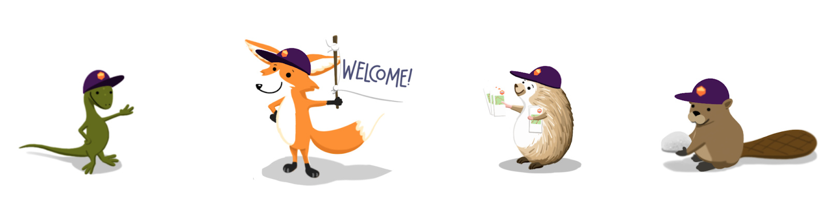
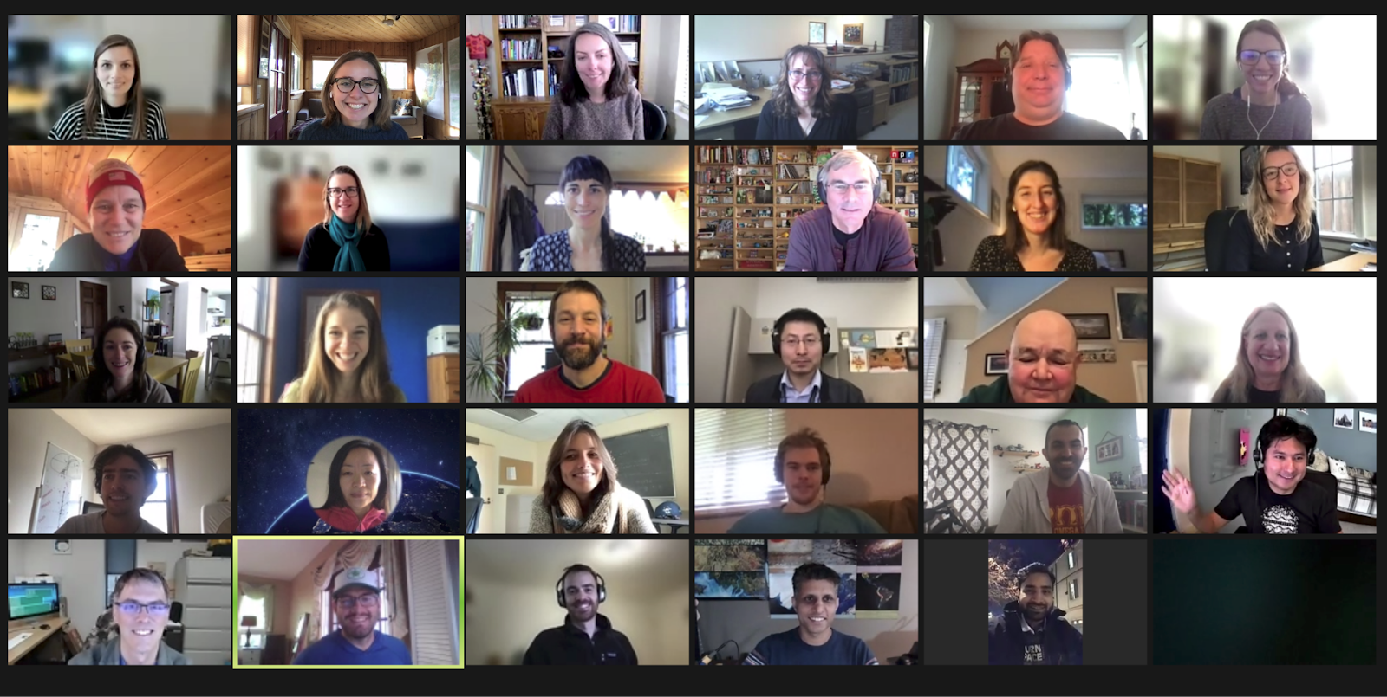
Thank you!
Join us:
Mastodon, Bluesky: @openscapes
openscapes.org
NASA Openscapes
NOAA Fisheries Openscapes
Openscapes at the Water Boards
Learn, reuse, remix, support others, grow the movement
Earthdata Cloud Cookbook
Champions Lesson Series
Approach Guide
Julia Lowndes
NASA Openscapes Mentors & Openscapes Community
Diverse, inclusive teams and communities are key
Thanks to the people who made this possible!
Not pictured: more people!
Slides: openscapes.org/media
Notes:
Thank you for your attention! There’s many links and resources in these slides and online; please find them from openscapes.org.

Slide 15
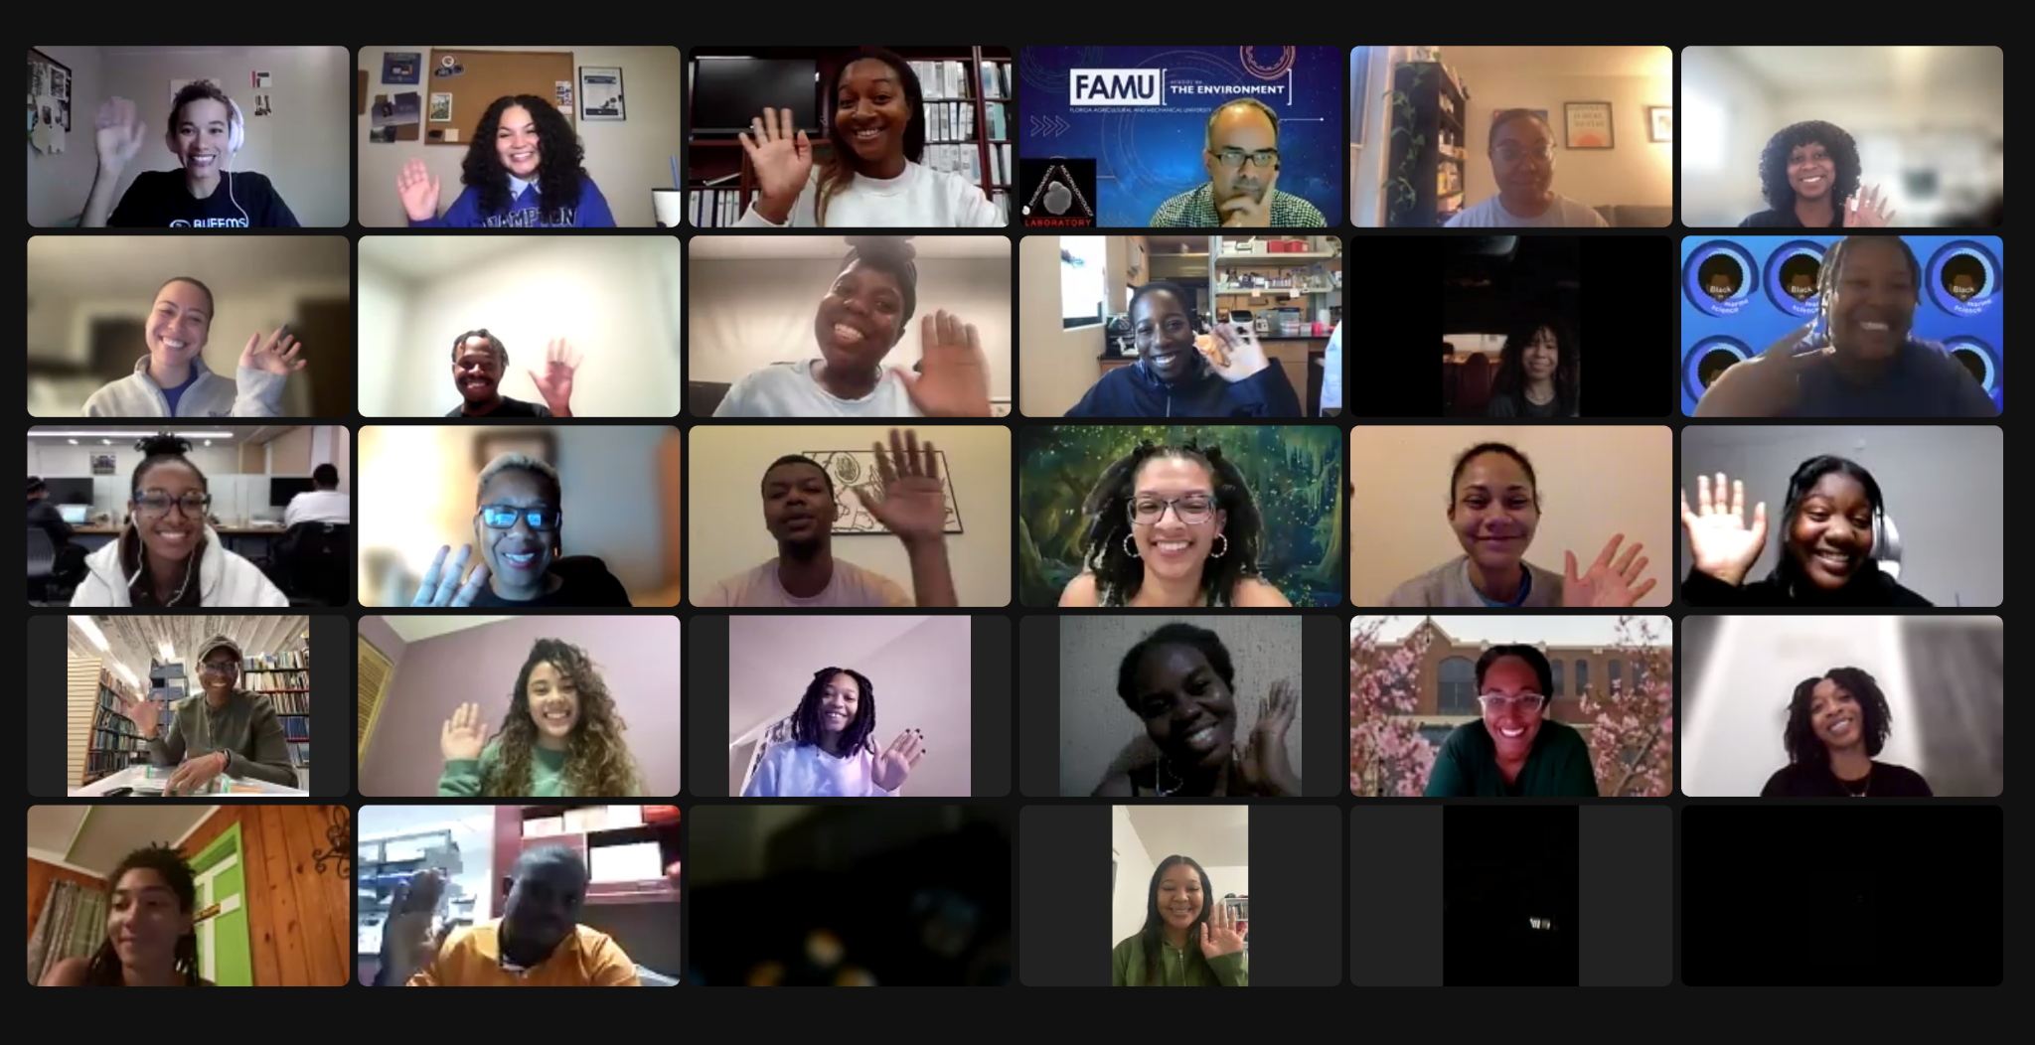
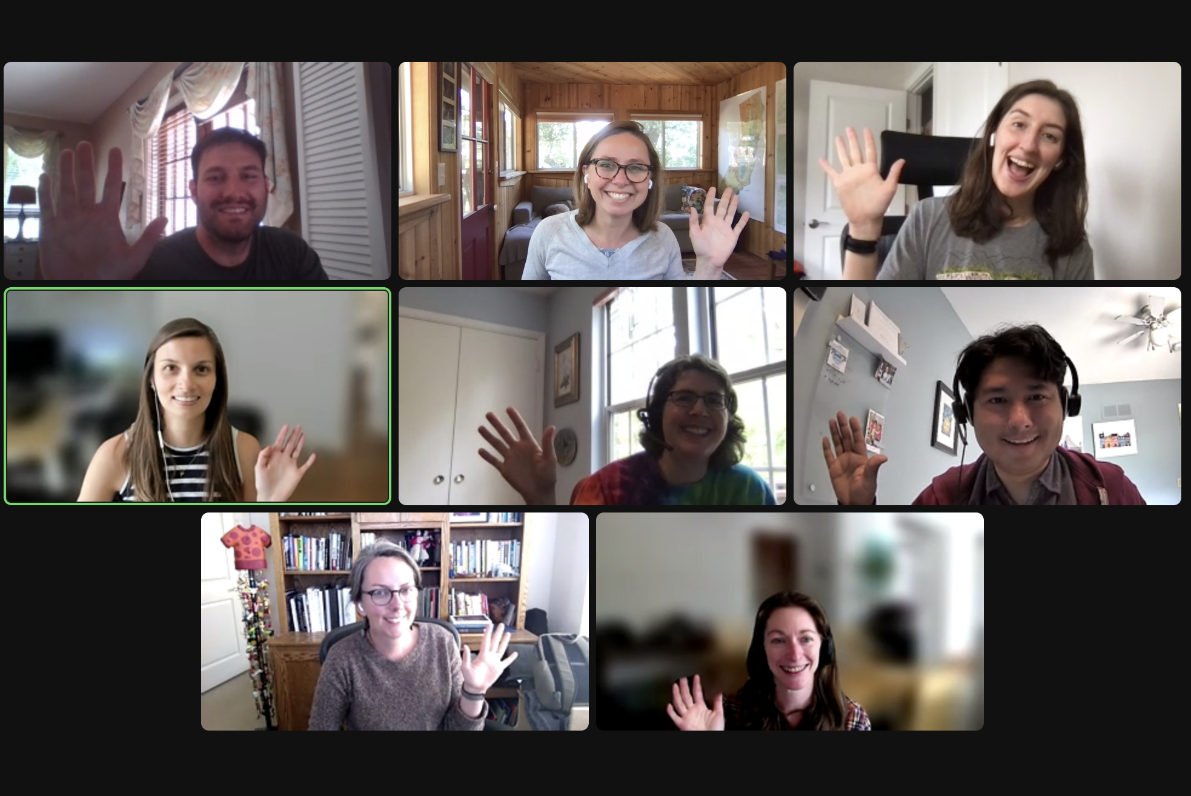
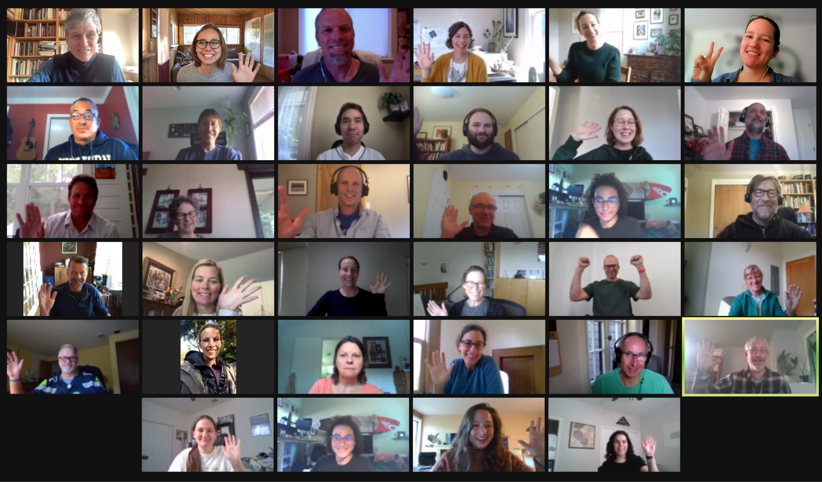
open source community: learning, doing, building together across academia and government.

Slide 16
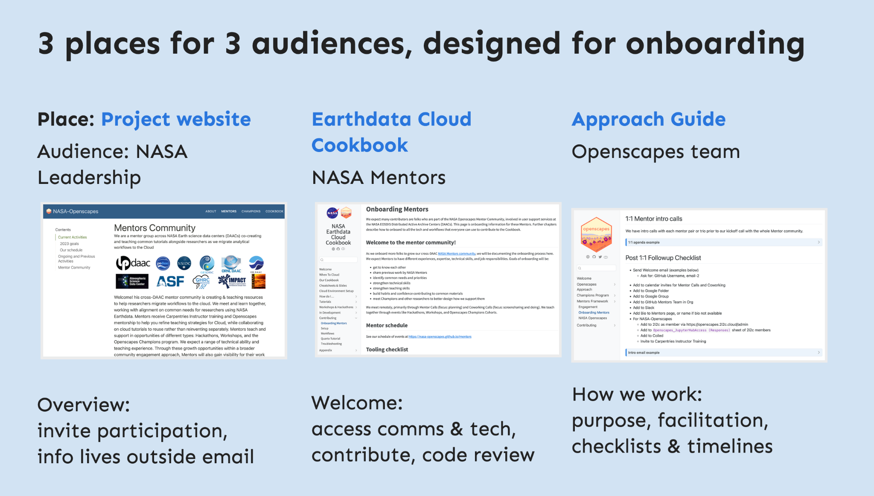
Documentation
https://openscapes.github.io/documenting-things

Slide 17
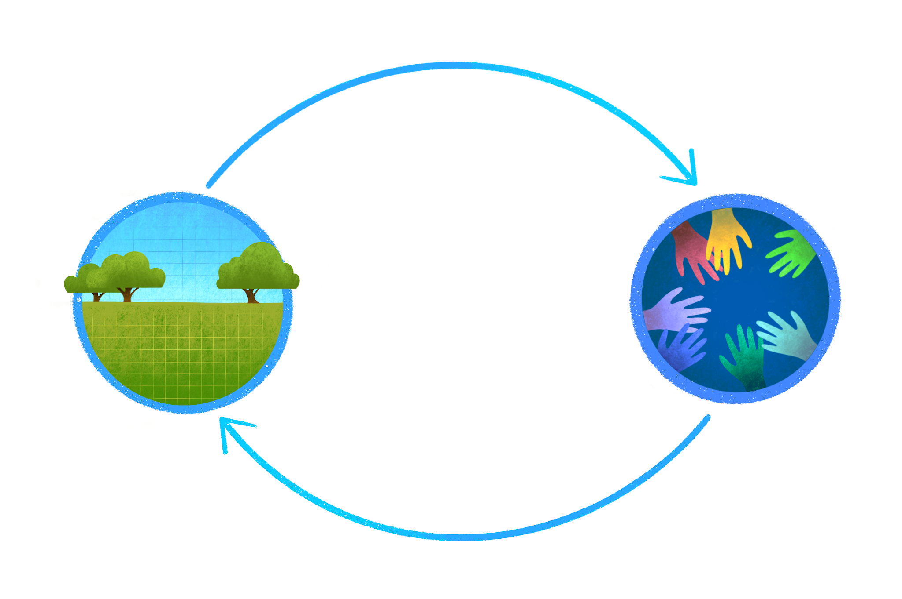
Technical & social infrastructure together
Tooling
tools & practices
People
teams & community
Notes:
What's made this possible is really a focus on tech and the social infrastructure over and over throughout. Becoming teachers coaching skills, listening mentoring live coding carpentries. Tech infrastructure to i2c open source communities, etc.

Slide 18
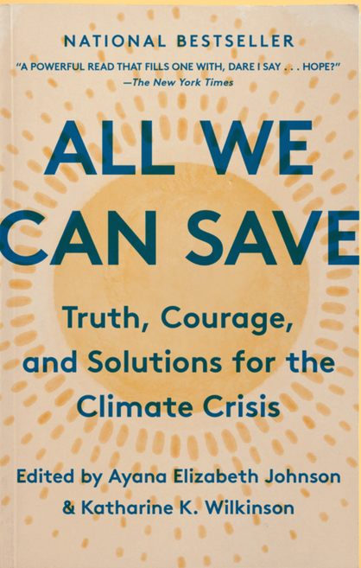
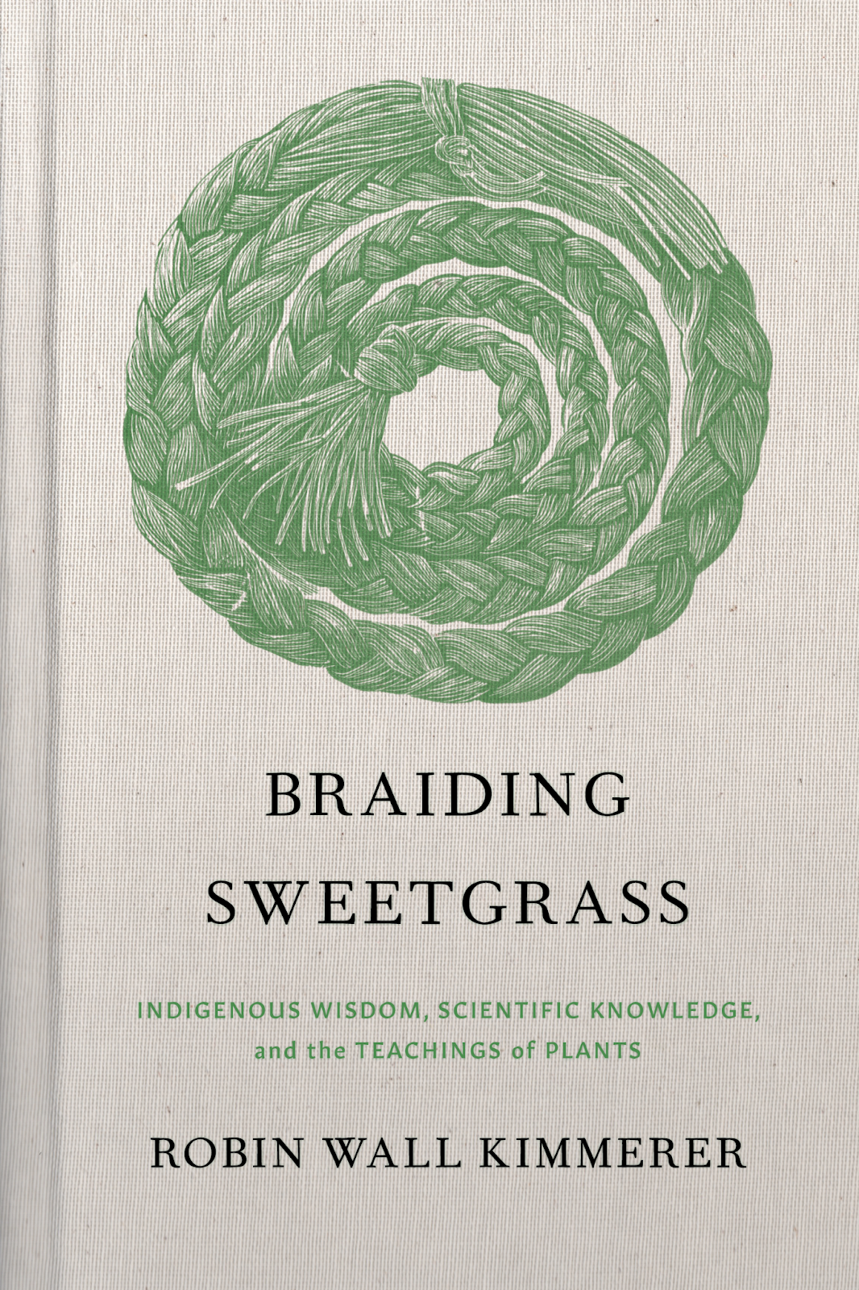

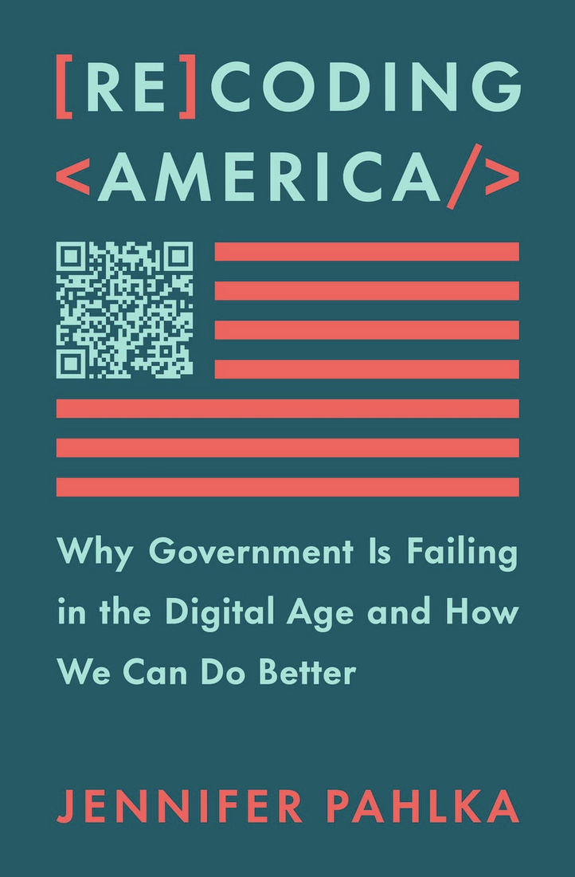
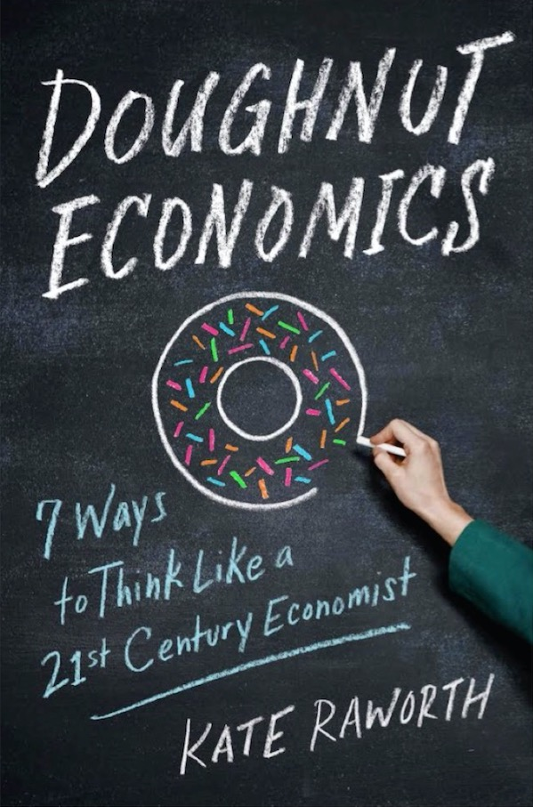
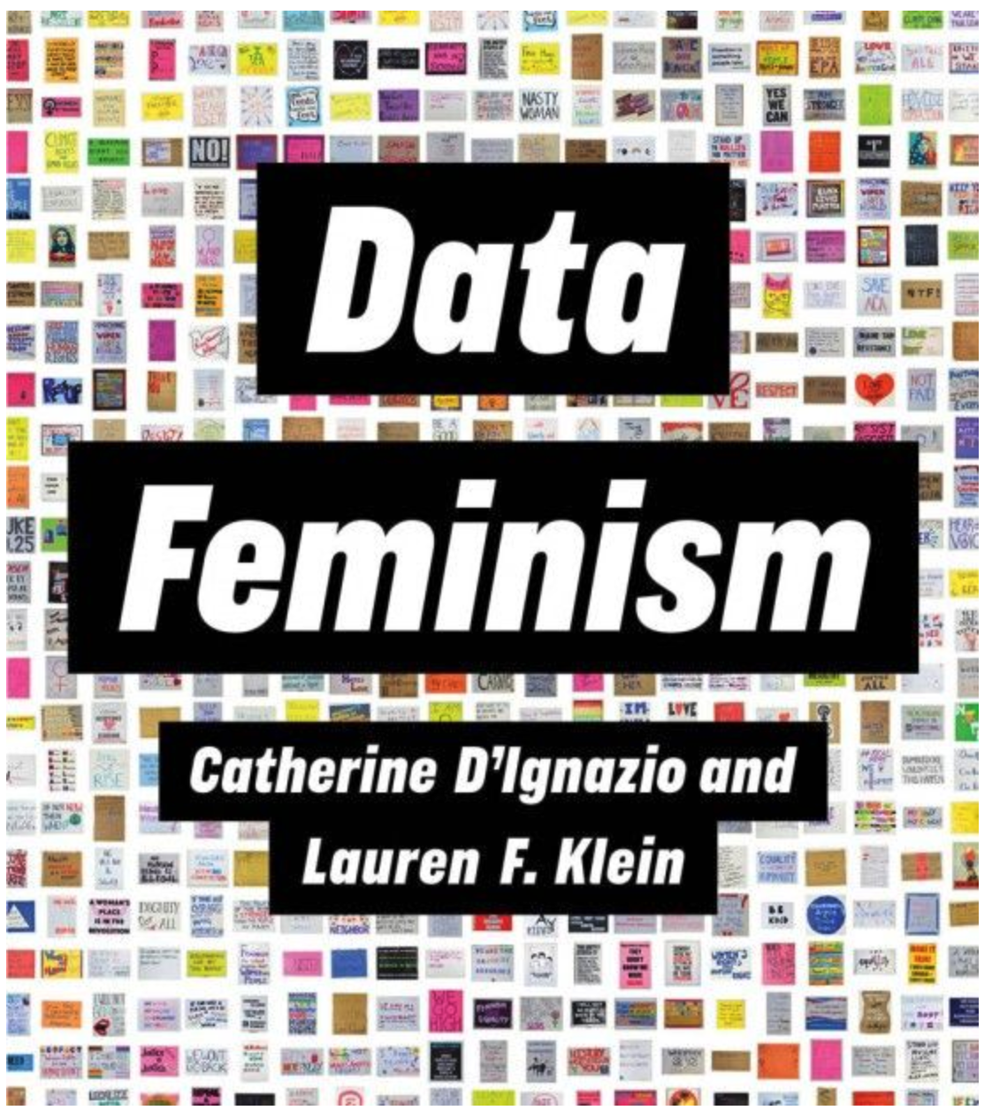
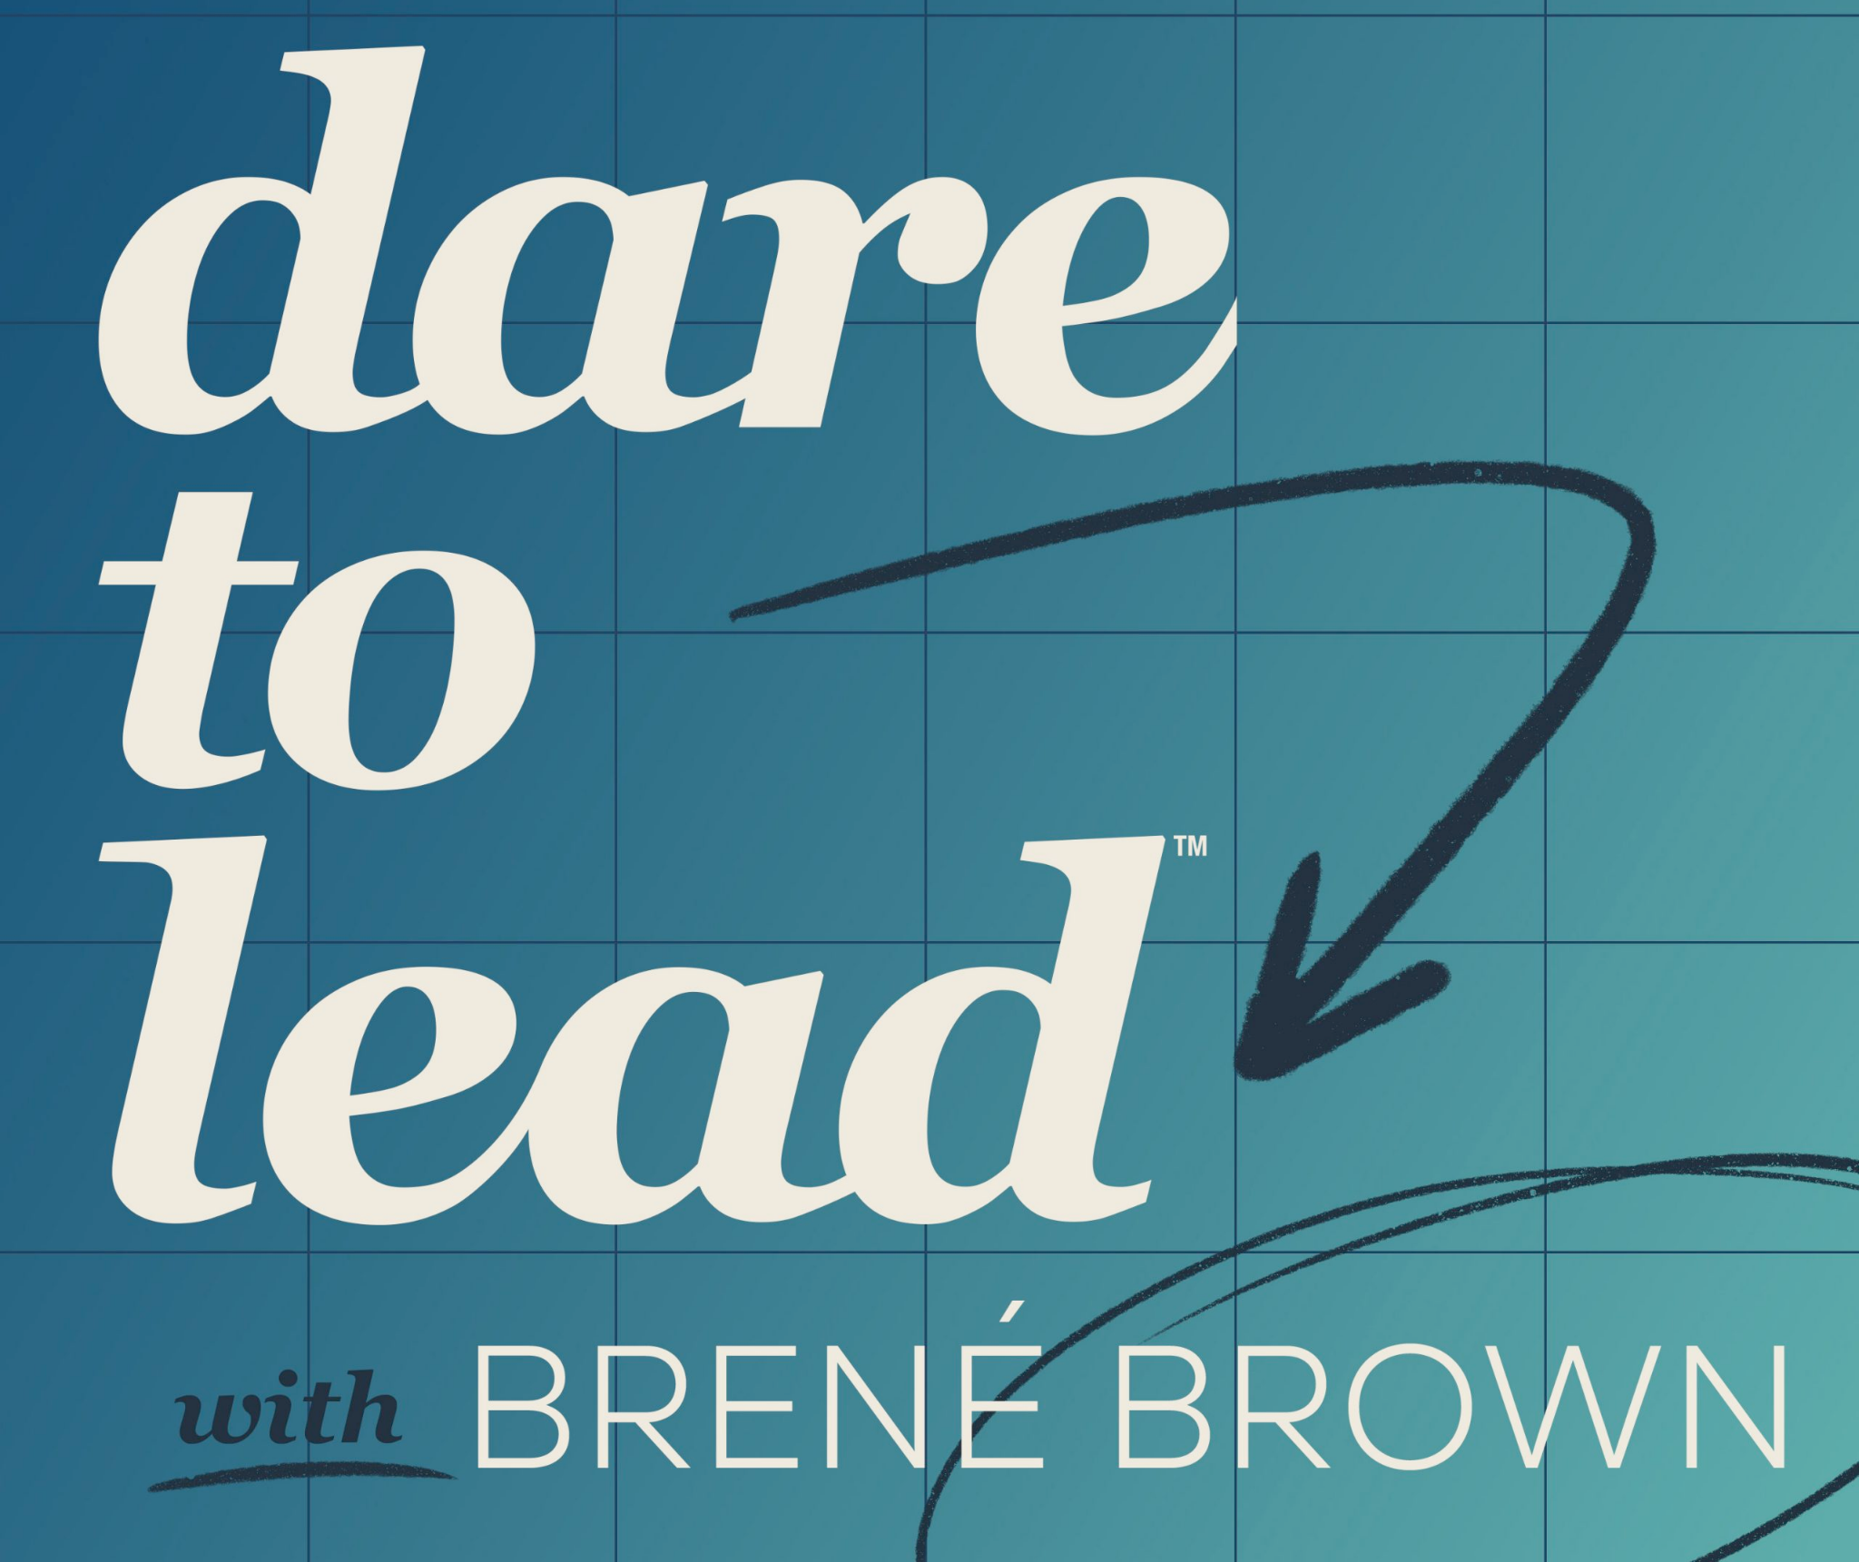



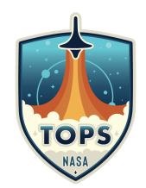

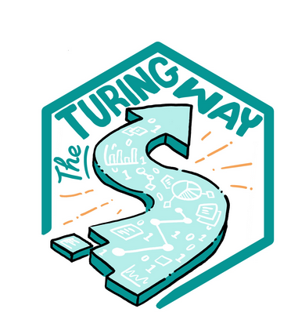
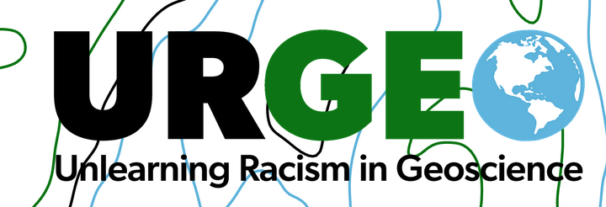

Developing a kinder, open science mindset
Mentorship is a skill we can all develop; let’s learn from & join existing efforts
Psychological Safety
Growth Mindset
Generosity
Empathy
Asking questions
Listening
Not solutioneering
Meeting folks where they are
Reflecting
Connecting values to daily actions
“Perfection is a colonial conditioning.
Worrying that you’re going to get it wrong holds you back from trying, and that erases.”
- Ta7talíya Michelle Nahanee, Nahanee Creative
Territorial Acknowledgements Interactive Workshop
Notes:
We can all develop a kinder science mindset; mentorship is a skill we can develop and we can learn from and join existing efforts. We all need continual learning not only to evolve with the softwarescape and work with new partners.
So many intersecting groups doing really impactful work, really grateful to be learning from and with them
I don’t have an ask but a welcome, an invite, a share

Slide 19
Further resources (incomplete list):
White Paper: The Value of Hosted JupyterHubs in enabling Open NASA Earth Science in the Cloud - Nickels et al 2023
Openscapes Flywheel: A framework for managers to facilitate & scale inclusive Open science practices - Robinson & Lowndes 2022
Shifting institutional culture to develop climate solutions with Open Science Lowndes et al 2023
NASA-Openscapes.github.io - NASA Openscapes Mentors
Hello Quarto: share • collaborate • teach • reimagine - Lowndes &Çetinkaya-Rundel 2022 Keynote (video)
A Journey to Data Science: Tools for Equity and Diversity in STEM - Fenwick 2022 (video)
Open software means kinder science - Lowndes 2019
Supercharge your research: a ten-week plan for open data science - Lowndes et al. 2019
Our path to better science in less time using open data science tools - Lowndes et al. 2017
3 lessons from remote meetings we’re taking back to the office - Cabunoc Mayes et al. 2020
Toolkit for Incentivizing Open Science - National Academies (NASEM) Report; Openscapes blog post
All We Can Save - Johnson & Wilkinson 2020, eds
Braiding Sweetgrass - Kimmerer, 2013
From Open Data to Open Science - Ramachandran, Bugbee, & Murphy 2021
Unmet needs for analyzing biological big data - Barone et al. 2017
How to bring open source to a closed community - Cabunoc Mayes 2016

Slide 20
Create space and place to connect and collaborate; remove barriers to participation (paid time, part of jobs)
Engage
A Future Us mindset
Invest in learning and trust Everyone has something to learn, ask, teach; don’t need to be an expert in everything. Cultivate psychological safety, growth mindset. Slowing down to speed up.
Welcome
bright spots (be they mentors or researchers) –people who want to work better and collaborate
Flywheel
Empower
Learning culture
Inspire broader research communities through celebrating people & small wins that accumulate – Open science shift
Work Openly Put what you learn into practice quickly, role- modeling sharing imperfect work. Identifying common challenges & opportunities. Documentation. Openness is a spectrum; first Future You and soon Future Us.
Amplify
Open leaders
Leverage common workflows, skills, tools. This is where we speed up: Iterate, reuse, remix with each other and the broader community
Robinson & Lowndes 2022
Notes:
Handoff back to Julie
This is how we work: we’ve developed a cyclical process we talk about as the Openscapes Flywheel. We engage a Future Us mindset through welcoming and creating space and place, we Empower a learning culture by investing in learning and trust, and working openly, and we amplify open leaders by leveraging common open data science workflows, skills and tools and inspire broader scientific culture.
The Flywheel is a concept developed by Jim Collins in the book Good to Great; it’s the idea that when building something to last, there is no single defining action. Rather, the process resembles relentlessly pushing a giant, heavy flywheel, turn upon turn, building momentum until a point of breakthrough, and beyond. We’ve found these are the synergistic and overlapping elements for open data science movement building which we’ve tested, iterated, and refined in working with over 150 research teams since 2019. We are really focused on building habits that last, and institutional change that lasts. Let me share a few example:
https://www.jimcollins.com/concepts/the-flywheel.html

Slide 21

Create space and place
Scaffolding & facilitation: regular meetings (Cohort Calls, Coworking, Clinics, Hackdays)
Manage software: Google Drive, Slack, GitHub Org, 2i2c JupyterHub, AWS Credits (remove Cloud cost), Quarto & notebooks
Time as part of their jobs
Engage
A Future Us mindset
Invest in learning and trust
Role-modeling to build trust, growth mindset & psych safety via live notes, screensharing, making mistakes, sharing early
Teach & learn technical collab skills w/ GitHub, 2i2c JupyterHub, Quarto, etc
Teaching & mentoring skills w/ Carpentries, coaching
Welcome
ESDSWG invite
Nomination form; opt-in; sign up as pairs or trios
Inspire
Storytelling & artwork
Teach researchers together
Slides, blogs, language for reuse
Braveness sharing details with different audiences
Empower
Learning culture
Work Openly
Promote & support live coding, tutorial review, onboarding docs, teaching dry runs
Planning & organizing
Support infrastructure for Cookbook (Quarto, GitHub, Docker, 2i2c, Slack, GDrive)
Flywheel
Leverage common workflows, skills, tools
Reuse resources from open science communities (Posit, RLadies, Pangeo) and each other (corn, earthaccess, cheatsheets)
Support communicating, dev’ing rapport in giving and receiving feedback and not having to ask where things are or to reuse
Amplify
Open leaders
Robinson & Lowndes 2022
Notes:
What’s openscapes’ hands-on role here for what we do, then the following slides are the impact

Slide 22
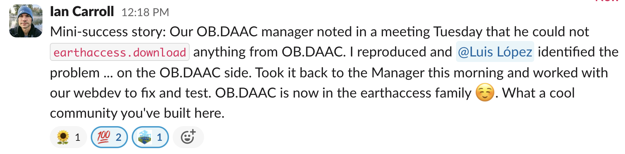
Notes:
Allowed people who use the data to connect with the people building. And the bridging between the daacs

