Slide 1
Introduction to APT:
The Algorithm Publication Tool
Brad Baker
NASA | MSFC | IMPACT
OBDAAC User Working Group
29 May 2024

Slide 2
Algorithm
Theoretical
Basis
documents that describe the physical theory, mathematical procedures and assumptions made in algorithms used to convert remotely sensed radiances into geophysical quantities
Documents

Slide 3
Historical Problems with ATBDs
No standard ATBD template used
  Every ATBD was different; inconsistent structure and information
  Scientists writing ATBDs were uncertain as the requirements
ATBD content was not searchable
  Not search engine optimized
  Most often Word/PDF docs that at time the content was not searchable
ATBDs were difficult to discover
  Important for scientific reproducibility, but not easy to locate
  No central repository for search and discovery of ATBDs
  Not consistently referenced in a dataset’s metadata
ATBDs were difficult to update/maintain once written
  Stewardship activities varied in quantity and quality
  No consistent versioning process was used

Slide 4
Goals for Standardizing and Managing ATBDs
Goal 1: Establish standardized policies and processes for ATBDs
  Develop ATBD template for consistent content
  Establish standard review process
  Identify and communicate requirements and guidelines
Goal 2: Develop and utilize standardized document best practices
  Develop ATBD stewardship requirements (citations, versioning, preservation, metadata)
Goal 3: Make ATBDs openly available and easily discoverable by all users
  Provide ATBDs in human and machine-readable format
  Provide a public discovery portal for ATBD access
  Ensure a persistent identifier (i.e., DOI) is assigned to ATBDs

Slide 5
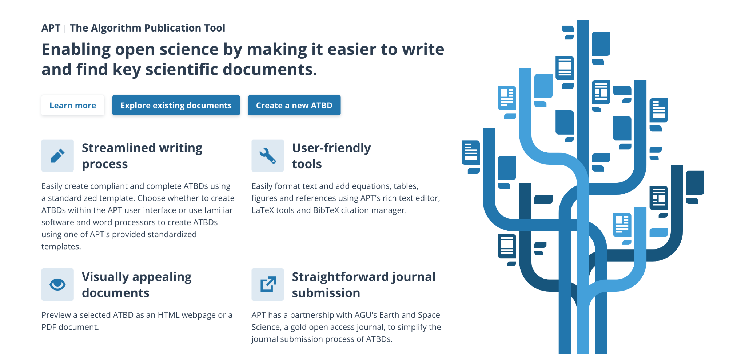
Algorithm Publication Tool
APT streamlines ATBD authoring, reviewing, and publishing
Provides user friendly tools
Facilitates the governance process and ensures document maintenance
Provides a public, centralized discovery repository for ATBDs
APT is one place to create, find, and access ATBDs

Slide 6
APT User Workflows
Option 1: Create ATBD using APT user interface
  Entire ATBD creation process within APT (draft, review, and publish)
  Write, edit, update ATBDs
  Track comment threads
  Version control
Option 2: Create ATBD using provided template
  Template options include Google Docs, Microsoft Word, LaTeX
  Complete template and upload PDF to APT
  Provide required metadata
  ATBD can be reviewed externally or within APT user interface after upload
    Download templates

Slide 7
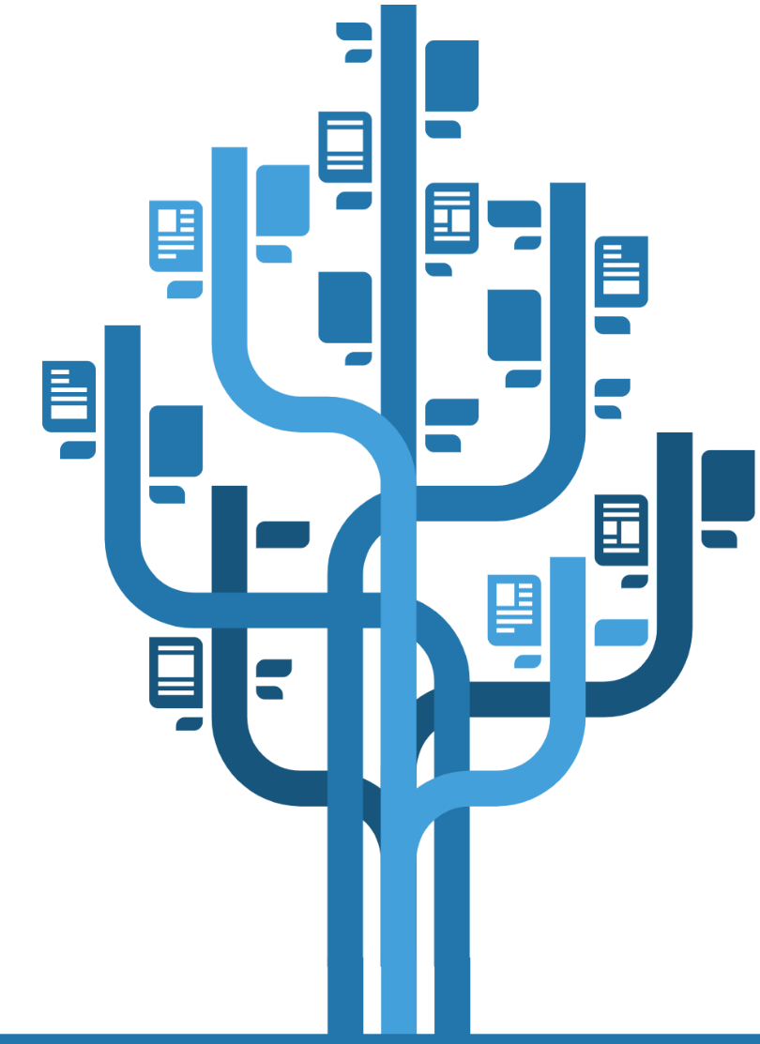


Use APT to Create ATBDs
APT
Authoring and Publishing Environment
ATBD Templates
Write, Edit, Update ATBDs
Permit Coauthors to Edit
Track Comment Threads
Automatic Version Control
View Document Metrics
Generate Journal-ready PDF
Choose Template for Use in Editing Tool of Choice (e.g., Google Doc; Word; LaTeX)
Upload PDF; Use Form to Provide Required Metadata
Governance Process Dashboard
ATBD PDF Document Repository
Track Authoring and Review Process
Track ATBD Updates
Curator Support
Track and View Metrics
Search, Discover, Download ATBDs
Obtain ATBD Citations and DOIs
Connect Related Data in CMR

Slide 8
Key APT Features
  Uses a standardized ATBD template
    Improves expectations of ATBD authors
    Enhances consistency in ATBD production
    Standardization of content allows for optimal storage
  APT rich text editor
    Easily insert tables, figures, equations
  ATBD content is stored as metadata, making this information readily available
    Machine readable
    Interoperable with other tools and services
  Communication capability is built into both the development and review process
    Comment threads

Slide 9
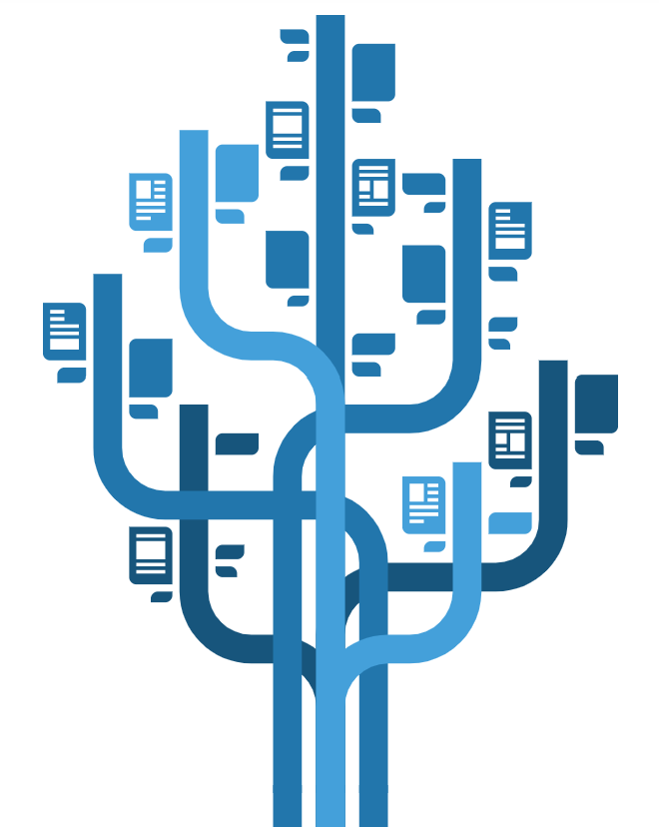
How to Use APT
  Researchers and scientists can begin using APT now
  Each APT author or reviewer must apply for an account first
  Authors can choose to use the APT environment or a template for creating their ATBD
  MFA is used to validate authors and reviewers and to ensure only scientists write ATBDs in the environment
  APT authoring environment has some limitations:
    only 1 author per section at a time allowed
    no autosave, users are prompted to save their work as they go
    APT has had full cross-browser testing, but full use will inherently identify new issues

Slide 10
Development Priorities
  Remove brackets from in-text citations (June)
  Allow users to only see drafts that they are associated with (June)
  Require ATBD titles to be unique (FY24 Q4)
  Update text prompts to be more detailed (FY24 Q4)
  Merge input/output variables into one table for each (June)
  Add multiple types of reference formatting (FY25 Q1)
  Make equation, figure, and table numbers visible in edit mode (FY25 Q1)
  Other minor user interface improvements (FY25 Q1)

Slide 11

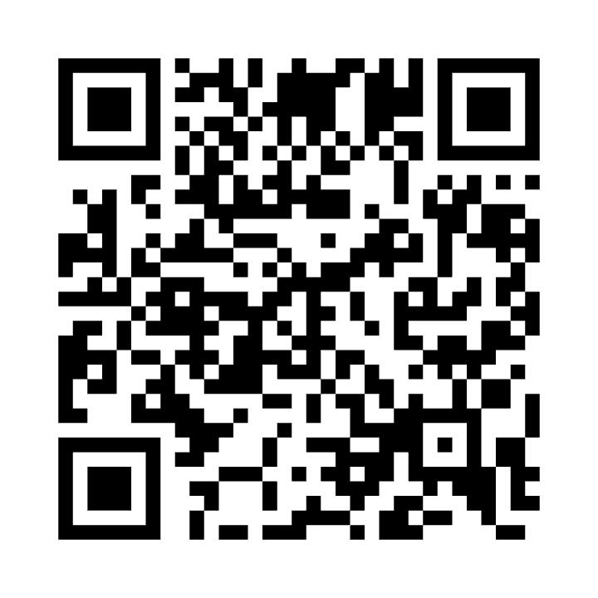
Thank You
https://www.earthdata.nasa.gov/apt/
Contact:
Dr. Brad Baker
bwb0013@uah.edu

