Slide 1
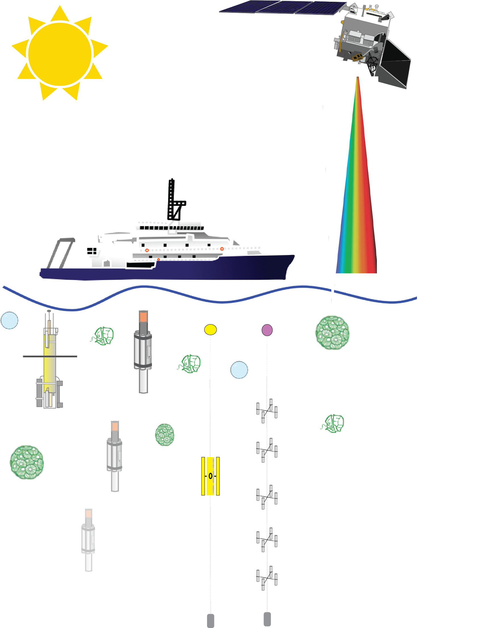

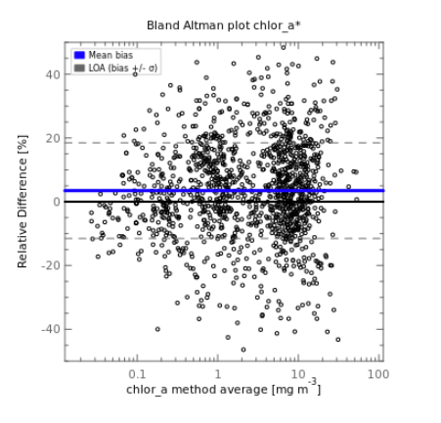





SeaBASS Discussion
UWG Meeting
May 29, 2024
SeaBASS
Data Archive
Data Format (.sb)
Services & Tools
Satellite Validation
Data Publicly Available
Notes:
1

Slide 2
Outline
Goal: facilitate conversation and feedback
Topics: Brief updates and plans:
  Quick Overview of SeaBASS, Systems and Tools
  Data Archival
  Validation + Value Added Analyses
  Software tools and other updates
Notes:
Presentation covers with news, recent updates, and plans relevant to familiar users. My hope is to facilitate conversation - almost all the time is for conversation.

Slide 3
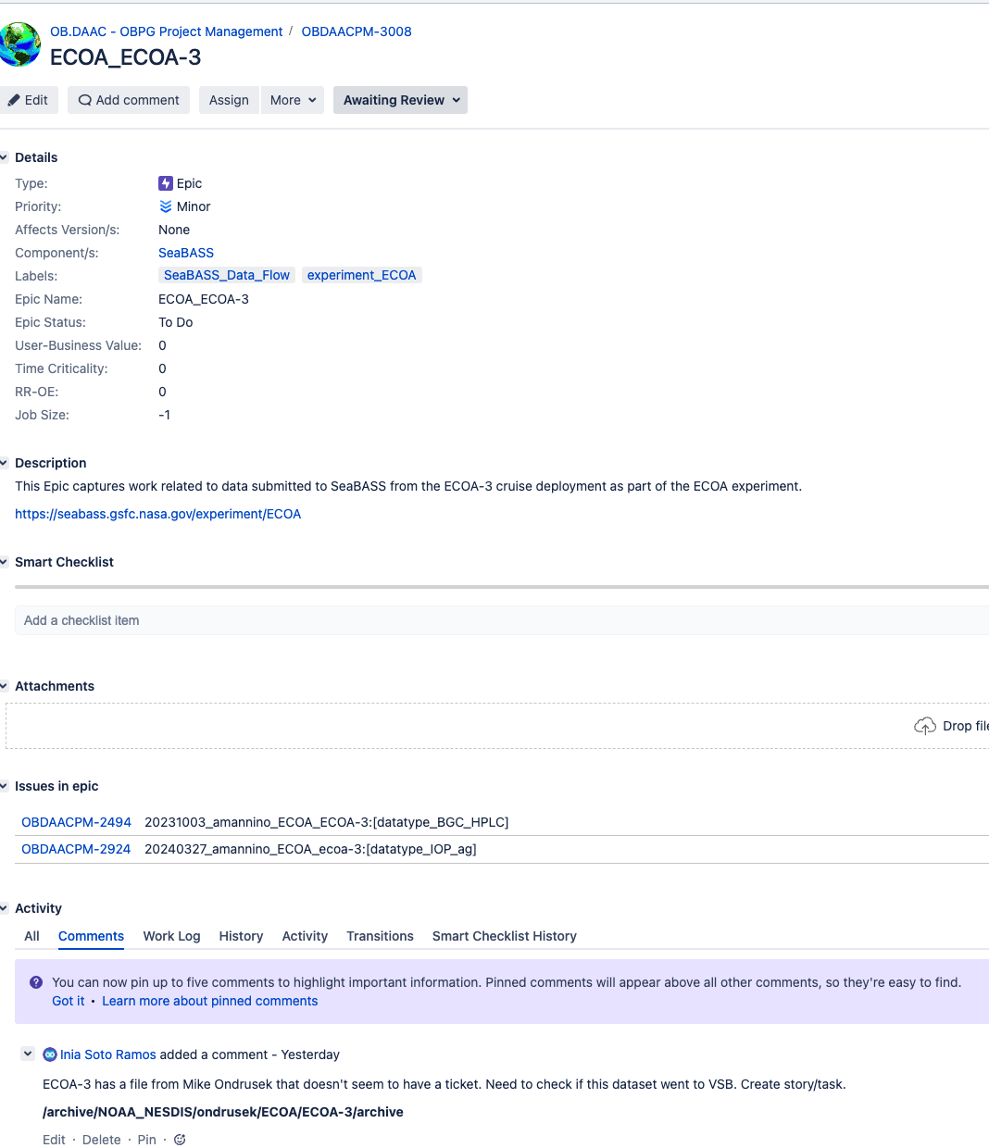
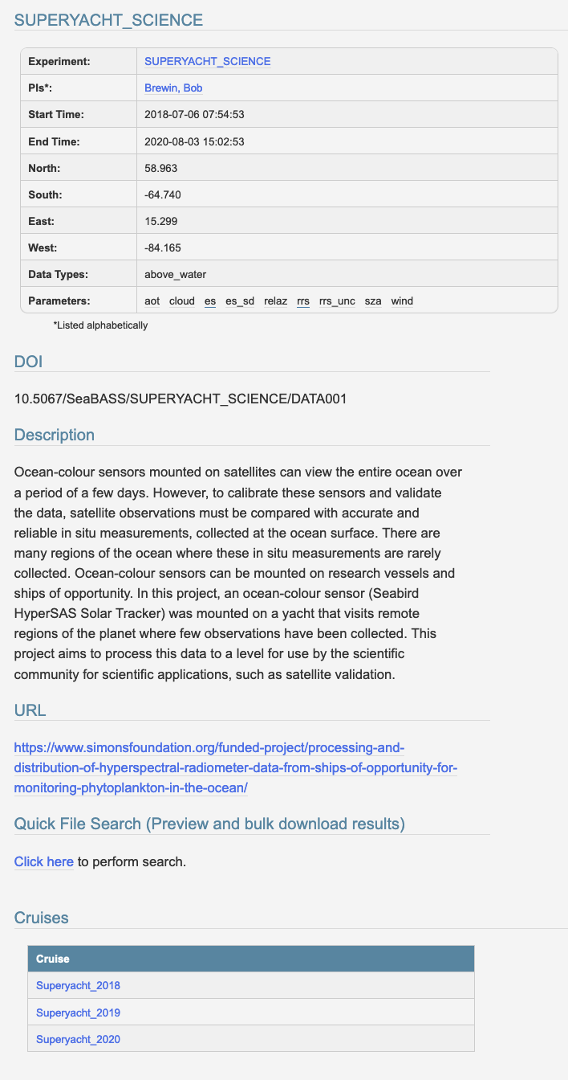

SeaBASS Systems & Web Tools Include:
Data Systems
Data Archive (over 130,000 files plus supporting documentation; over 350 Experiment DOIs)
Relational database: metadata catalogue, facilitates web-services, tools, validation, etc.
ODPS-integrated validation system for satellite data match-ups
SFTP user submission system (~200 submitter accounts)
DOI Experiment landing pages (~400)
Project management tracking for dataset QA/QC + submission feedback loops

Slide 4
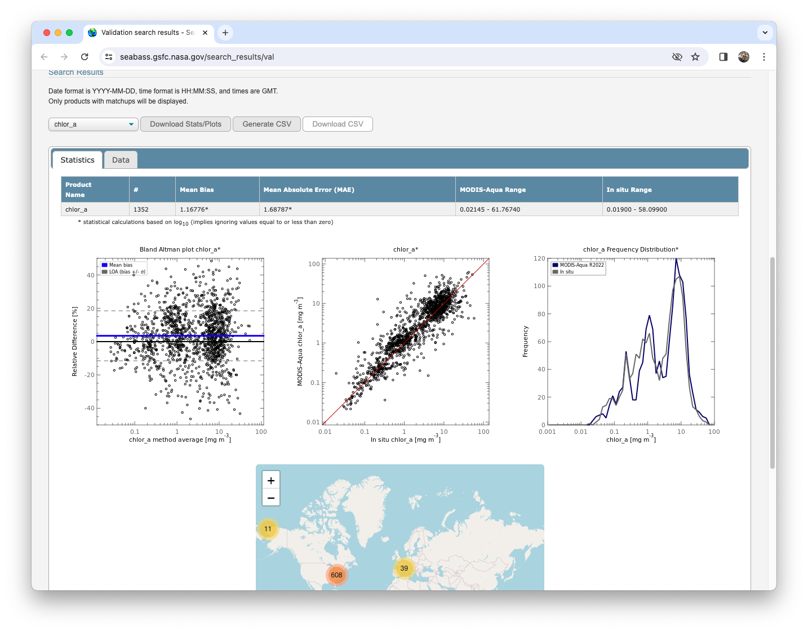
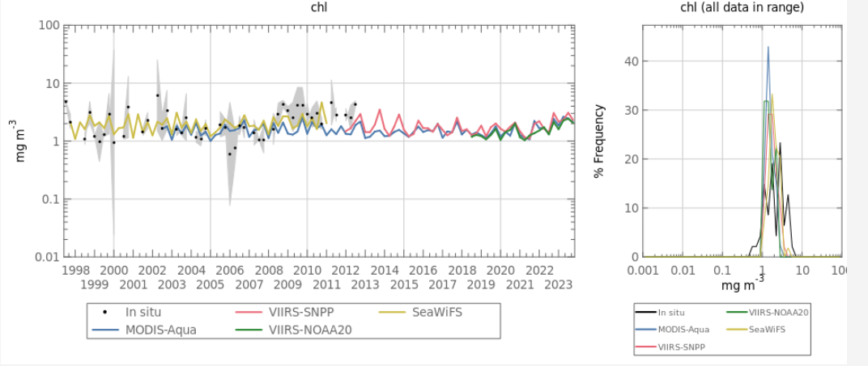
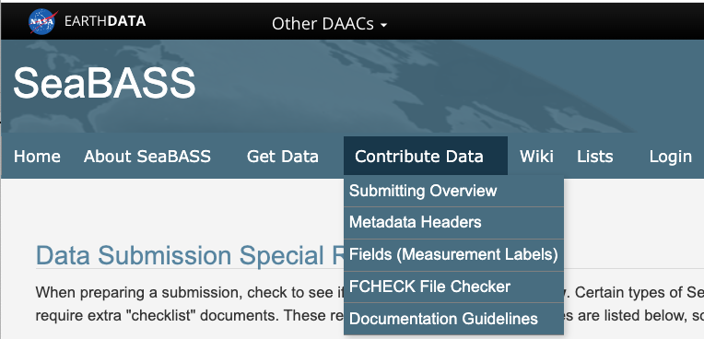



SeaBASS Systems & Web Tools Include:
Web-based tools
File Search
Enhanced data access pages: Recent data updates, Browse Archive, Lists, etc.
Validation Search (Match-ups with 12 OC Sensors)
Time Series Tool
Extensive web pages with documentation, technical information, and examples for users and submitters
NOMAD, legacy V2 & future V3
SST Validation (over 90 million validation match-ups across 4 satellite sensors)

Slide 5

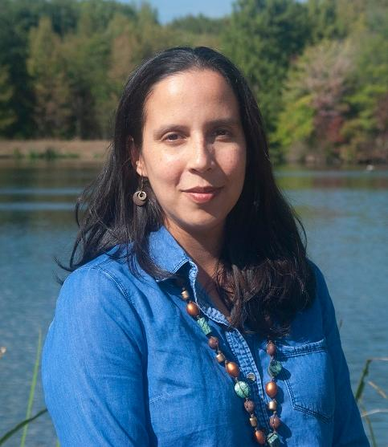

Staff Updates
Chris Proctor
SeaBASS Manager
Inia Soto Ramos
Validation Lead
Mike Maniscalco
Data Manager
Extended SeaBASS team includes many others!
OB.DAAC software and web developers
Field Support Group Subject Matter Experts (SMEs)
PACE Validation Leads and other contributors
NOMAD lead (Violeta Sanjuan Calzado)
Notes:
Extended team also includes several other close collaborators, including analysis and QA/QC provided by members of the Field Support Group
Collaboration with Violeta Sanjuan Calzado who is leading efforts to produce a new version of the NOMAD algorithm dataset
Various other OBPG scientists and developers who are assisting with validation and other projects

Slide 6
Submission Feedback Cycles
Submissions (esp. validation products) are reviewed by SMEs
Submitters might be asked for clarifications or resubmissions
Submitters
SeaBASS Data Manager
Subject Matter Experts (SMEs)
Validation Leads
SeaBASS Archive
(OB.DAAC)
+
EarthData Search
Notes:
Dataset submissions go through multiple review cycles, and I wanted to share some of how that works so that data submitters are informed. There’s the upfront back and forth between submitters and the SeaBASS data manager. That’s where the majority of format issues are solved.
After submission, we recheck the data formats, make sure the submission and types of documentation appear complete, and perform basic checks (mainly locations), then dataset is archived and available to the public.
Submissions are then divided by measurement types and assigned to a relevant subject matter experts (field support group). They internally reviews submissions, taking a deeper look at data and documentation. QA/QC is performed for types of measurements that can be used standard ocean color satellite validation.
Those are labeled for their suitability in further validation processing. However, if there are questions about datasets, anything major is missing or flagged, they pass that info back to our data manager, who might reach out to you to ask for clarification, or to discuss if any portions of the dataset might need to be resubmitted for an update
Data are then passed to analysts for validation processing. We’ve spent a lot of time this past year building up the software and workflows for these processes

Slide 7
Recently Archived Data Summary
~6,600 data files from 60 cruises archived April 2022-2023
18,000 data files from 400+ cruises archived since April 2023
Data collection
Data Sources include:
OBB funded PIs
PACE Validation Science Team (PVST)
Voluntary data submissions
Field support group
[External Sources: e.g., AERONET-OC]
[SVC Data Sources]
Notes:
EXPORTS closeout
Many PIs resubmitted datasets. Transitioning Pis (e.g., torch passing, e.g., GNATS), or housekeeping due to recent attention, or voluntarily updating their datasets to add additional metadata or intermediary data (USF –SFMBON)

Slide 8
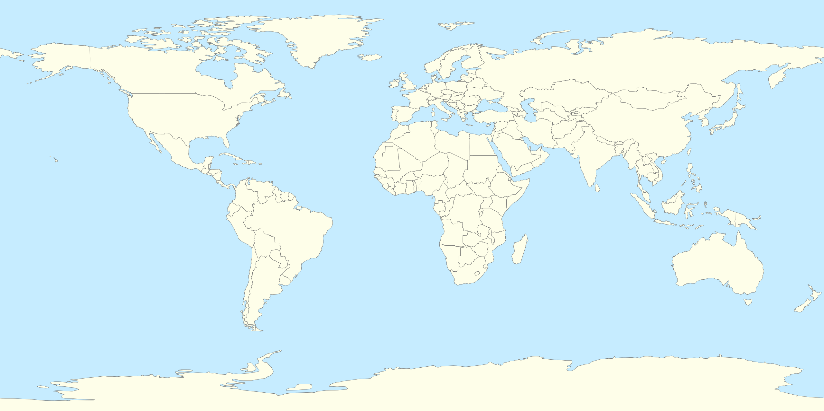

PACE mission Validation Science Team (PVST)
Upcoming & Incoming Data 2024: PVST
NASA HQ solicited in ROSES 2022
Rapid data-turnaround requires extra data management and coordination with submitters
R/V Tara (global)
Global UNOLS
Hyperspectral BGC-Argo
Add-ons for AERONET (global)
Ocean inherent optical properties | a_{p} | a_{ph} | a_{nap} | a_{cdom} |  | a_{cdom+nap} |  | b_{bp} | VSF
Ocean apparent optical properties | PAR | K_{d} | K_{Lu} | L_{u} |  | L_{w} |  | L_{sky} | E_{d} | R_{rs} | nLw
Ocean Biogeochemistry | Chl (fluorometric) | HPLC | UHPLC | PCC |  | NPP (and associated metrics) |  | PSD | TSM (TBD) | Carbon (PIC, POC DOC, Cphyto)
Aerosols & clouds | AOD | Aerosol microphysical properties |  |  | COD |  | Cloud droplet size distribution, ice properties

Slide 9
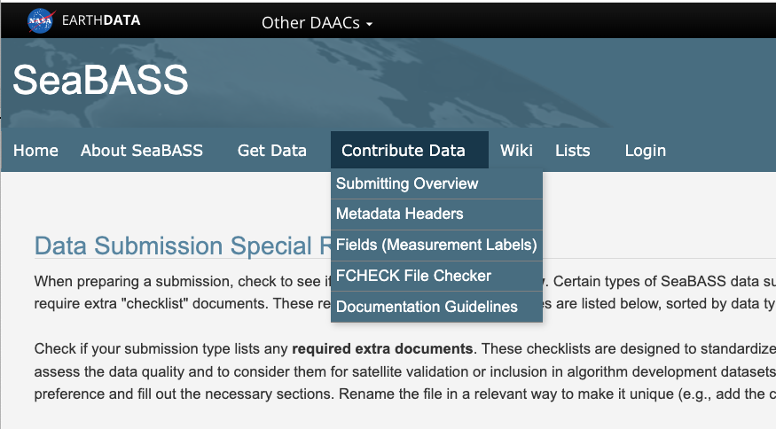
Measurement-Specific Support & Requirements
Special requirements page (measurement-specific instructions):
Metadata requirements & checklists
  Goal: guide data collection and submission around community protocols for traceability, interoperability, and quality
New or recently updated submission guidelines:
Above-water radiometry (mounted)
PSD
Upcoming:
Improvements for Above-water radiometry “Hand-held” & “Buoy-mode”
Microscopy
Notes:
Data submissions can’t be accepted if they are missing required types of data or metadata (e.g,. Absorbance measurements should be part of spectrophotometric datasets). NASA requirements built upon community protocols – metadata & measurements needed for data traceability, reproducibility, and uncertainties. Please review these ahead of time!

Slide 10
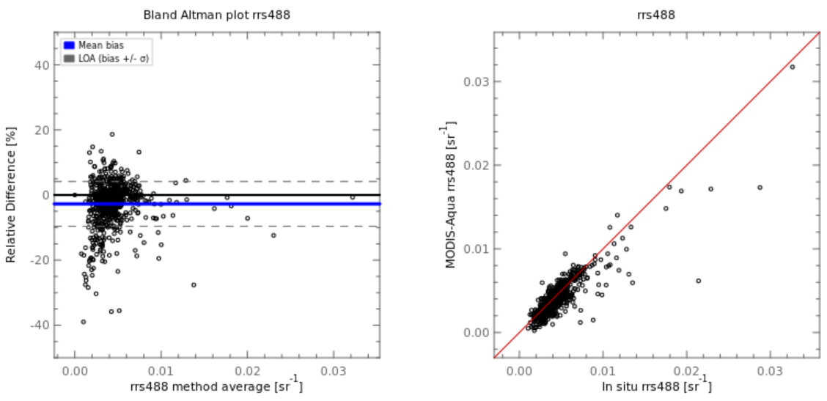
Validation Updates (Systems, Workflows, Data)
General Workflow Updates
  Build & improve internal workflows (Proj. Management, other software)
  Address match-up backlog (for other OC sensors)
  Goal: quick turn-around from submissions to validation
Other external data sources
  AERONET-OC (V4, Level 1.5)
  WATERHYPERNET
PACE-driven validation developments include:
  Near Real Time validation
  Improving statistical metrics
  Incorporating uncertainties
  Hyperspectral data
  New products/algorithms
  Dataset Versioning
Notes:
A significant amount of effort going into PACE preparations, particularly getting ready for PACE Validation. New and updated data, code, workflows (and refreshing, working through backlog of older datasets for validation will be releasing those later this year)
We have a team working to update SeaBASS Validation web-based tools used to analyze match-ups, and for comparing different processing or algorithm versions.
Putting staff in place for QA/QC --> calculate validation products & intermediate tracing --> run validation
We're on the cusp of readiness, for PACE-OCI but also other missions.

Slide 11
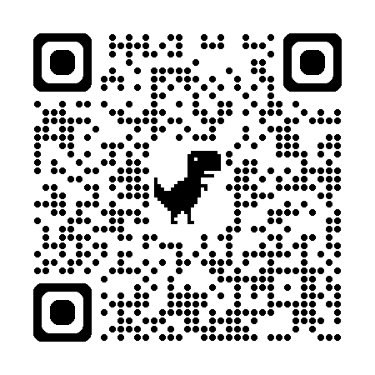
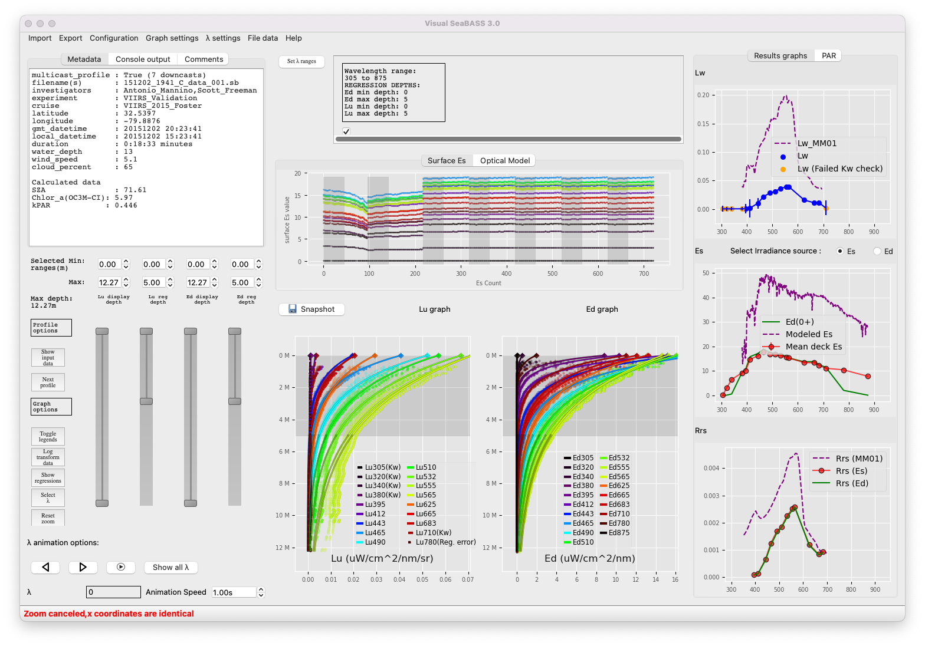
SeaBASS software tools: news
https://seabass.gsfc.nasa.gov/wiki/seabass_tools
FCHECK .sb Format Checker
Frequent updates (new metadata headers and fields)
File Converters
HPLC Submission assistance (Excel-to-SeaBASS format)
Stand-alone Satellite Match-up Tools (Python)
Soon: update to fetch OCI data from NASA CMR
Awaiting public release
AOP Profile Analysis (“VSB”)

Slide 12
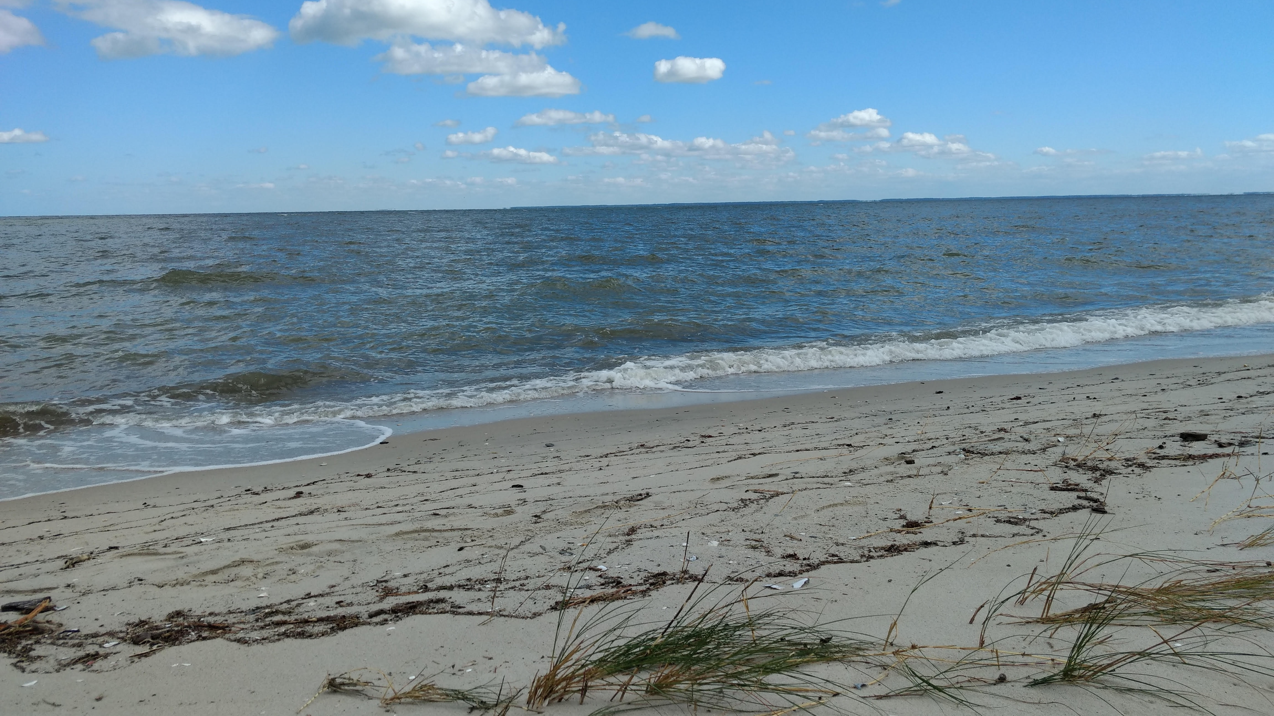
Questions, Comments, Suggestions?
Notes:
What do you like? What could we do better?

Slide 13
Extra Miscellaneous slides

Slide 14
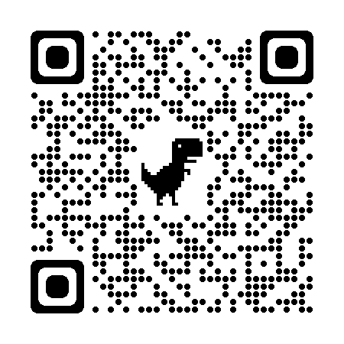
SeaBASS
Data collection
Data management, archival, QA/QC
Additional services, analyses
Data Sources include:
OBB funded PIs
PACE Validation Science Team (PVST)
Voluntary data Submissions
Field support group
External, e.g.,AERONET-OC
seabass.gsfc.nasa.gov
SeaBASS Manager: Chris Proctor; Validation Lead: Inia Soto Ramos; Data Manger: Mike Maniscalco

