Slide 1
NASA’s Fire Information for Resource Management System (FIRMS).
NASA: Diane Davies, Jenny Hewson, Otmar Olsina, Asen Radov, Dylan Mendes
USFS: Brad Quayle
UMD: Louis Giglio, Joanne Hall
NASA Official: Sadashiva Degadiva

Slide 2
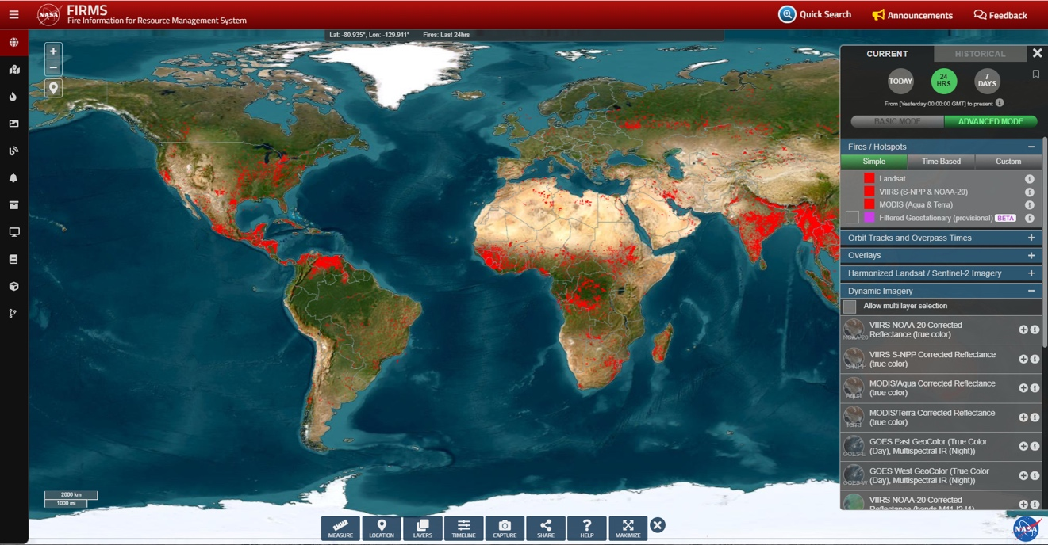
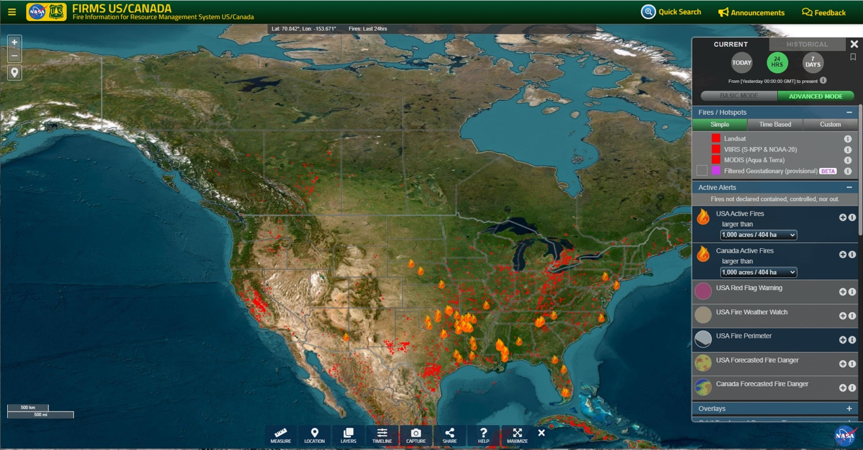
FIRMS Global and FIRMS US/Canada
https://firms.modaps.eosdis.nasa.gov
NRT and RT imagery and fire remote sensing products for the world.
Developed by U of Maryland in early 2000s and used data from MODIS Rapid Response.
Transitioned to NASA LANCE in 2012.
https://firms.modaps.eosdis.nasa.gov/usfs
Partnership between NASA and USDA Forest Service
FIRMS US/Canada was launched within NASA LANCE in 2021.
NRT, RT and URT imagery and fire remote sensing products for the US & Canada.
Provides contextual data/information relevant to fire management.
Notes:
Two instances of FIRMS – FIRMS Global and FIRMS US/CanadaFIRMS funded by NASA HQ AS and UN FAO & developed at UMD
Transitioned to NASA LANCE in 2012
Role of LANCE
In 2020? NASA approached by USFS to develop a US/Canada instance of FIRMS

Slide 3
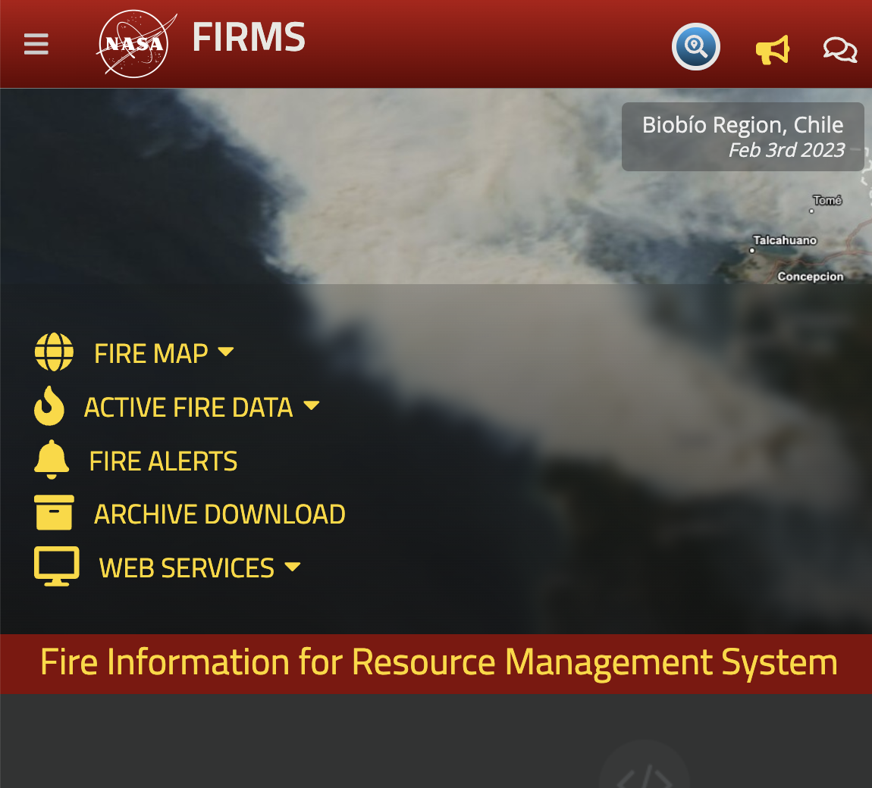
FIRMS
Components

Slide 4
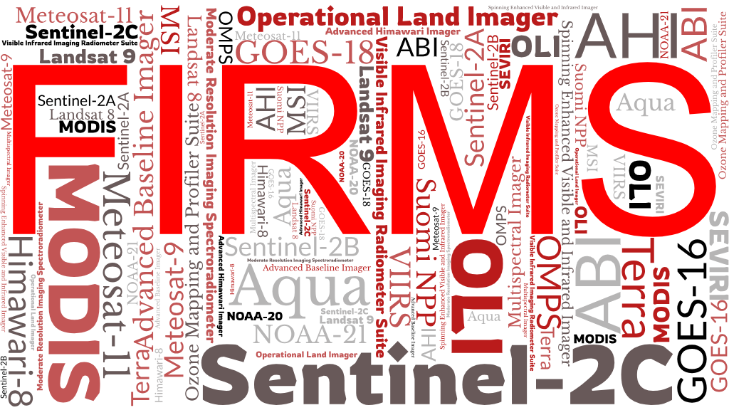
Earth Observation Satellites and Sensors Used in FIRMS
15 satellites
  10 polar-orbiting
  5 geostationary
16 Sensors
5 Space Agencies
  NASA
  NOAA
  ESA
  EUMETSAT
  JAXA

Slide 5
Satellite Active Fire Detection Data Used in FIRMS
Active Fire and Thermal Anomalies Data
Sensor (Platform) | Source | Spatial Resolution | Temporal Resolution | Latency⁴ (Coverage)
ABI (GOES-16 & 18) | NOAA | 2km sub-satellite¹ | Sub-hourly | RT - ~20-30 mins (Americas)
ABI (GOES-16 & 18) | KCL/IPMA | 2km sub-satellite¹ | Sub-hourly | RT - ~20-30 mins (Americas)
SEVIRI (Meteosat 9 & 11) | EUMETSAT/LSA SAF | 3km sub-satellite¹ | Sub-hourly | RT - ~30 mins (Europe-Africa-India)
AHI (Himawari-8) | KCL/IPMA | 2km sub-satellite¹ | Sub-hourly | RT - ~30 mins (Australia-Asia)
MODIS (Terra/Aqua) | NASA LANCE | 1km sub-satellite¹ | Twice daily² | NRT - <3 hours (Global)
VIIRS (Suomi NPP/NOAA-20/21) | NASA LANCE | 375m sub-satellite¹ | Twice daily² | NRT - <3 hours (Global)
MODIS (Aqua) | SSEC Univ of Wisconsin | 1km sub-satellite¹ | Twice daily² | RT - <30 mins (US-Canada)
VIIRS (Suomi NPP/NOAA-20/21) | SSEC Univ of Wisconsin | 375m sub-satellite¹ | Twice daily² | RT - <30 mins (US-Canada)
MODIS (Aqua) | SSEC Univ of Wisconsin | 1km sub-satellite¹ | Twice daily² | URT - <1 min (US-Canada)
VIIRS (Suomi NPP/NOAA-20/21) | SSEC Univ of Wisconsin | 375m sub-satellite¹ | Twice daily² | URT - <1 min (US-Canada)
OLI (Landsat 8 & 9) | USGS EROS | 30m | 8 days³ | RT - <30 mins (US-Canada)
¹ The pixel size systematically grows from sub-satellite towards the edge of the disk/swath.
² Thermal data are collected for daytime and nighttime observations ~ 12 hours apart.
³ L8 and L9 orbit cycles each have 16-day orbit cycles and their orbits are 8 days out of phase. This does not include potential nighttime observations.
⁴ Latency refers to the estimated time from satellite observation to availability in FIRMS. Near Real-Time (NRT), Real-Time (RT) & Ultra-Real-Time (URT).
Coverage over US/Canada only
Notes:
FIRMS continues to emphasize providing current and new products at lower latencies and provide higher resolution products to meet user requirements
RT geostationary active fire detection data is available as a result of efforts and support by NASA Applied Sciences, UMd.
Active fire detection data derived from direct readout (DR) is available, including URT active fire detection data
RT and URT DR data are derived using NASA SPAs to ensure consistency with data derived in LANCE.
RT Landsat 8/9 RT active fire detection data for US and Canada are available as a result of efforts and support by NASA Applied Sciences, UMd, USGS EROS, FIRMS and the Forest Service.

Slide 6
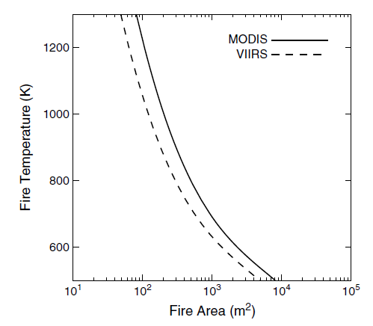
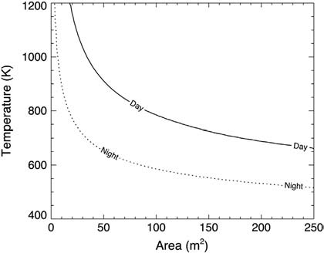
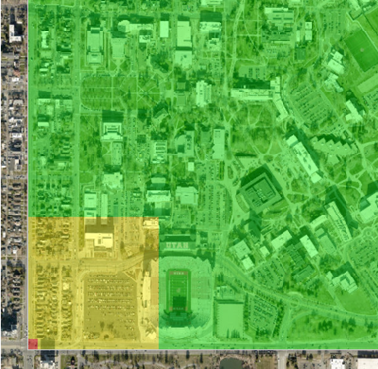
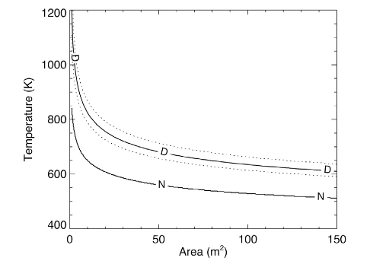
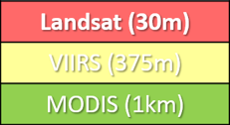
What sizes/types of fires can be detected by satellite
MODIS (1000m)
  ~1,000m² smoldering to flaming fires in good conditions (day)
  ~100m² flaming fire in good conditions (day)
VIIRS I-Band (375m)
  ~100m² smoldering to flaming fires in good conditions (day)
  ~20m² flaming fire in good conditions (day)
  ~2m² flaming fire in good conditions (night)
Landsat OLI (30m)
  ~10-20m² smoldering to flaming fires in good conditions (day)
  ~4m² flaming fire in good conditions (day)
  ~1m² flaming fire in good conditions (night)
Algorithms and products are not perfect!
1km
750m
Schroeder & Giglio, 2017
375m VIIRS I-Band
Schroeder et al., 2014
30m Landsat 8
Schroeder et al., 2016
Notes:
https://viirsland.gsfc.nasa.gov/PDF/VIIRS_activefire_750m_ATBD.pdf
https://doi.org/10.1016/j.rse.2013.12.008
https://doi.org/10.1016/j.rse.2015.08.032

Slide 7
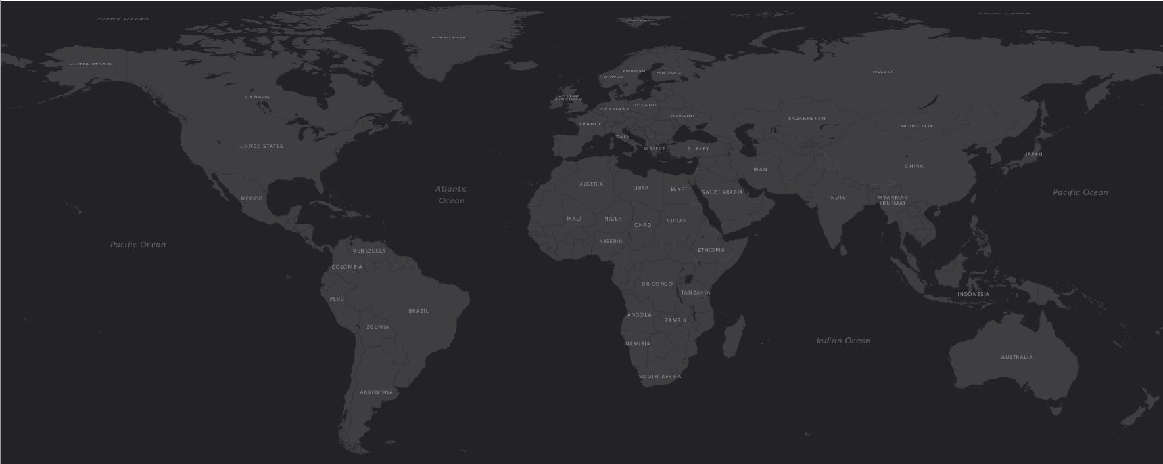




FIRMS Partners and Sources of Satellite Products
University of Wisconsin
Space Science Engineering Center
EUMETSAT Land Surface Analysis Satellite Application Facility
Copernicus Program
USGS EROS Data Center
NASA LANCE
European Space Agency
NASA GIBS
NOAA
JAXA
NASA IMPACT
University of Maryland Geographical Sciences
Portuguese Institute for the Ocean and Atmosphere
- Ground stations providing direct readout MODIS/VIIRS active fire data
- Potential ground stations for providing direct readout MODIS/VIIRS active fire data
- Ground station providing direct readout Landsat OLI active fire data

Slide 8
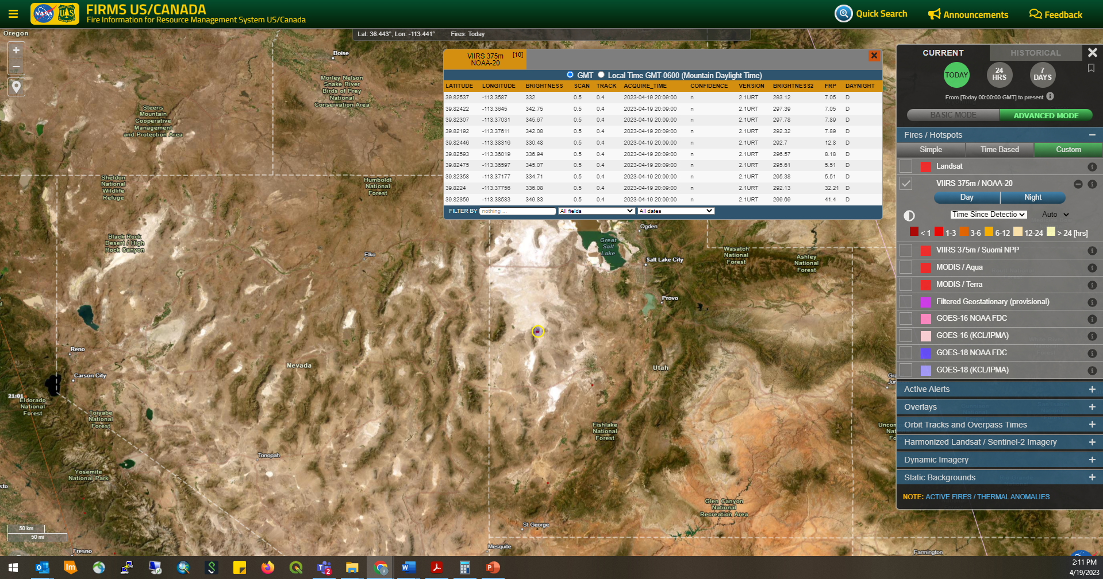
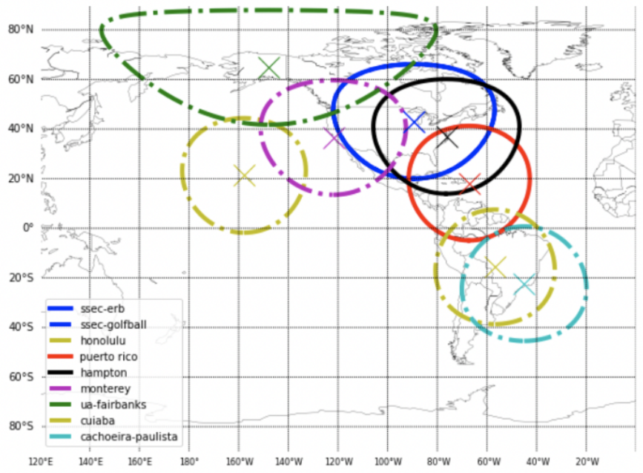
URT Direct Readout MODIS/VIIRS Active Fire Data in FIRMS
MODIS and VIIRS “micro granules” are instantly transferred to UWisc/SSEC during satellite overpass.
Level 0 to Level 2 processing conducted using NASA science algorithms.
Derived active fire detection data available < 1 minute of satellite observation.
Data available within FIRMS within 2 minutes.
NOAA-20: April 19, 2023, 20:09 UTC/14:09 MDT
Direct readout stations with solid lines currently contribute URT active fire data to FIRMS
Notes:
FIRMS has taken steps over the past year to implement direct readout active fire data.
Currently, 4 X-band ground stations provide URT active fire data into FIRMS Global and FIRMS US/Canada.
This slide illustrates the timeliness of URT data between time of satellite overpass and when the data are available in FIRMS.
FIRMS is working to integrate additional direct readout data sources, particularly for western CONUS, AK and Canada.

Slide 9
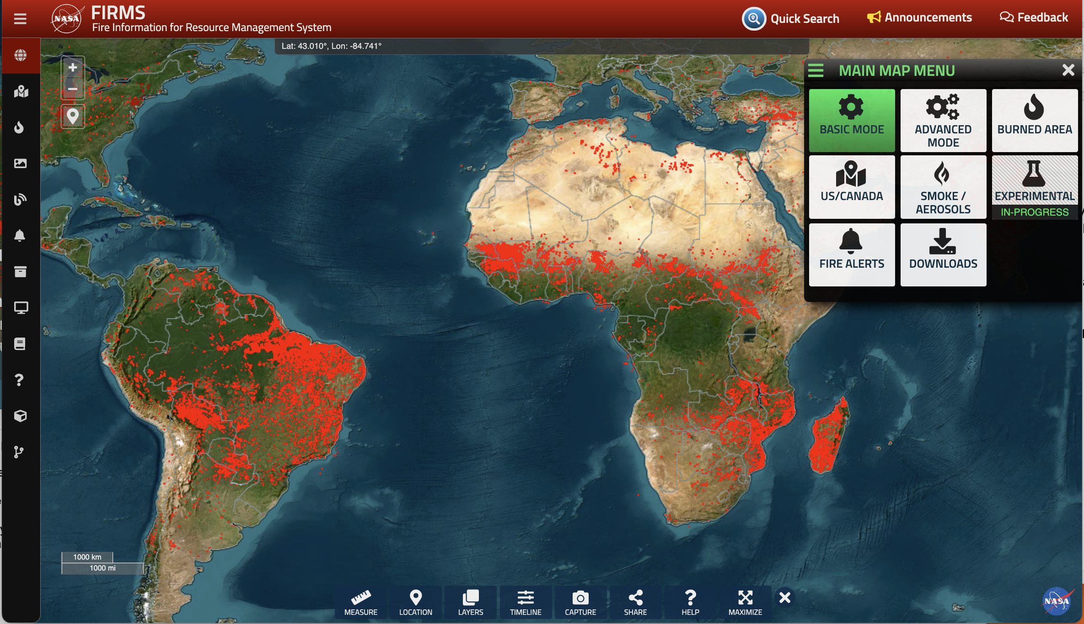
FIRMS Map User Interface (UI) Updates
Available Modes for User Needs and Capabilities
FIRMS UI Refinement Objectives:
Support an increasingly diverse set of users
Make more intuitive for users
Provide easier access to other FIRMS products/services
Allow greater flexibility to filter/query remote sensing data (sub-daily)
Provide access to, and maintain separation of, prototype products
Notes:
FIRMS provides access to a large temporal and spatial record of remote sensing products and supporting data.
Approximately 60 datasets are available.
A significant challenge is providing a UI that is scalable and intuitive for both layperson and advanced users.
Work is ongoing to enhance the user interface to:
Make it more intuitive to users, particularly help users better recognize different modes are available
Provide easier/more obvious access to other FIRMS products/services
Allow greater flexibility to filter/query remote sensing data (hourly/sub-hourly)
Provide access to, and maintain separation of, prototype/experimental data products and products/applications dedicated to meeting specific needs

Slide 10
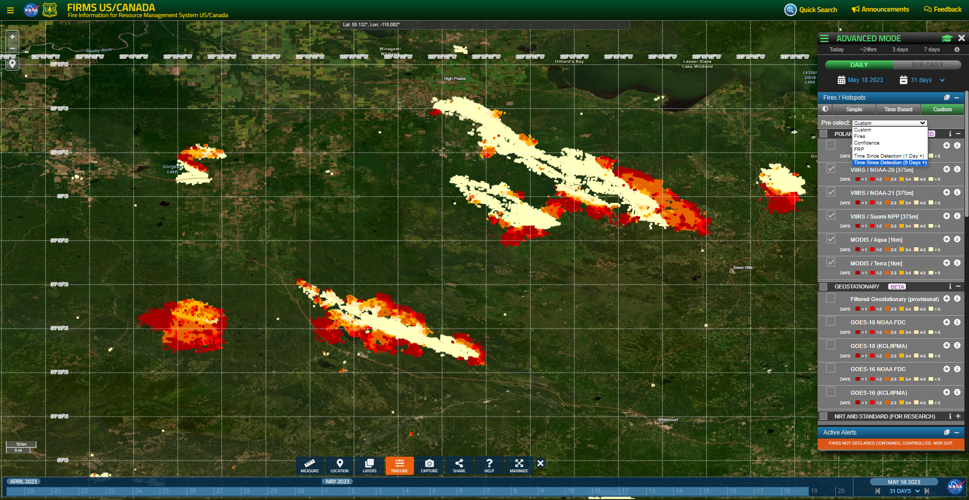
Fire Detection Data Sources & Visualization Options
Multiple detection classifications available
TSD - Detections symbolized by relative time of detection
Discern active fire front/fire progression
Notes:
FIRMS provides NRT, RT and URT active fire detection data from multiple polar-orbiting and geostationary satellites.
Detection data can be visualized/symbolized using multiple classification schemes.
This example displays all MODIS and VIIRS active fire data for the past 31 days symbolized based on time since detection by day relative to May 18, 2023.

Slide 11
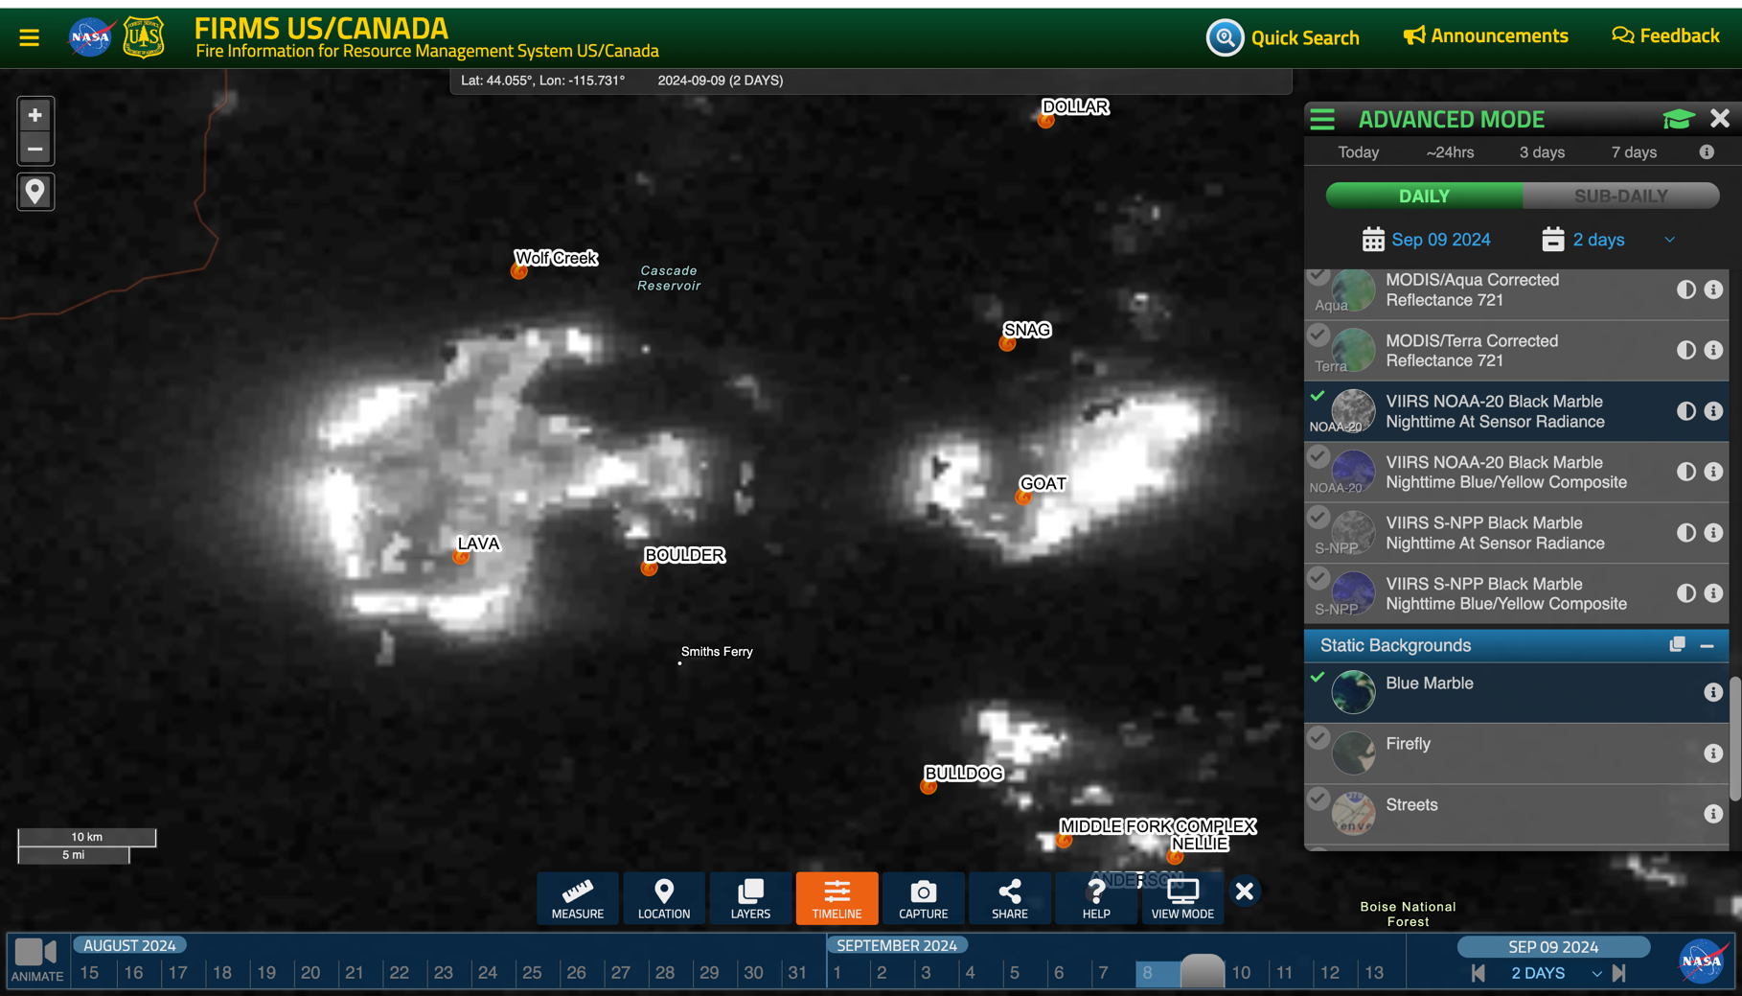
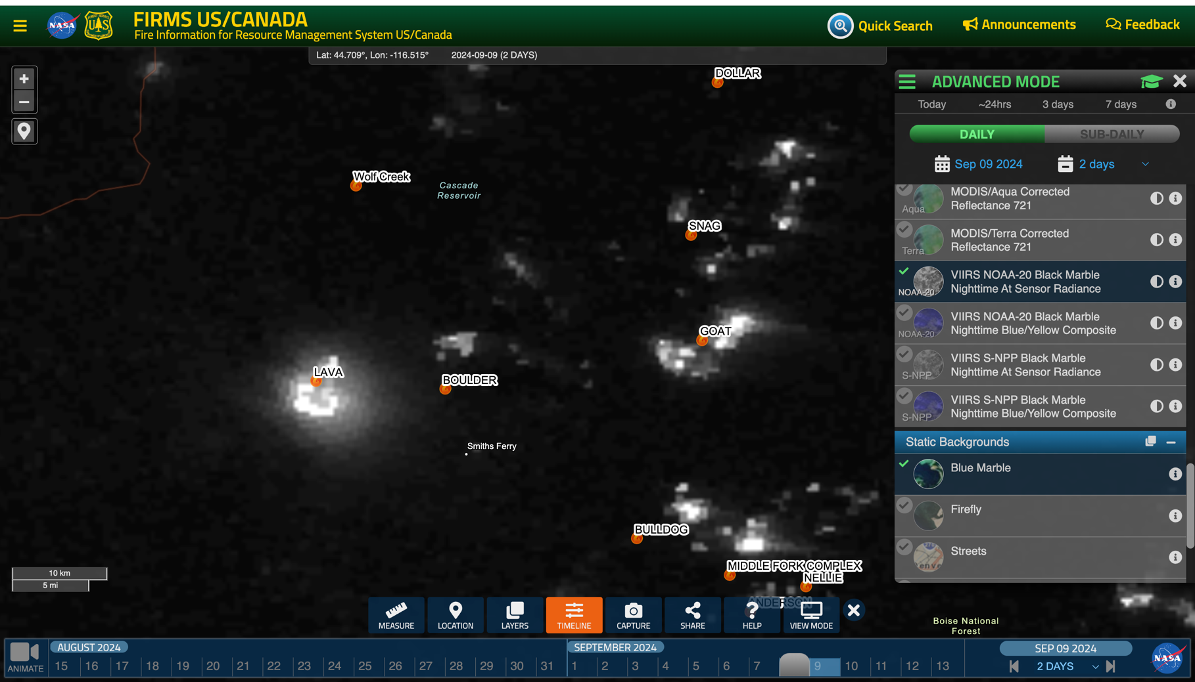
Recently Added to FIRMS
Volcanoes and Static Thermal Anomalies
US Fire Perimeters: now include a 12-month rolling window and can
VIIRS Night-lights imagery (At sensor radiance and Nighttime Blue/Yellow Composite)
Reginal KMZ data files at the request of Canadian partners

Slide 12
Persistent/Semi-Persistent Anomaly Sources
Identify thermal anomaly locations not attributable to vegetation fires
- started with the volcano layer (already in FIRMS)
Ongoing review of ~15 global data layers from authoritative sources
  Natural features, industrial, energy extraction/processing and mineral extraction/processing facilities, etc.
  555,000+ features
Assess data in context of annual active fire detection data
  Identify routinely detected anomaly sources
Provide output dataset(s) as reference or to generate value-added data to aid/guide users
Notes:
This cover mainly ‘in the pipeline’ items…
Effort is currently ongoing.
Source data provided by reliable sources (Smithsonian Institution, World Bank, Spatial Finance Initiative, Global Energy Monitor, World Resources Institute, HIFLD, USGS

Slide 13
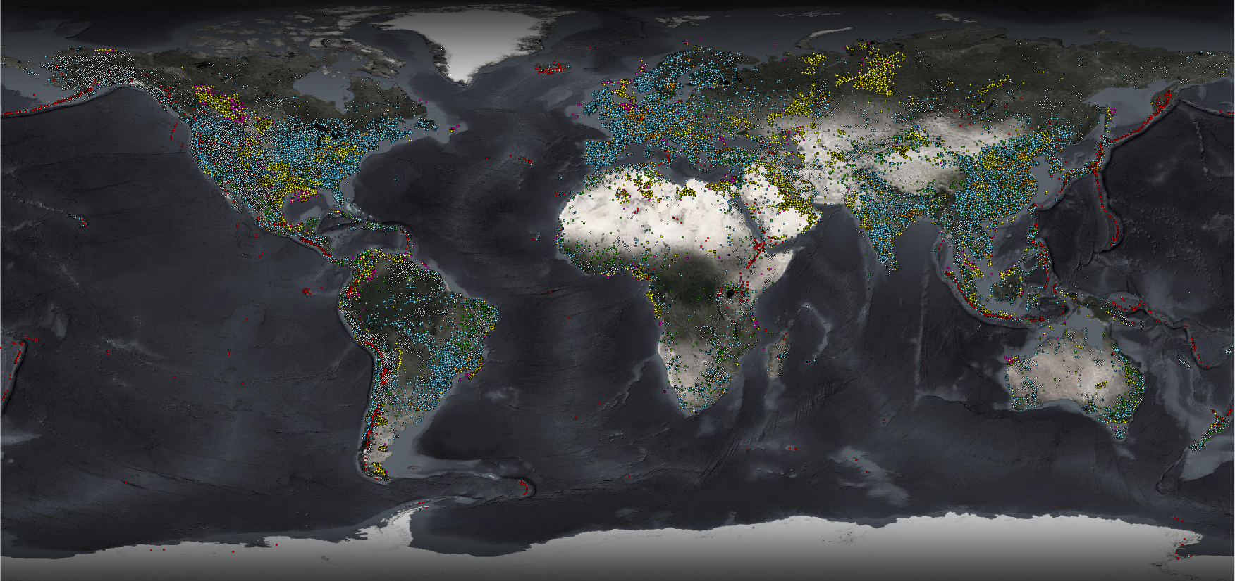
Potential Persistent/Semi-Persistent Anomaly Locations
Volcanoes
Aim to identify enable users to filter on persistent/semi-persistent anomaly locations by identifying thermal anomalies that may be associated with industrial activities and natural features
Gas Flares
Petroleum Extraction/Processing
Power Plants (including solar)
Steel Plants
Mineral Extraction/Processing
Photovoltaic Plants
(Unfiltered data)

Slide 14
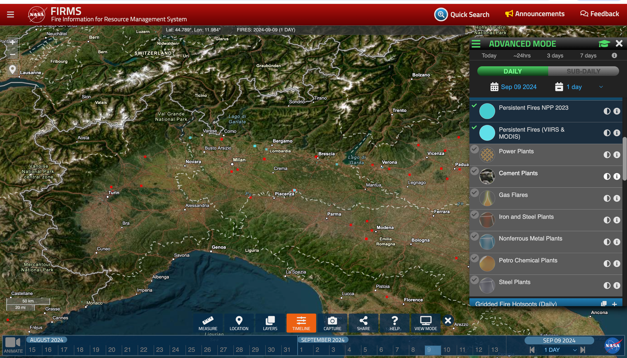
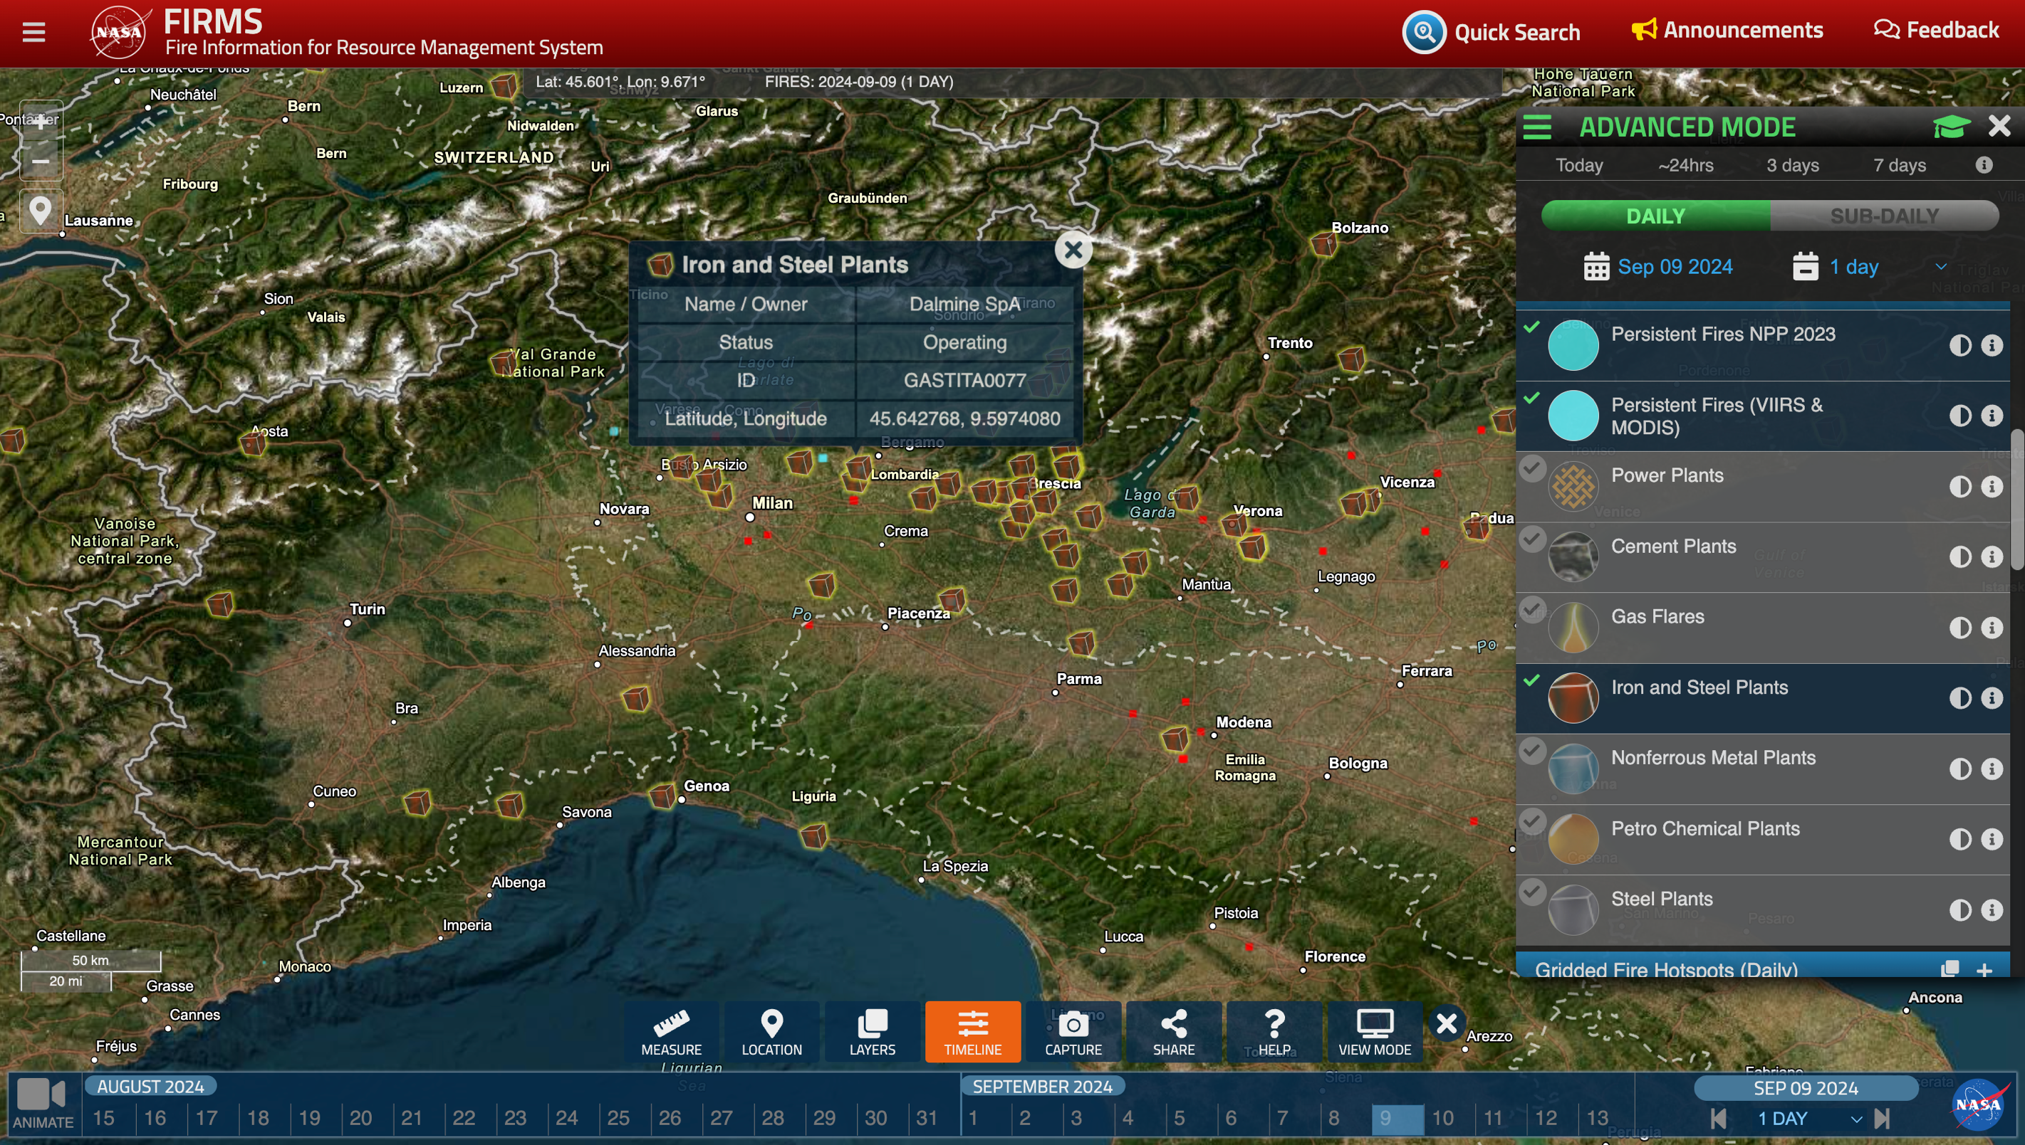

Slide 15

FIRMS Outreach Activities
  Objectives
  Target Audience
  What we learned

Slide 16
Objectives
Inform users about FIRMS data and capabilities
Understand how FIRMS data and capabilities have been used in recent fire seasons
Receive suggestions for enhancements to support operational needs

Slide 17
FIRMS Outreach Activities
  Objectives
  Target Audience
  What we learned
Notes:
Brad from here

Slide 18



Canada: Provincial/National Government Users
Provincial Governments
  Northwest Territories Dept of Environment and Climate Change
  Northwest Territories Forest Management Division
  British Columbia Wildfire Service
  Saskatchewan Public Safety Agency
National Government
  Canadian Forest Service, Northern Forestry Centre
  Natural Resources Canada (NRCAN)
Notes:
In Canada, chats w government cooperators to see how they used FIRMS, particularly in light of the 2023 fire season.

Slide 19


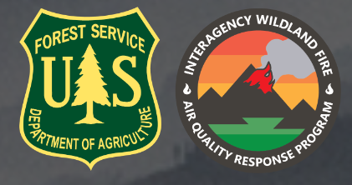

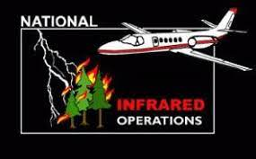

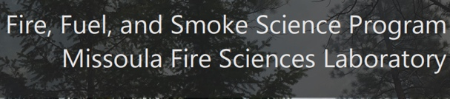
US: Federal/State Users
Programs and Applications
  National Interagency Coordination Center
  USFS/Interagency Air Quality Response Program
  USFS Wildland Fire Management Research, Development and Applications
  USFS Rocky Mtn Research Station Fire, Fuel and Smoke Sciences
  USFS Fire & Aviation Management - Tools and Technology
  USFS Fire & Aviation Management - National Infrared Operations
  BLM California Desert Interagency Fire Program
  Minnesota Emergency Preparedness group
Notes:
Included national and state level entities
Ask Brad to cover ‘included cooperators we routinely coordinate with as well as new ones in his ‘target audience’ discussion

Slide 20




Private Sector Users
SCE – Southern California Edison Electricity
PG&E – Pacific Gas and Electric
San Diego Gas & Electric
Indji
Notes:
Private Sector users
Ask Brad to discuss this in target audience section: highlight direct conversations made to private industry folks who we know access FIRMS data and we wanted to learn more about how they are using it.
hitting services from ESRI and not aware they come from FIRMS

Slide 21
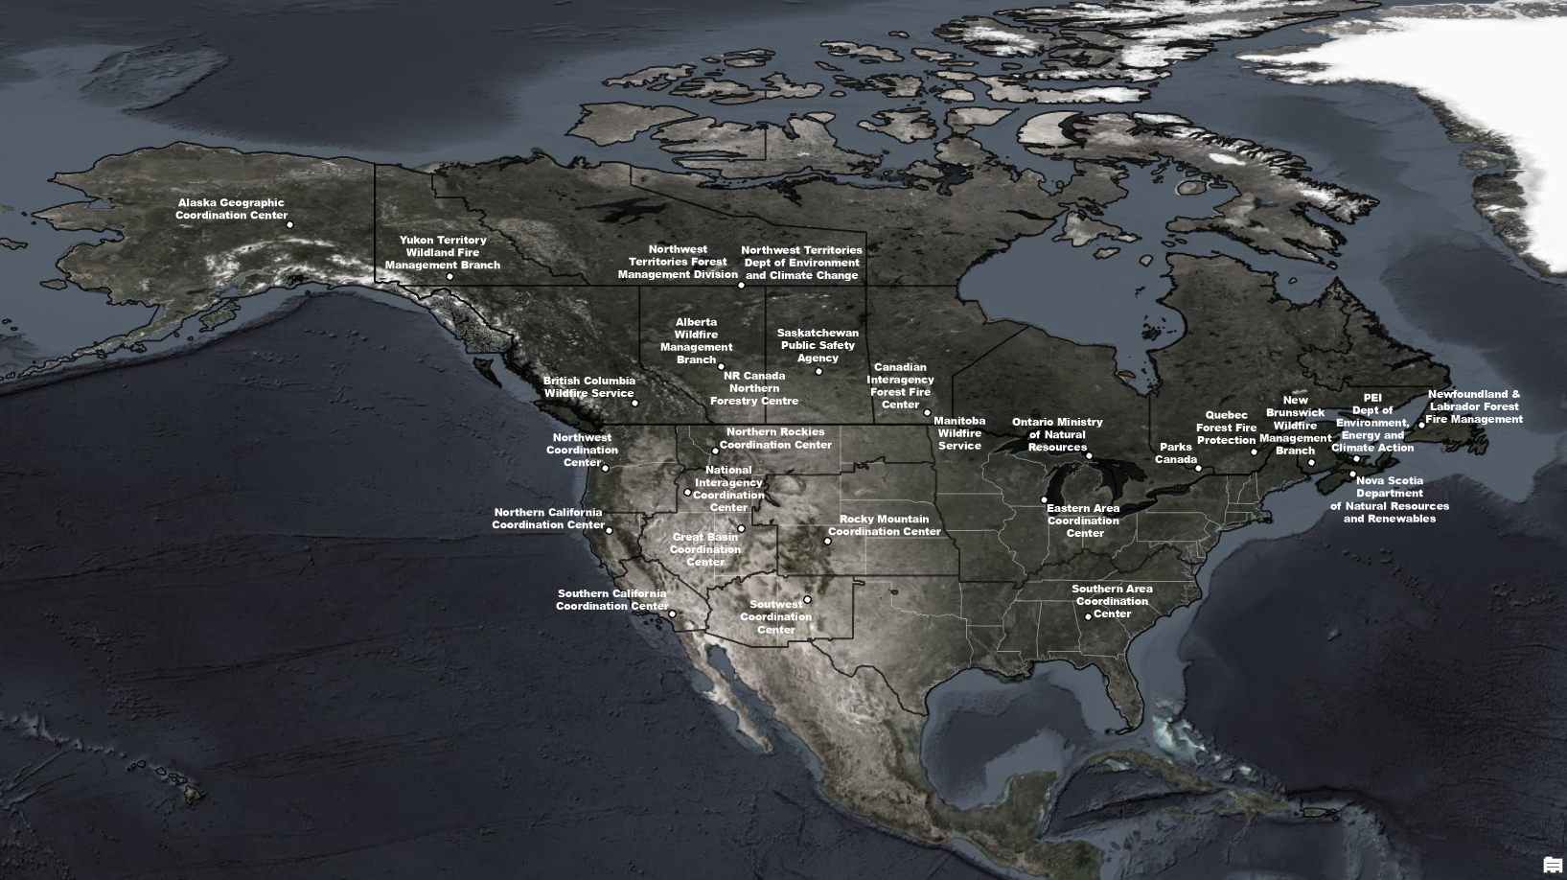
Recent FIRMS Technology Transfer/Training Engagements
National Interagency Coordination Center (NICC) / Geographic Area Coordination Center (GACC) Intel Group
CIFFC Geospatial Working Group
NRCan Community of Practice for Remote Sensing in Operational Fire Management
Minnesota Emergency Preparedness Committee
U of Louisiana at Lafayette Regional Application Center
Notes:
Primary focus has been on Canada and the US. In Canada we have focused on provincial and national government users.
And in the US Federal and state users including the NICC
Would discuss how the first 3 activities engaged with members of the organizations/centers on the map.
Can discuss how this relationship with US and Canada cooperators has occurred and evolved over the years.

Slide 22
FIRMS Outreach Activities
  Objectives
  Target Audience
  What we learned
Notes:
Brad from here

Slide 23
Examples of What we Learned
Comments about FIRMS:
Essential to fire management operations. When not available, can significantly affect operations for some agencies.
Critical source of intel, particularly when aerial reconnaissance is not possible
System redundancy is helpful during periods of high demand, load balancing
Imagery and Active Fire Data Use Cases:
Monitor new ignitions and ongoing fire activity
Burned area delineation using Landsat/Sentinel 2 imagery (potential use case)
Validation of national burned area products using Landsat/Sentinel 2 imagery (potential use case)
Assess potential risk for new fires/fire growth in context of fire danger data
Validate fire growth forecasts
Retrospectively investigate origin of fires and cause
Brief agency/interagency leadership and develop intel reports
Monitor infrastructure assets (electricity transmission, renewable energy sources, etc.)
Support mapping and DSS applications through use of map services, APIs and downloadable data
Monitor fire activity in other countries for which mutual assistance agreements are maintained
Notes:
Regarding use of detections to create perimeters or extent of current fires, these users acknowledged that NASA products that provide similar pseudo-perimeters as well as a NRT burned area product based on use of surface reflectance imagery and detections would be highly valued.

Slide 24
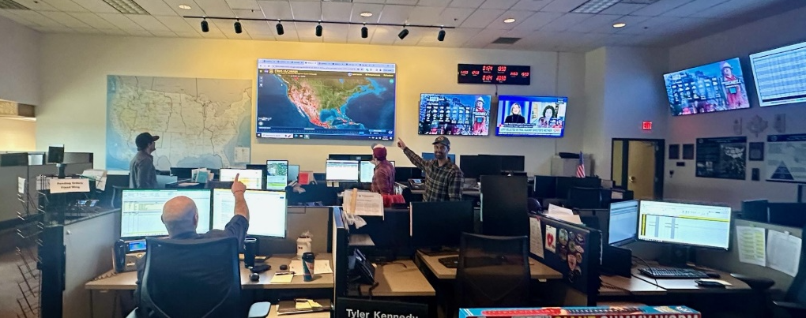
National Interagency Coordination Center Command Center Floor

Slide 25


Requests:
Additional FIRMS training/tech transfer resources
Tools to filter incident location data
NRT VIIRS burned area product – in progress
Increased functionality, tools and data for USFS air resource/smoke management needs
Identify sources of persistent/semi-persistent anomalies – done
Provide more platforms and daily observations to support operational and science activities
Notes:
Regarding use of detections to create perimeters or extent of current fires, these users acknowledged that NASA products that provide similar pseudo-perimeters as well as a NRT burned area product based on use of surface reflectance imagery and detections would be highly valued.
entries above w * were suggested by 1-2 cooperators not unanimous

Slide 26
Recent Comments by Operational FIRMS Users
Active fire data are mission critical particularly because there is a large land base and a small population… critical first alert tool
Gov’t of NWT
As local systems failed to fill national system …so went to FIRMS (and USFS legacy system). Data from FIRMS is mission critical..
Northwest Territories
I use FIRMS Rapid Alerts A LOT. I have each of our regions entered as an A0I so get alerts on all the detections
Northwest Territories
Those images (from FIRMS) really demonstrate how your work is critical to everything we do
Northwest Territories
It’s the first thing I check every morning, of every fire season, while I have morning coffee.
Wildfire Information Systems Parks Canada Agency Government of Canada
Several weeks in 2023 where they could not fly thermal aerial surveys due to unprecedented situation (so hotspots and multi-spectral was all they had)
BC Ministry of Forests
Hotspots are default currency of fire information everywhere – so critical
Province of British Columbia
I can’t tell you how grateful we are to have FIRMS as a resource!
GIS & Wildfire Technician, NWT
7. We get Canadian wildfire data from FIRMS
National Interagency Coordination Center
Use it daily and routinely to brief the NMAC
National Interagency Coordination Center
Satellite detection programs such as FIRMS and other remote sensing techniques are essential to tracking active wildfires throughout the province of BC during busy fire seasons
Province of British Columbia
Thank you as well for all the hotspot data, which is ever so useful and which you/FIRMS has been providing for many years
Natural Resources Canada
Use Fire Map to look at what support is needed, or likely to be needed, internationally (Australia, Argentina, Chile
NICC
Use Fire Map a lot for situational awareness and to pass to managers
National Interagency Fire Center

Slide 27
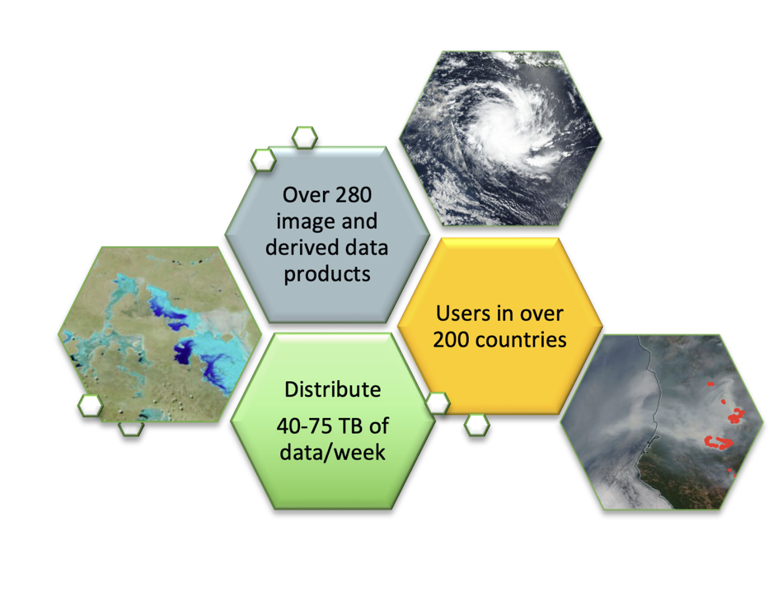
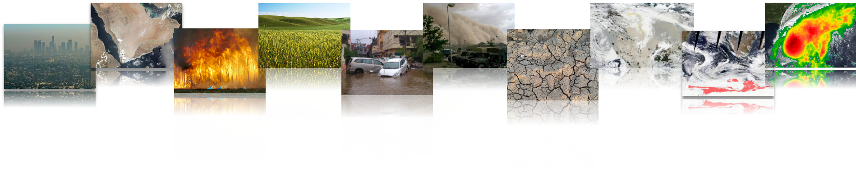
FIRMS - part of NASA’s Land, Atmosphere Near Real-time Capability for Earth observation (LANCE)
Goal: to provide near real-time (NRT) data products within 3 hours of observations to meet the timely needs of applications users including disasters.
NRT Imagery is available from GIBS and Worldview.
LANCE aims to enable NRT science and applications and is used by a broad range of operational and applications users.
Notes:
NRT MISR production has been down since the Terra Constellation Exit Maneuver in October 2022
ISS LIS will be decommissioned in mid-November

Slide 28
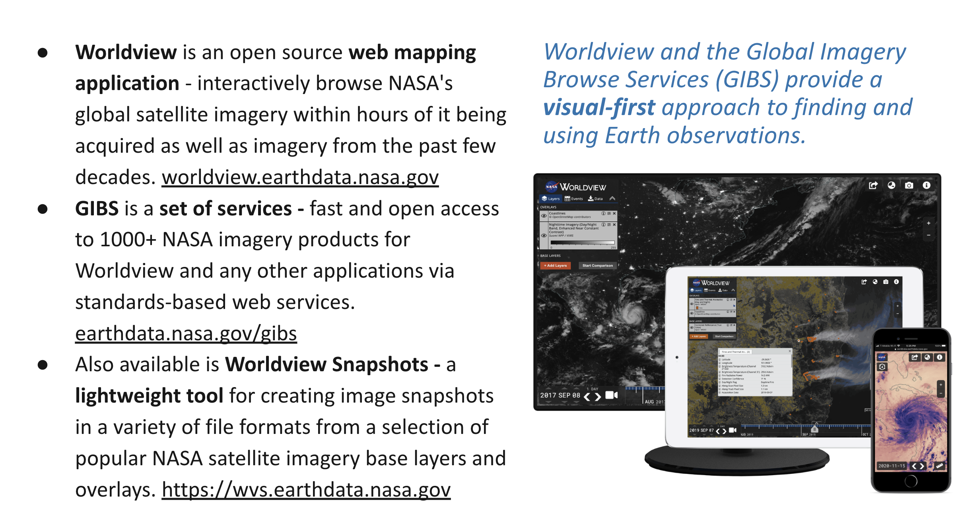

Slide 29
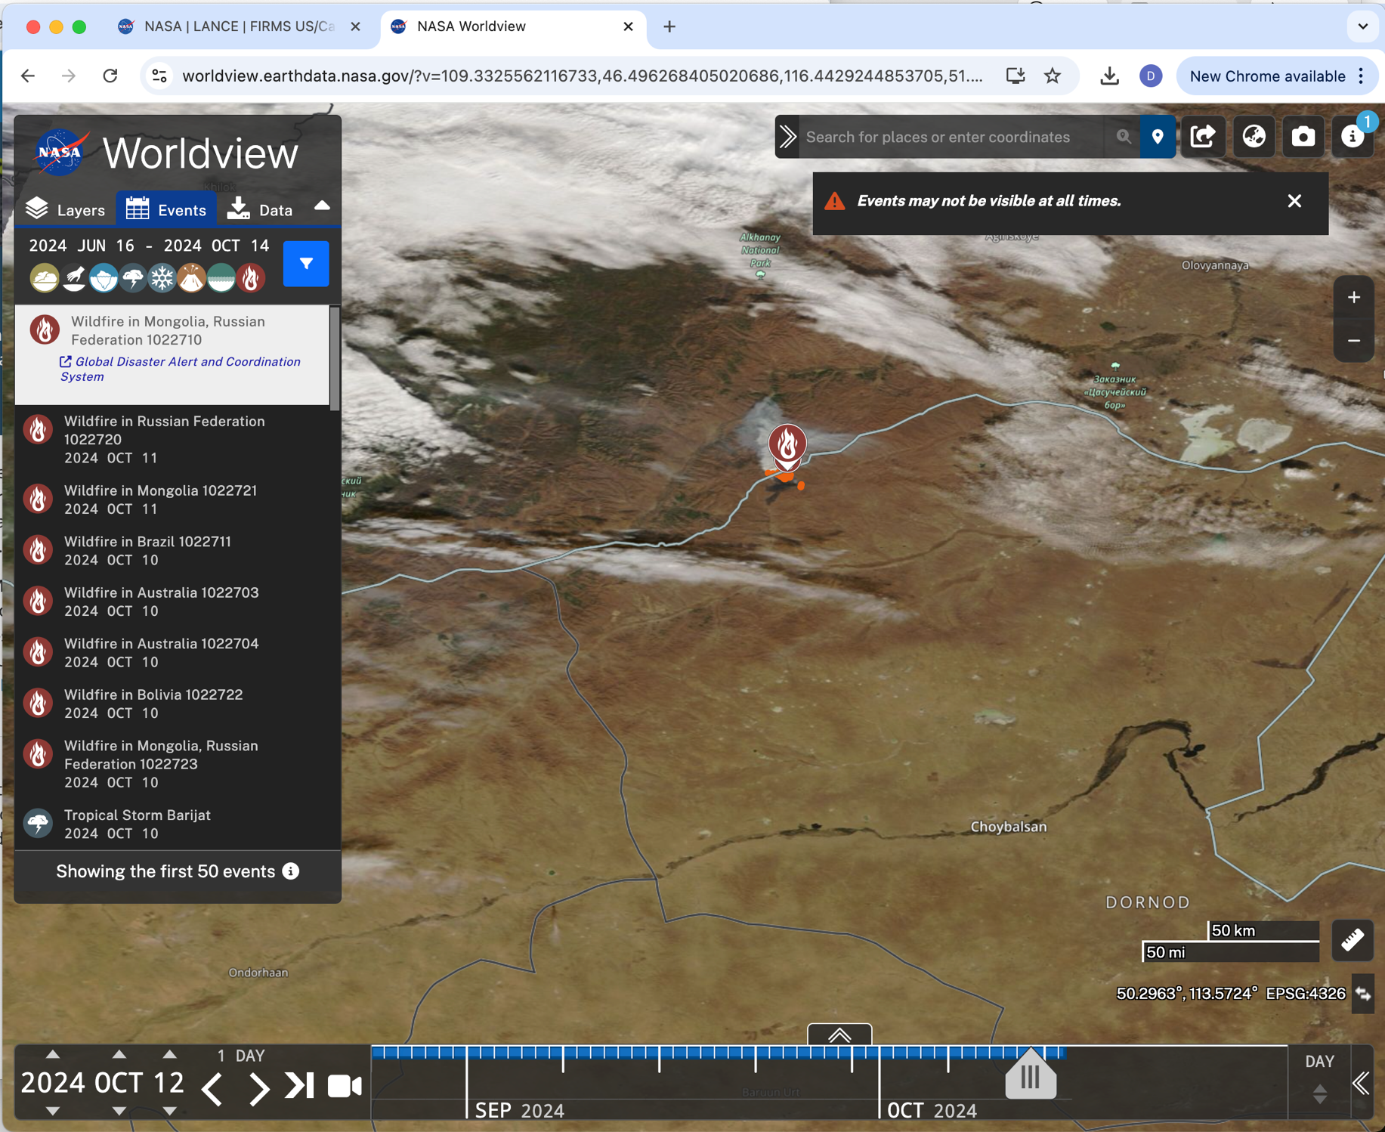
Worldview
- Event picker

Slide 30
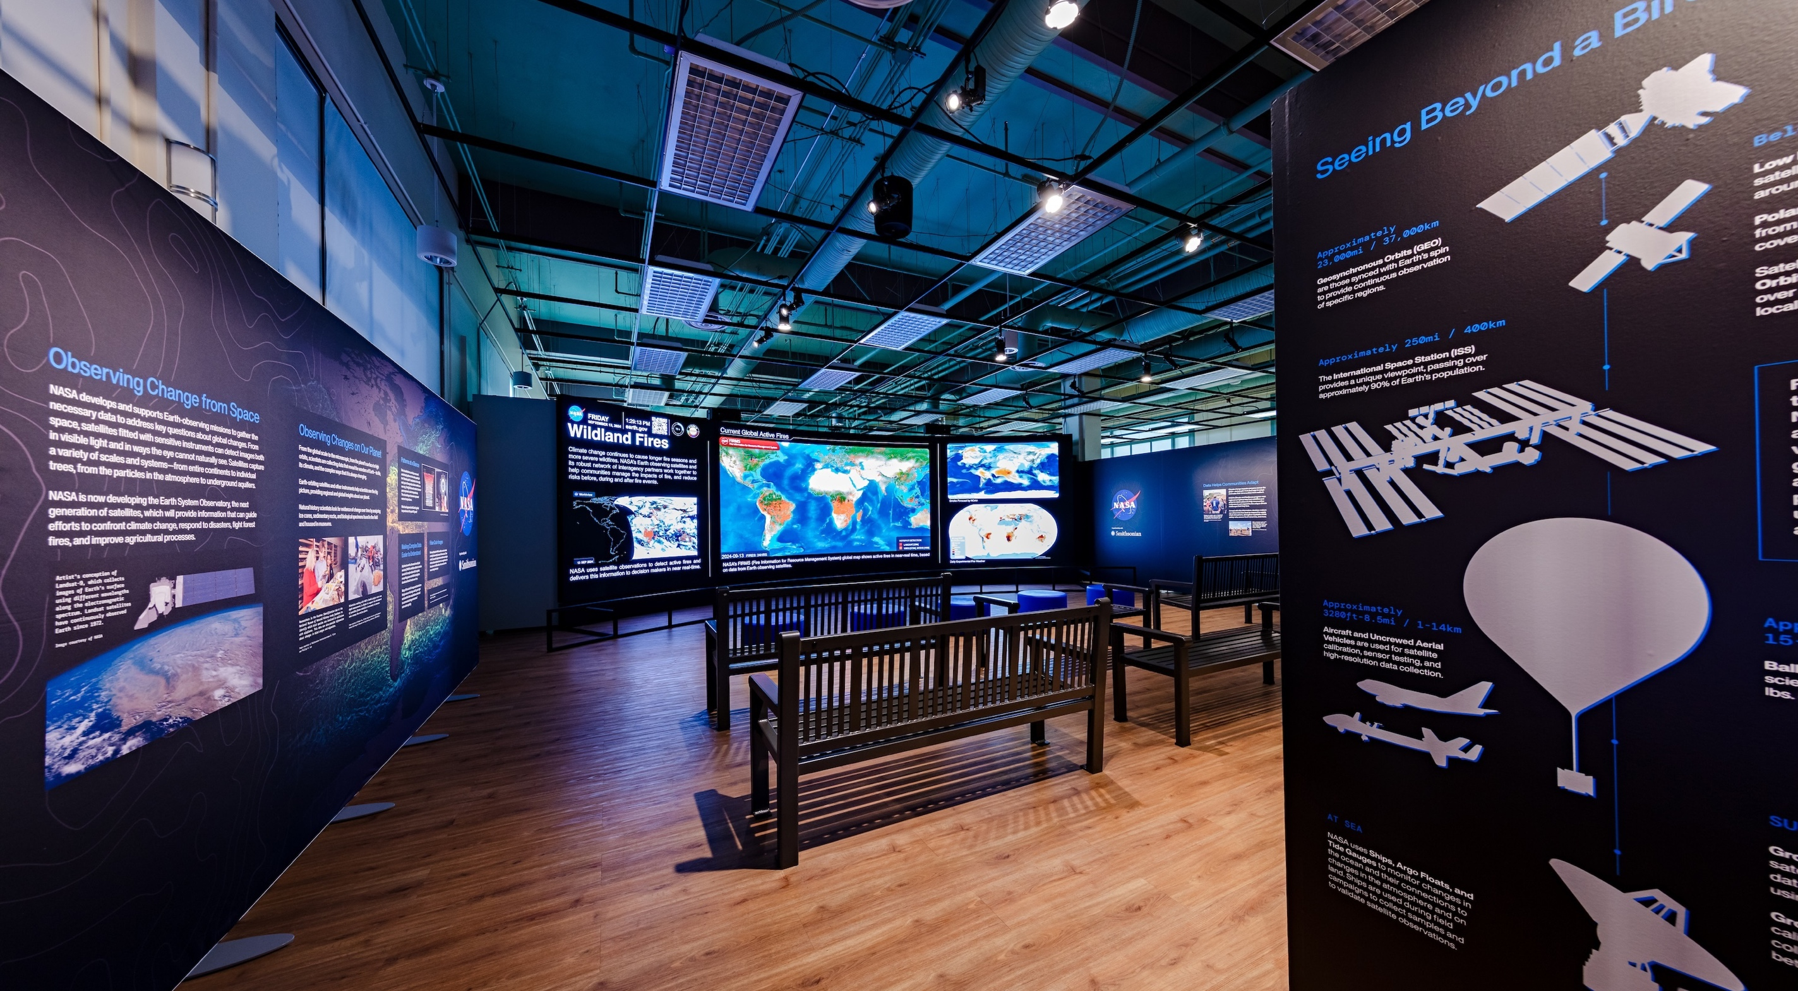

Slide 31
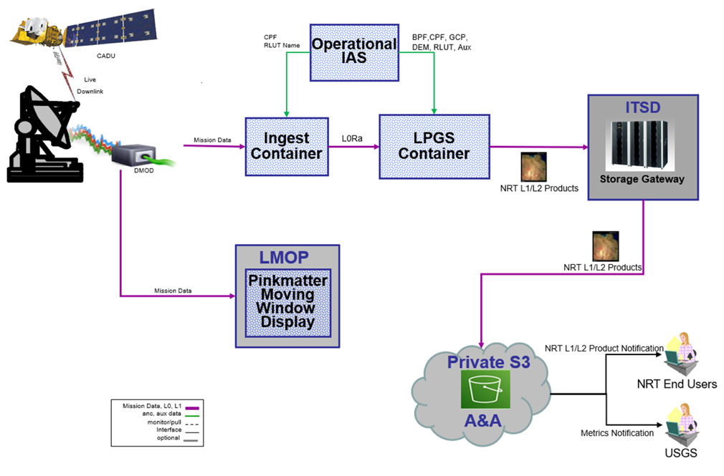
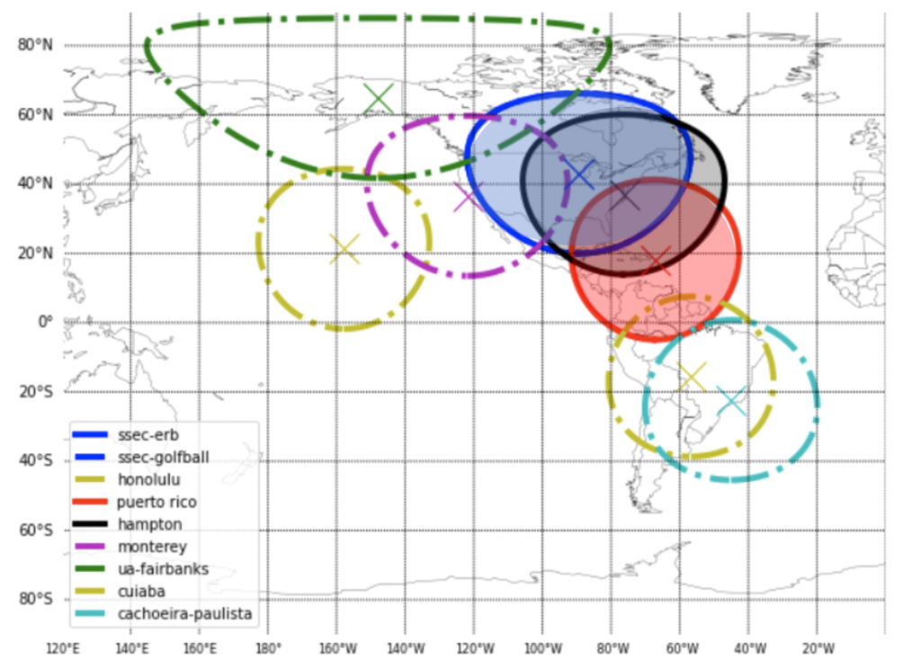
Other Ongoing FIRMS Enhancements
Maintain/improve existing products
  Migration of RT Landsat active fire detection processing from EROS to AWS cloud
  Continuity and expansion of MODIS/VIIRS URT data coverage
  Adding in OMPS AI data from NOAA 20/21
  Developing a NRT VIIRS Burned Area product

Slide 32
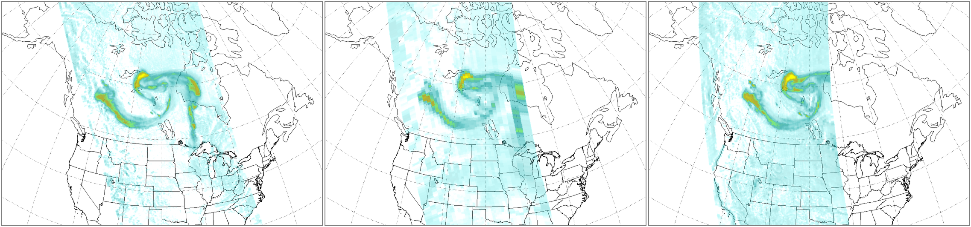

LANCE OMPS Aerosol Index
OMPS Aerosol Index for 11 May 2024
N21 (178 xtrack FOVs)
10x10 km nadir
S-NPP (36 xtrack FOVs)
50x50 km nadir
N20 (140 xtrack FOVs)
12x17 km nadir
0
Aerosol Index
15
Notes:
Data from the OMPS sensors on NOAA-20 and 21 will be introduced to ensure continuity beyond end-of-life for SNPP. An advantage of the NOAA-20 and 21 OMPS instruments (vs SNPP) is that they have a smaller Field of View (FOV), providing higher resolution. Colin pointed out that the OMPS instruments on all three satellites are essentially the same, and SNPP could have had the same level of resolution. But since this is an Ozone instrument, the NOAA requirement was for the wider FOV (50 km by 50km at nadir). NASA and NOAA scientists successfully lobbied the JPSS Project to increase the resolution to 12 x 17 km for NOAA-20 and 10 x 10 km for NOAA-21.

Slide 33
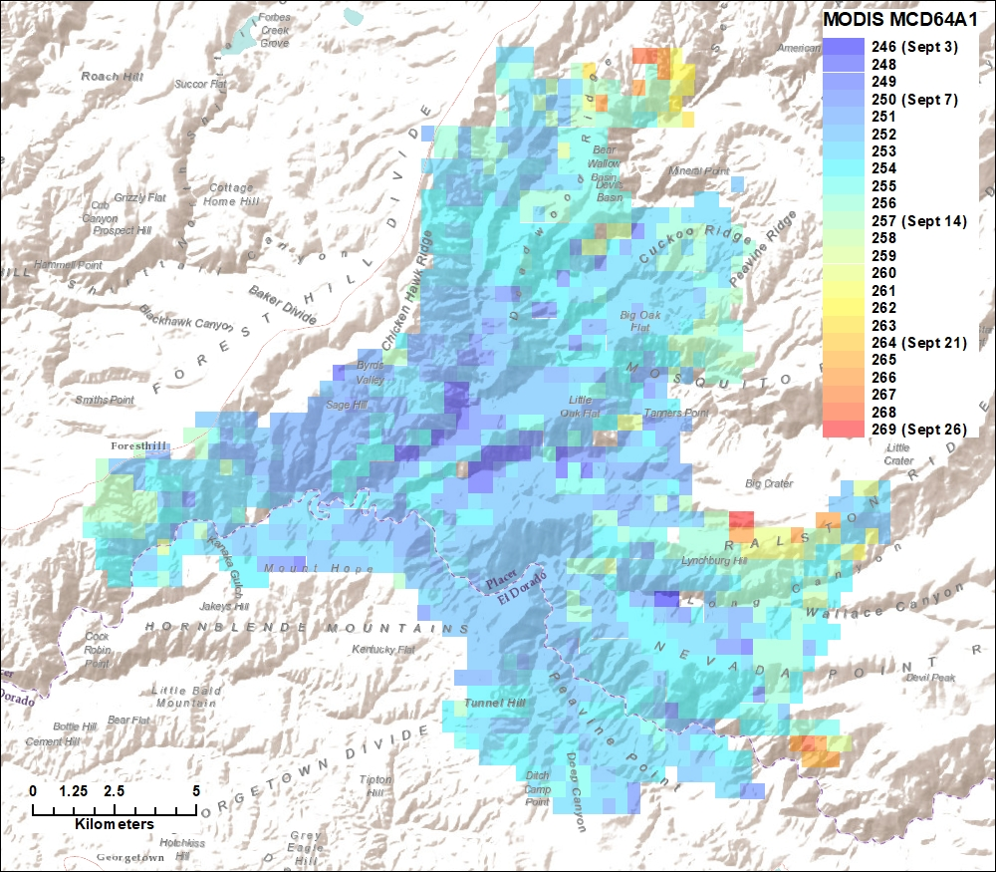
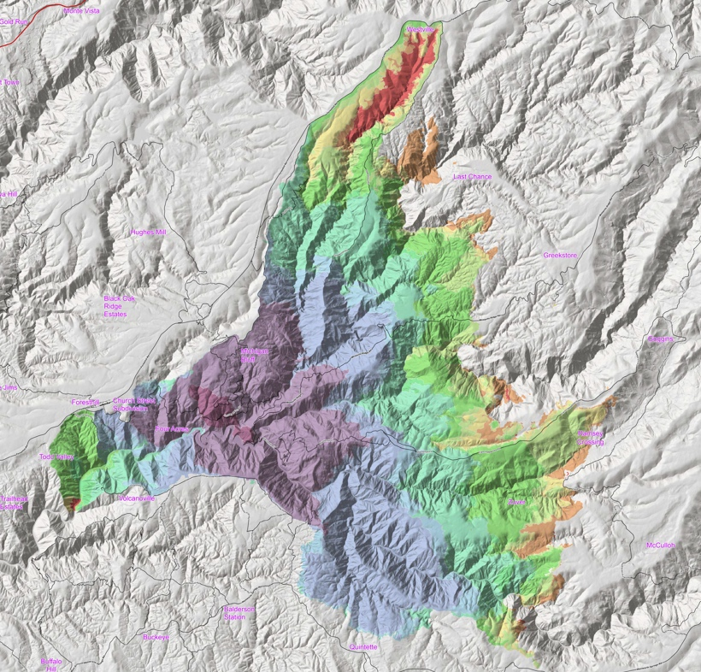
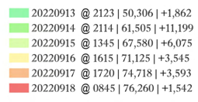
Other Ongoing FIRMS Enhancements
Development/implementation of new products
  NRT VIIRS burned area product development/implementation
Sentinel-3 imagery and active fire detection data evaluation and integration
Mosquito Fire – MCD64A1
September 2022
Mosquito Fire – Progression Map

