Slide 1
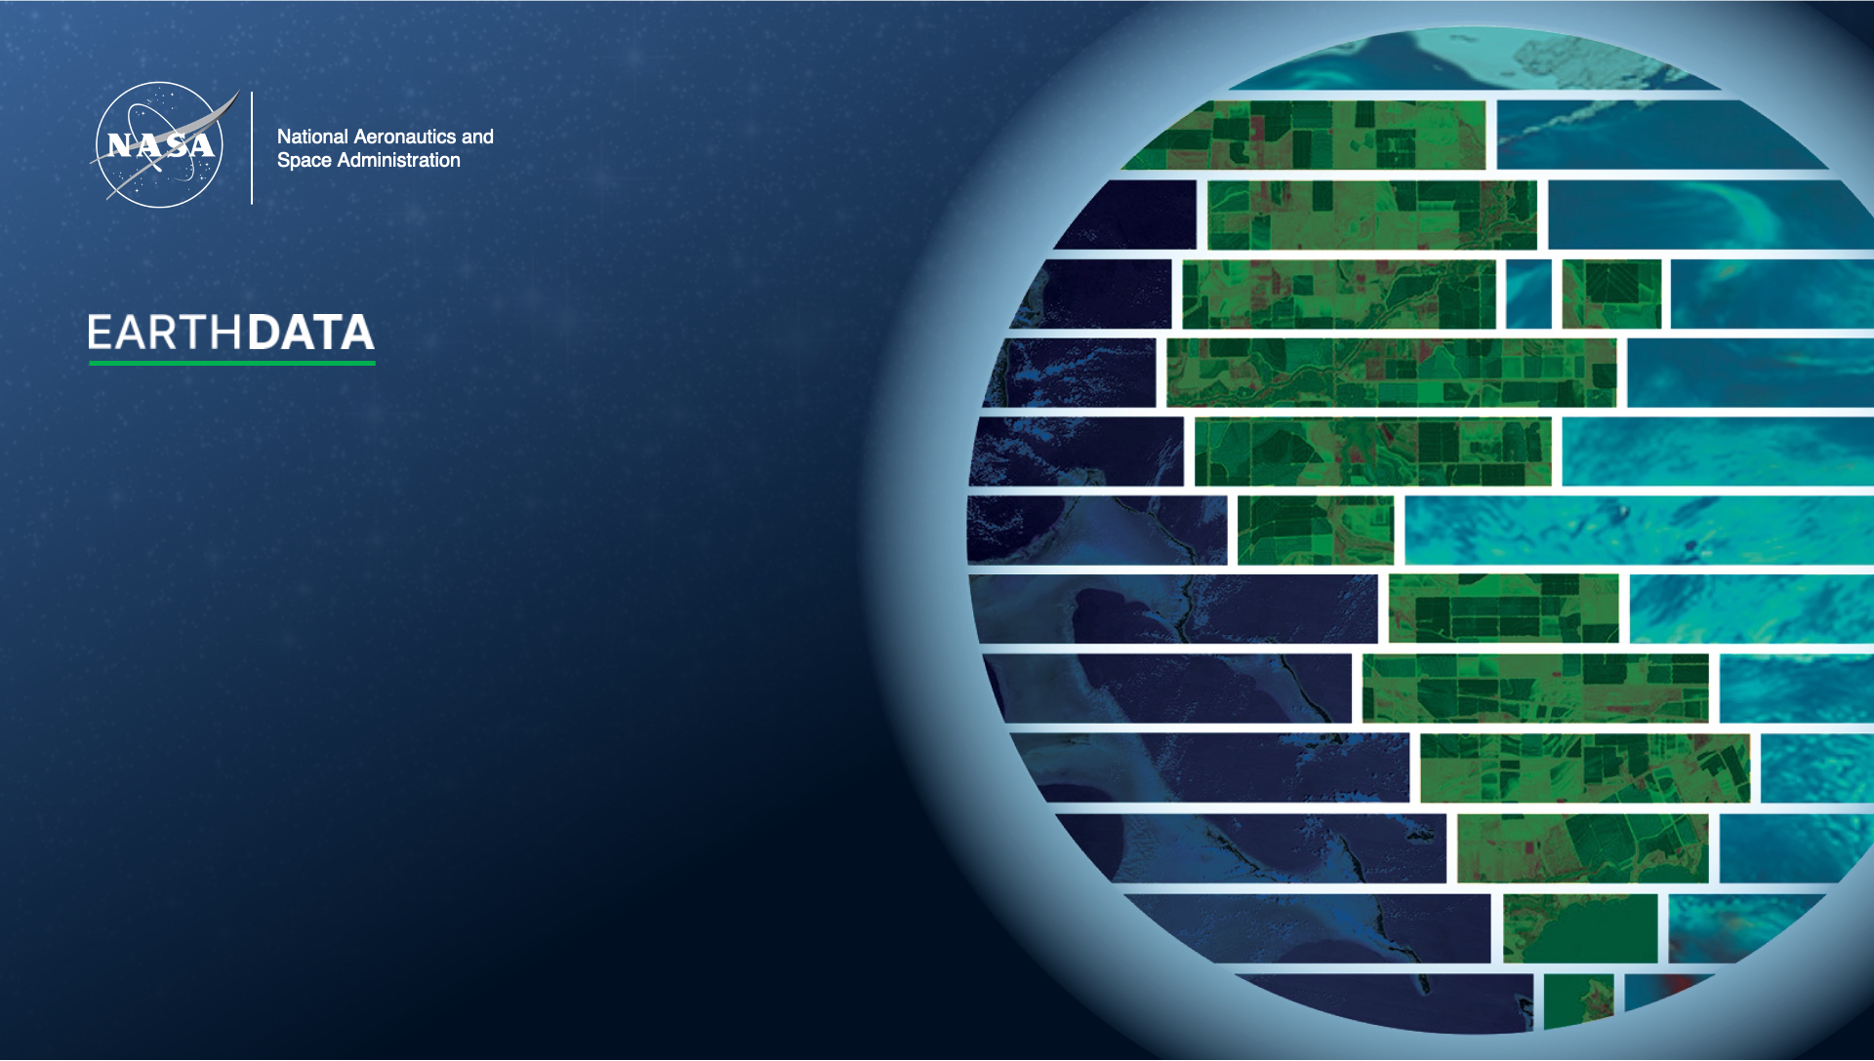
NASA’s Fire Information for Resource Management System (FIRMS): A Wildfire Management Platform
AGU Fall Meeting: Session IN33E
Wednesday, 11 December 2024
14:10 – 15:40 EST

Slide 2
Contributors
Otmar Olsina¹, Diane Davies¹, Jenny Hewson¹,
Brad Quayle², Louis Giglio³, Joanne Hall³,
Karen Michael¹, Sadashiva Devadiga¹
¹NASA GSFC,
²USDA Forest Service,
³University of Maryland

Slide 3
Overview
Background & Introduction to FIRMS
Strengths
Limitations
Future Plans
Notes:
Guidance on use will be covered in the first three sections

Slide 4
Background & Introduction

Slide 5
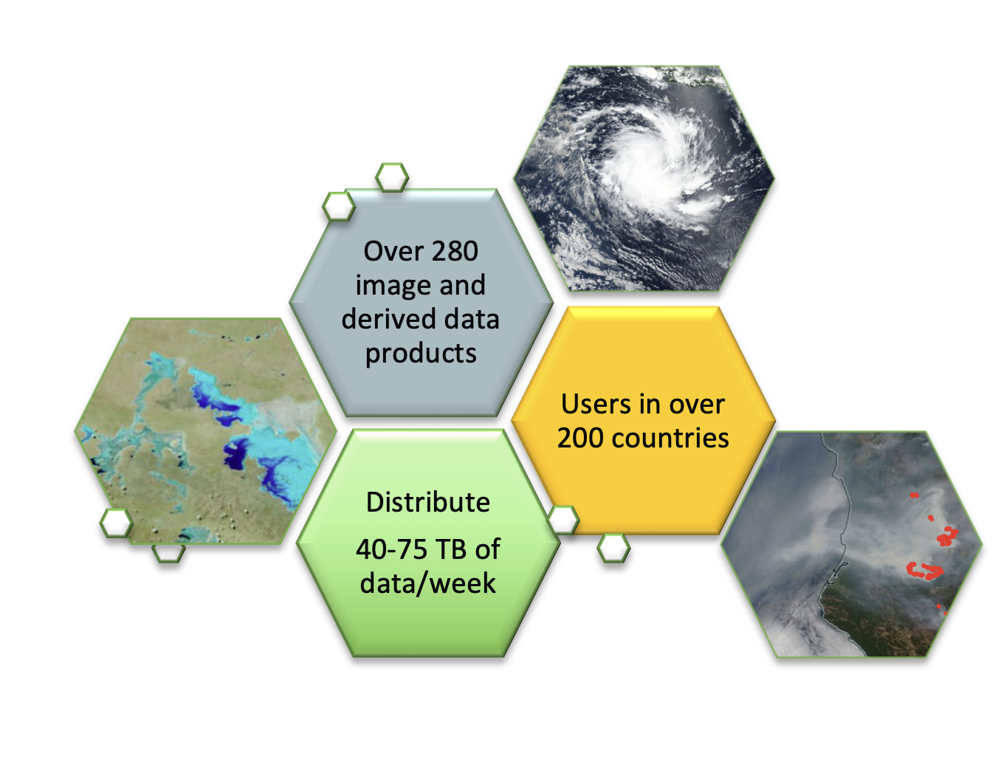
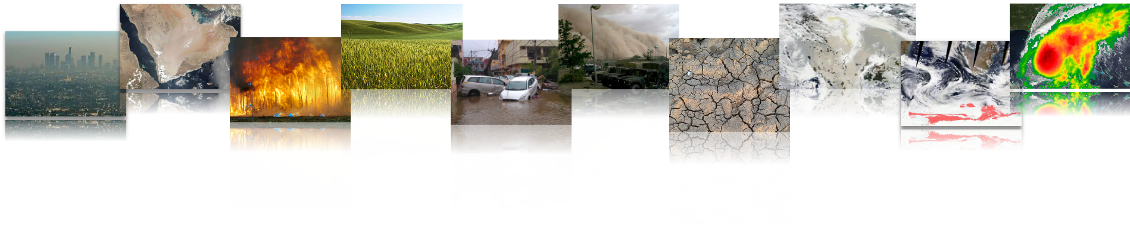
FIRMS - part of NASA’s Land, Atmosphere Near Real-time Capability for Earth observation (LANCE)
Goal: to provide near real-time (NRT) data products within 3 hours of observations to meet the timely needs of applications users including disasters.
NRT Imagery is available from GIBS and Worldview.
LANCE aims to enable NRT science and applications and is used by a broad range of operational and applications users, including USDA-FAS, USAID FEWS-NET, USFS, US National Ice Center, NRL, FEMA, NASA SPoRT, Global Forest Watch, Conservation International, GEOGLAM, ECMWF
Notes:
NRT MISR production has been down since the Terra Constellation Exit Maneuver in October 2022
ISS LIS will be decommissioned in mid-November

Slide 6
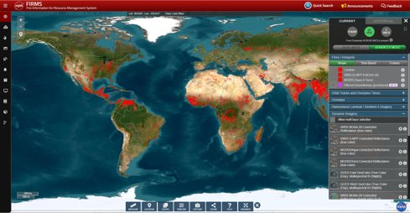
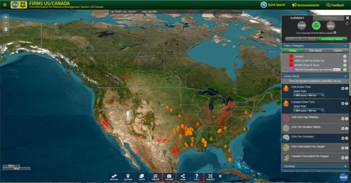
FIRMS Global and FIRMS US/Canada
https://firms.modaps.eosdis.nasa.gov
NRT and RT imagery and fire remote sensing products for the world.
Developed by U of Maryland in early 2000s and used data from MODIS Rapid Response.
Transitioned to NASA LANCE in 2012.
https://firms.modaps.eosdis.nasa.gov/usfs
FIRMS US/Canada was launched within NASA LANCE in 2021.
NRT, RT and URT imagery and fire remote sensing products for the US & Canada.

Slide 7
Strengths
Web map interface caters for range of users (modes).
Components include email alerts, web services, GIS-friendly data downloads
Active fire data provided in multiple formats
Multi-mission. Integrates AF data from multiple sources.
Notes:
range of ‘points of access’ from Alerts, to web services etc

Slide 8
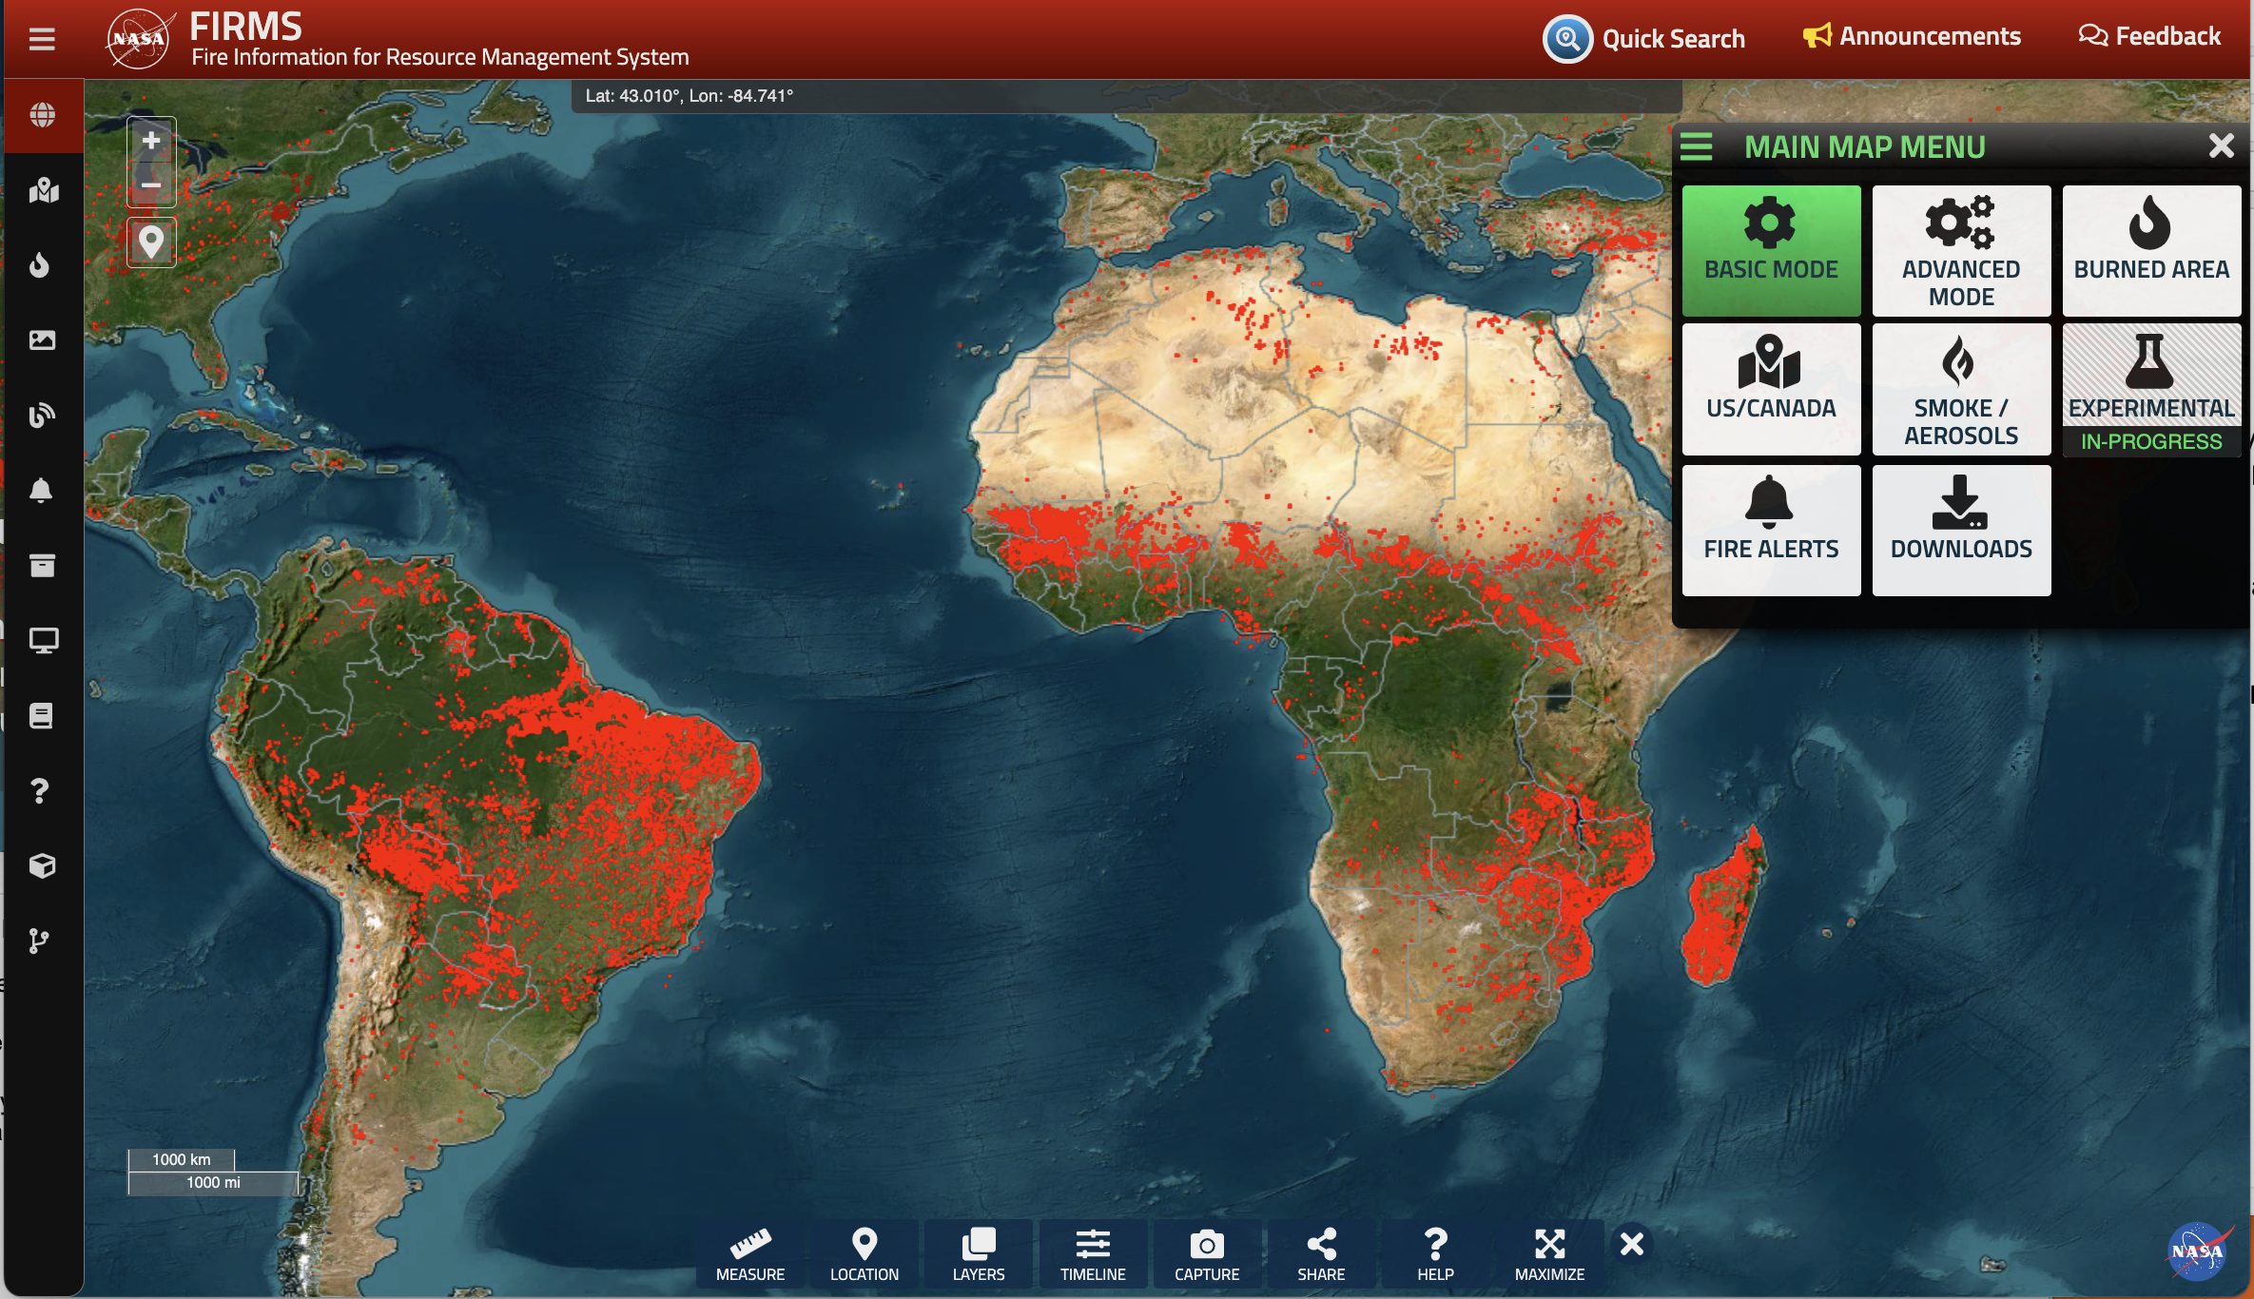
FIRMS Map User Interface (UI) Updates
Available Modes for User Needs and Capabilities
FIRMS UI Refinement Objectives:
Support an increasingly diverse set of users
Make more intuitive for users
Provide easier access to other FIRMS products/services
Allow greater flexibility to filter/query remote sensing data (sub-daily)
Provide access to, and maintain separation of, prototype products
Notes:
FIRMS provides access to a large temporal and spatial record of remote sensing products and supporting data.
Approximately 60 datasets are available.
A significant challenge is providing a UI that is scalable and intuitive for both layperson and advanced users.
Work is ongoing to enhance the user interface to:
Make it more intuitive to users, particularly help users better recognize different modes are available
Provide easier/more obvious access to other FIRMS products/services
Allow greater flexibility to filter/query remote sensing data (hourly/sub-hourly)
Provide access to, and maintain separation of, prototype/experimental data products and products/applications dedicated to meeting specific needs

Slide 9
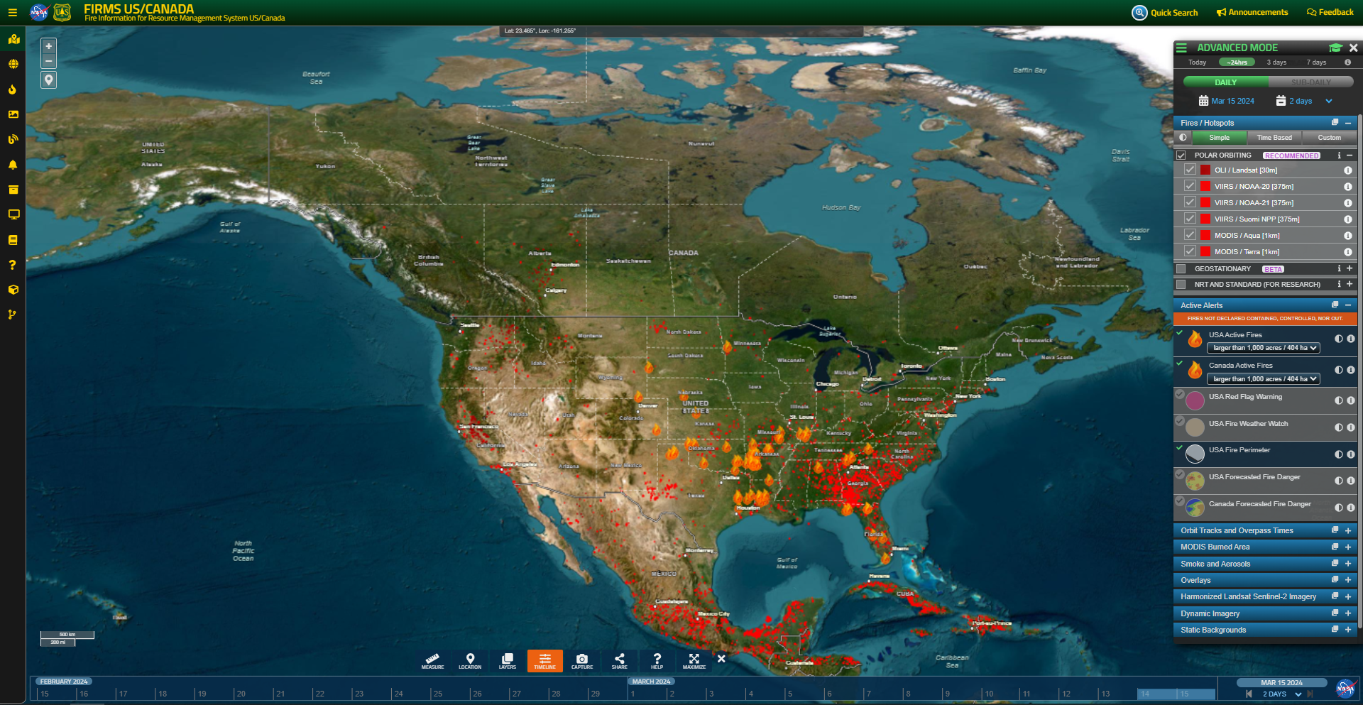
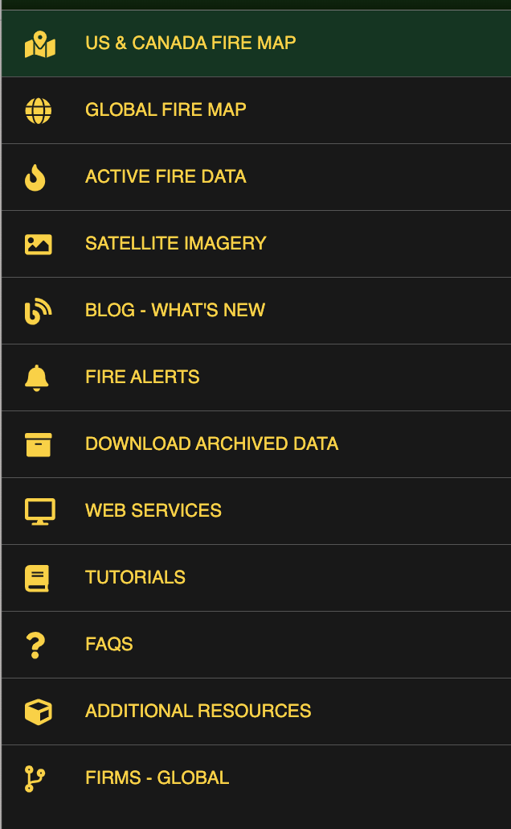
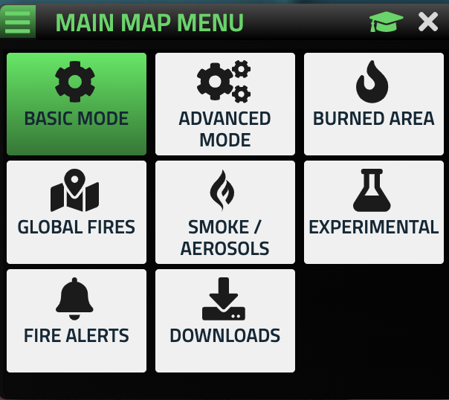
FIRMS US/Canada Map User Interface (UI)
Mode
Daily-Sub-daily / Calendar Controls
Layer Display Controls
Viewer Tools
Timeline/Calendar Controls
Notes:
FIRMS provides access to a large temporal and spatial record of remote sensing products and supporting data.
Approximately 60 datasets are available.
A significant challenge is providing a UI that is intuitive and scalable for both layperson and advanced users.
Goals of recent FIRMS UI enhancements:
Make more intuitive for users
Increase visibility/access to other FIRMS products/services
Maintain distinctive UIs for user levels, use cases & prototype products
Enhance ability to filter and visualize data
default is basic mode: Provides essential layers to quickly identify and visualize current/recent fire activity and factors affecting satellite fire detection.
Advanced: provides all satellite imagery, other satellite data products and ancillary geospatial data to visualize, explore and analyze for current and past fire activity.
Burned area: Provides satellite imagery and other derived satellite data products to detect, visualize, explore and analyze burned areas.
Smoke and aerosols: Provides satellite products useful for highlighting the extent and tracking the transport of smoke
Experimental: Provides new and/or prototype satellite data products for access and evaluation by the user community.
Timeline - another way to visually see what time period you are looking at. Can be used to adjust the calendar / days viewed.

Slide 10
Satellite Active Fire Detection Data Used in FIRMS
Active Fire and Thermal Anomalies Data
Sensor (Platform) | Source | Spatial Resolution | Temporal Resolution | Latency⁴ (Coverage)
ABI (GOES-16 & 18) | NOAA | 2km sub-satellite¹ | Sub-hourly | RT - ~20-30 mins (Americas)
ABI (GOES-16 & 18) | KCL/IPMA | 2km sub-satellite¹ | Sub-hourly | RT - ~20-30 mins (Americas)
SEVIRI (Meteosat 9 & 11) | EUMETSAT/LSA SAF | 3km sub-satellite¹ | Sub-hourly | RT - ~30 mins (Europe-Africa-India)
AHI (Himawari-8) | KCL/IPMA | 2km sub-satellite¹ | Sub-hourly | RT - ~30 mins (Australia-Asia)
MODIS (Terra/Aqua) | NASA LANCE | 1km sub-satellite¹ | Twice daily² | NRT - <3 hours (Global)
VIIRS (Suomi NPP/NOAA-20/21) | NASA LANCE | 375m sub-satellite¹ | Twice daily² | NRT - <3 hours (Global)
MODIS (Aqua) | SSEC Univ of Wisconsin | 1km sub-satellite¹ | Twice daily² | RT - <30 mins (US-Canada)
VIIRS (Suomi NPP/NOAA-20/21) | SSEC Univ of Wisconsin | 375m sub-satellite¹ | Twice daily² | RT - <30 mins (US-Canada)
MODIS (Aqua) | SSEC Univ of Wisconsin | 1km sub-satellite¹ | Twice daily² | URT - <1 min (US-Canada)
VIIRS (Suomi NPP/NOAA-20/21) | SSEC Univ of Wisconsin | 375m sub-satellite¹ | Twice daily² | URT - <1 min (US-Canada)
OLI (Landsat 8 & 9) | USGS EROS | 30m | 8 days³ | RT - <30 mins (US-Canada)
¹ The pixel size systematically grows from sub-satellite towards the edge of the disk/swath.
² Thermal data are collected for daytime and nighttime observations ~ 12 hours apart.
³ L8 and L9 orbit cycles each have 16-day orbit cycles, and their orbits are 8 days out of phase. This does not include potential nighttime observations.
⁴ Latency refers to the estimated time from satellite observation to availability in FIRMS. Near Real-Time (NRT), Real-Time (RT) & Ultra-Real-Time (URT).
Coverage over US/Canada only
Notes:
FIRMS continues to emphasize providing current and new products at lower latencies and provide higher resolution products to meet user requirements
RT geostationary active fire detection data is available as a result of efforts and support by NASA Applied Sciences, UMd.
Active fire detection data derived from direct readout (DR) is available, including URT active fire detection data
RT and URT DR data are derived using NASA SPAs to ensure consistency with data derived in LANCE.
RT Landsat 8/9 RT active fire detection data for US and Canada are available as a result of efforts and support by NASA Applied Sciences, UMd, USGS EROS, FIRMS and the Forest Service.

Slide 11
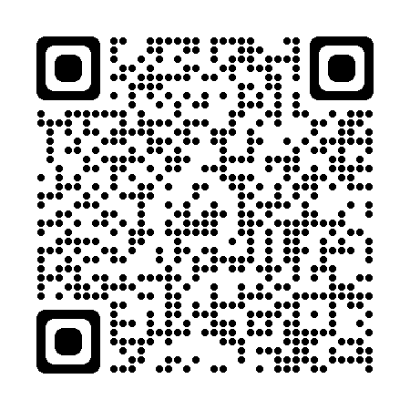
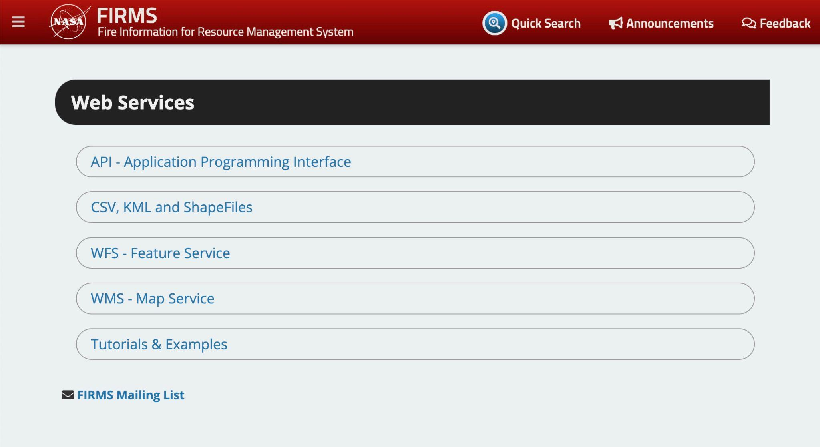
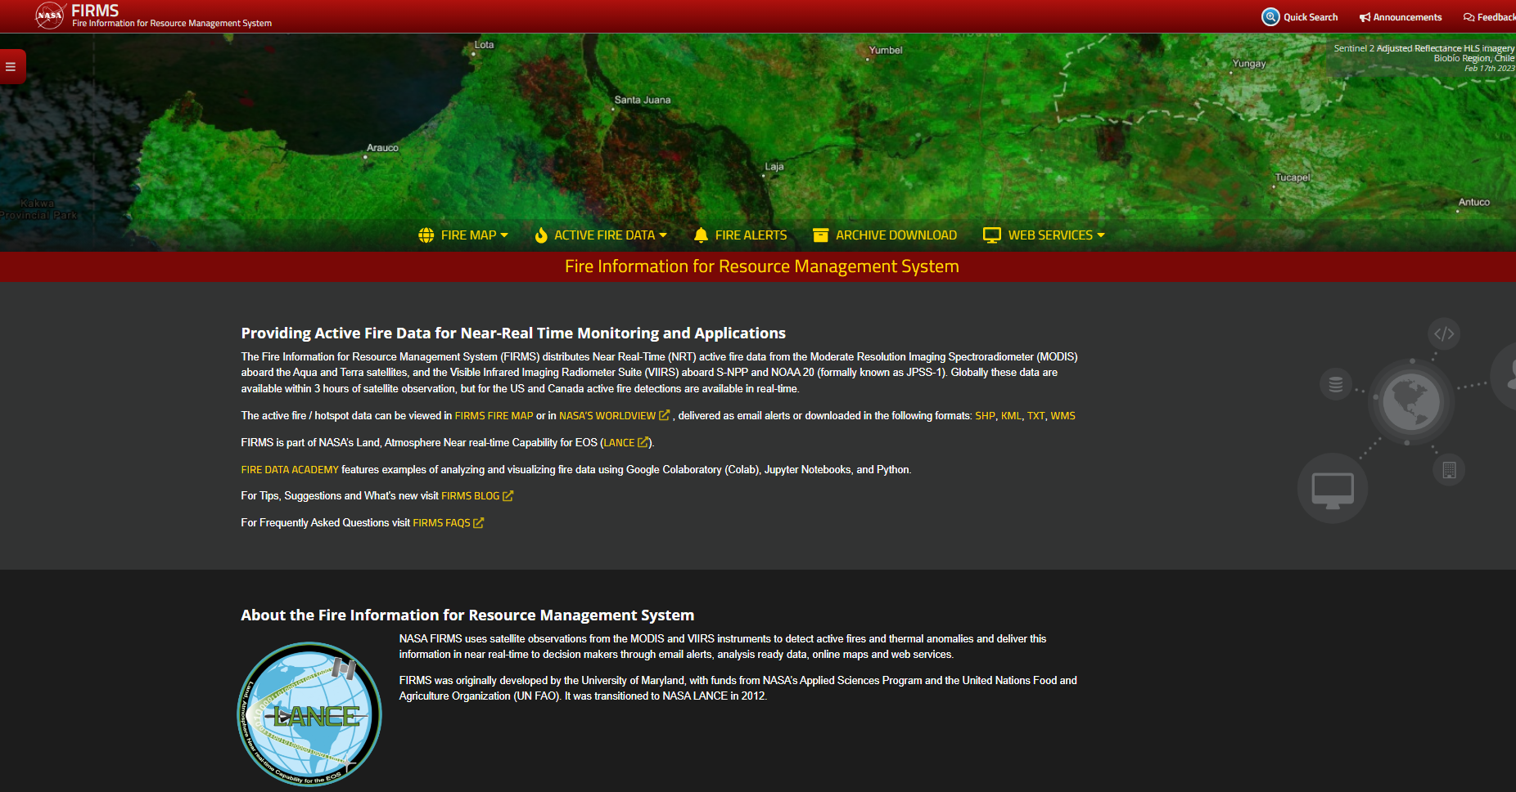
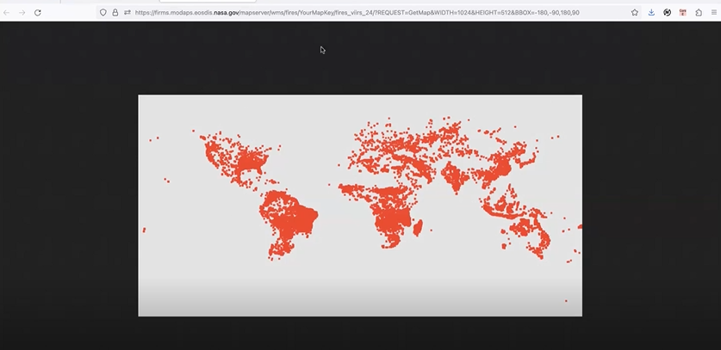
API & Web Map Services
Notes:
I’ll also mention that to support users wanting to ingest FIRMS data into their software, browsers, and tools, etc, FIRMS has continued to develop the backend ‘web services’ including API support; CSV, KML, and shapefiles of the active fire data to display in QGIS, ArcGIS, GEE etc); there are also WMS and WFS options for ingesting into the data directly into QGIS, ArcGIS

Slide 12
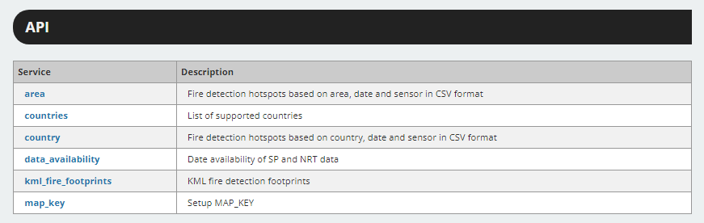
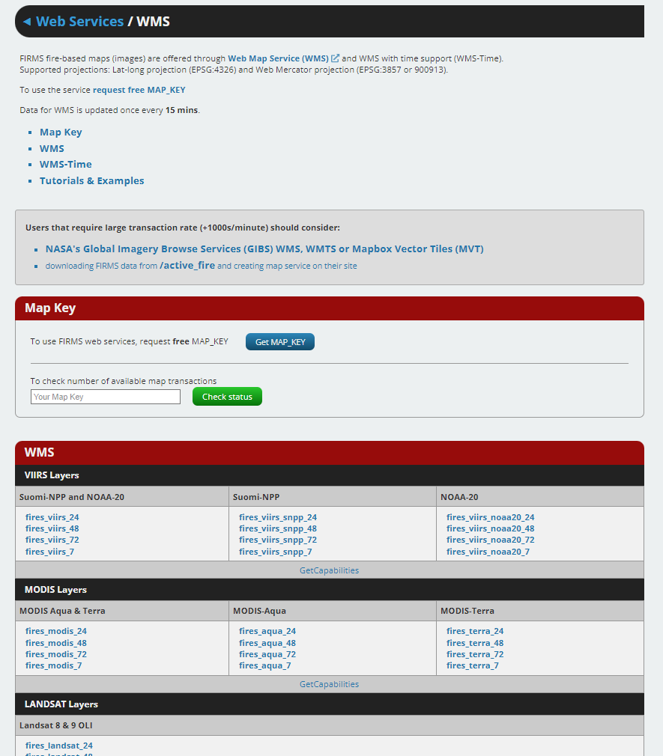
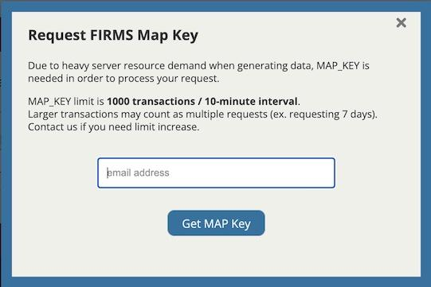
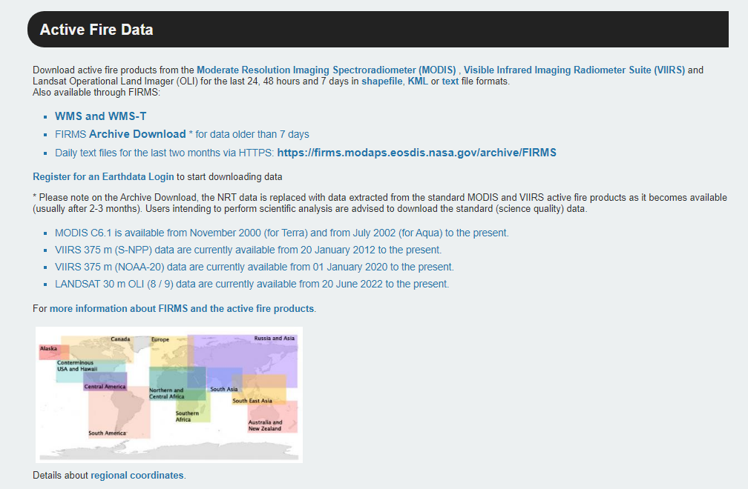
Sign up for FREE Map Key for:wms, wfs. api
Notes:
Users simply request a free FIRMS map key, and have multiple options to select from (in terms of temporal and geographical extent, source of the active fire data, etc)

Slide 13
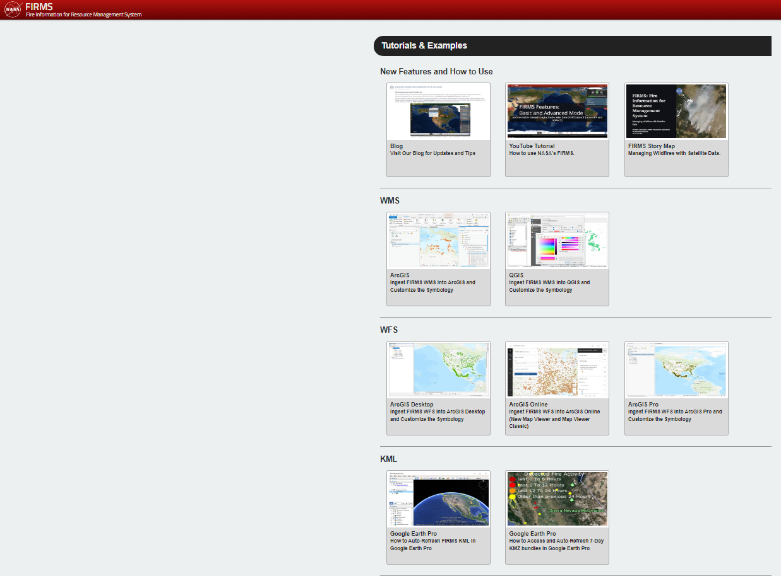
Tutorials and Examples
/tutorials/
Notes:
Finally, there are multiple tutorials and examples available

Slide 14
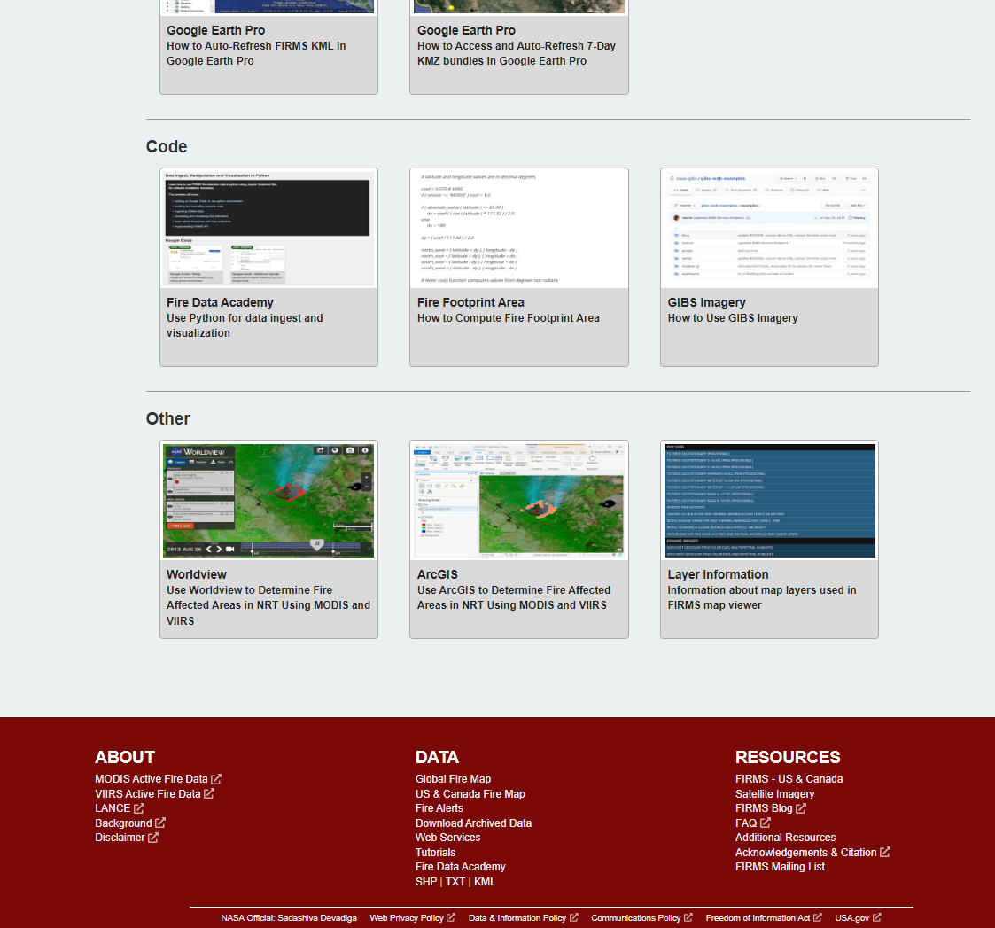
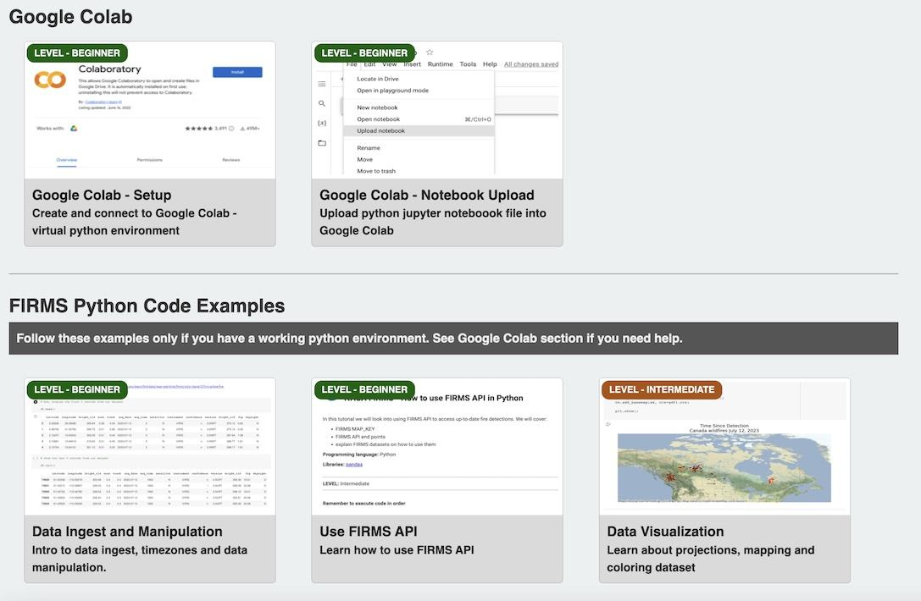
Fire Data Academy
/academy/
Jupyter Notebooks
Google Colab
Python
data ingest
data manipulation
visualization
API examples
Notes:
And, most recently, a Fire Data Academy has been included with jupyter notebook, google colab, and python examples

Slide 15
Limitations
Polar orbiting satellites each typically collect two observations per day and only detect fires as they pass over head.
Geostationary provide 24/7 coverage spatial resolution is coarser and less sensitive to small fires
Heavy cloud/smoke can obscure fire detections – example of Jasper fire
Notes:
geostationary satellite sensors can provide repeated observations on a sub-hourly basis, making it possible to detect fires which may not be detected at longer temporal intervals. Geostationary satellites provide data at 10-15 minute intervals, so they can detect more fire events and capture their growth and change. However, the spatial resolution of geostationary satellite data is coarser and therefore less sensitive to small fires.

Slide 16
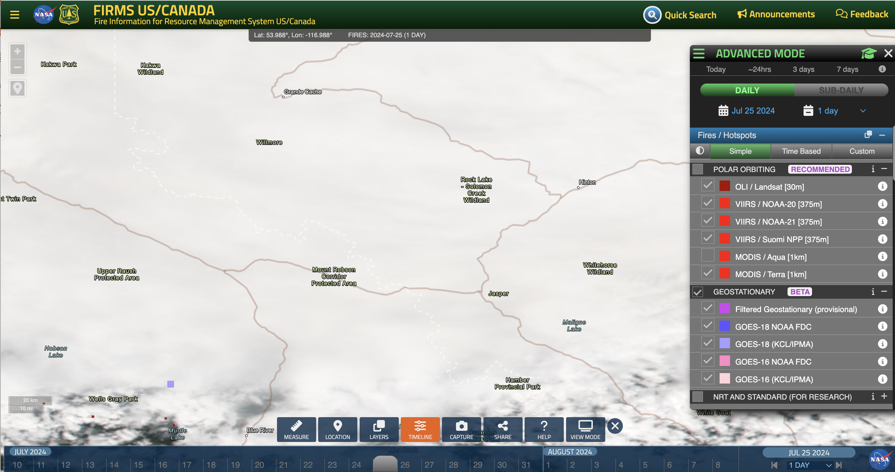
Example from Jasper, Alberta, Canada
July 25, 2024.
Fires were reported in the news and by locals but on FIRMS the fires were obscured by heavy cloud causing users to question whether FIRMS was working
Notes:
Jasper, Alberta, Canada highlighted the impact of cloud on active fire detections. Active fire detections were captured by MODIS and VIIRS on 07/23/24, and to the south/southeast of Jasper on the daytime observations between 12:30PM and 3:00PM PDT on 07/24/24. However, no additional detections were captured for several consecutive days following these detections. FIRMS received multiple questions from users about the wildfire in Jasper and, therefore, this blog explains the reasons for the limited active fire detections during this period.
FIRMS provides active fire detections from both polar orbiting satellites and geostationary satellites. The polar orbiting satellites each typically collect two observations per day over Jasper, Alberta, based on the latitude of Jasper – once during the day and again about 12 hours later in the night. As mentioned above, on 07/24/24 there was some limited fire activity detected by MODIS and VIIRS further south/southeast of Jasper captured on the daytime observations between 1:30PM and 4:00PM MDT. However, if users view the MODIS and VIIRS imagery that were acquired on 07/24/24 (the imagery can be loaded by selecting the VIIRS and MODIS Corrected Reflectance imagery within the Dynamic Imagery dropdown), they will notice that the Jasper area was under heavy cloud cover. Unfortunately, the satellite sensors cannot discern fire activity under heavy clouds or smoke cover and, therefore, under these conditions there will be very limited active fire detection. Thick cloud continued to persist for several days and continued to impact the active fire detections. The images below, acquired on 07/25/24, 07/26/24, and 07/28/24 show thick cloud over the area:

Slide 17
Future Plans
Experimental tab enables product evaluation
Static Thermal Anomalies
NRT burned area
With MODIS end of life – VIIRS provides continuity for Aqua (PM) overpass. No replacement for Terra (AM) overpass. NASA is considering Sentinel 3 for active fire and corrected reflectance imagery to provide continuity for the morning observations
Notes:
Too many to go in to in detail here

Slide 18
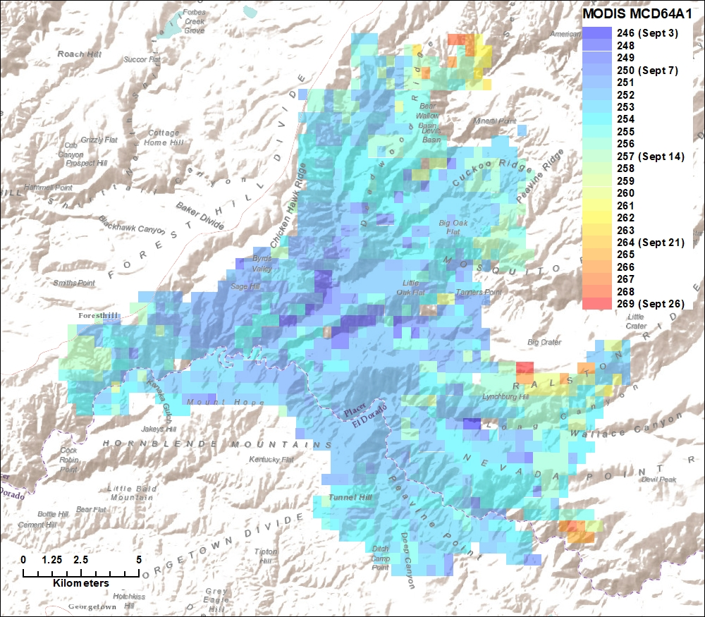
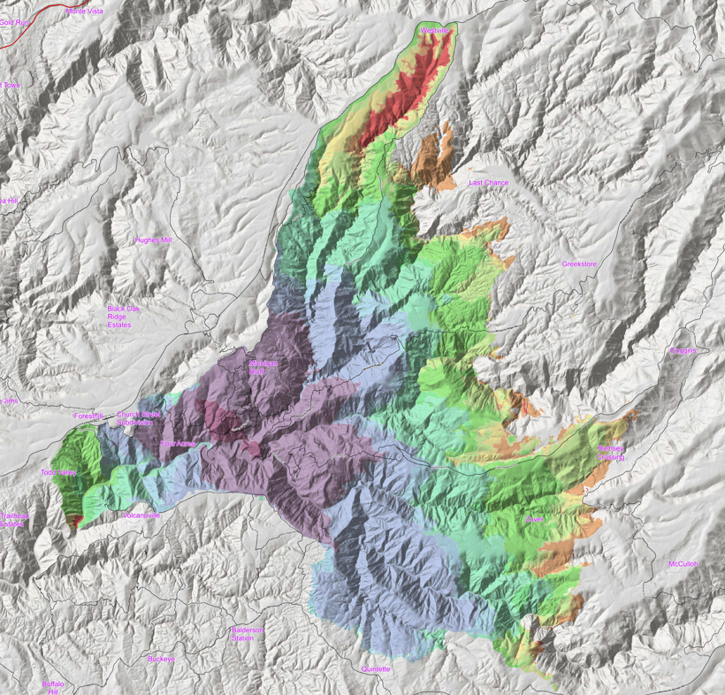
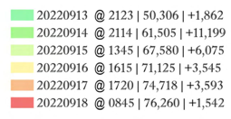
NRT VIIRS Burned Area Product
Daily/sub-daily capture of fire growth is beneficial to multiple applications
Product details:
  Based on an adaptation of MODIS MCD64A1/VIIRS VNP64A1
  Daily cumulative updates at ~375m spatial resolution
  Global coverage
  Produce operationally in LANCE/MODAPS environment
  Anticipate 12-to-24-month period to implement
Mosquito Fire – MCD64A1
September 2022
Mosquito Fire – Progression Map
Notes:
In the context of experimental/prototype products, FIRMS is working with VIIRS science team PIs and LANCE to identify a pathway to implement a global NRT VIIRS burned area product.
This product will complement existing FIRMS content, support active and post-fire needs, and is desired by multiple cooperators.
Require consistently derived data on a daily basis
The product would benefit multiple applications and user needs and provide daily data vs. the monthly VNP64A1 burned area product provided monthly approximately 60 days later than RT.
The graphics for the 2022 Mosquito Fire, which burned during September 2022, compares the standard MCD64A1 output and a fire progression map using incident perimeter data for dates where perimeter data was available (compiled from multiple sources).

Slide 19
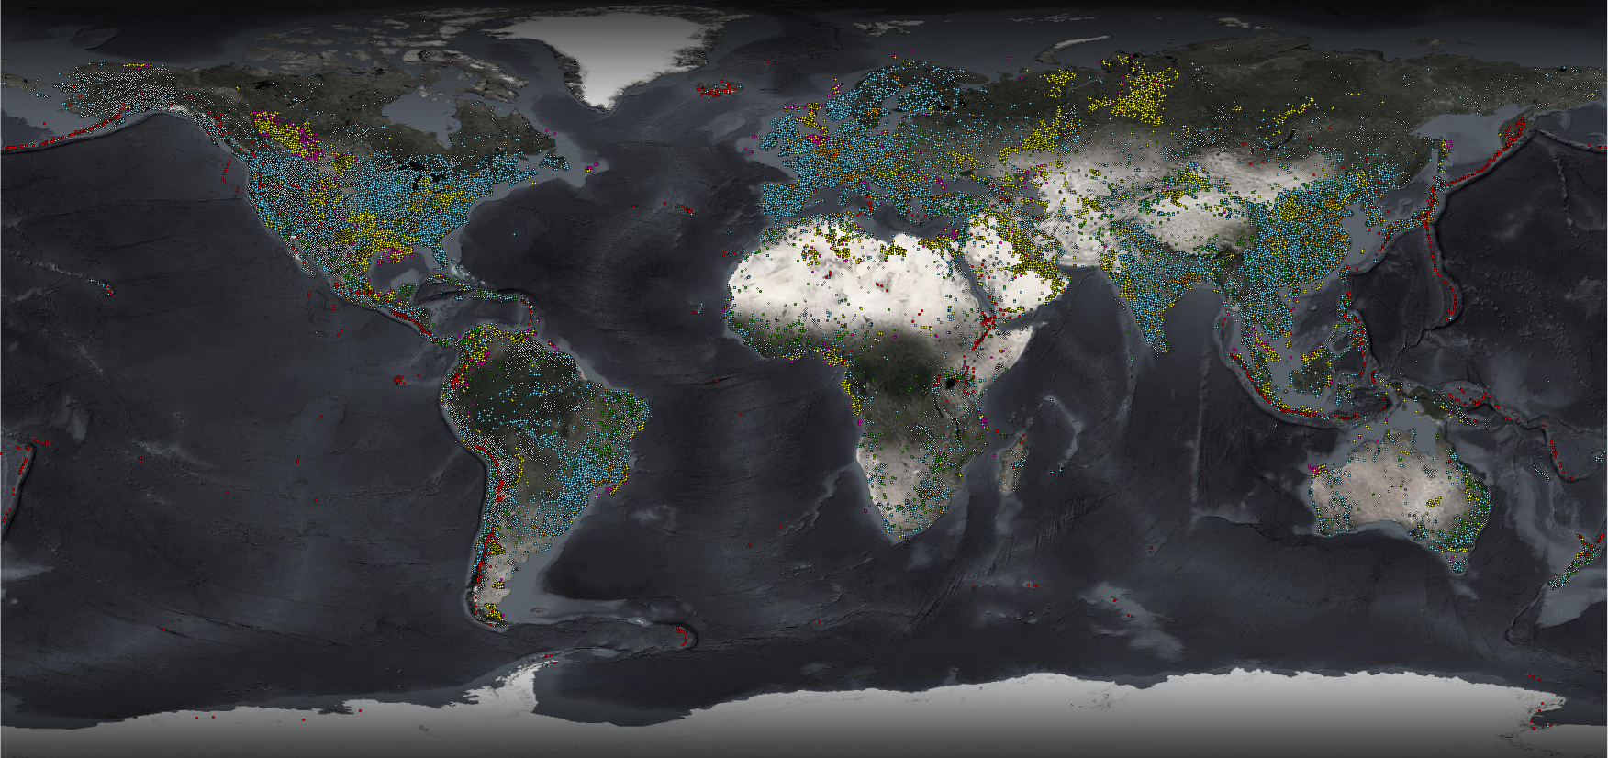
Potential Persistent/Semi-Persistent Anomaly Locations
Volcanoes
Aim to enable users to filter on persistent/semi-persistent anomaly locations by identifying thermal anomalies that may be associated with industrial activities and natural features
Gas Flares
Petroleum Extraction/Processing
Power Plants (including solar)
Steel Plants
Mineral Extraction/Processing
Photovoltaic Plants
(Unfiltered data)

Slide 20
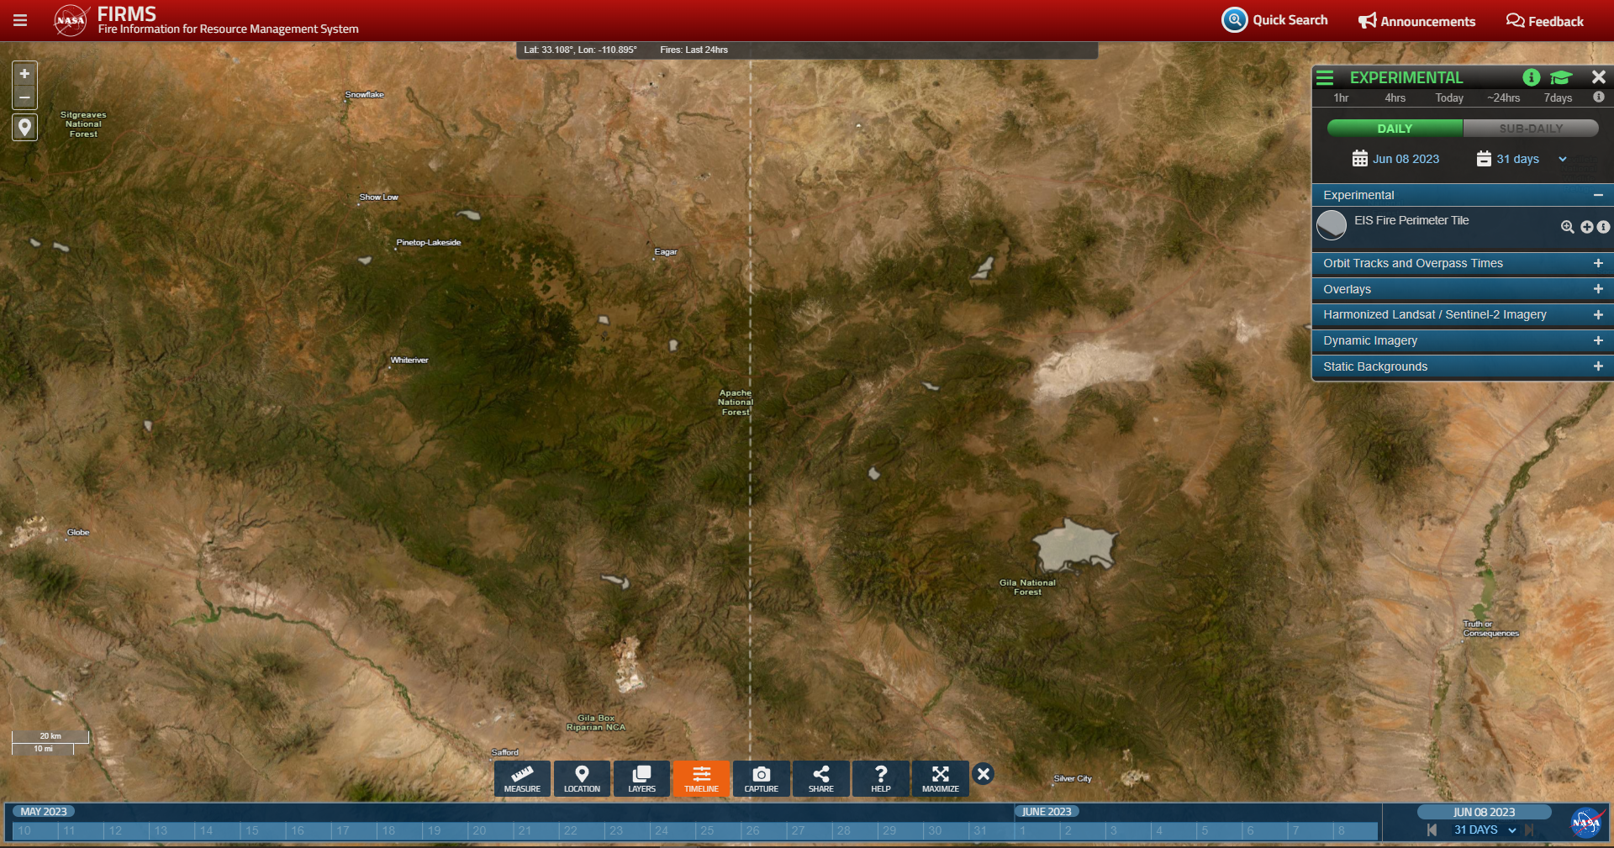
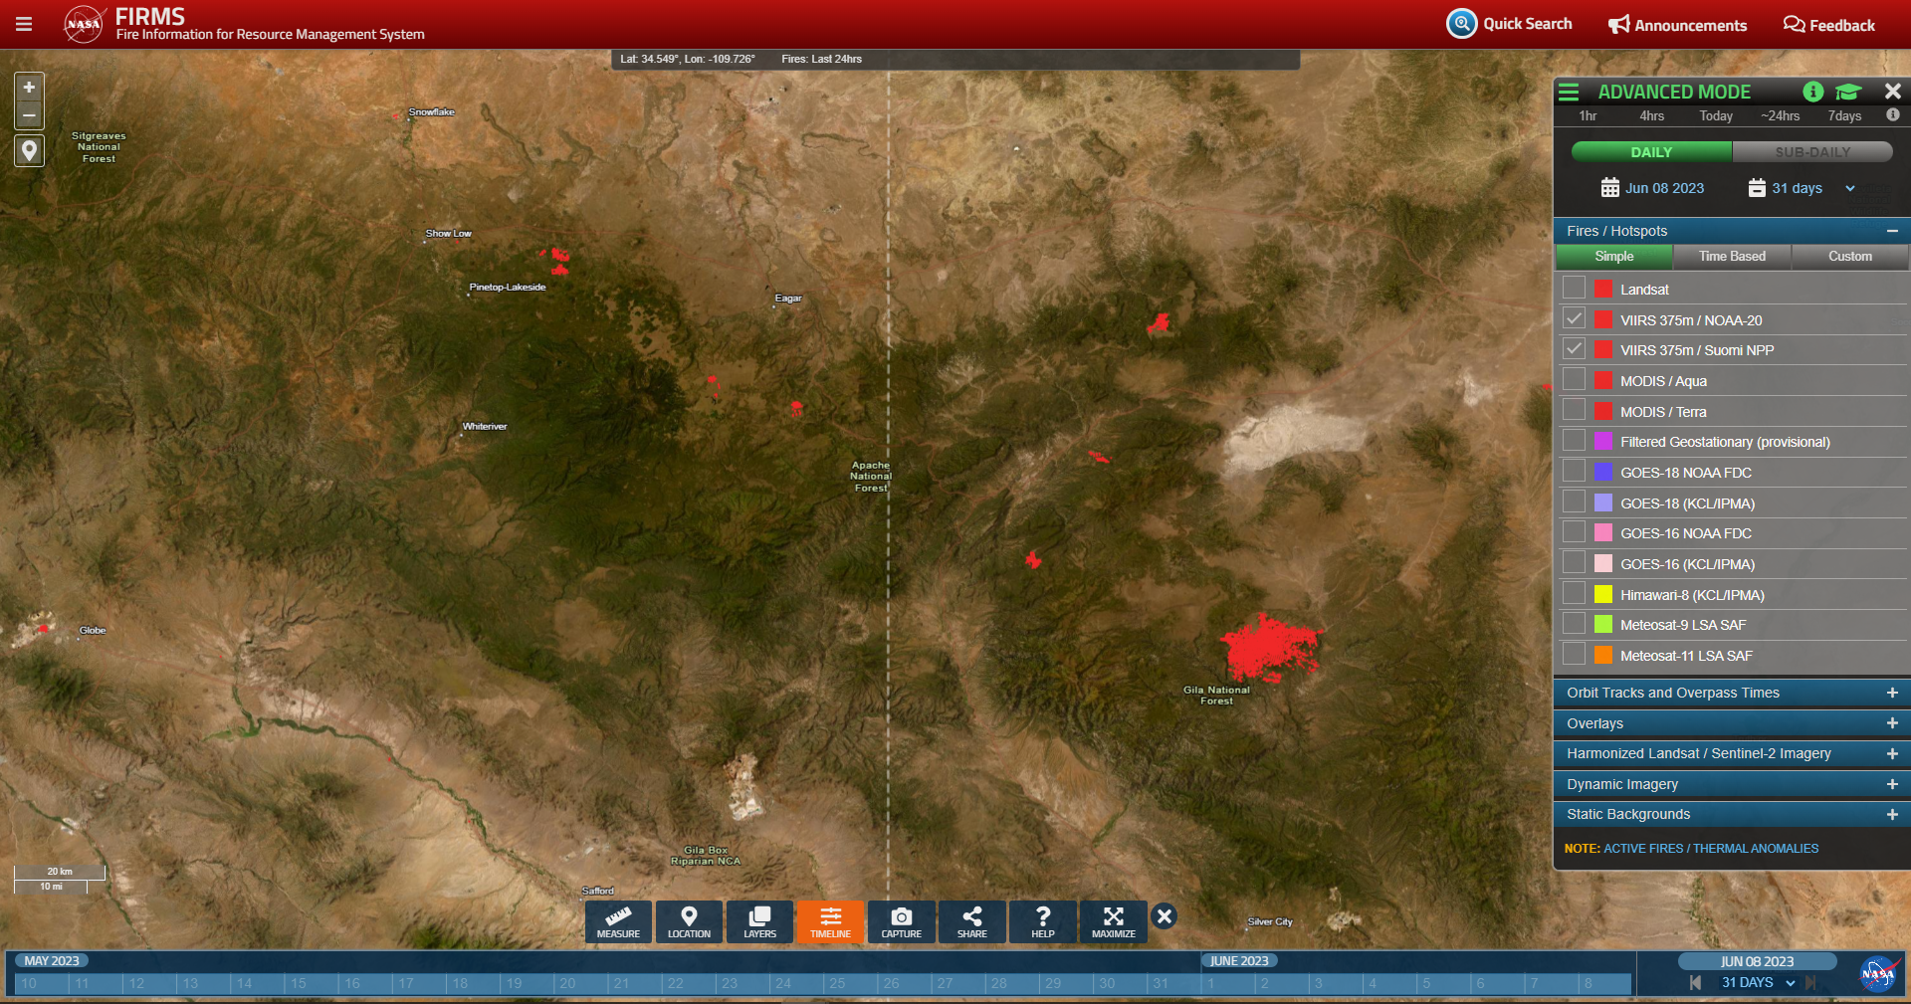
FIRMS: Experimental Products
Mogollon Rim
Eastern Arizona/Western New Mexico
June 8, 2023
MODIS/VIIRS Fire Detections for Past 31 Days
2023 NASA EIS Fire Perimeters
Access to Prototype Data Products
Modeled FirePerimeter Product (Tess McCabe and Eli Orland):
Provided only for the US
Derived from SNPP and NOAA-20 VIIRS active fire detections (375m)
Clustering of active fire detections to approximate area burned
Cumulative product, updated every 12 hours
Provides a time series of fire growth for each incident
Notes:
Earth Information System (EIS)
Example of the FIRMS Experimental product viewer
Allows for evaluation of prototype/experimental products separate from other operational products and avoid minimize misuse.
NASA EIS Fire Products are being considered for integration in FIRMS, including the EIS fire perimeter dataset derived from clustering VIIRS 375m active fire detection data.
Tess McCabe - UMD

Slide 21
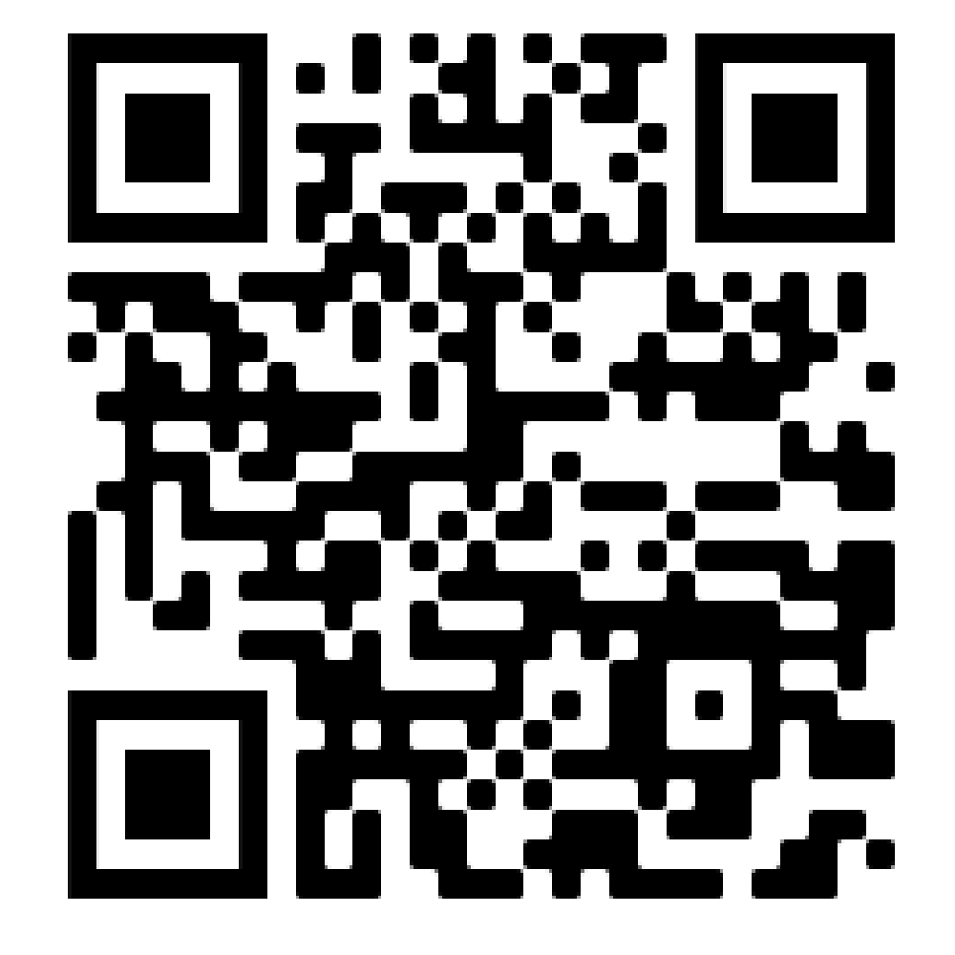
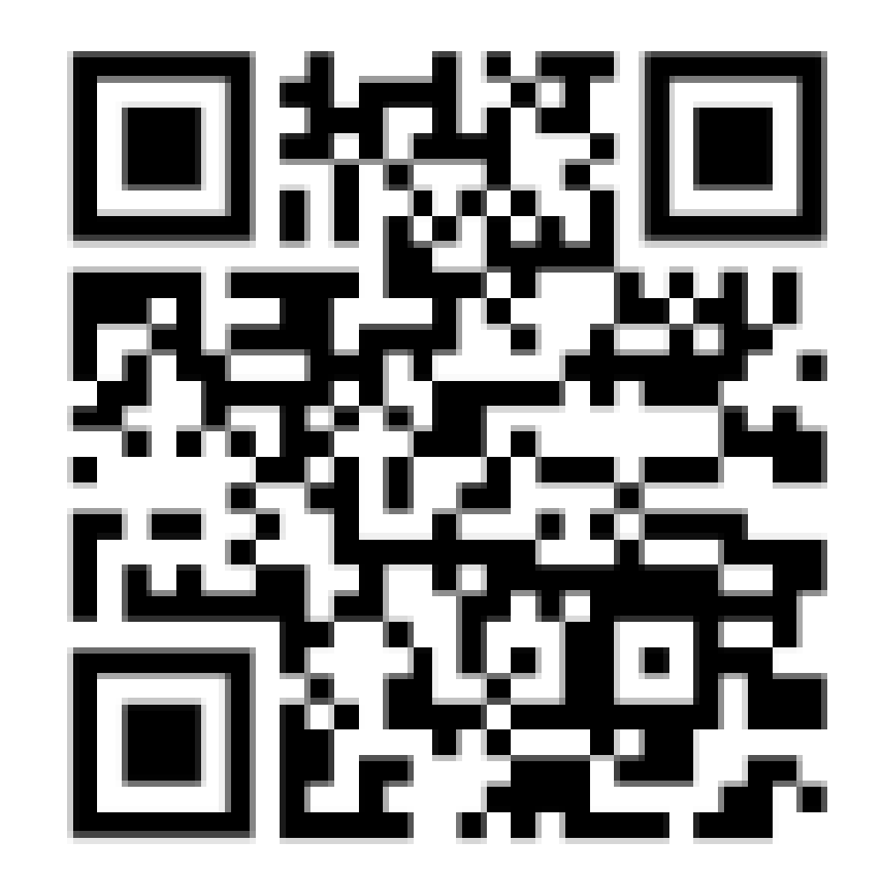
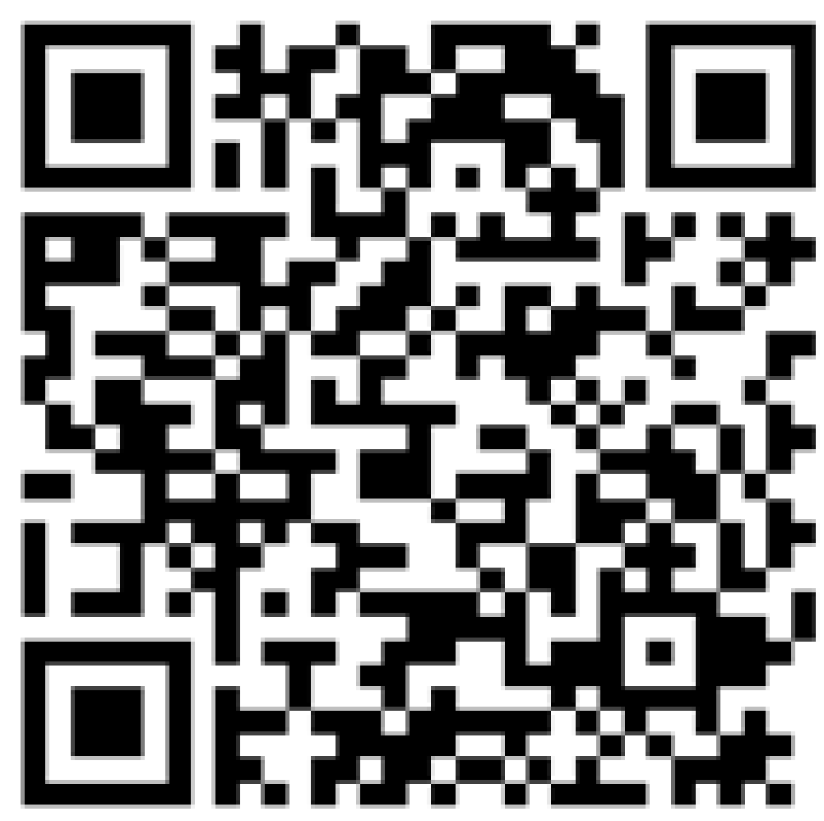
Thank you
More information on FIRMS:
FIRMS US/Canada
FIRMS Global
NASA LANCE

