Slide 1
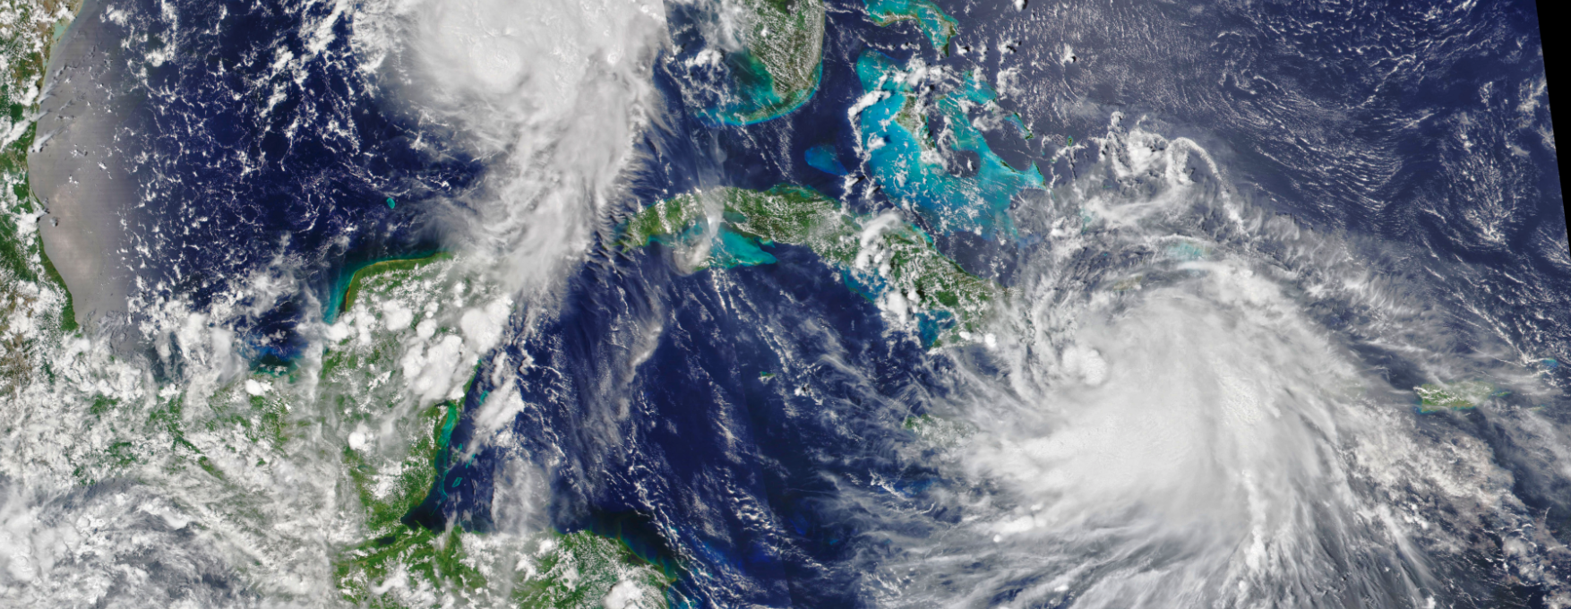
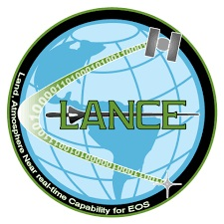
LANCE – NASA’s Land, Atmosphere Near Real-time Capability for EOS
User Working Group Meeting Nov 9-10, 2022
Sentinel 3 Pilot Study

Slide 2
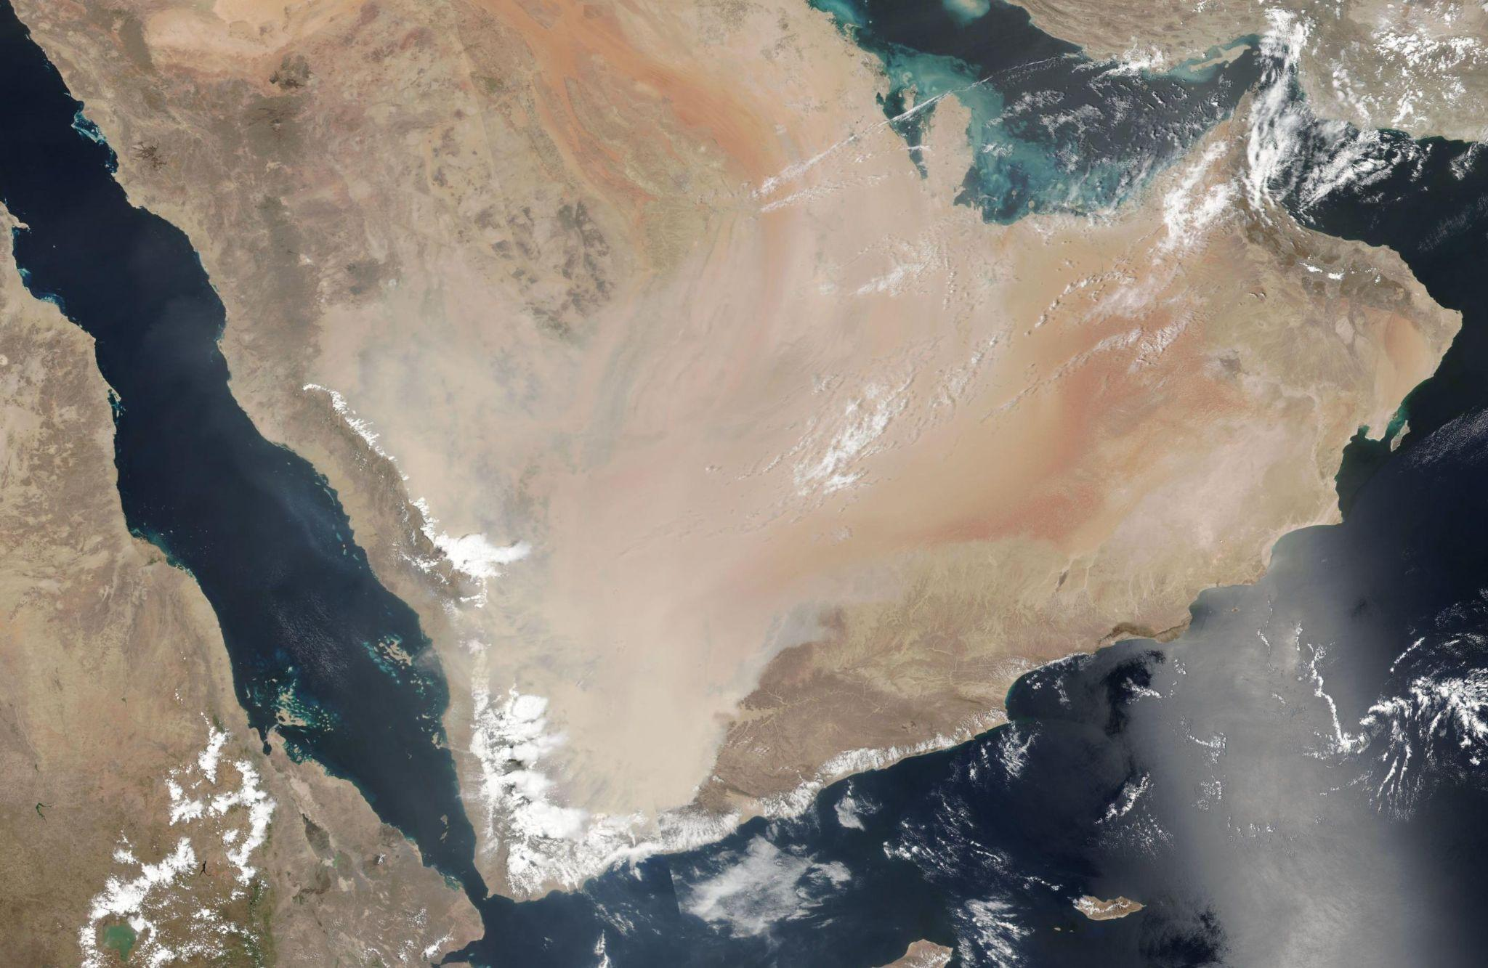

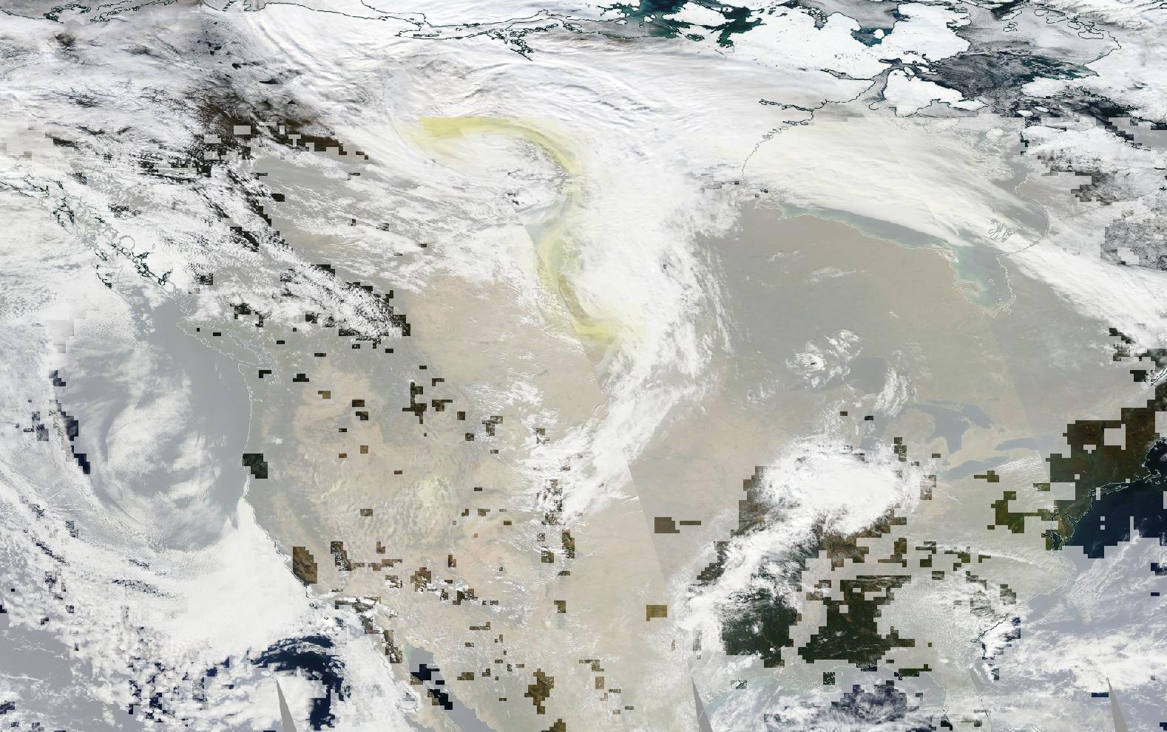
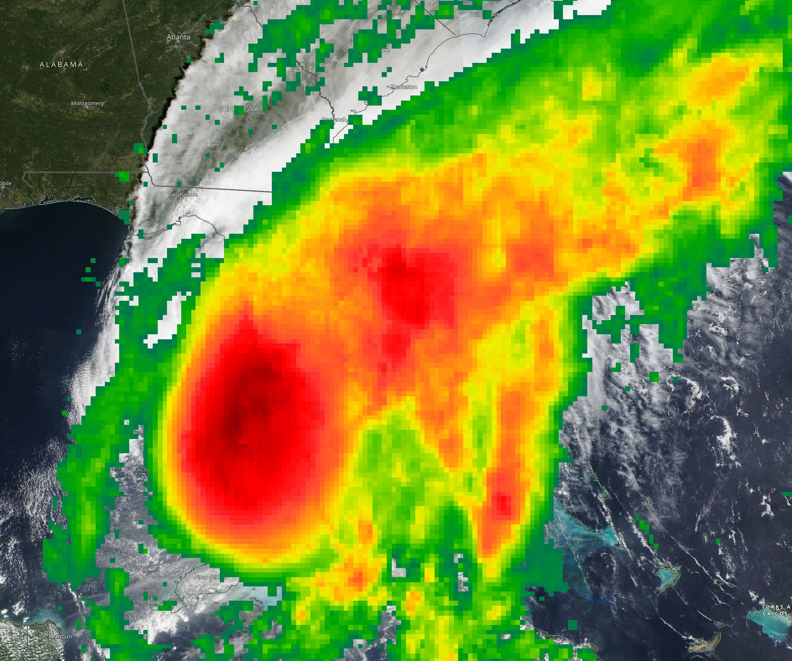
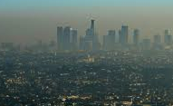
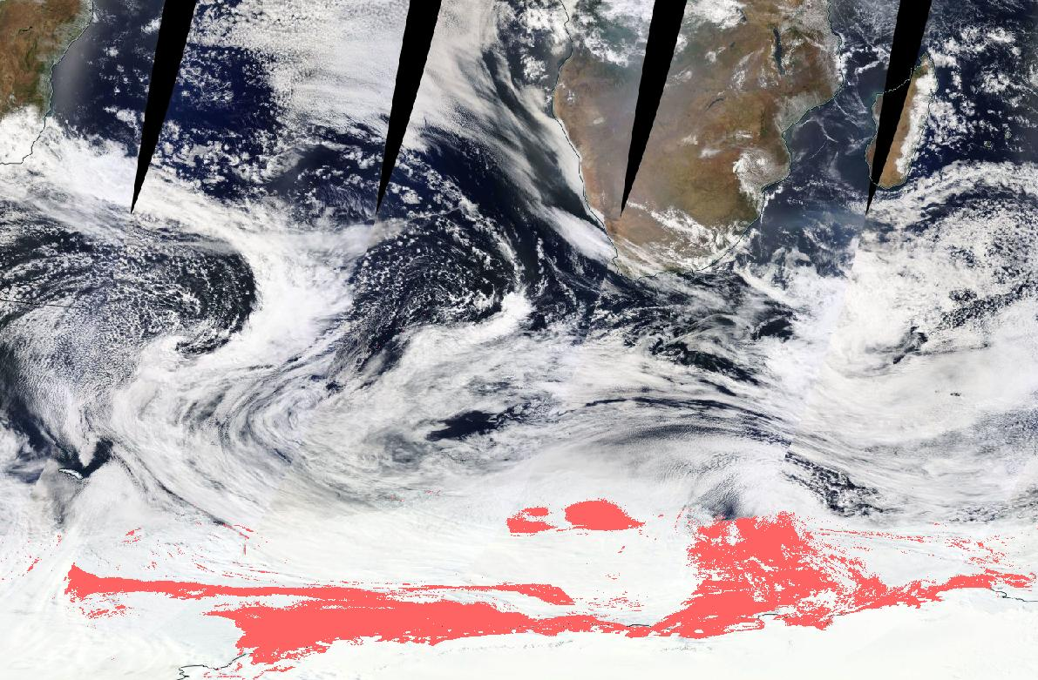
Sentinel 3 Pilot Study (part 1)
Participants:
  Louis Giglio, Eric Vermote, Sadashiva Devadiga, Diane Davies, Ryan Boller, Miguel Román, Jenny Hewson, Robert Wolfe, Chris Justice, Dawn Lowe, Karen Michael
Primary Goal:
  Demonstrate the use of Sentinel-3 data to ensure continuity for Terra-AM MODIS
Notes:
https://commons.wikimedia.org/wiki/File:Smog_descends_on_Wuhan,_Hubei,_China.jpg
https://commons.wikimedia.org/wiki/File:Northwest_Crown_Fire_Experiment.png
https://commons.wikimedia.org/wiki/File:Barley_field-2007-02-22(large).jpg
https://commons.wikimedia.org/wiki/File:2020_Hyderabad_floods.jpg
https://commons.wikimedia.org/wiki/File:Sandstorm_in_Al_Asad,_Iraq.jpg
https://commons.wikimedia.org/wiki/File:Dry_mother_earth.jpg

Slide 3
Sentinel 3 Pilot Study (part 2)
Study Approach:
  Part 1: Evaluate the application of EUMETSAT S3 Fire products into LANCE FIRMS
    Ingest EUMETSAT NRT SLSTR Fire Radiative Power (FRP) product and evaluate
    Test and evaluate the product’s application in FIRMS
    Provide feedback to EUMETSAT
  Part 2&3: Generate Land Surface Reflectance (LSR) and Corrected Reflectance (CR) Products and evaluate their application in Worldview
    Obtain the S3 SLSTR and OLCI Top of Atmosphere (TOA) products from NSG Hub
      SLSTR (Sea and Land Surface Temperature Instrument) TOA; NRT available from ESA but only standard product is currently available in NSG
      OLCI (Ocean and Land Color Instrument) TOA; NRT currently available in NSG; latency 130-150 min
    Update existing MODIS algorithms to run with S3 data
    Ingest imagery into GIBS and evaluate the products application for Worldview

Slide 4
NASA Terra MODIS Sentinel-3 Continuity Pilot Study
Update on Corrected Reflectance
LANCE UWG – November 2022
Eric Vermote and Sadashiva Devadiga
NASA/GSFC 619
Eric.f.vermote@nasa.gov

Slide 5
Sentinel-3: Continuity to Terra-AM MODIS Corrected Reflectance and Land Surface Reflectance
Evaluate a Sentinel 3A (S3A) and 3B (S3B) NRT L2 Corrected Reflectance (CR) Product to be ingested in LANCE/GIBS/Worldview
Prototype Sentinel 3 standard product for Land Surface Reflectance at SIPS.
Support, as appropriate, program-wide engagement with CEOS WGCV on ESA/NASA Bilateral Activities

Slide 6
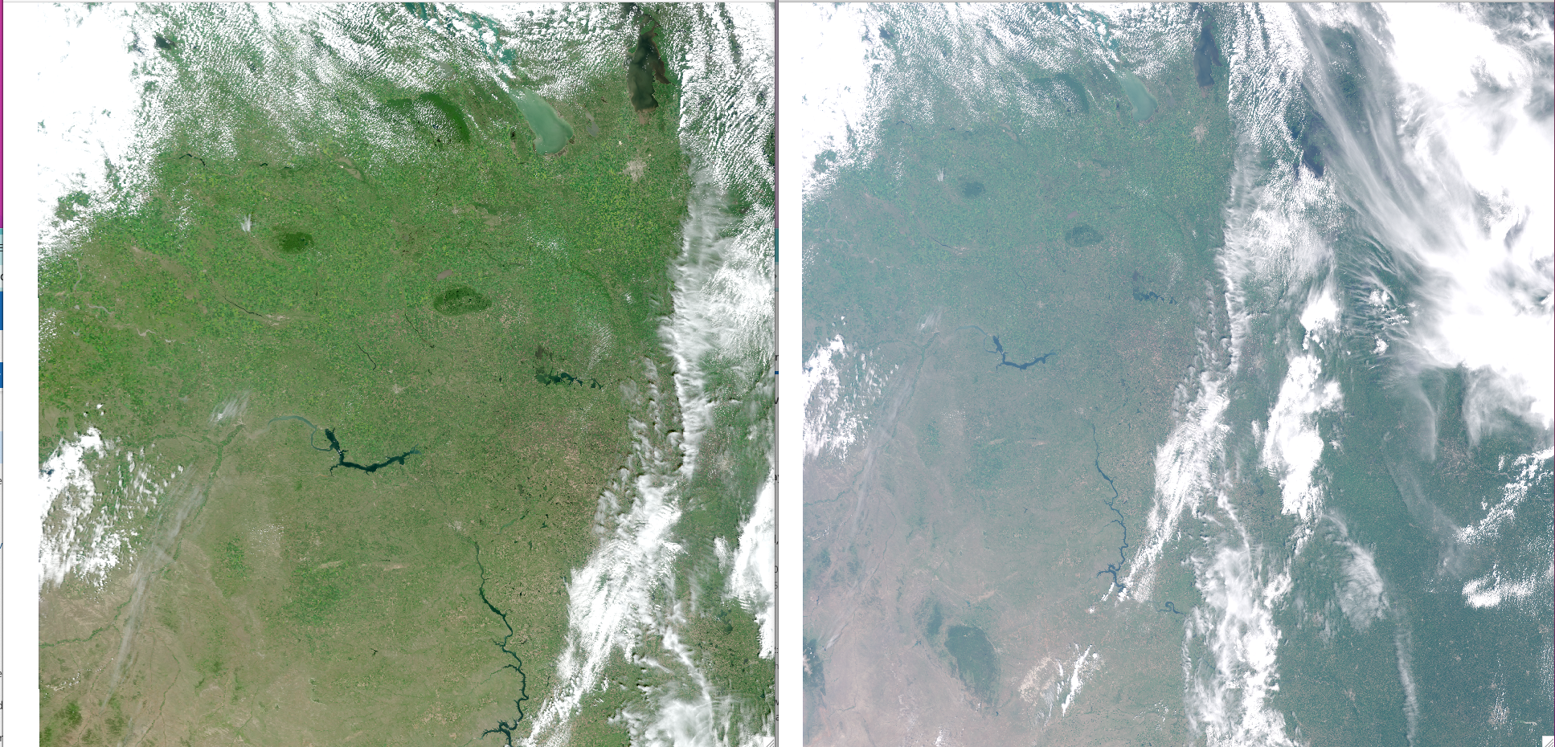
Sentinel 3 Corrected Reflectance (CREFL) Update (E. Vermote)
Two PGE’s, CREFL-O (OLCI), CREFL-S (SLSTR) (L1 inputs netcdf)
  CREFL-O (300m bands R,G,B NIR), almost completed (see example) expected delivery in ~2 weeks.
  CREFL-S (500m bands, R,G,NIR SWIR1 (1.6mic), SWIR2 (2.1mic) needs to be developed but Level 1 of SLSTR and OLCI are compatible in terms of format
Corrected reflectance’s (OLCI)
RGB
Top of the atmosphere reflectance’s (OLCI)
RGB

