Slide 1

NASA LANCE Metrics and Updates
Diane Davies, LANCE Operations Manager
Karen Michael, LANCE Manager
Jenny Hewson, LANCE Outreach & Implementation Manager
LANCE UWG - November 9-10th 2022

Slide 2
Acknowledgements
LANCE Elements
AIRS & MLS – Feng Ding (GSFC)
AMSR2 & ISS LIS - Leigh Sinclair (UHA)
ICESat2 – Lisa Kaiser and Mike Sutherland (NSIDC)
MODIS and VIIRS Land – Sudipta Sarkar (GSFC)
MISR – Ingrid Garcia-Solera and Makan Virdi (LARC)
MOPITT – Dan Ziskin (UCAR)
OMI & OMPS – Phil Durbin (GSFC)
SMAP – Nga Chung /Lala Pashaian (JPL) and Mike Sutherland (NSIDC)
VIIRS Atmosphere – Jess Braun (Atmosphere SIPS, Univ Wisconsin-Madison)
Earthdata / Worldview – Ryan Boller / Minnie Wong (ESDIS)
LANCE – Applied Sciences Coordinator – Tian Yao (GSFC)
FIRMS
Otmar Olsina, Greg Ederer, Asen Radov (MODAPS / NASA GSFC)
Brad Quayle (USFS)
Louis Giglio, Joanne Hall (University of Maryland)

Slide 3
METRICS AND USE

Slide 4
Higher latencies are due to issues related to system mount failure, upgrades, incorrect coefficients, and delays in receiving data from EDOS
Notes:
Does not include ICESat-2 or SMAP

Slide 9
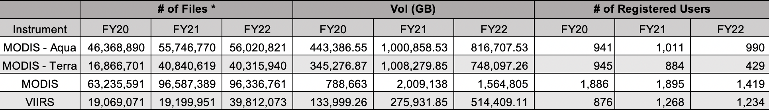
Yearly LANCE NRT Data Distribution by MODAPS NRT for MODIS and VIIRS Instruments
Note: VIIRS data from S-NPP and JPSS was combined together

Slide 10
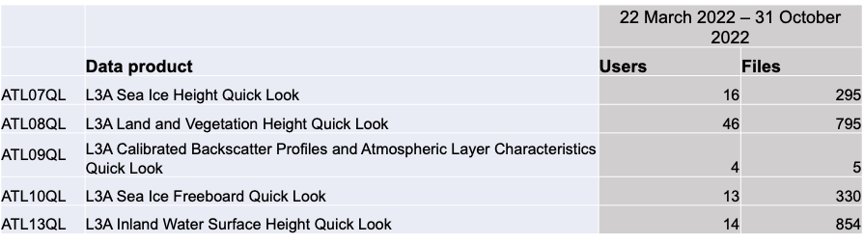

ICESat-2 Metrics
Country | Distinct Users
United States | 38
China | 28
India | 11
United Kingdom | 4
Canada | 4
Near Real Time/Quick Look Products
22 March 2022 – 31 October 2022
86 registered usernames of 5 available products
2,279 science file downloads
Users from 20 countries

Slide 11
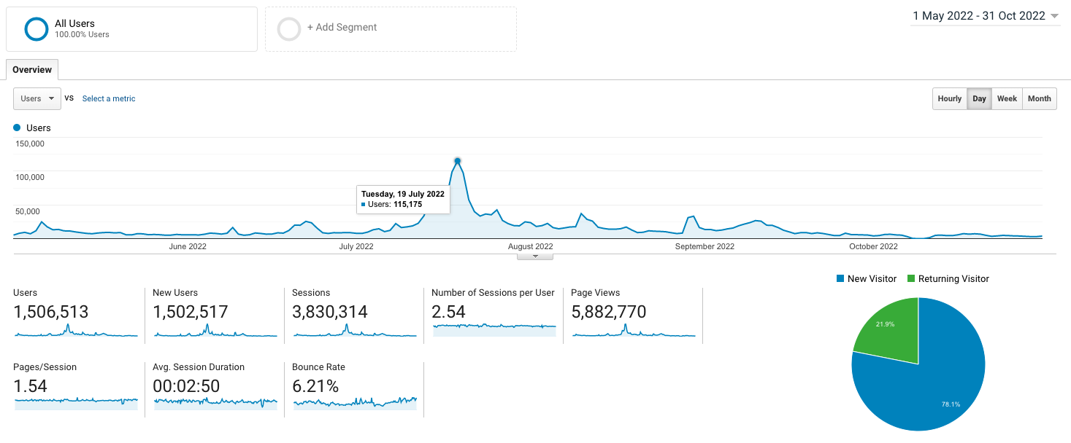
Google Analytics for all LANCE Web Pages including FIRMS: 1 May – 31 Oct 2022
Fires in Europe
Fires in Pacific NW
War in Ukraine
By Device:
57.6% mobile
39.94% desktop
2.46% tablet
Notes:
More users access LANCE web pages via mobile and tablet

Slide 12
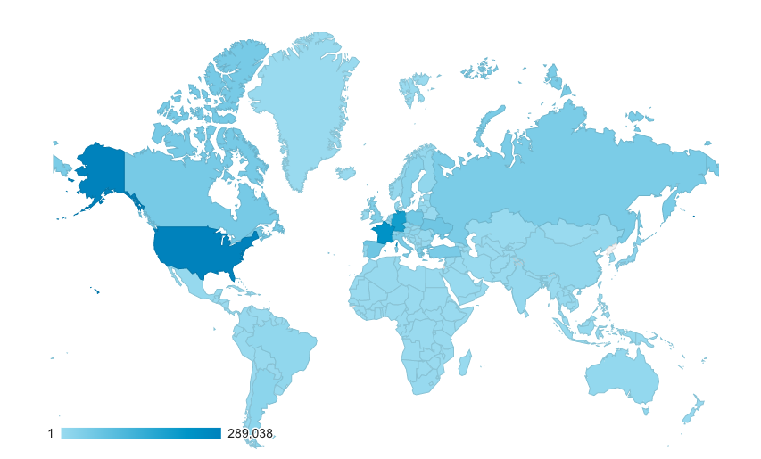
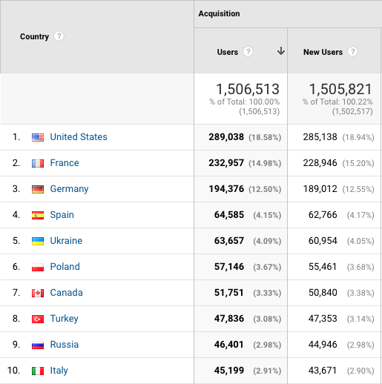
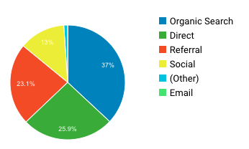
Google Analytics for all LANCE Web Pages including FIRMS: 1 May – 31 Oct 2022
Distribution of Users by Country
Notes:
26% email referral
23% referral
13 % social media

Slide 13
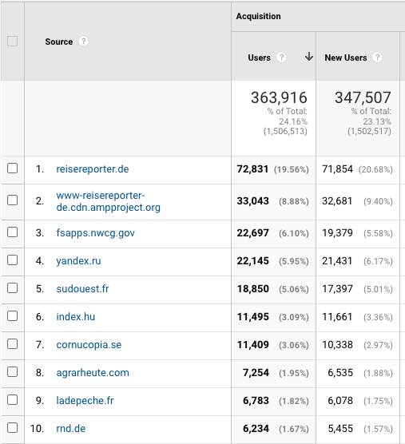
TRAFFIC SOURCES
TRAFFIC SOURCES
Accounts for 23% of users visiting LANCE

Slide 14

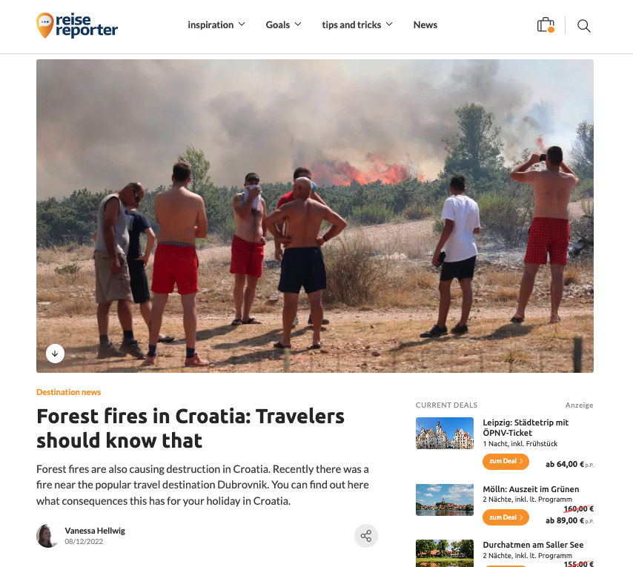
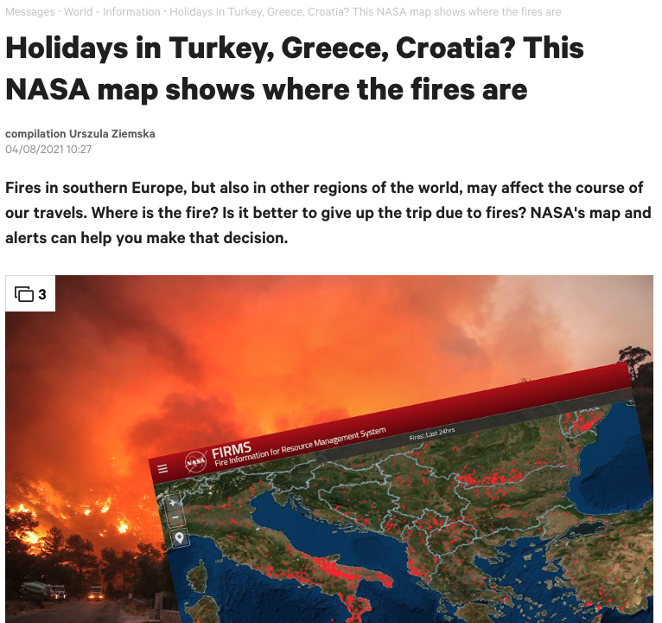
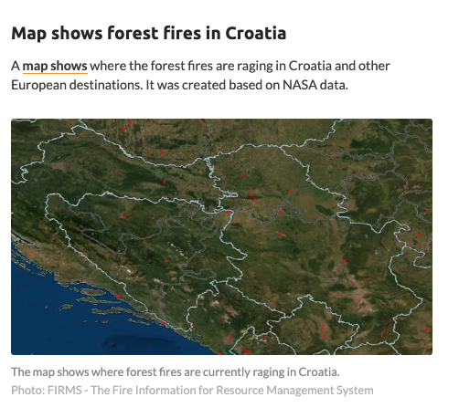
Notes:
https://www.reisereporter.de/artikel/15479-waldbraende-in-kroatien-wo-brennt-es-sind-urlaubsorte-betroffen
https://next.gazeta.pl/next/7,172392,27431132,plonaca-planeta-rekordowy-sezon-pozarow-krwawe-niebo-nad-europa.html

Slide 15
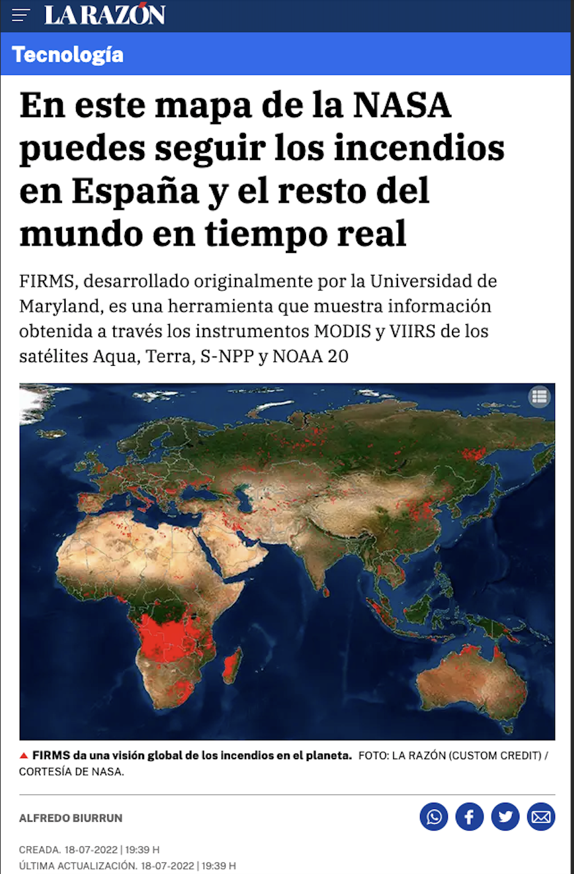
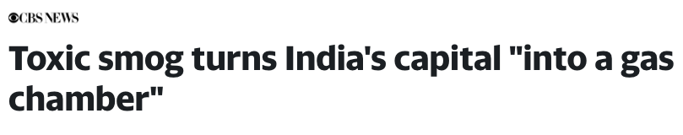
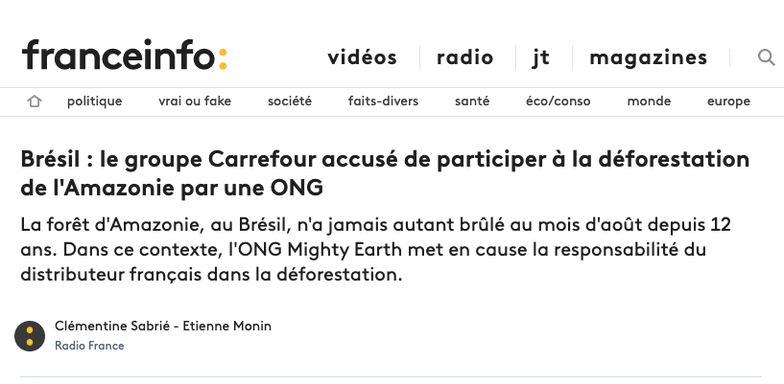
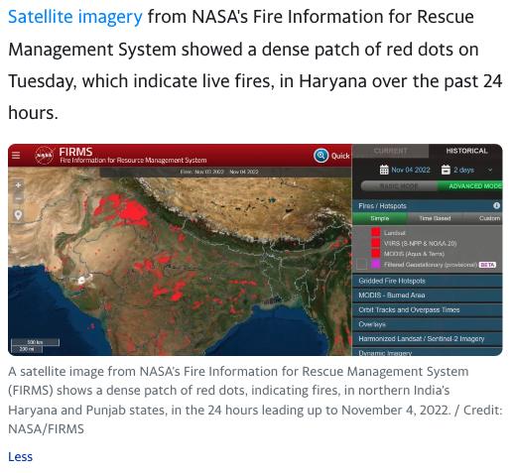
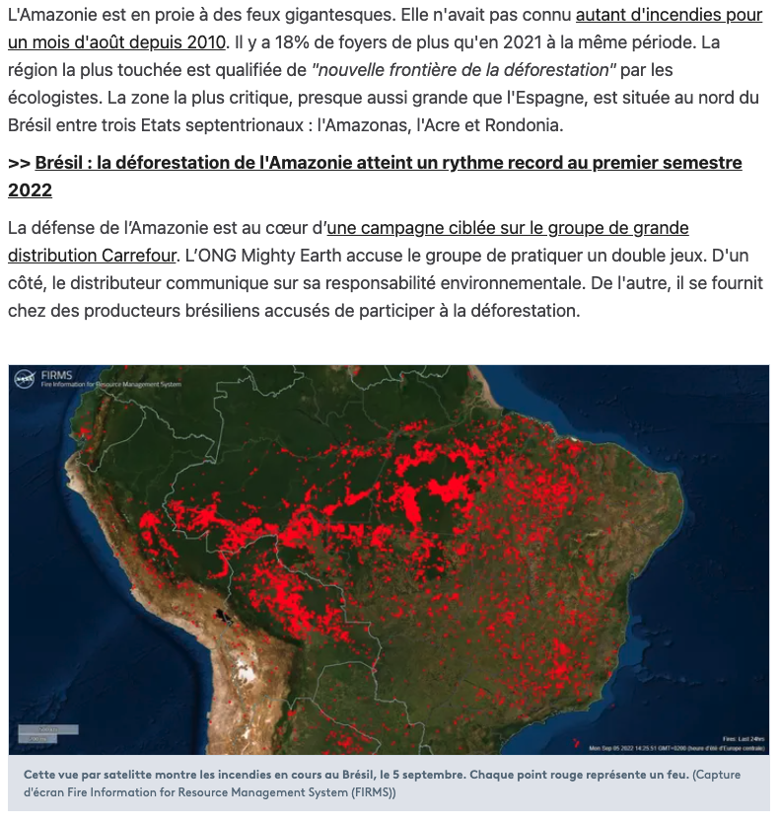
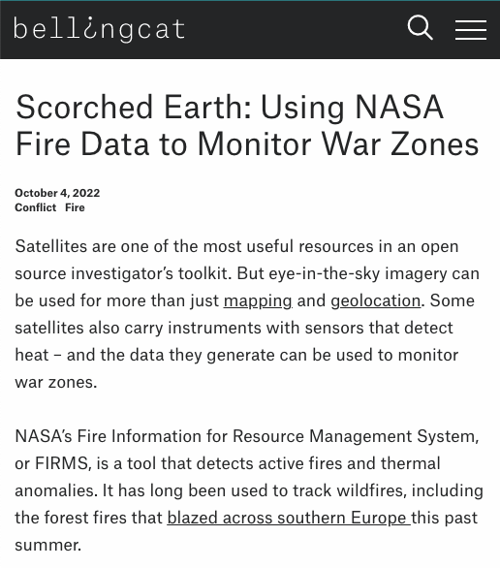
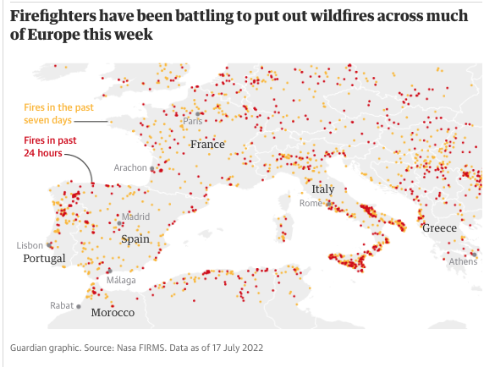
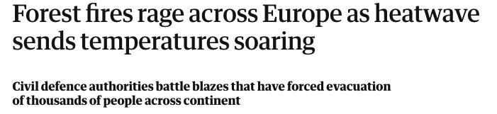
Notes:
https://sports.yahoo.com/toxic-smog-turns-indias-capital-103300104.html
https://www.bellingcat.com/resources/2022/10/04/scorched-earth-using-nasa-fire-data-to-monitor-war-zones/
https://www.francetvinfo.fr/monde/ameriques/amazonie/bresil-le-groupe-carrefour-accuse-de-participer-a-la-deforestation-de-l-amazonie-par-une-ong_5343472.html
https://www.theguardian.com/world/2022/jul/17/forest-fires-rage-across-europe-as-heatwave-sends-temperatures-soaring
https://www.sudouest.fr/gironde/incendies-en-gironde-comment-suivre-en-temps-quasi-reel-la-progression-du-feu-grace-aux-satellites-11647237.php

Slide 16
UPDATES FROM LANCE ELEMENTS

Slide 17
Plan for LANCE MLS Algorithm Update
The Aura Microwave Limb Sounder (MLS) team is finalizing an upgrade to the MLS Near-Real-Time (NRT) data processing system that will give improved versions of the O3, CO, and SO2 products. SO2 is intended for near-real-time volcano detection.
based on a neural network trained on 17 years of MLS v5 production level 2 processing calculation
more accurate than prior NRT algorithms, which relied on radiative transfer calculations that included significant approximations necessitated by meeting the NRT latency requirement
better captures features such as strong horizontal gradients, and significantly reduces data latency
Timeline:
New algorithm ready and updating documentation work on-going
Release date TBD
Slide courtesy of Feng Ding (NASA GES-DISC)
Notes:
MLS science team updated algorithms to provide improved NRT versions of the O3, CO, and SO2 (for near-real-time volcano detection)
The Aura Microwave Limb Sounder (MLS) team is finalizing an upgrade to the MLS Near-Real-Time (NRT) data processing system that will give improved versions of the O3, CO, and SO2 products (the latter intended for near-real-time volcano detection). Initially the ST said that new NRT version would lead to the discontinuation of NITRIC ACID HNO3 and NITROUS OXIDE N2O products (which were previously included mainly to aid retrievals of other species) but they have decided these products will continue to be produced. So if you heard they were going away and were concerned – this has now changed and our understanding is they will continue.

Slide 18
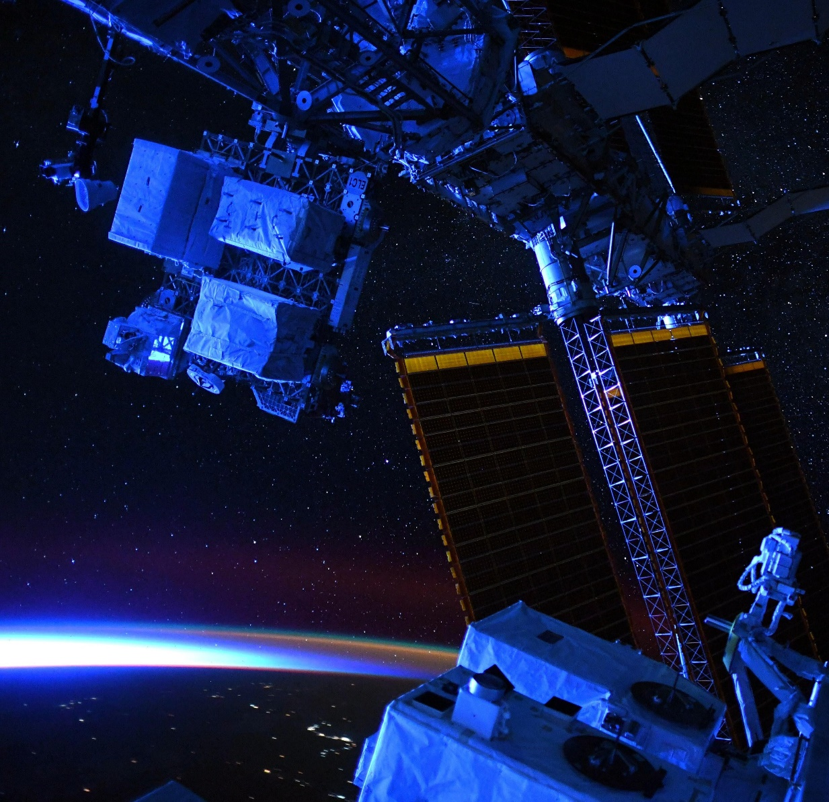
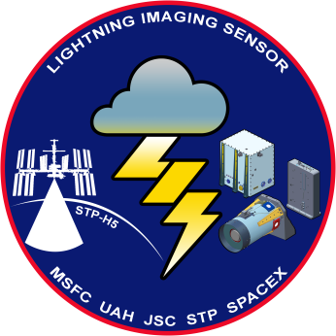
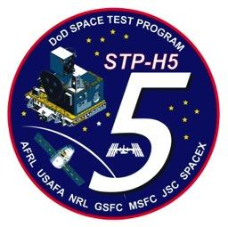
NRT ISS LIS Status
ISS LIS was relocated on the ISS in June 2022
Version 2.2 NRT ISS LIS data available since October 18, 2022 at: https://lance.nsstc.nasa.gov/
  Improvements included in version 2.2 data:
    Refined the pointing code to >2 km for the new ISS location
    Updated various LIS pointing parameters
    Can handle R24 changes to the BAD file
ISS LIS will continue operations until at least late 2023
Slide courtesy of Leigh Sinclair (UHA)

Slide 19


VIIRS Atmosphere Updates
Updates to both Aerosol products
  New version of Dark Target (Production and NRT) anticipated 4Q 2022.
    Includes release of NOAA-20 products.
  New version of Deep Blue (Production) anticipated 4Q 2022.
    Includes release of NOAA-20 products.
Access to Atmosphere SIPS LANCE products: https://earthdata.nasa.gov/earth-observation-data/near-real-time/download-nrt-data/viirs-a-nrt
Slide courtesy of Jess Braun (SSEC / University of Wisonsin-Madison)

Slide 20
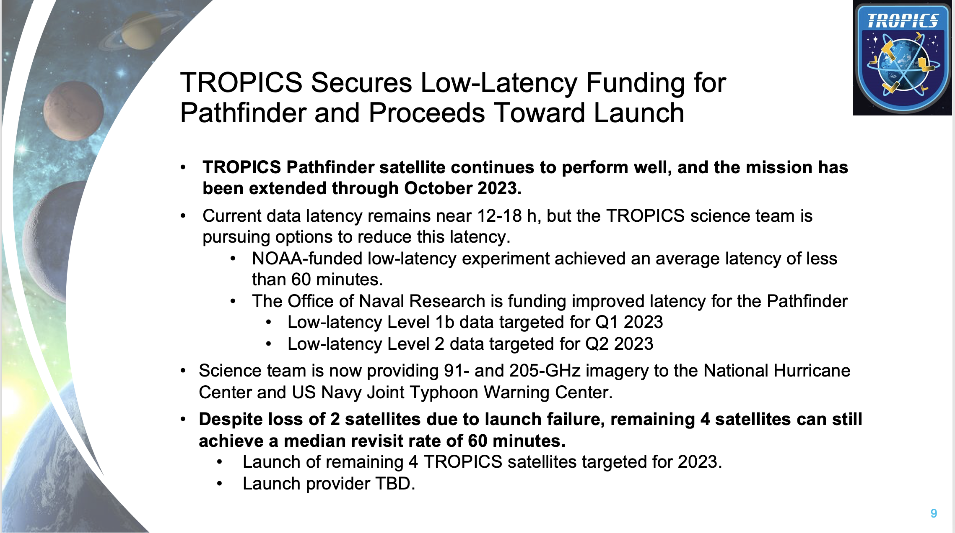
Slide courtesy of David Green / Tian Yao (NASA Applied Sciences)

Slide 21
TROPICS Updates
Project is working towards a public release of the Pathfinder data estimated for 1Q 2023.
  If interested in becoming a TROPICS early adopter, contact Patrick Duran patrick.t.duran@nasa.gov
Refer to this site for additional information and updates: https://tropics.ll.mit.edu/CMS/tropics/latest-news-and-updates
Slide courtesy of Jess Braun (SSEC / University of Wisconsin-Madison)

Slide 22
Joint Communications Efforts: EOSDIS/LANCE
May 5, 2022– November 8, 2022
  Feature Articles/Announcements
  Social Media
  Video Tutorials
  EOSDIS Quarterly Update Newsletter
MEETINGS
ICAP Meeting – October 2022
Global Flood Partnership Meeting, Leeds – October 2022
FIRMS was presented at the SED Directors 610 monthly webinar
Training was provided to the Columbian National Directorate of Fire Fighters
as part of Advancing Satellite Applications for Disaster Risk Reduction
& NRM workshop). Karyn Tabor (NASA GSFC) with funding from Applied Sciences
OUTREACH

Slide 23
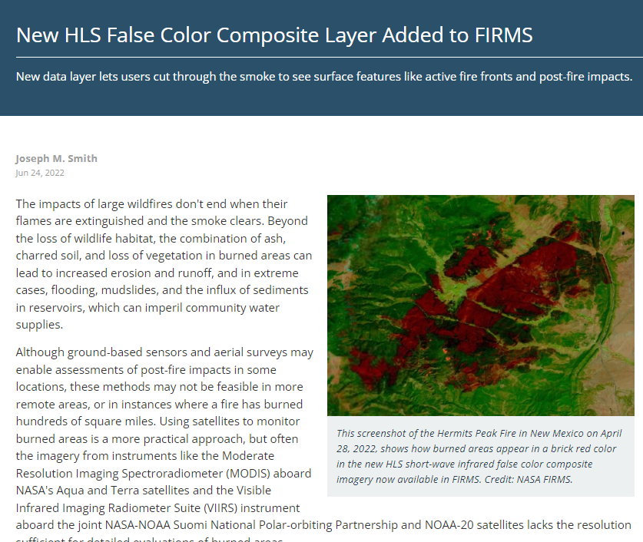
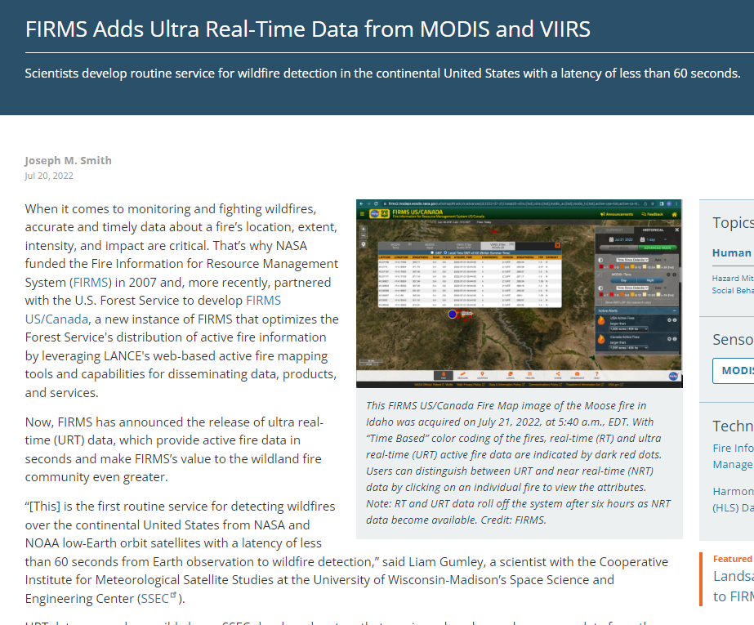
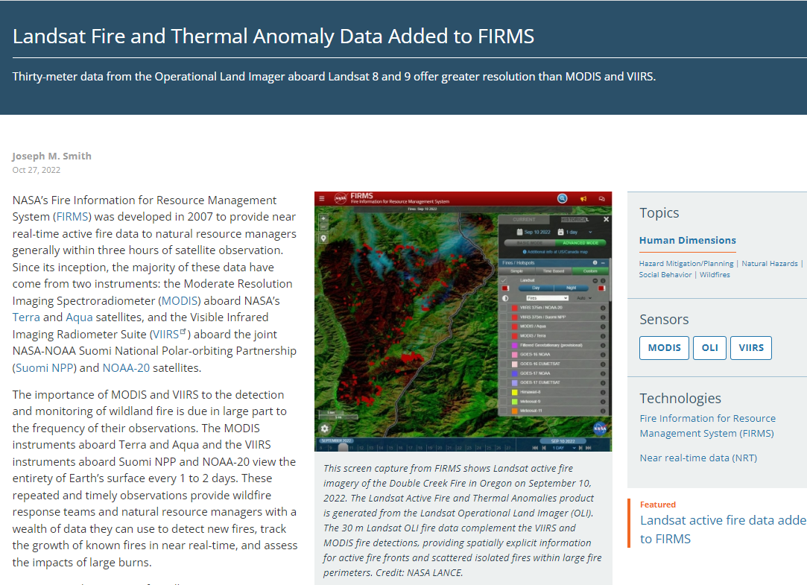
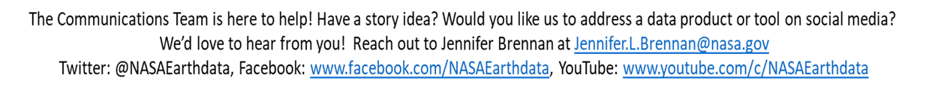
Feature Articles
Published 6/24/22: https://go.nasa.gov/3Ujbwqk
Published 7/20/22: https://go.nasa.gov/3fMMSz9
Published 10/27/22
https://go.nasa.gov/3tehGvV
Slide courtesy of Jennifer Brennan NASA ESDIS

Slide 24
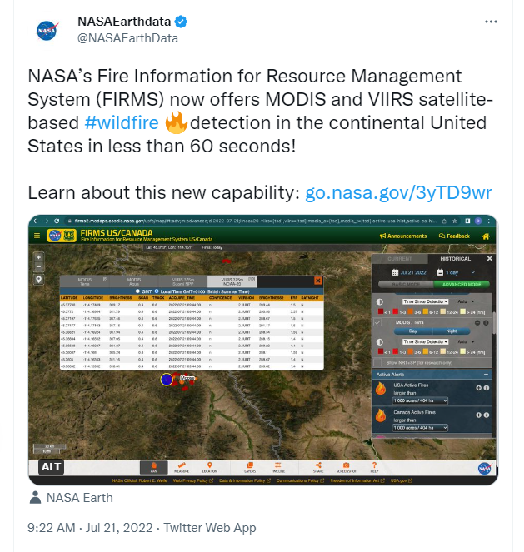
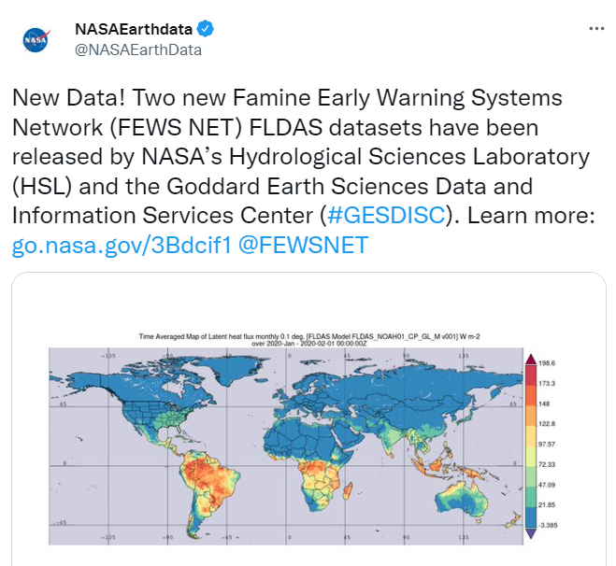
Social Media- Twitter (@NASAEarthdata) and Facebook
Time period: 5/4/22 – 11/8/22
6 LANCE-specific/related tweets announcing new data products or data service updates (Note: Metrics pulled on 11/8/22)
72,517 Impressions
1,124 Engagements
10 LANCE/FIRMS-specific or related Facebook posts announcing new data sets or tool capabilities.
Total Post Impressions 39,776, Post Reach 38,913, and Post Engagements 2,157
NASA Earthdata Facebook Account
www.facebook.com/NASAEarthdata
Highest Number Impressions
59,065 Impressions, 615 engagements
Posted 7/20/22
https://twitter.com/NASAEarthData/status/1550108873952051200
*Note: Also cross-promoted on the NASA Earth flagship account.
Highest Engagement Rate
6.7% Engagement Rate, 1,190 Impressions
80 Engagements
Posted 7/18/22
https://twitter.com/NASAEarthData/status/1549122395050475528
Slide courtesy of Jennifer Brennan NASA ESDIS

Slide 25

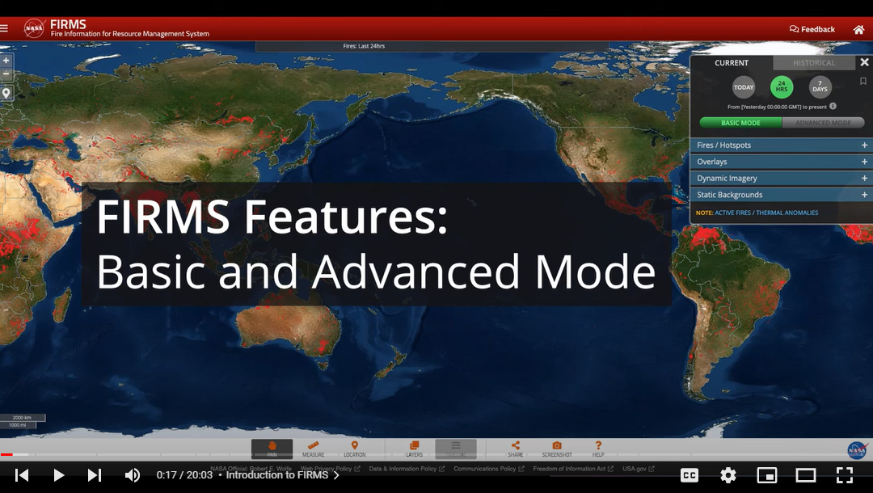
NASA Earthdata YouTube Metrics
# 1 Video!
How to Use NASA’s Fire Information for Resource Management System (FIRMS) (5/4-11/8/22)
NASA Earthdata YouTube Channel
www.youtube.com/c/NASAEarthdata
9.81 K Subscribers
Over 150 data discovery and access webinars
More than 30 short data tutorial videos
Playlists include the annual Earthdata webinars dating back to 2013, Earth System Observatory (ESO) Mission: Data Processing Study Workshops, Earthdata GIS Resources, Commercial Smallsat Data Acquisition Program webinars, EO Dashboard Hackathon videos and more!
Quick Stats:
5,683 Views since published (5/10/22)
268 hours of watch time (that is significant considering the length of the video)
Slide courtesy of Jennifer Brennan NASA ESDIS

Slide 26
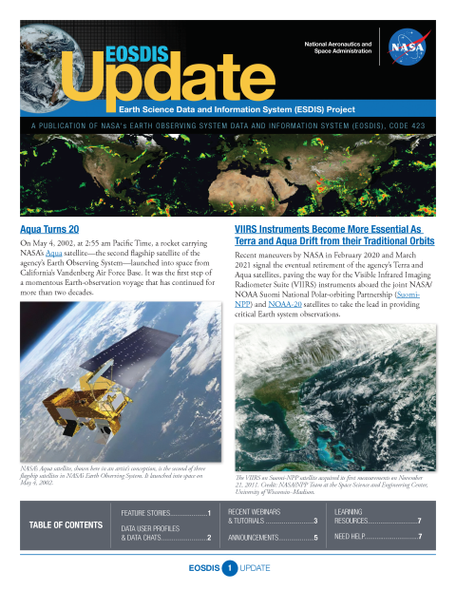
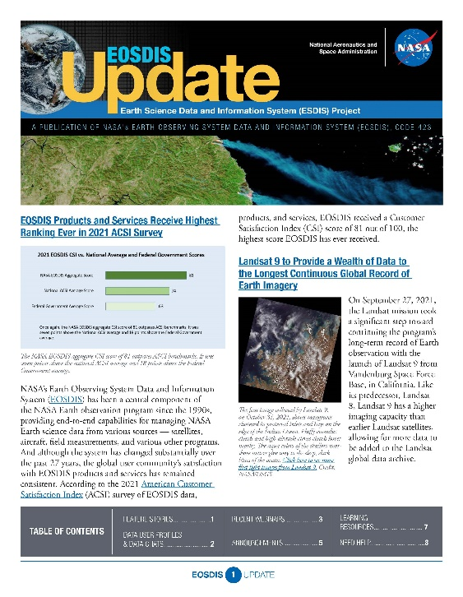
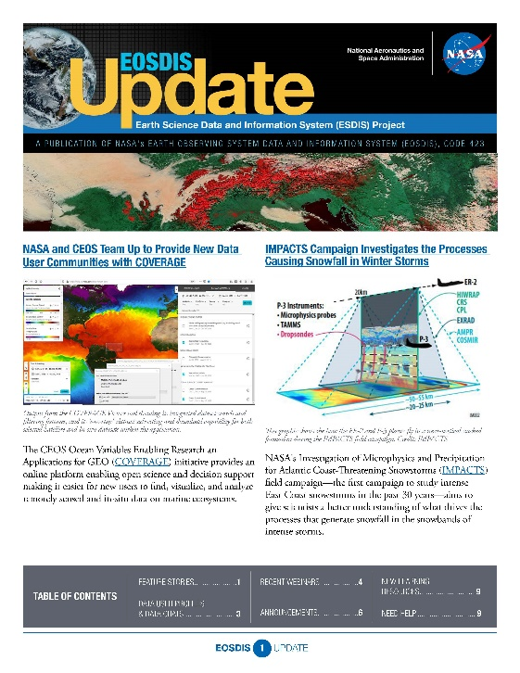
Other Efforts
EOSDIS Quarterly Newsletter
DAAC specific data announcements, data tutorials and data recipes, webinars and data user profiles appear in each quarterly newsletter.
https://earthdata.nasa.gov/learn/user-resources/eosdis-newsletter
*Note: Our final quarterly newsletter was just released on June 30th. Beginning in July, all of the webinar, dataset and data tool news, Data User Profiles, feature articles, etc. appear in the ESDS program newsletter, “Earthdata Discovery”
To sign-up: https://www.earthdata.nasa.gov/subscribe
Slide courtesy of Jennifer Brennan NASA ESDIS

Slide 27
BACK UP SLIDES

Slide 28
Notes:
We think the decrease in # of users may be due to discontinue of MODIS (TERRA/AQUA) collection 5.

Slide 29
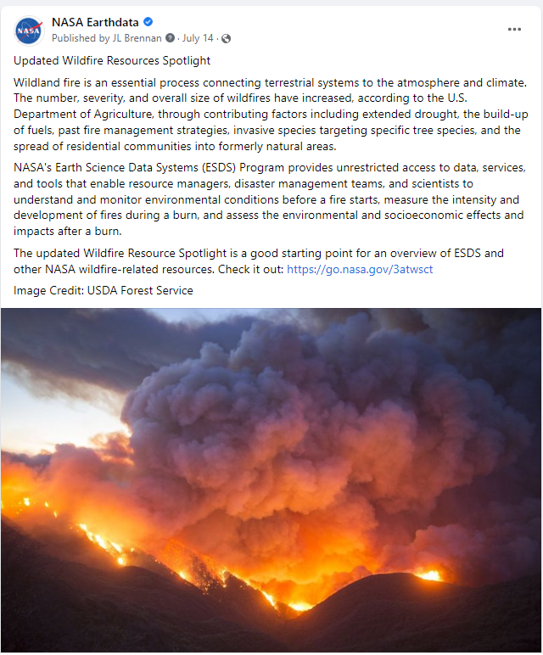
Social Media- Earthdata Facebook
Time period: 4/08/22 - 11/8/22*
10 LANCE/FIRMS-specific or related posts announcing new data sets or tool capabilities.
Total Post Impressions 39,776, Post Reach 38,913, and Post Engagements 2,157
NASA Earthdata Facebook Account
www.facebook.com/NASAEarthdata
55,363 Followers on 11/8/22 (Pulled at 1:50 PM ET)
Facebook Metrics
The FIRMS or FIRMS/US Canada posts tend to have a much higher engagement rate (on average) than most posts, particularly when we provide tutorials, imagery, and information about specific fire events.
We welcome more of this!
Highest Performing Post: Impressions
Topic: Updated Wildfires Resource Spotlight
13,606 Post Impressions, 13,429 Post Reach, 1,026 Post Engagements
* Did not include FB metrics for the May 2022 UWG meeting
Slide courtesy of Jennifer Brennan NASA ESDIS

Slide 30

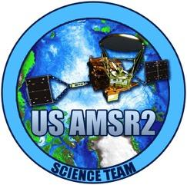
LANCE AMSR2 / ISS LIS
Leigh Sinclair (leigh.sinclair@uah.edu)
Presented at the LANCE UWG
November 9-10, 2022

Slide 31
AMSR NRT Data Metrics
Volume of Data Downloaded
NRT AMSR2 Unified L2B Global Swath Ocean Products
NRT AMSR2 Unified L3 Daily 6.25 km Polar Gridded 89 GHz Brightness Temperatures
NRT AMSR2 Unified L3 Daily 12.5 km Brightness Temperature & Sea Ice Concentration
Number of Files Downloaded
NRT AMSR2 Unified L2B Global Swath Ocean Products
NRT AMSR2 Unified Global Swath Surface Precipitation GSFC Profiling Algorithm
NRT AMSR2 Unified L2B Half-Orbit 25 km EASE-Grid Surface Soil Moisture Beta
Unique Number of Users
NRT AMSR2 Unified L2B Half-Orbit 25 km EASE-Grid Surface Soil Moisture Beta
NRT AMSR2 Unified L2B Global Swath Ocean Products
NRT AMSR2 Unified Global Swath Surface Precipitation GSFC Profiling Algorithm
Slide courtesy of Leigh Sinclair (UHA)

