Slide 1

NASA LANCE Metrics and Updates
Diane Davies, LANCE Operations Manager
Karen Michael, LANCE Manager
LANCE UWG
November 9-10th 2022

Slide 2
Acknowledgements
LANCE Elements
AIRS & MLS – Feng Ding (GSFC)
AMSR2 & ISS LIS - Leigh Sinclair (UHA)
ICESat2 – Lisa Kaiser and Mike Sutherland (NSIDC)
MODIS and VIIRS Land – Sudipta Sarkar (GSFC)
MISR – Ingrid Garcia-Solera and Makan Virdi (LARC)
MOPITT – Dan Ziskin (UCAR)
OMI & OMPS – Phil Durbin (GSFC)
SMAP – Nga Chung /Lala Pashaian (JPL) and Mike Sutherland (NSIDC)
VIIRS Atmosphere – Jess Braun (Atmosphere SIPS, Univ Wisconsin-Madison)
LANCE Outreach & Implementation Manager - Jenny Hewson
Earthdata / Worldview – Minnie Wong (ESDIS)
LANCE – Applied Sciences Coordinator – Tian Yao (GSFC)
FIRMS
Otmar Olsina, Greg Ederer, Asen Radov (MODAPS / NASA GSFC)
Brad Quayle (USFS)
Louis Giglio, Joanne Hall (University of Maryland)

Slide 3
Higher latencies are due to issues related to system mount failure, upgrades, incorrect coefficients, and delays in receiving data from EDOS

Slide 4
Notes:
We think the decrease in # of users may be due to discontinue of MODIS (TERRA/AQUA) collection 5.

Slide 9
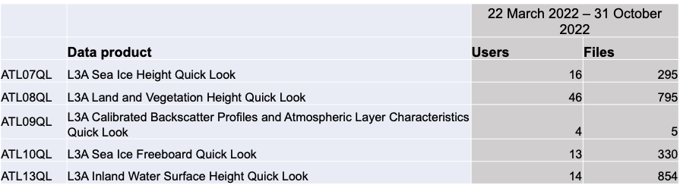

ICESat-2 Metrics
 | Number of Distinct Users
United States | 38
China | 28
India | 11
United Kingdom | 4
Canada | 4
Near Real Time/Quick Look Products
22 March 2022 – 31 October 2022
86 registered usernames of 5 available products
2,279 science file downloads
Users from 20 countries

Slide 10
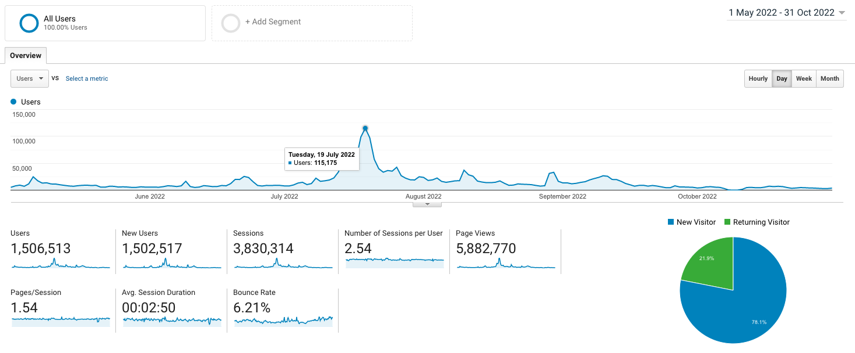
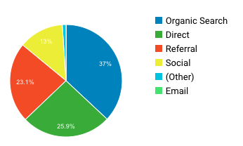
Google Analytics for all LANCE Web Pages including FIRMS: 1 May – 31 Oct 2022
By Device:
57.6% mobile
39.94% desktop
2.46% tablet

Slide 11
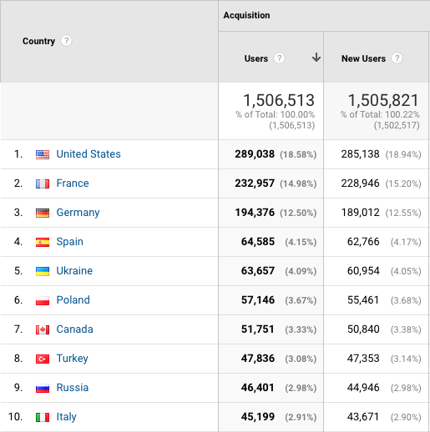
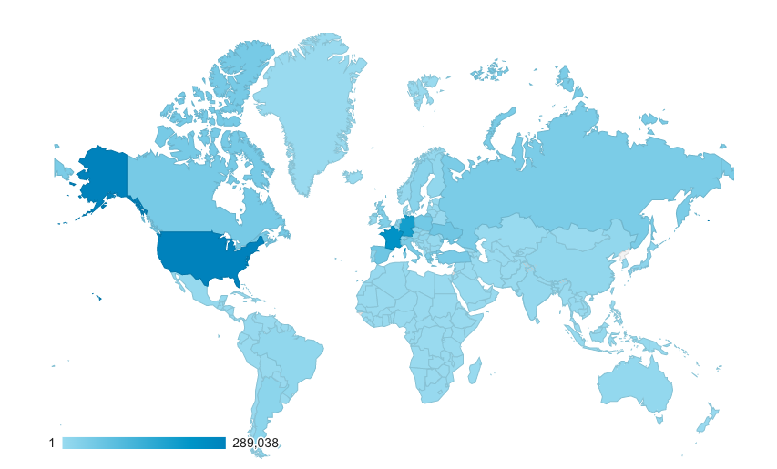
Google Analytics for all LANCE Web Pages including FIRMS: 1 May – 31 Oct 2022
Distribution of Users by Country

Slide 12
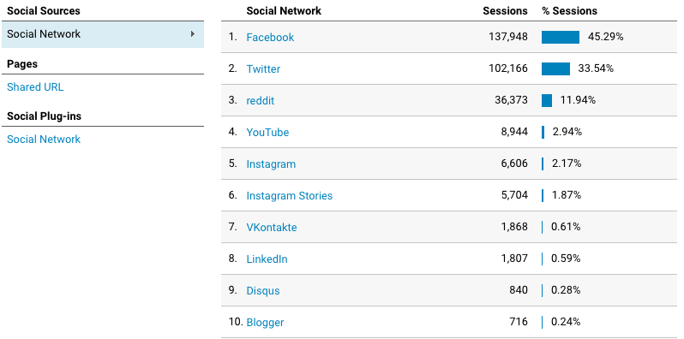
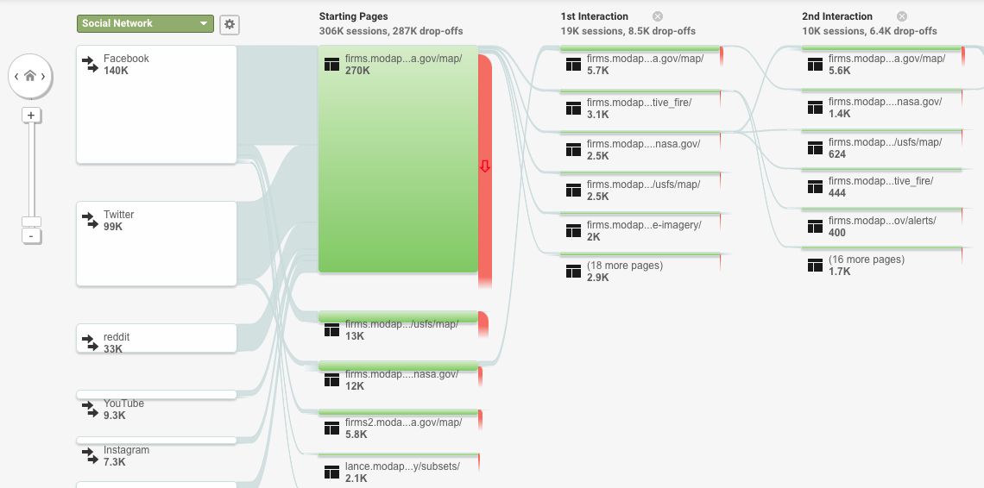
SOCIAL MEDIA

Slide 13
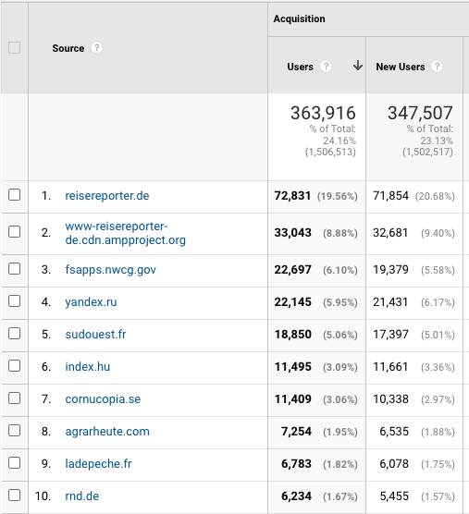
TRAFFIC SOURCES
TRAFFIC SOURCES

Slide 14
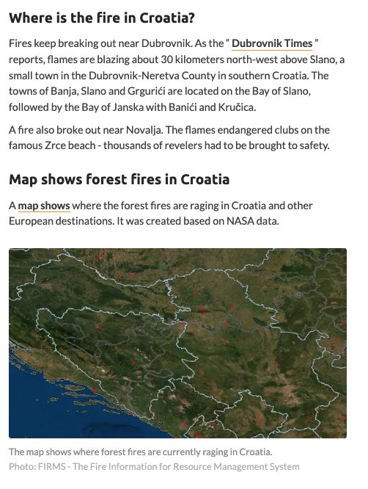
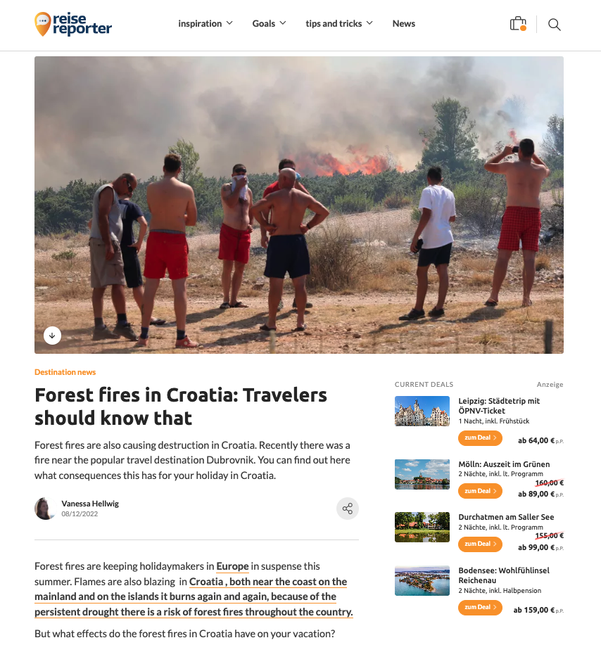
Notes:
https://www.reisereporter.de/artikel/15479-waldbraende-in-kroatien-wo-brennt-es-sind-urlaubsorte-betroffen

Slide 15
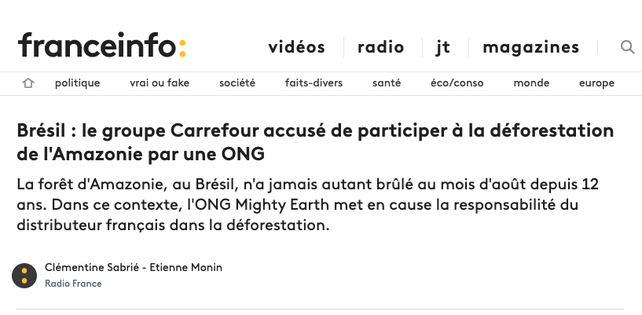
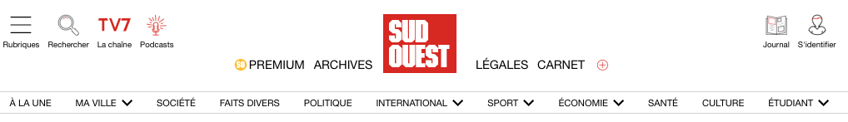
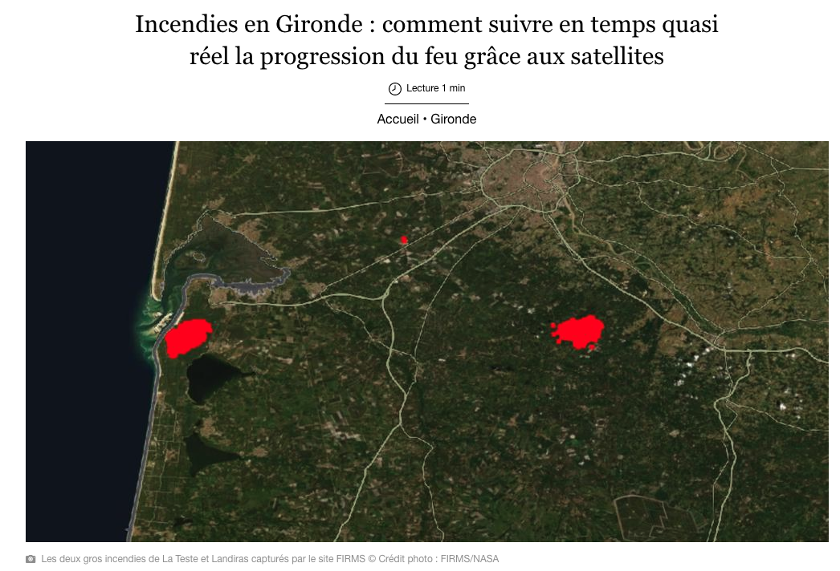
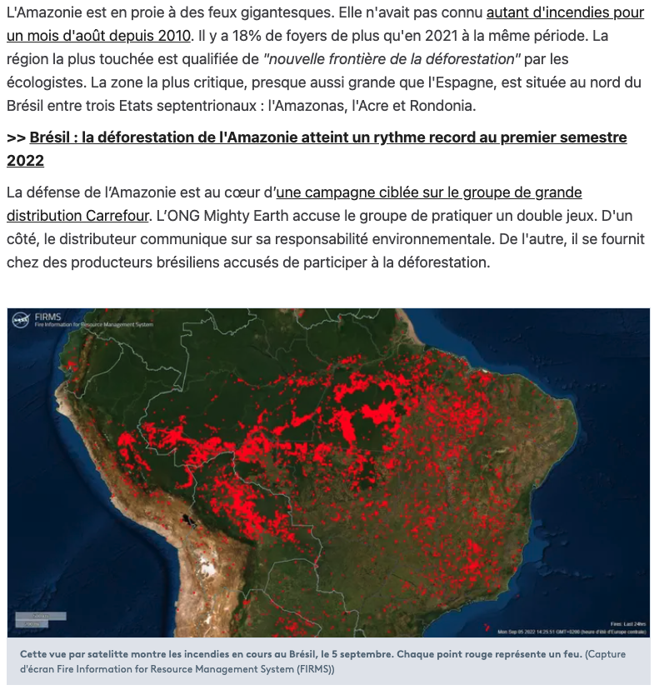
Notes:
https://www.sudouest.fr/gironde/incendies-en-gironde-comment-suivre-en-temps-quasi-reel-la-progression-du-feu-grace-aux-satellites-11647237.php

Slide 16
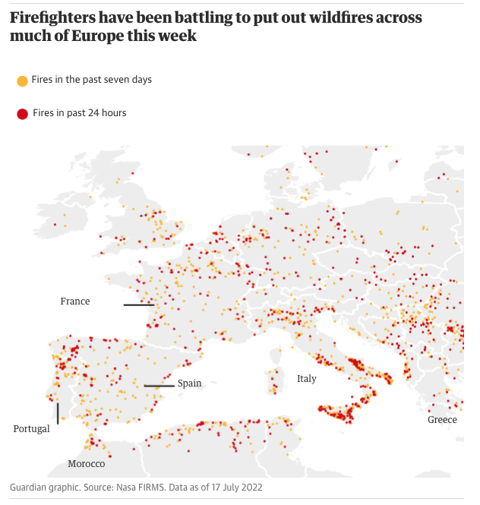
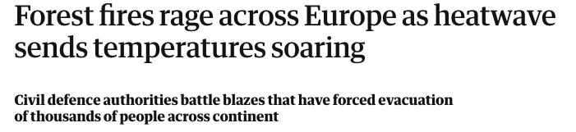
Notes:
https://www.theguardian.com/world/2022/jul/17/forest-fires-rage-across-europe-as-heatwave-sends-temperatures-soaring

Slide 17
MEETINGS
ICAP Meeting – October 2022
Global Flood Partnership Meeting, Leeds – October 2022
EARTHDATA ARTICLES – coming soon from Jennifer
OUTREACH

Slide 18
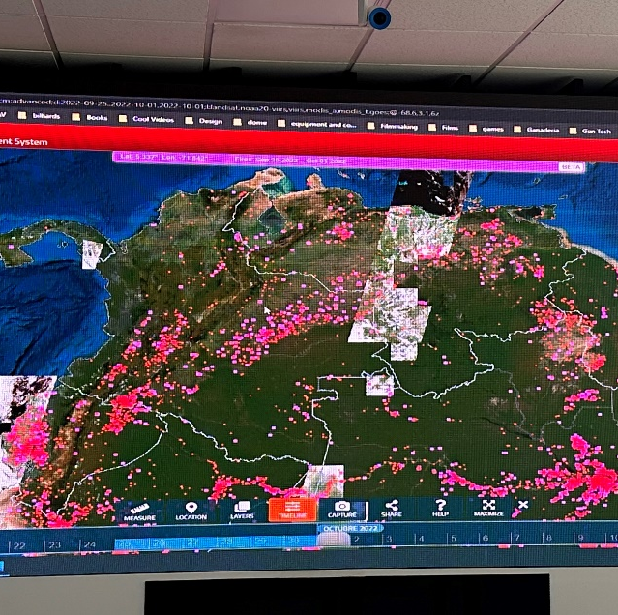
FIRMS Outreach
Undertaken by Karen Tabor, funded by David Green, Wildfire Program
Training was provided to the Columbian National Directorate of Fire Fighters - Dirección Nacional de Bomberos de Colombia (DNBC) as part of Advancing Satellite Applications for Disaster Risk Reduction & NRM workshop)
FIRMS data are used to compare with incident reports especially in remote/dangerous areas
Request for capacity building on:
New data streams in FIRMS
Spanish Translation

Slide 19
Joint Communications Efforts: EOSDIS/LANCE
May 5, 2022– November 8, 2022
Feature Articles/Announcements
Social Media
Video Tutorials
EOSDIS Quarterly Update Newsletter

Slide 20
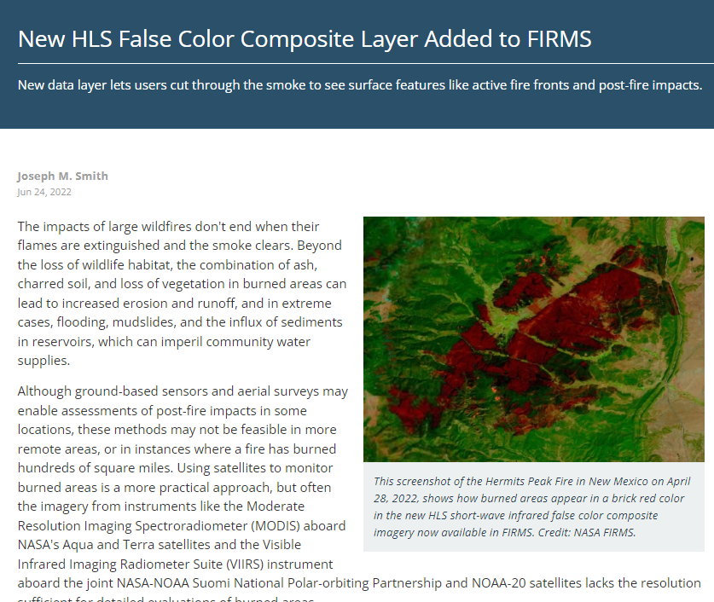
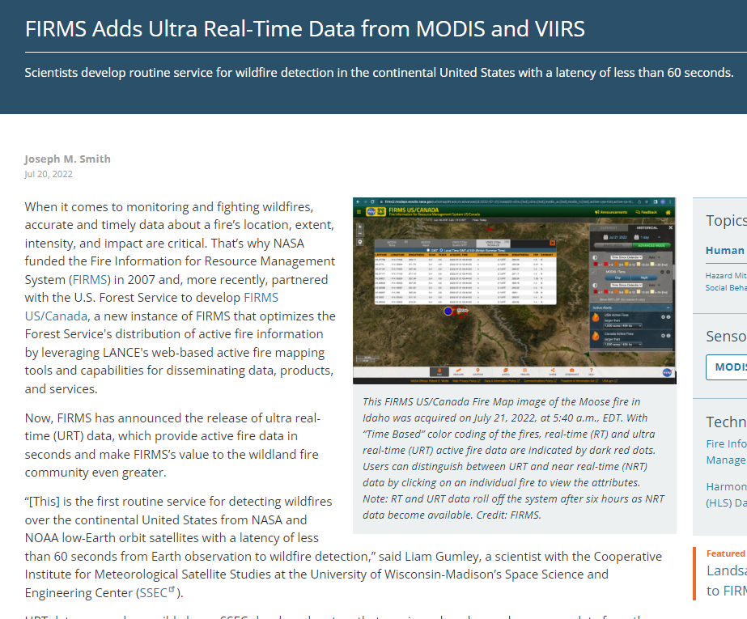
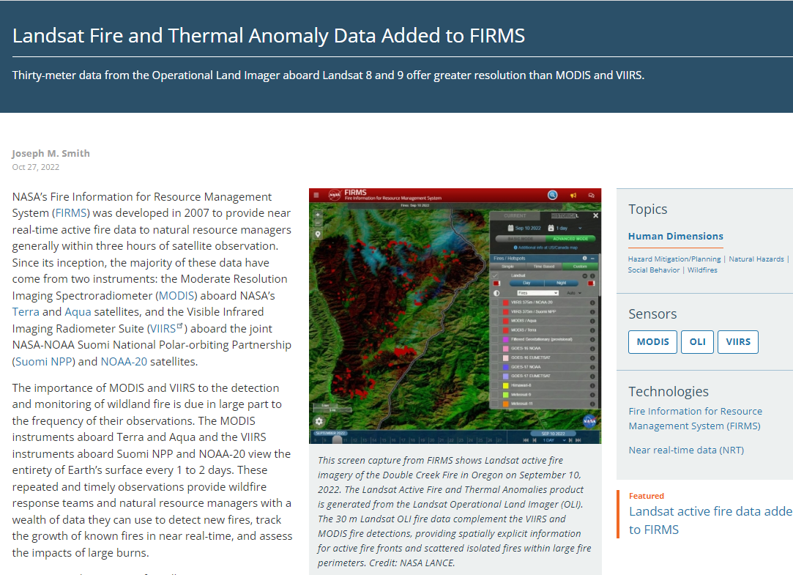
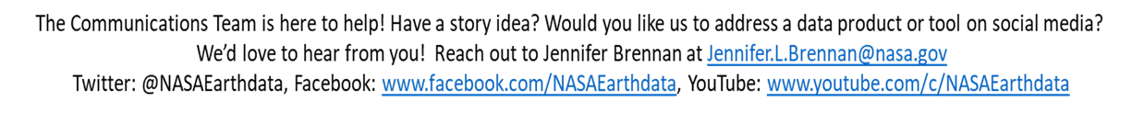
Feature Articles
Published 6/24/22: https://go.nasa.gov/3Ujbwqk
Published 7/20/22: https://go.nasa.gov/3fMMSz9
Published 10/27/22
https://go.nasa.gov/3tehGvV

Slide 21
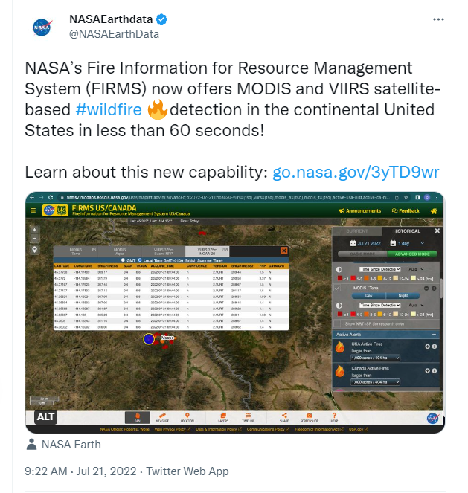
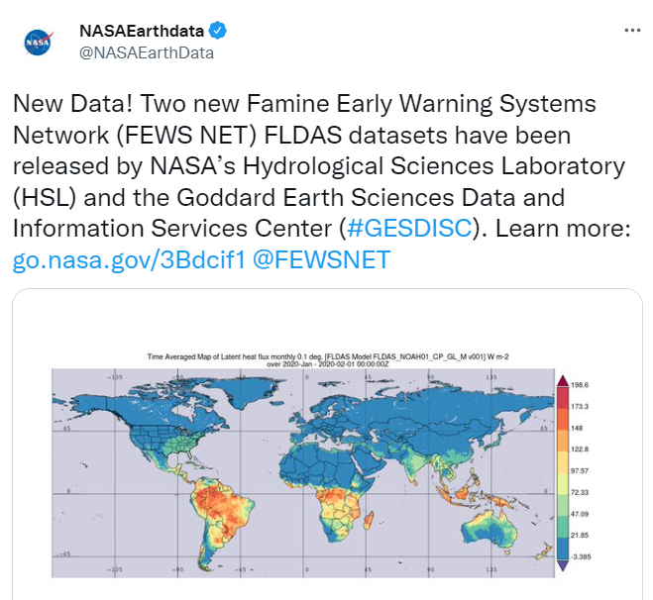
Social Media- Twitter (@NASAEarthdata)
Time period: 5/4/22 – 11/8/22
6 LANCE-specific/related tweets announcing new data products or data service updates (Note: Metrics pulled on 11/8/22)
72,517 Impressions
1,124 Engagements
NASA Earthdata Twitter Account
35,257 Followers on 11/8 (pulled at 1:40 pm ET)
The most popular content on our Twitter account is data recipes and tutorials!
We welcome more of it!
Highest Number Impressions
59,065 Impressions, 615 engagements
Posted 7/20/22
https://twitter.com/NASAEarthData/status/1550108873952051200
*Note: Also cross-promoted on the NASA Earth flagship account.
Highest Engagement Rate
6.7% Engagement Rate, 1,190 Impressions
80 Engagements
Posted 7/18/22
https://twitter.com/NASAEarthData/status/1549122395050475528

Slide 22
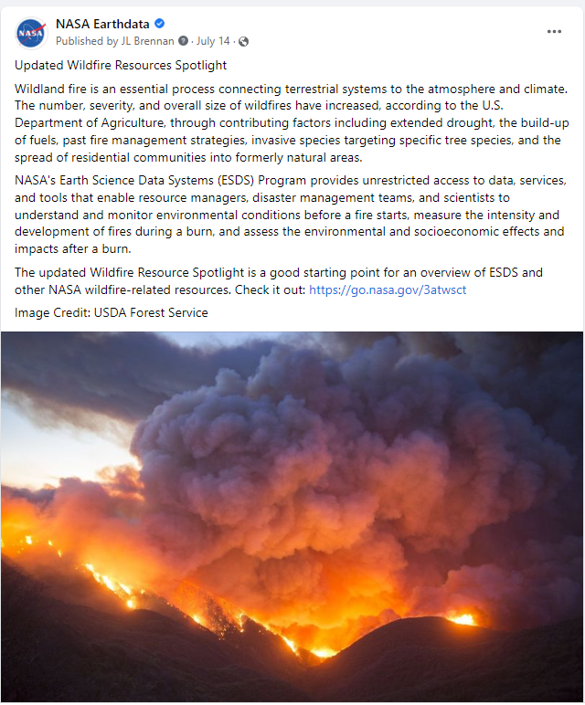
Social Media- Earthdata Facebook
Time period: 4/08/22 - 11/8/22*
10 LANCE/FIRMS-specific or related posts announcing new data sets or tool capabilities.
Total Post Impressions 39,776, Post Reach 38,913, and Post Engagements 2,157
NASA Earthdata Facebook Account
www.facebook.com/NASAEarthdata
55,363 Followers on 11/8/22 (Pulled at 1:50 PM ET)
Facebook Metrics
The FIRMS or FIRMS/US Canada posts tend to have a much higher engagement rate (on average) than most posts, particularly when we provide tutorials, imagery, and information about specific fire events.
We welcome more of this!
Highest Performing Post: Impressions
Topic: Updated Wildfires Resource Spotlight
13,606 Post Impressions, 13,429 Post Reach, 1,026 Post Engagements
* Did not include FB metrics for the May 2022 UWG meeting

Slide 23

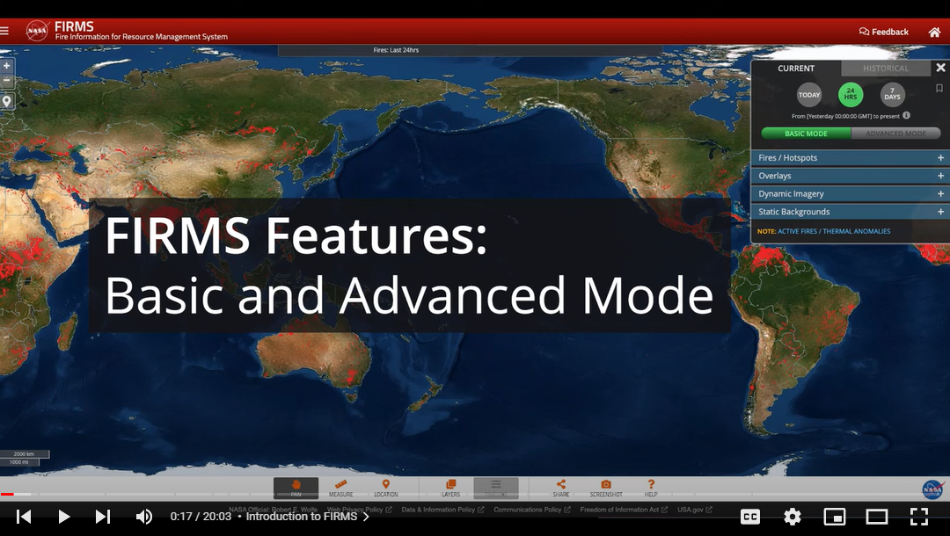
NASA Earthdata YouTube Metrics
# 1 Video!
How to Use NASA’s Fire Information for Resource Management System (FIRMS) (5/4-11/8/22)
NASA Earthdata YouTube Channel
www.youtube.com/c/NASAEarthdata
9.81 K Subscribers
Over 150 data discovery and access webinars
More than 30 short data tutorial videos
Playlists include the annual Earthdata webinars dating back to 2013, Earth System Observatory (ESO) Mission: Data Processing Study Workshops, Earthdata GIS Resources, Commercial Smallsat Data Acquisition Program webinars, EO Dashboard Hackathon videos and more!
Quick Stats:
5,683 Views since published (5/10/22)
268 hours of watch time (that is significant considering the length of the video)

Slide 24
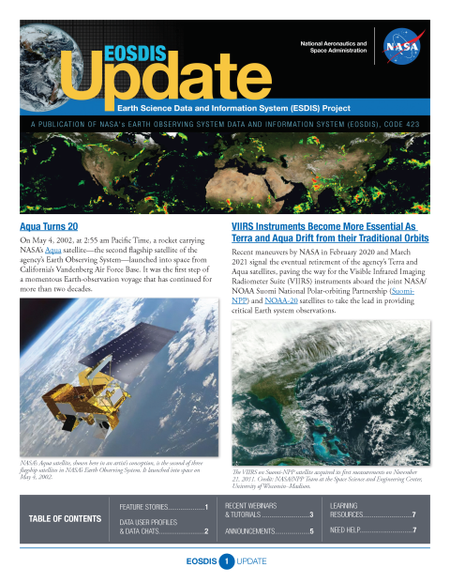
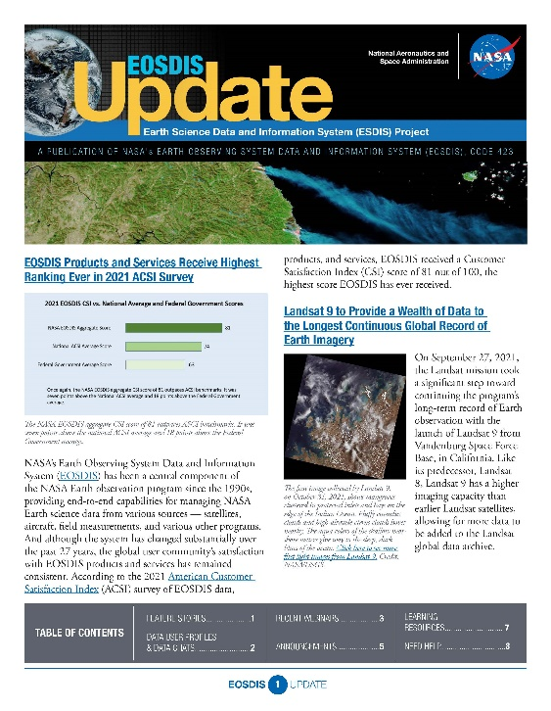
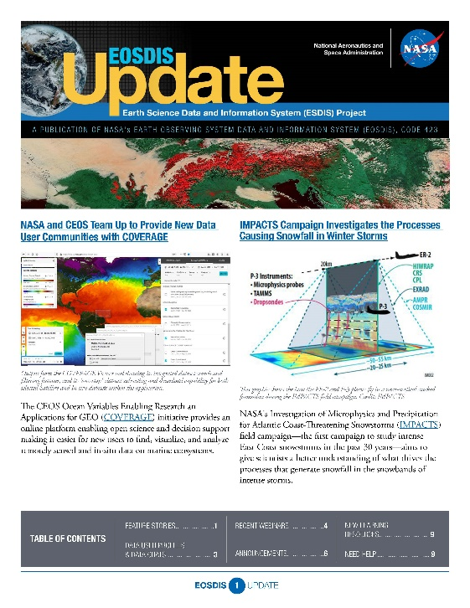
Other Efforts
EOSDIS Quarterly Newsletter
DAAC specific data announcements, data tutorials and data recipes, webinars and data user profiles appear in each quarterly newsletter.
https://earthdata.nasa.gov/learn/user-resources/eosdis-newsletter
*Note: Our final quarterly newsletter was just released on June 30th. Beginning in July, all of the webinar, dataset and data tool news, Data User Profiles, feature articles, etc. appear in the ESDS program newsletter, “Earthdata Discovery”
To sign-up: https://www.earthdata.nasa.gov/subscribe

Slide 25
UPDATES FROM LANCE ELEMENTS

Slide 26
Plan for LANCE MLS Algorithm Update
New MLS NRT Algorithm:
Is based on a neural network trained on 17 years of MLS v5 production level 2 processing calculation
Be considerably faster and has been shown to be more accurate than prior NRT algorithms, which relied on radiative transfer calculations that included significant approximations necessitated by meeting the NRT latency requirement
Better captures features such as strong horizontal gradients, and significantly reduces data latency
Timeline:
New algorithm ready and updating documentation work on-going
Release date TBD

Slide 27

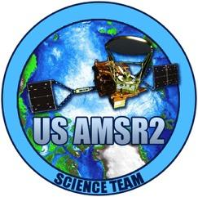
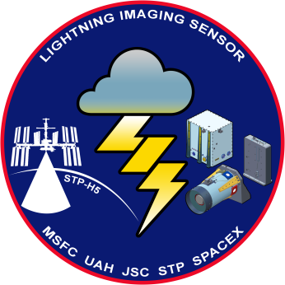
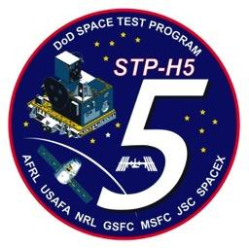
LANCE AMSR2 / ISS LIS
Leigh Sinclair (leigh.sinclair@uah.edu)
Presented at the LANCE UWG
November 9-10, 2022

Slide 28
AMSR NRT Data Metrics
Volume of Data Downloaded
NRT AMSR2 Unified L2B Global Swath Ocean Products
NRT AMSR2 Unified L3 Daily 6.25 km Polar Gridded 89 GHz Brightness Temperatures
NRT AMSR2 Unified L3 Daily 12.5 km Brightness Temperature & Sea Ice Concentration
Number of Files Downloaded
NRT AMSR2 Unified L2B Global Swath Ocean Products
NRT AMSR2 Unified Global Swath Surface Precipitation GSFC Profiling Algorithm
NRT AMSR2 Unified L2B Half-Orbit 25 km EASE-Grid Surface Soil Moisture Beta
Unique Number of Users
NRT AMSR2 Unified L2B Half-Orbit 25 km EASE-Grid Surface Soil Moisture Beta
NRT AMSR2 Unified L2B Global Swath Ocean Products
NRT AMSR2 Unified Global Swath Surface Precipitation GSFC Profiling Algorithm

Slide 29
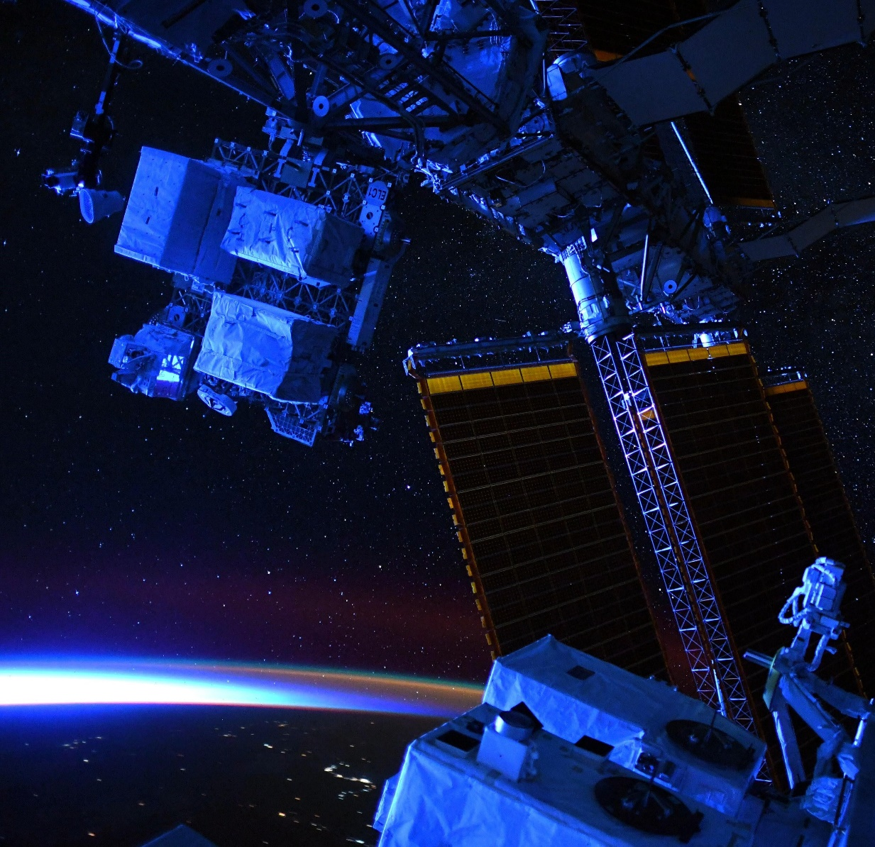
NRT ISS LIS Status
ISS LIS relocated on the ISS in June 2022
Version 2.2 NRT ISS LIS data available since October 18, 2022 at: https://lance.nsstc.nasa.gov/
  Improvements included in version 2.2 data:
    Refined the pointing code to >2 km for the new ISS location
    Updated various LIS pointing parameters
    Can handle R24 changes to the BAD file
ISS LIS will continue operations until at least late 2023

Slide 30


VIIRS Atmosphere Updates
Updates to both Aerosol products
  New version of Dark Target (Production and NRT) anticipated 4Q 2022.
    Includes release of NOAA-20 products.
  New version of Deep Blue (Production) anticipated 4Q 2022.
    Includes release of NOAA-20 products.
Access to Atmosphere SIPS LANCE products: https://earthdata.nasa.gov/earth-observation-data/near-real-time/download-nrt-data/viirs-a-nrt

Slide 31
TROPICS Updates
TROPICS Pathfinder is still running operationally.
Project is working towards a public release of the Pathfinder data estimated for 1Q 2023.
  If interested in becoming a TROPICS early adopter, contact Patrick Duran patrick.t.duran@nasa.gov
NASA is in the middle of rebidding the constellation TROPICS launches with a target of launching before the 2023 Atlantic hurricane season.
TROPICS NRT data will become available around the same time as the public release, including data from both Pathfinder and the constellation.
  Both NRT availability depends on funding.
Refer to this site for additional information and updates: https://tropics.ll.mit.edu/CMS/tropics/latest-news-and-updates

Slide 32
Thank you!

