Slide 1
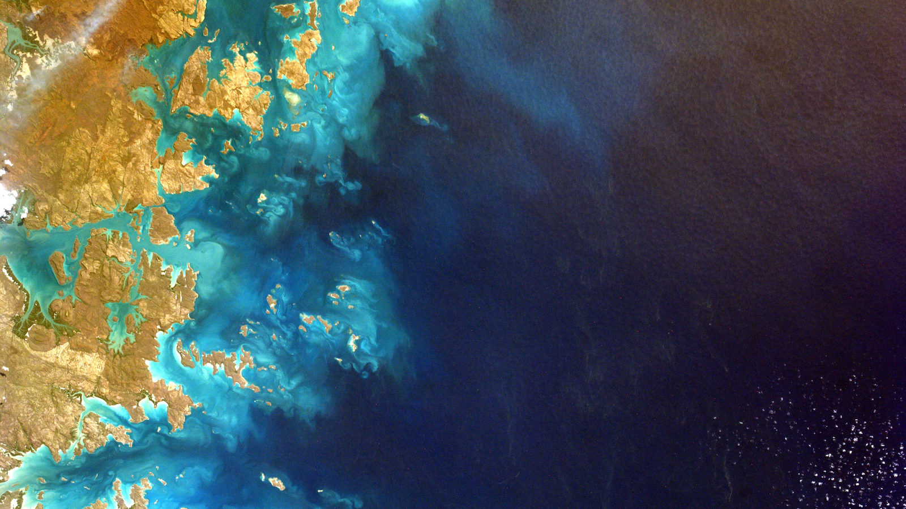
HQ Perspective and Open Source Science
LANCE User Working Group
November 9, 2022
Cerese Albers, Ph.D
Program Executive, Earth Science Data Systems
Chief Science Data Office
NASA Headquarters

Slide 2
Discussion Highlights
Engagement in NASA’s Open Source Science Initiative (OSSI)
Infusion of OSS Science Data Policy Updates SPD-41a
Preparing for the ESO Mission era
ESO Mission Data Processing Study -preparing for the next generation of NASA missions- the Earth Systems Observatory (ESO)
Cloud Migration of Priority Earth Science Datasets
Preparing for the end of the Terra / Aqua / Aura Missions
NASA’s commitment to Equity and Environmental Justice (EEJ)

Slide 3
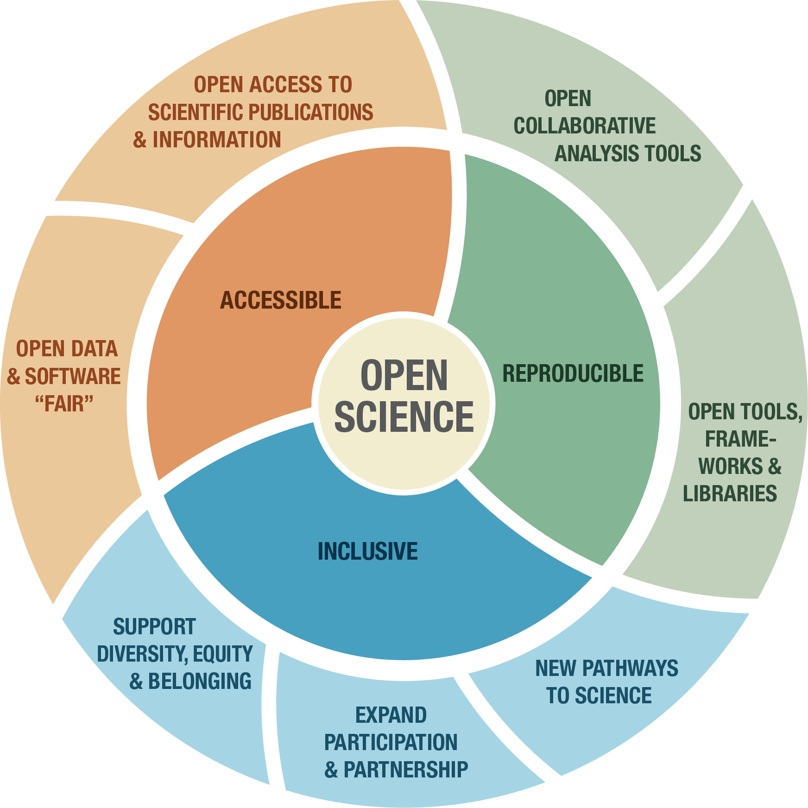
What is Open Science?
A collaborative culture enabled by technology that empowers the open sharing of data, information, and knowledge within the scientific community and the wider public to accelerate scientific research and understanding.
Ramachandran, R., Bugbee, K., & Murphy, K. J. Moving from Open Data to Open Science. Earth and Space Science, Wiley Publication
https://doi.org/10.1029/2020EA001562

Slide 4
White House Office Of Science and Technology Policy (OSTP)
Guidance to Make Federally Funded Research Freely Available Without Delay
Federal Agencies must update public access policies to make Publications and Research funded by taxpayers publicly accessible without embargo or cost.
Compliance by Dec. 31, 2025
“When research is widely available to other researchers and the public, it can save lives, provide policymakers with the tools to make critical decisions, and drive more equitable outcomes across every sector of society,” said Dr. Alondra Nelson, head of OSTP. “The American people fund tens of billions of dollars of cutting-edge research annually. There should be no delay or barrier between the American public and the returns on their investments in research.”

Slide 5
ESD is Putting NASA’s Open-Source Science Initiative (OSSI) into practice.
Open the entirety of the scientific process, from start to finish
Broaden community involvement in the scientific process
Increase accessibility of data, software, & publications
Facilitate inclusion, transparency, and reproducibility of science

Slide 6
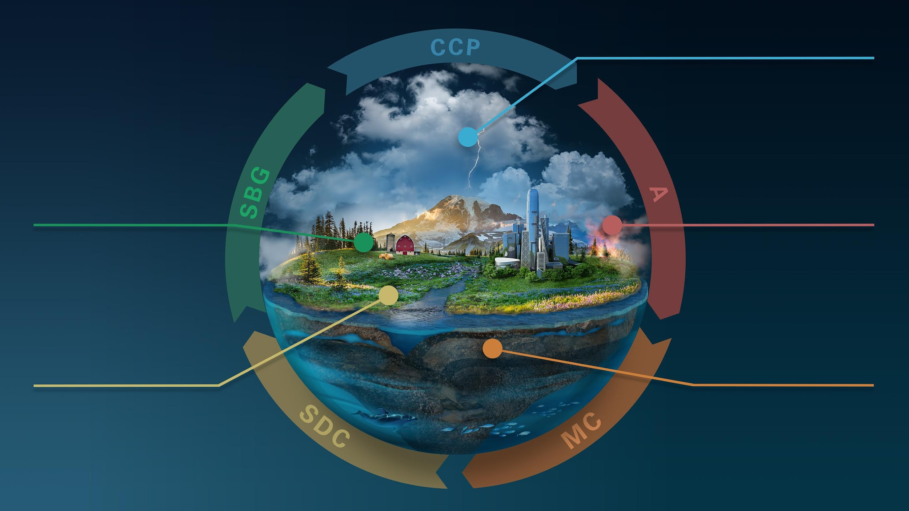

CLOUDS, CONVECTION
AND PRECIPITATION
Water and Energy in
the Atmosphere
INTERCONNECTED
CORE MISSIONS
SURFACE BIOLOGY
AND GEOLOGY
AEROSOLS
Particles in the
Atmosphere
Earth Surface & Ecosystems
SURFACE DEFORMATION
AND CHANGE
MASS CHANGE
Large-scale Mass
Redistribution
Earth Surface Dynamics
Notes:
NASA is formulating the Earth System Observatory (ESO), a set of Earth-focused missions to provide key information to guide efforts related to monitoring climate change, mitigating disasters, fighting forest fires, and improving real-time agricultural processes

Slide 7
NASA ESD Document Updates In Work for SPD-41a Policy Guidance
Near-Term Document Updates In Progress to Support ESO:
Earth Science Information Policy
ESD Program Level Requirements Appendix (PLRA) template
ESD Data Management Plan (DMP) template for Data Producers
ESD Data Management Plan (DMP) template for DAACs
ESD Data Product Development Guide
Increase openness & accessibility of Algorithm Theoretical Basis Document (ATBD) development & updates

Slide 8
Core Values of Open Source Science and Policy Guidance
As open as possible, as restricted as necessary, always secure.
Increase the accessibility, inclusion, and reproducibility of SMD scientific activities
When possible, minimize the burden.
SPD-41a brings together existing NASA and Federal Guidance. It is forward looking, meaning it is meant to apply to work going forward. Existing missions and investigations should adopt parts of this policy consistent with available resources.

Slide 9
Implications on Missions and Solicitations
SPD-41a implementation plan is under development now in preparation for the release of SPD-41a. There will be an upcoming Town Hall (likely in Dec or Jan).
We are working with pre-KDP-B missions in a dedicated way.
Open Science Guidance and response to RFI are in development and will be released in December for all SMD divisions.
Updates for ROSES23 are underway. We’re working the Earth Science Division scientific policy updates now, and we’re on-track for the February release.
F.14 TOPST - optional NOI 11/10, proposals due 12/8. The solicitation requests support for development of Science curriculum and for training events starting in Summer 2023. This program supports 2 or 3 year projects.
F.15 High Priority Open Science will be released soon to provide support for innovative, open science projects that align with the goals of the Open Source Science Initiative. This program supports 1 year projects in high priority areas.
Notes:
Discussion on Day 3 by Dr. Yaitza Luna-Cruz, TOPS Program Officer

Slide 10
Looking Ahead: ESO Mission Data Processing Study
Goal: Identify and assess potential architectures that can meet the ESO mission science processing objectives, enable data system efficiencies, promote open science principles, and seek opportunities that support Earth system science.
Led by: a Steering Committee and a System Architecture Working Group (SAWG)
Status: First of 2 deliverables met: Held 2 workshops. Second deliverable a trade study that will present architectural recommendations. Report-out in December 2022.
Notes:
Open Source Science for the Earth System Observatory Mission Data Processing Study Workshops | Earthdata (nasa.gov)

Slide 11
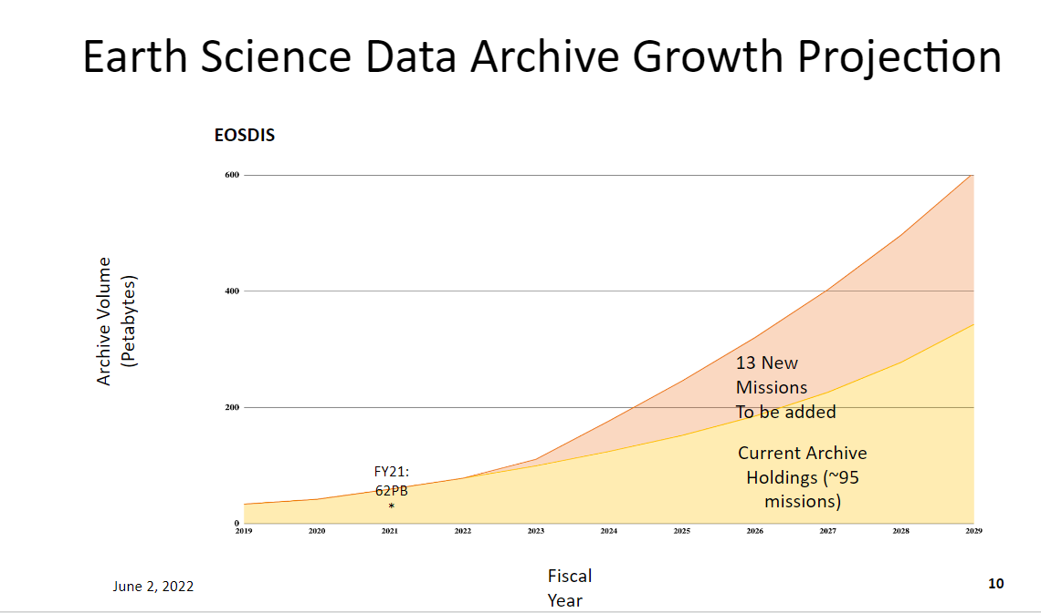
Courtesy: ESDIS

Slide 12
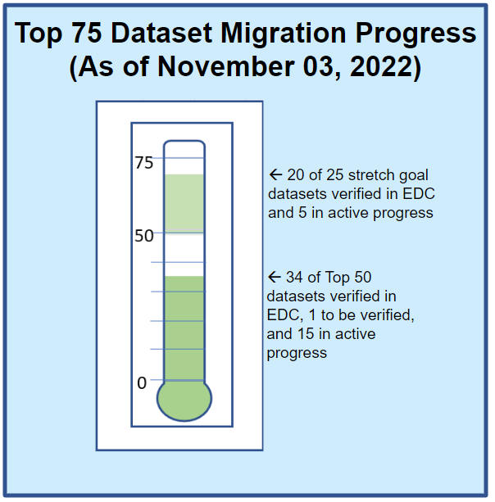
Priority ESD Dataset Cloud Migration
75 Earth Science datasets were identified & prioritized for migration from on-premise storage to the cloud
54 Datasets have already been migrated and are undergoing active verification
DAACs will focus on enabling user communities’ ability to conduct Science in the Cloud

Slide 13
Terra / Aqua / Aura
Following the drifting orbits workshop that occurred last week, NASA ESD will be continuing to disposition the RFI.
There will be a second round of RFI and surveying of the community, this time more focused on the continuity of science products from the EOS missions. Some of those products already have continuity products deriving from partner work, such as from JPSS or Sentinel.
The second RFI and survey of the community will then be followed by a series of workshops, held in the mid-to-late spring and will be similar in nature to the drifting orbits workshops, but potentially focused on specific communities, and suites of products.

Slide 14
NASA ESD’s EEJ Commitment
Diversify Earth science research and applications communities with representation from all backgrounds.
Support Equity and Environmental Justice communities by expanding awareness, accessibility, and use of Earth science data and enabling contributions to Earth science research and applications from a broad array of users.
Funding through ROSES-2022 A.28, subelement 4
Reaching new users of NASA data through UNBOUND
Notes:
Discussion on Day 3 by Dr. Yaitza Luna-Cruz, TOPS Program Officer

Slide 15

Take-Home Points
ESD is committed to open source science- a necessary preparation for the ESO mission era
SPD-41a release coming w/ changes to missions & solicitations
Science in the cloud is becoming a near-term reality via priority dataset cloud migration at DAACs
Future of LANCE and NRT products in the ESO mission era means enabling users to conduct science in Cloud on big data.
DEIA and Environmental Justice are priorities
Notes:
gray rocks on seashore during daytime photo – Free Image on Unsplash

Slide 16
Thank You!

Slide 17
Back Up Materials

Slide 18
SPD-41a Policy Updates
Data
Scientific data should be FAIR and shall be made publicly available with a clear, open, and accessible data license no later than the publication of the research, and be citable.
Mission data shall be openly available with no period of exclusive access.
Software
Research software shall be publicly available no later than the publication of the research, assigned a permissive software license, and be citable.
Mission software shall additionally be developed openly in a publicly accessible, version-controlled platform that allows for contributions and engagement from the community.
Publications
Manuscripts versions of as-accepted manuscripts shall be deposited in a NASA repository and made publicly available within 12-months. Publishing as open access is supported and posting preprints is encouraged.
Mission publications shall additionally be made publicly available at the time of their publication.
Science workshops and meetings shall be open to broad participation and documented in public repositories.
Open science activities will be considered in reviews of proposals.

Slide 19
Open-Source Science Policy for Earth System Observatory- What To Infuse Into ESD Policies
All mission data, metadata, software, databases, publications, and documentation shall be available on a full, free, open, and unrestricted basis starting in Phase B with no period of exclusive access. Science workshops and meetings shall be open to broad participation and documented in public repositories.
1 | Software shall be developed openly in a publicly accessible, version-controlled platform using a permissive software license allowing for community use and contributions. | 4 | Scientific data, metadata, software, publications and documentation shall be archived and made available by NASA and/or [Partner] starting in Phase B.
2 | Manuscripts shall be published with open access licenses; versions of as-accepted manuscripts shall be made available as open preprints and deposited in a NASA or [Partner] repository upon publication. | 5 | NASA and [Partner] software, documentation and data shall be properly marked, cited, and/or attributed. Metrics to measure and acknowledge open-source science contributions will be developed.
3 | All mission data, calibration information, and simulated products supporting development and validation of algorithms shall be made available without any conditions to use. | 6 | NASA and [Partner] will mutually develop an Open-Source Science Plan that specifies details of collaboration.

Slide 20
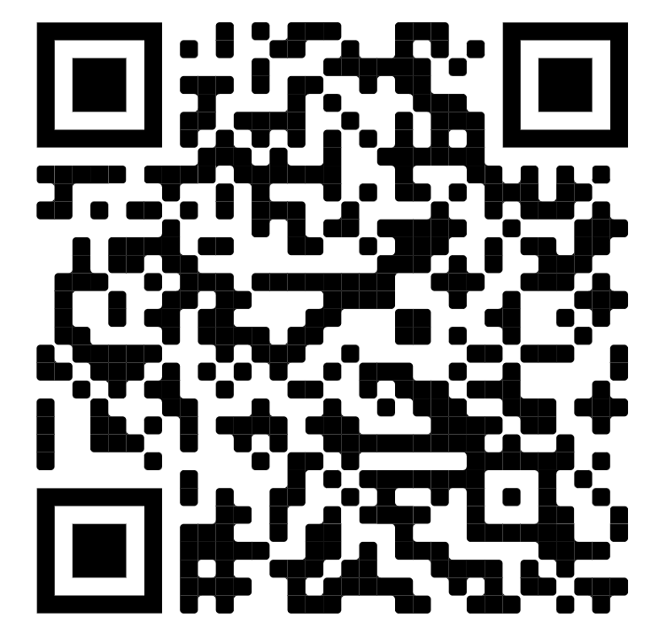
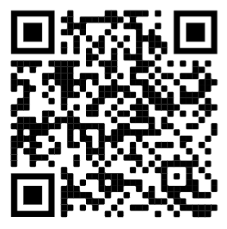
Current EEJ Activities
SCAN TO LEARN MORE:
  ESD Equity and Environmental Justice webpage
  EJ Data Backgrounder - Learn how NASA data are being used to support environmental and climate justice efforts
  Earth Science Data Systems discovery for Environmental Justice – Student Intern Project
  On Feb. 14, 2022, ESD released Research Opportunities in Space and Earth Science (ROSES)-2022, A.28 Interdisciplinary Research in Earth Science, Subelement 4: Environmental and Climate Justice using Earth Observations
ESD’s Equity
and EJ Page
EJ Data
Backgrounder

