Slide 1
NOAA Pathfinder Initiative
Traceability. Impact. Value.
LANCE User Working Group
Vanessa Escobar, User Engagement Lead for NOAA NESDIS
Office of Systems Architecture and Advanced Planning (OSAAP)
9-10 November 2022

Slide 2
Objectives for today
Give an overview of User Engagement at NESDIS
Present the Pathfinder Initiative as part of our NESDIS’ User Engagement Process and Mission Life Cycle
Share how the Initiative is growing coordination within LEO, GEO and SWO User Engagement for developing Value Chains in their current stage of the mission life-cycle

Slide 3
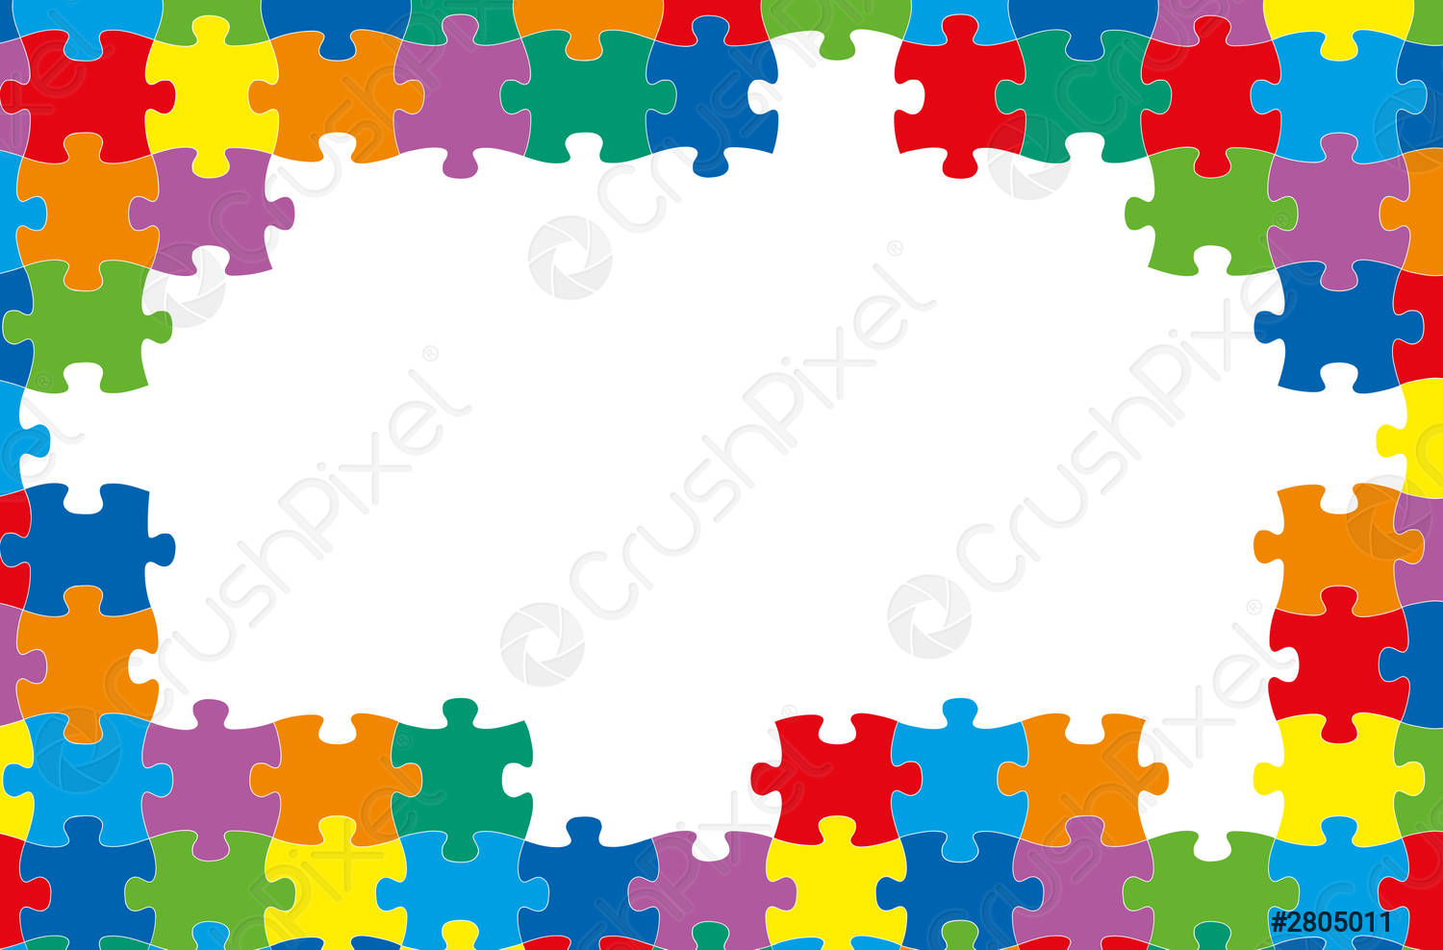
NESDIS User Engagement
Provides a common framework that:
Establishes best practices and enhance UE across NESDIS
Coordinates user information across missions, products and services
Formalize roles and responsibilities
Strengthen relationships
Improve user experiences and outcomes
Create a clearer record of impact
“take advantage of what’s working and reinvent what’s not working”
Notes:
Establish best practices, follow a framework that provides a uniform way of collecting and sharing data enables sharing across office boundaries, lock in step for usable data and transparency , take advantage of what's working and whats not… and build that frameworks

Slide 4
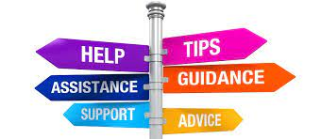
User Engagement Council and UE Guidance
User Engagement Council (UEC) is an advisory body within NESDIS that helps provide guidance and support for user engagement efforts across NESDIS by connecting the dots to data, people inside and outside NOAA
  Optimizing data products and services
  Trace uses to decisions
  Communicate awareness, access and availability in society
    “Meet the User” NESDIS User Engagement Speaker Series
    Pathfinder Value Studies
Notes:
Pathfinders is a key element of User Engagement
What is "user engagement"?
User engagement is a discipline that helps us to learn about the needs, challenges, and working environment of those we serve so that we can provide the most useful, usable and used products and services.
User engagement is concerned with fostering trust and good relationships between the organization and its clients.

Slide 5
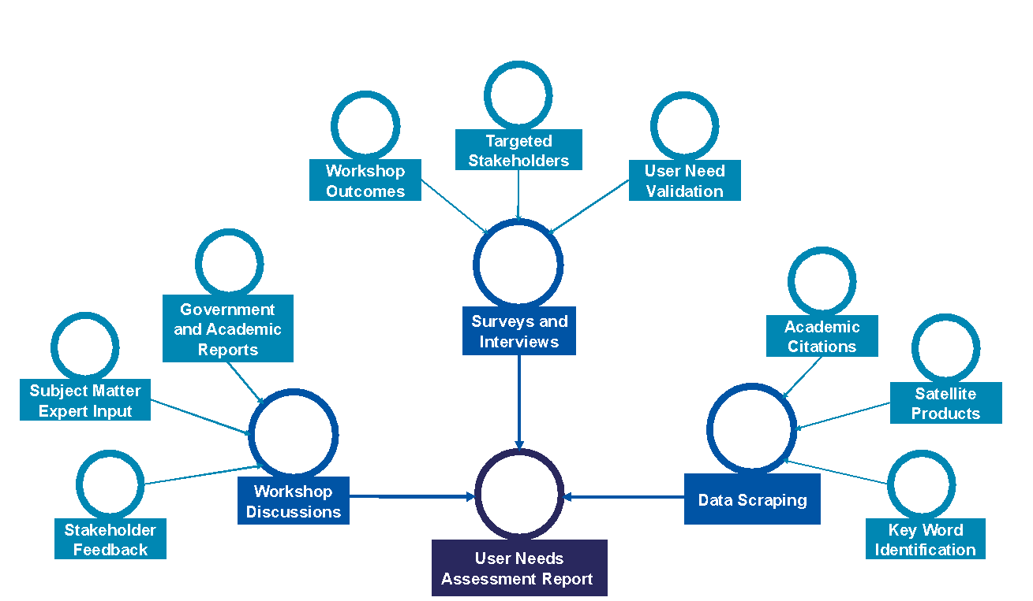
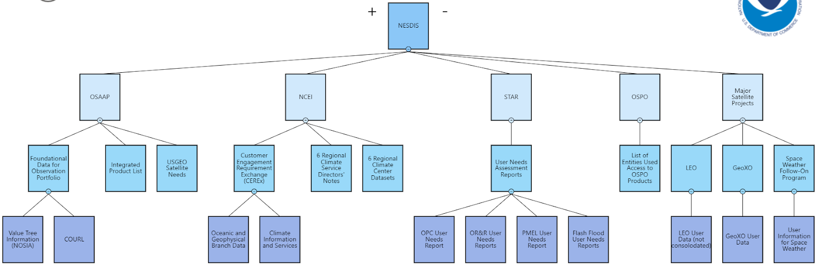
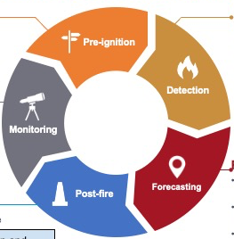
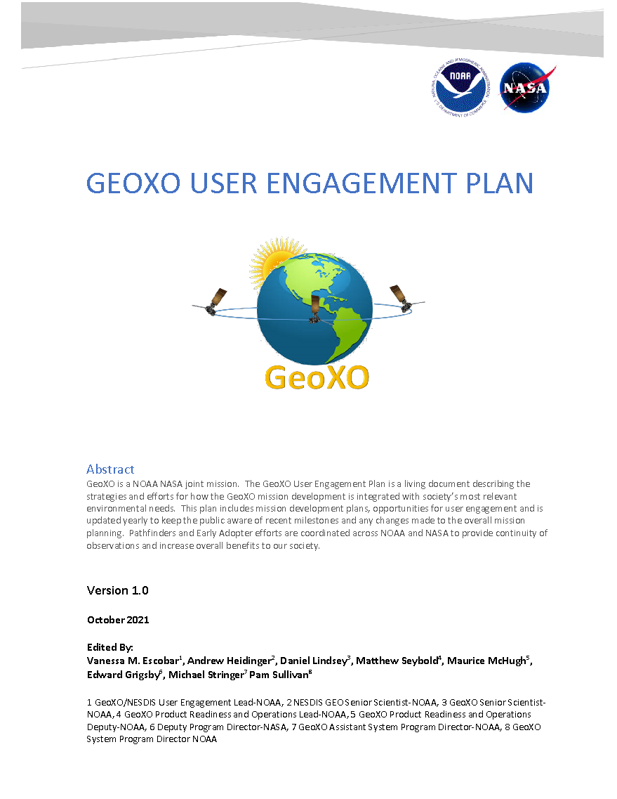
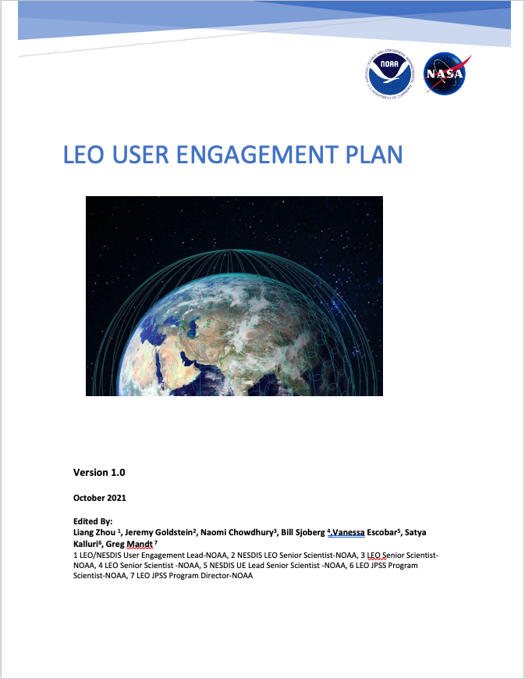
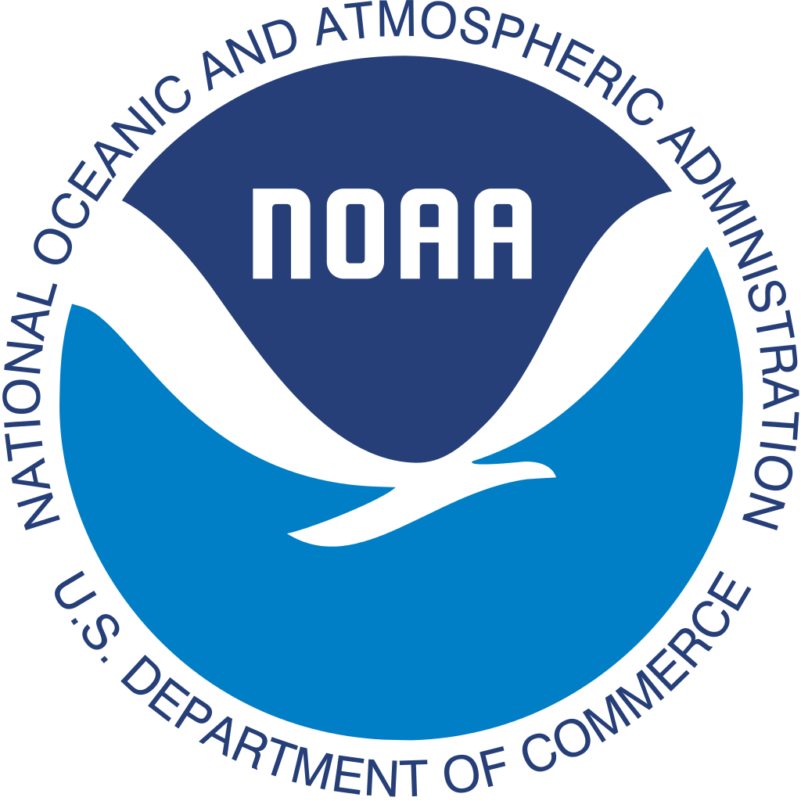
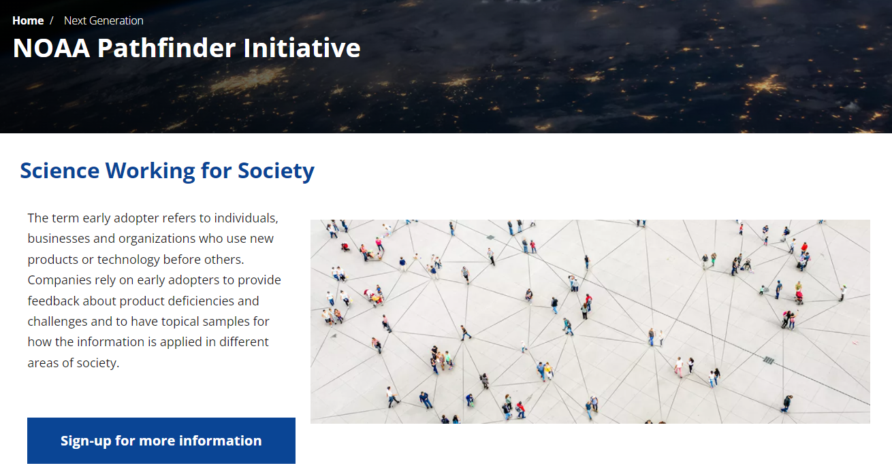
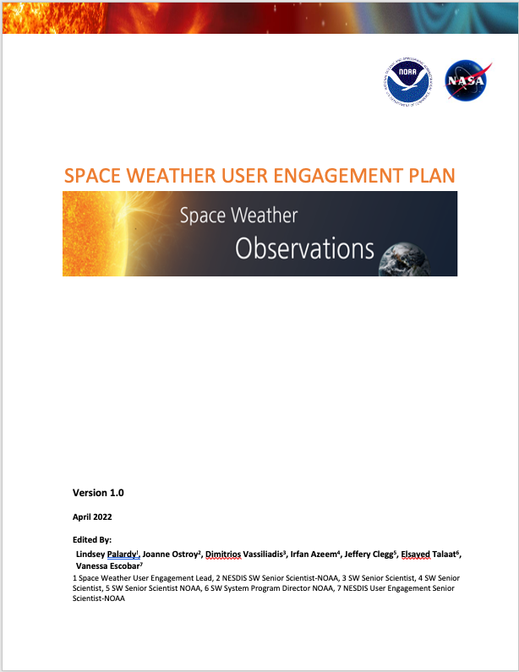

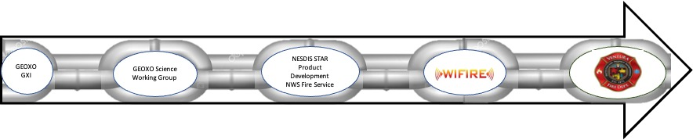
Thematic User Information and appropriate subcategories
NESDIS User Information Map
“One of the most important and challenging parts of wildfire response is translating complex geospatial information into meaningful products for decision-makers”
NESDIS 5-year
Product Plan
NOAA Pathfinders Initiative: Value Chains, Traceability, Translation and Impact
Products and Services Best Practices
Translation
Translation
Translation
Translation
UEC Strategic Plan

Slide 6
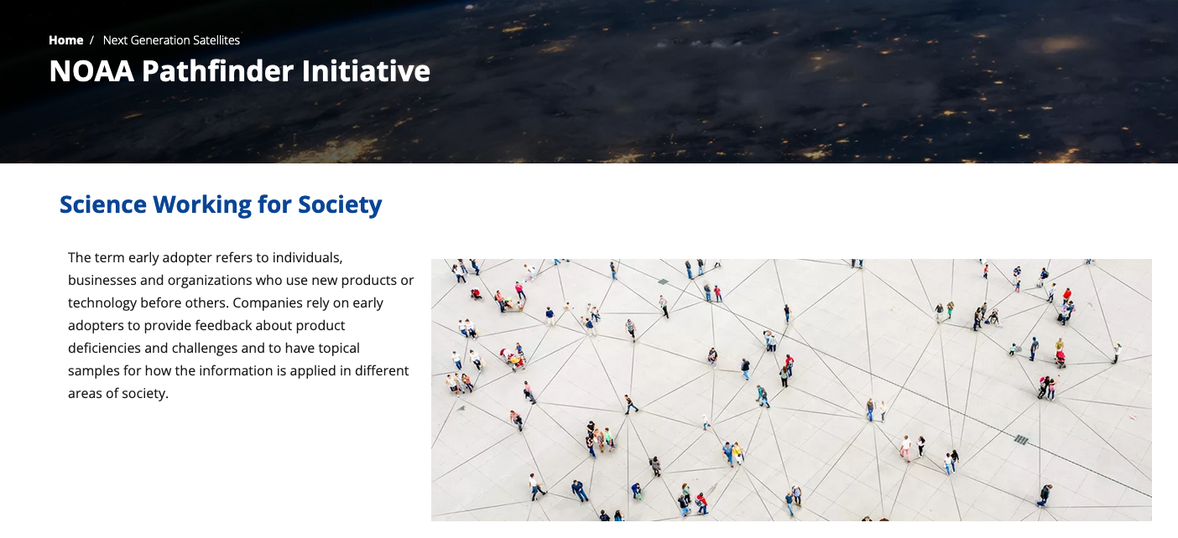



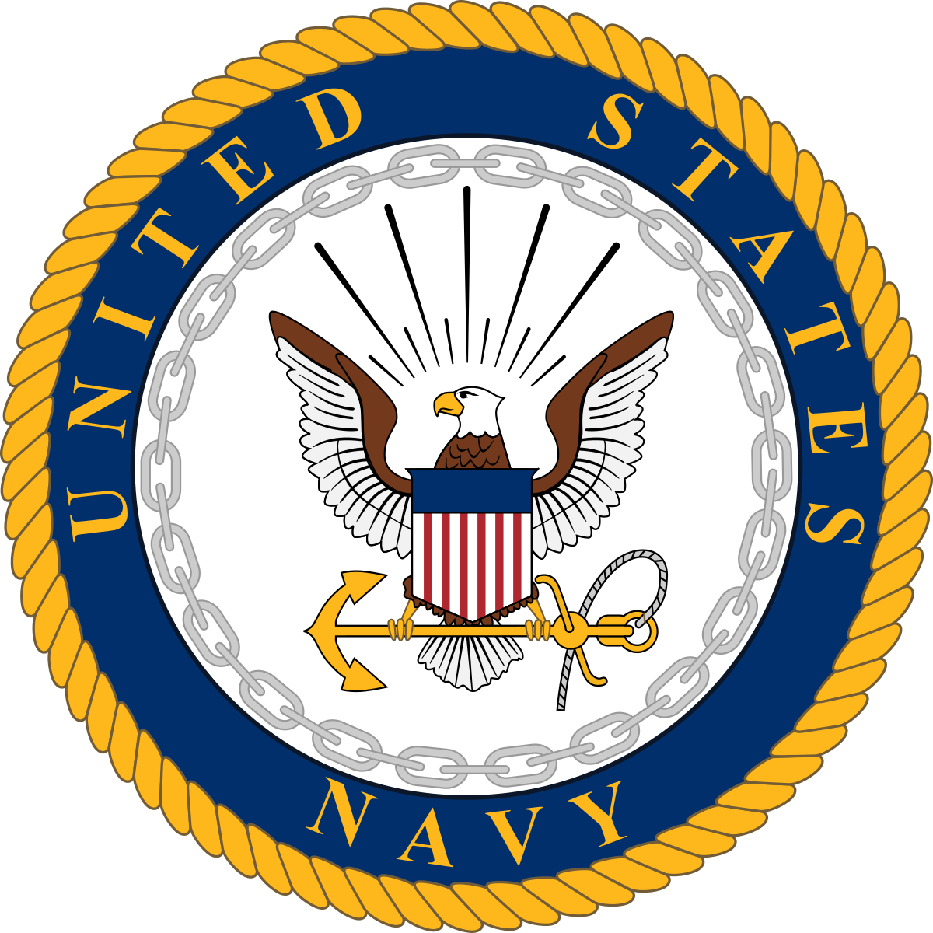




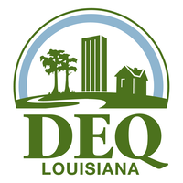


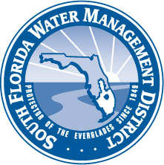


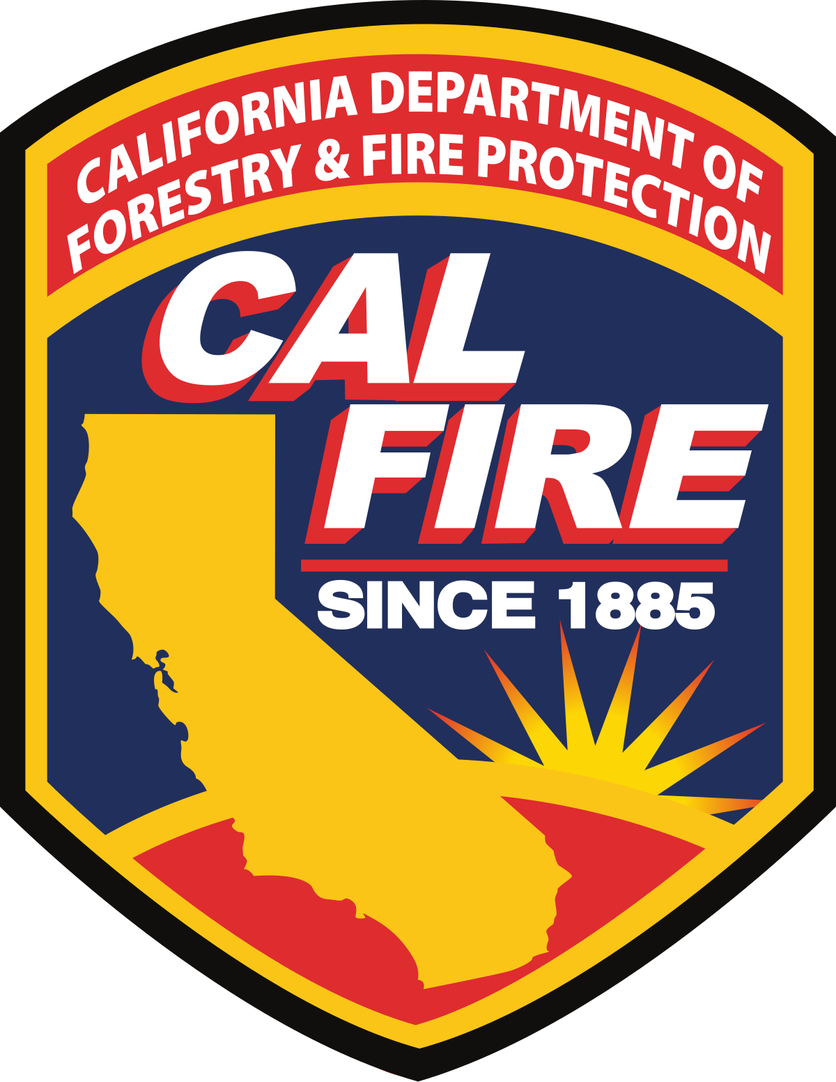



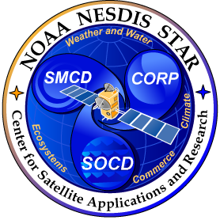





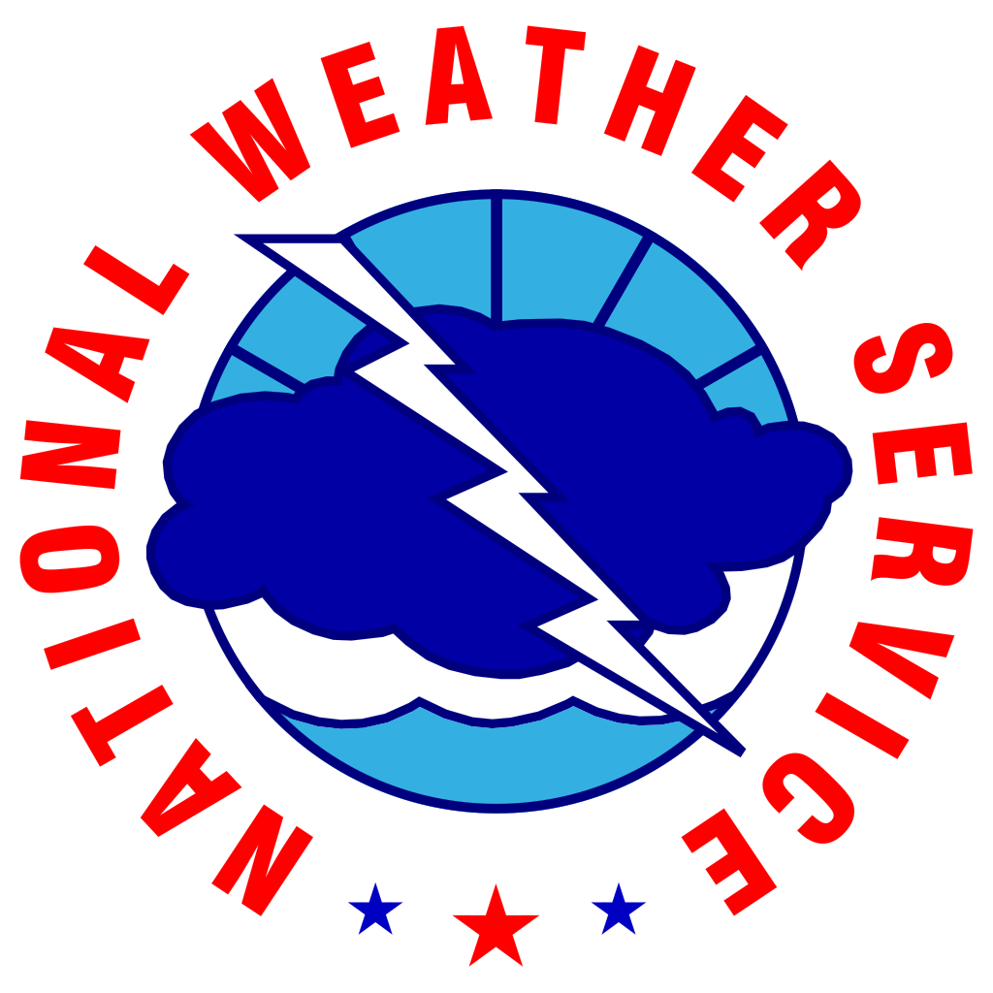














NOAA Pathfinder Initiative
https://www.nesdis.noaa.gov/next-generation-satellites/noaa-pathfinder-initiative
SCIENCE WORKING IN SOCIETY
NOAA Pathfinders is a community of practice that can demonstrate impact through the traceability of their use of NOAA information. Pathfinders use a scenario based approach to help quantify existing value and project future benefits of developing systems.
Pathfinder value chains aim to communicate:
Impacts and needed adjustments to existing performance data and information
Recommendations to future instrument, products and services
NOAA Pathfinders are a community of practice that can demonstrate impact through the traceability of their use of NOAA data, products and services.
Notes:
People using data now and the direct adjustments to performance, data and information
The goal of the NOAA Pathfinder Initiative is to help develop socioeconomic value studies for the future applications of mission data products shortly after they are launched. NOAA missions such as Geostationary Extended Observations (GeoXO), Low Earth Orbit (LEO), and Space Weather Follow-On (SWFO) sponsor Pathfinders and provide specific support to engage in pre-launch research.

Slide 7

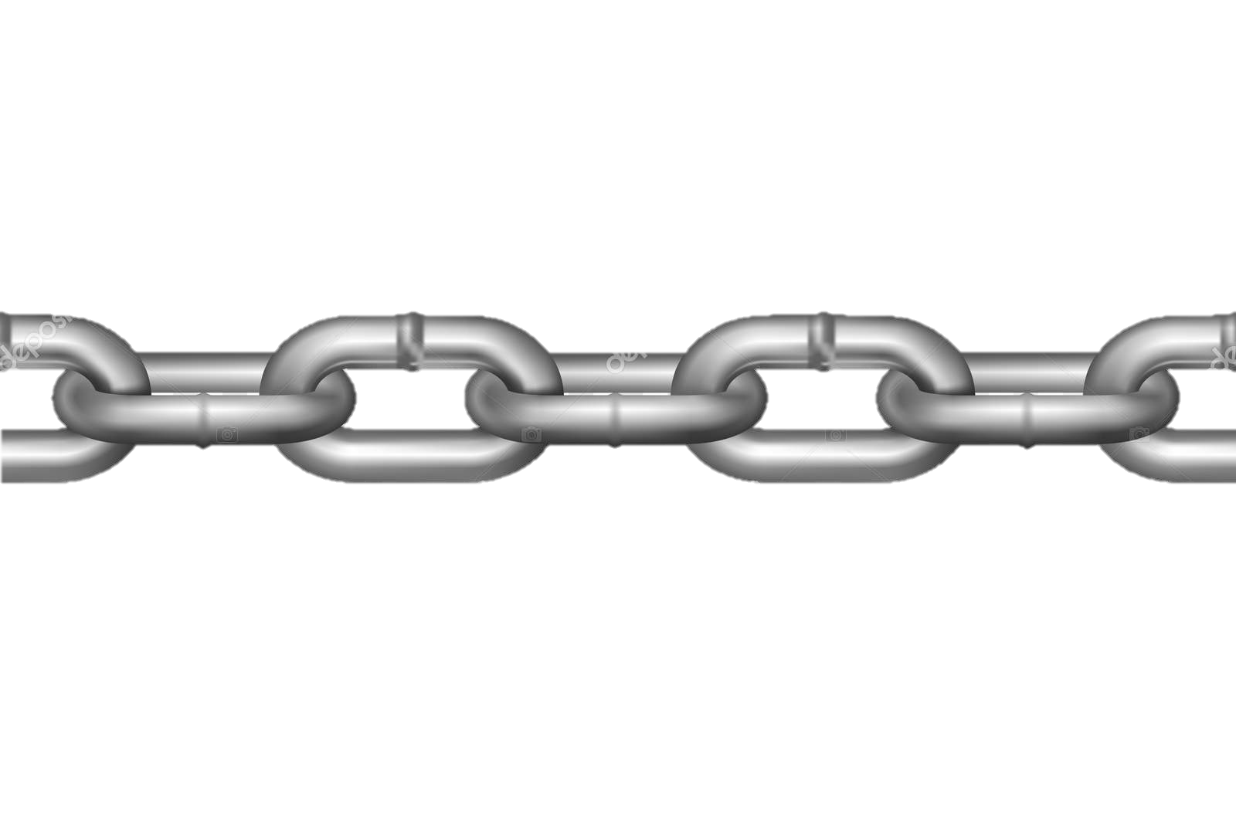
Traceability with Pathfinders
The Process is designed to:
Describe/demonstrate a complete value chain from instrument to impact and the improvement of services and delivery
Validate/coordinate user information and user engagement efforts within NESDIS
Inform the prioritization, decisions and process of mission instruments, products and services
Support co-discovery, co-development for Climate Ready needs and demands with Service Delivery and Proving Grounds
Pathfinders
Relationships Outside NOAA
Inside NOAA
Missions/
Instruments
Product Developer(s)
NOAA Integrator(s)/
Distributor(s)
Integrator/Developer
Distributor
End User
Baseline information (OSAAP NOSIA, COURL, Archives)
Mission instrument development decisions
Product Demand Prioritization
Line Office needs and prioritization
NOAA tools, process, services and distribution
Existing customer experience and feedback (NCEI)
External user relationships
Product distribution and implementation decisions
Tools and Implementation Prioritization
Resources, challenges and capabilities
Impact quantification

Slide 8

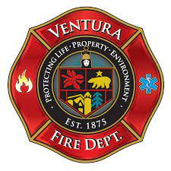



Impact Demonstrated through Value Chains
NOAA Pathfinders has 6 value chains in development with current products/observations and look toward the use and economic benefits future data products and services.
Value chains are tracing impacts from LEO, GEO and SWO into Fire, Air Quality, Coastal Tourism, Flight Safety, Hurricane Evacuation, Viticulture.
Chains are co-developed with the Pathfinder to quantify the impact in their areas of society
TEMPO/ ACX
Science Working Group
NESDIS STAR Product Development,
EPA, CDC and HHS
ABI/GXI
Science Working Group
NESDIS STAR Product Development
NWS Fire Service
WiFIRE
SWO and LXM
Science Working Group
NESDIS STAR Product Development
NWS
FAA
Notes:
Value chains show the pathways by which different types of data from missions create value to society through the creation of new and improved products and the direct use of the data. Each value chain focuses on a single use case, identifying specific end-users who apply GeoXO data or products that rely on GeoXO data to reduce losses, increase productivity, save lives, or improve other societal outcomes.
we conduct user engagement from a mission agnostic perspective to provide the most useful, impactful and usable products and services to society. We present five value chains that help demonstrate how value is realized through the transfer of knowledge from instrument to product supporting user decisions.
We use value chains to communicate each use case and ensures that benefit studies reflect an accurate understanding of the connection between Earth observations, the product that rely on those observations, and the means by which societal outcomes are improved to generate societal benefits. This presentation will also describe the Pathfinder Initiative and the role of NESDIS user engagement efforts in support of Satellite development, Ground Systems, Enterprise Proving Ground and Products and Services.
Leverages NASA Early Adopters and existing studies that were aligned with Mission Science Teams
Value Chains and Pathfinder will continue work through the NESDIS UEC to get more pointed benefits for NOAA’s full understanding of benefits to society
WiFIRE Pathfinder now funded by the NOAA Fire Program

Slide 9
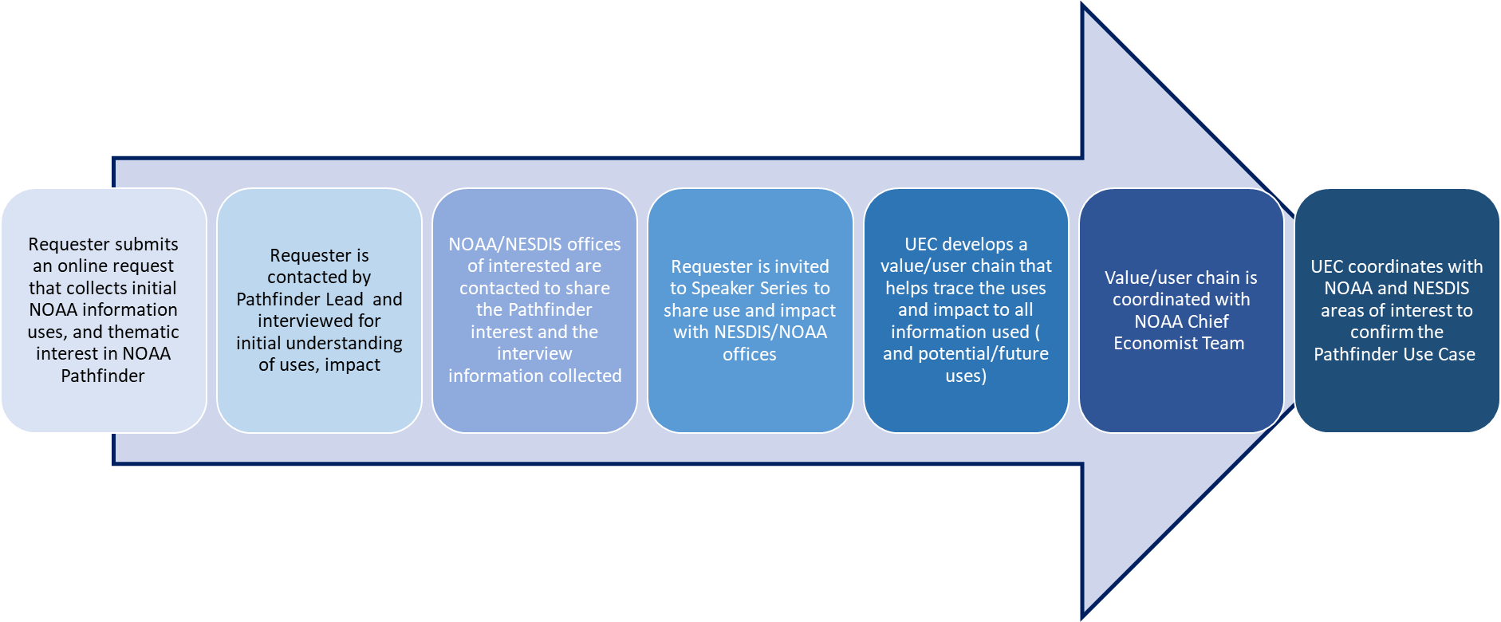
Process and Progress
Pathfinder Initiative Plan in development and part of the Formal NESDIS User Engagement Planning
Pathfinders websites actively collecting names of people interested in the Pathfinder Initiative
Currently interviews potential Pathfinder candidates for LEO, GEO and SWO.

Slide 10
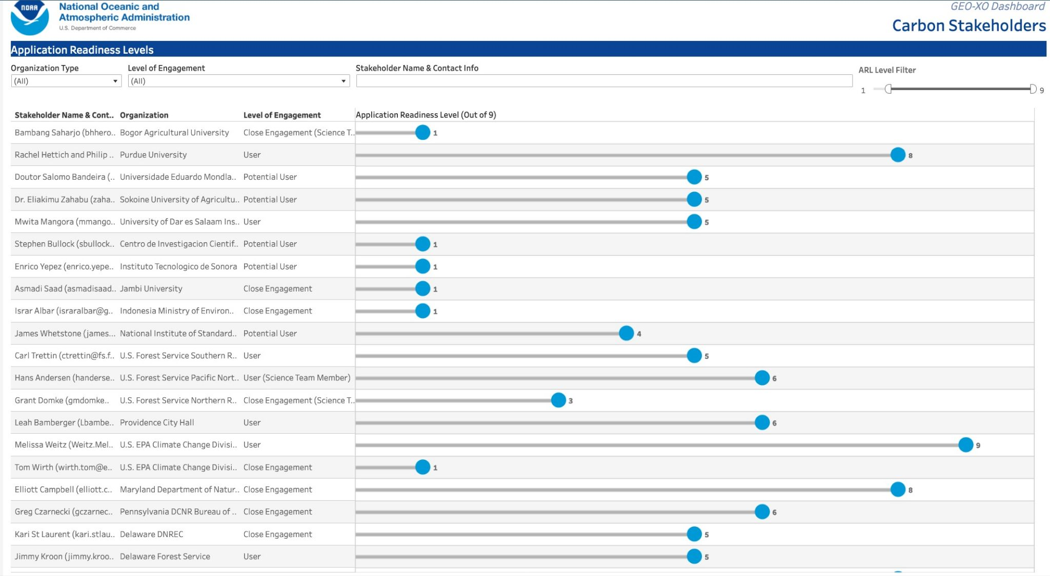
Understanding Community Readiness through NOAA Pathfinders
User Readiness Levels
URL Level Filter
User Readiness levels (out of 9)
Pathfinder User readiness level (URL) are defined based on some of the following citerea:
How mature is the relationship?
How ready are users for ingestion of information?
Are users aware of the full suite of product and services opportunities available?
Are user in need of training?
Are technologies and tool compatible?
Is the community familiar enough for ingest?
Are products of interest ready for user validation?
Are there co-development opportunity?
Notes:
Pathfinders bring awareness to the use of data at all levels of user readiness levels and walk across NOAA Enterprise Proving Grounds
How ready are users for ingestion of information?
Are they in need of training?
Are technologies and tool compatible?
Is the community familiar enough for ingest?
Are products ready for validation?
Is there co-development opportunity?

Slide 11
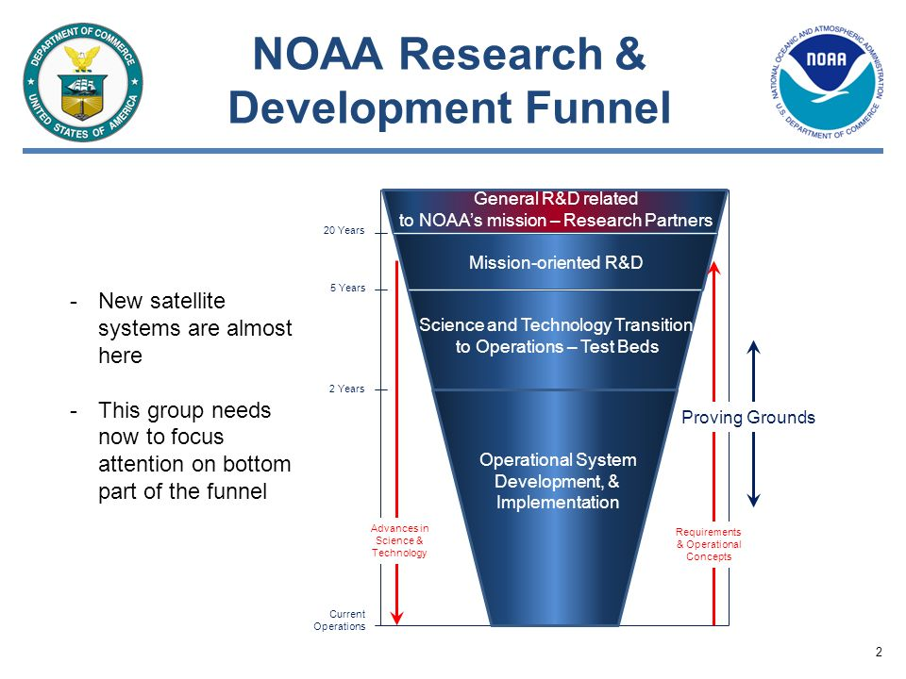
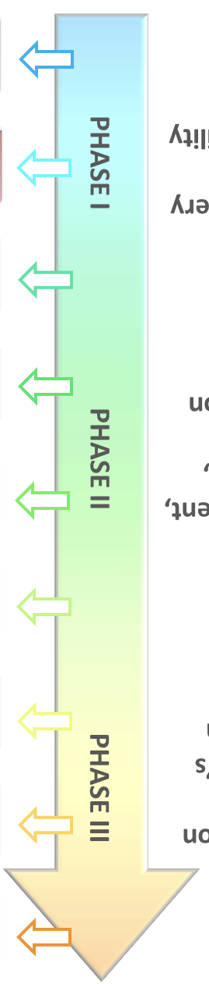
WHY USER READINESS LEVELS ARE IMPORTANT
INTERSECTION OF ENTERPRISE PROVING GROUNDS AND NOAA PATHFINDER INITIATIVE AS AN EXMPLE
Pathfinder User Readiness Level (URL)
1 | Basic awareness and interest (research)
2 | Application concept and framing (research)
3 | Proof of the application (development)
4 | Initial integration and verification with proxy data (development)
Group 1: New Satellite Systems are almost here. This group focuses on the awareness and planning for applications
Group 2 Where Pathfinders and Proving Grounds best overlap with the Cal/Val, Testbeds & Co-development/Co-Discovery of products and services
5 | Validation in the users’ relevant environment (development)
6 | Potential of application value demonstrated (development)
7 | Prototype developed for/by user organization (demonstrate functionality) (development)
8 | Integration completed and functionality is proven (final development)
9 | Approved, fully integrated and used in a decision making environment (application)
Pathfinders
Group 3: This group is now ready to focus on testing and operational development with actual data (proxy and post launch data)
Notes:
User Readiness Awareness through URLs help address the approach we need to take for our UE>
One example of this is Enterprise proving grounds-URL knowledge can help us identify Pathfinders that are well suited for Proviing Grounds and visa versa!
The sweet spot for coordination of opportunities is right at the ARL/TRL/URL 4 and 5.
The Enterprise Proving Grounds and the Pathfinders help support each other.
User Readiness of Pathfinders… match up with the Test bed (TRL/URL 4 and 5) community of Proving grounds and the Proving grounds. (TRL/URL 8and 9)

Slide 12
Our 3 most mature Pathfinder Value Chains
Notes:
Mature from the perspective of relationship. Engagement and the Users readiness to move forward with activities and actions

Slide 13
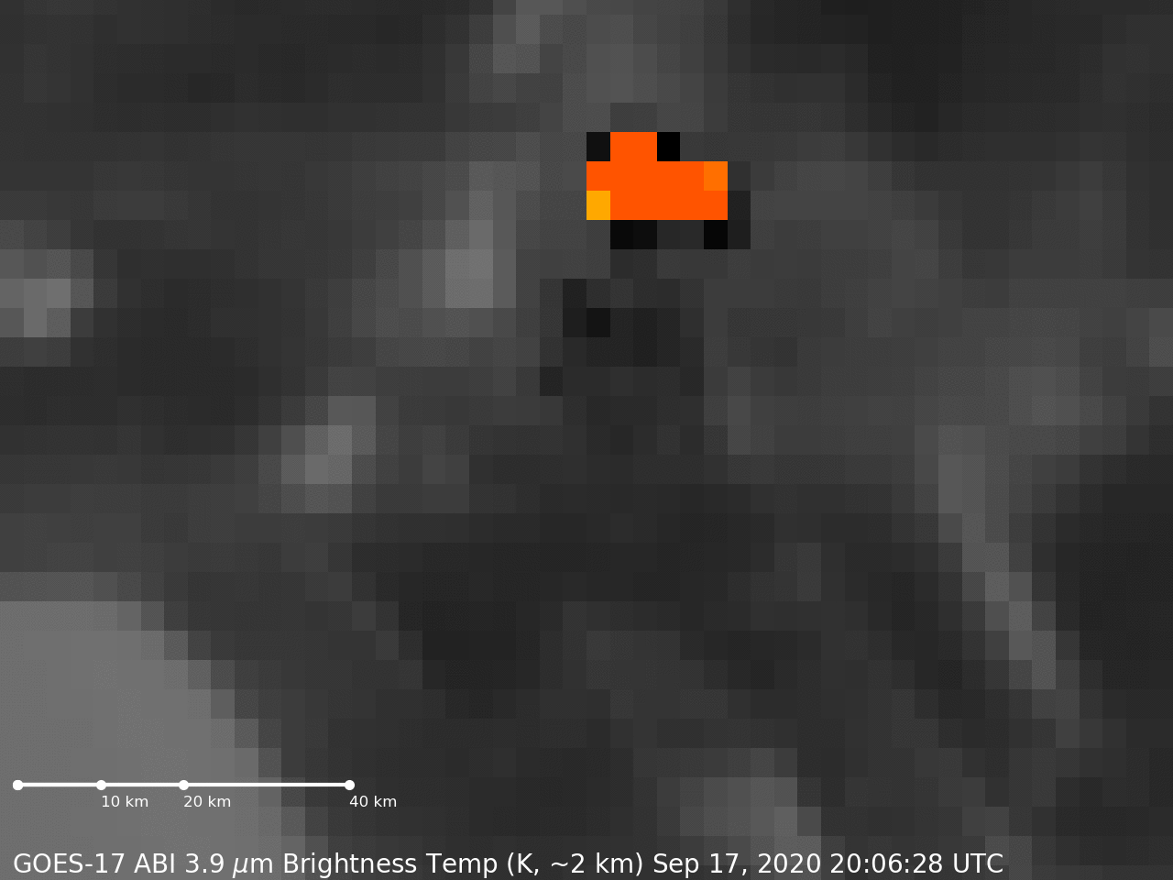
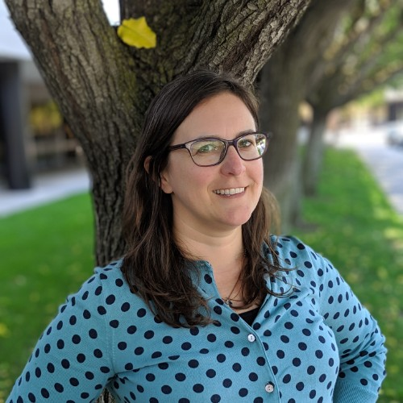
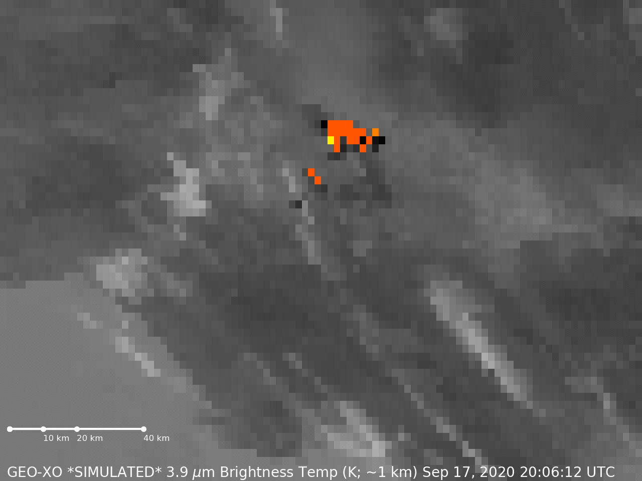
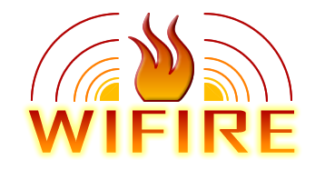




California Wildfire Fire Detection and Response
Recruited to provide feedback on the future benefits of GeoXO’s ABI and Fire detection product.
  Project will expand to include VIIRS and future JPSS
Presented at speaker series as an “Information Integrators” of fire observations and Artificial Intelligence (AI)
Co-Developed a scenario based tabletop exercise (with a GeoXO ABI example) to demonstrate the differences between current and future fire detection with Geo.
  Better spatial resolution led to faster response time and better allocation of resources (people and supplies)
Funded by NOAA Fire Program to help develop future Fire products and Services.
Dr. Jessica Block,
Univ. of California San Diego WiFIRE
Responding to Emerging Wildfires through Integration of NOAA Satellites with Real-Time Ground Intelligence
Translation
Translation
Translation
Translation

Slide 14


Maricopa County Air Quality Awareness and Equity
ASU will map the AQ community for Maricopa County and trace information to decisions using a value chain that looks at the benefits of VIIRS, MODIS,TEMPO and ACX in AQ (PM2.5) readings.
  OAR has been contacted and will be involved with the Pathfinder use case
  NOAA Chief Economist Team will be engaged for the Value Study development
  OSAAP Foundational data is informing the internal traceability to instruments, products and services
  UEC OAR Liaison will help develop the AQ user map and Value Chain
Next Steps:
Scheduled Maricopa County as a speaker at the NESDIS Meet the User Speaker series.
Complete kick off meeting and map the AZ AQ user chain.
Develop the NOAA side of the chain to include NOAA AQ information and services being used in Maricopa County.
Stay engaged with NOAA Missions and LOs to include future Leo and Geo asset in study.
Dr. Timothy Lant
Director of program development for Arizona State University's Knowledge Enterprise
VIIRS TEMPO ACX
Science Working Groups
Product and Services Development
EPA, CDC and HHS

Slide 15
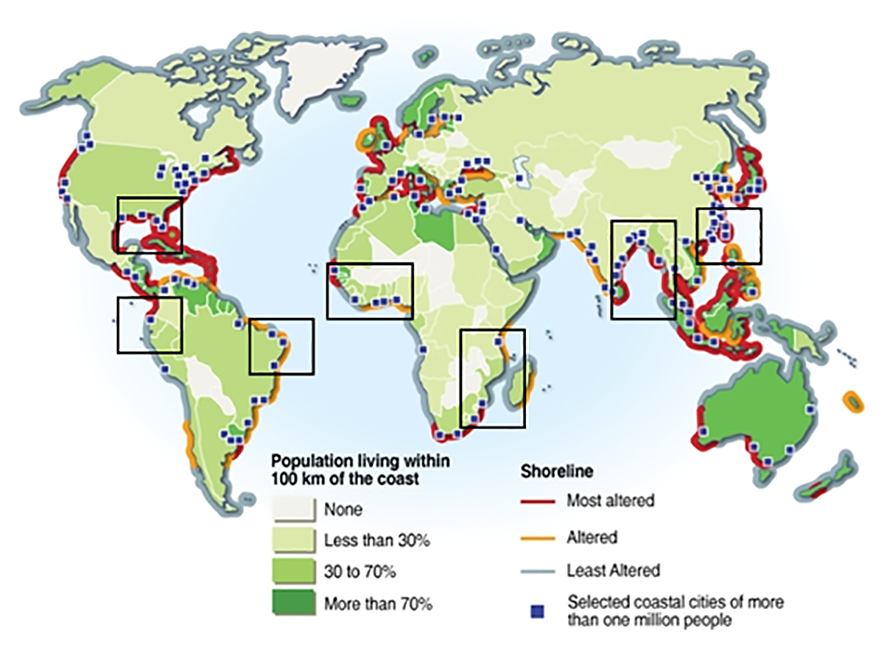
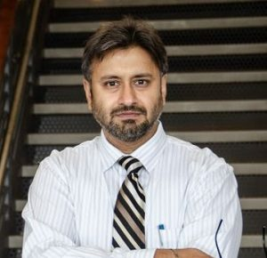


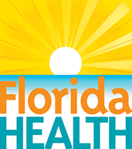
Florida Coastal Health and Tourism
Predictive Assessment of Clinically Active Biothreats in Coastal and Ocean Waters Using NASA Polar data
Value Study focused on the predictive risk assessment for coastal HABs using polar and geo observations.
Zooplankton may inhibit algal blooms which are toxic to fishes and be aerosolized through sea spray. ​
Needs for data from: VIIRs, Sentinel, PACE, GLIMR and OCX
Will work with: UEC, OAR, NOS, Coast Watch LEO and GEO for Value Chain development
Dr. Antarpreet Jutla
Environmental Engineering Sciences,
University of Florida
Florida Offices of
Health
Coastal Tourism
Shellfish Industry
VIIRS, PACE, OCX, ACX
Science Working Groups
Product and Services Development
Notes:
Partnered with: Regional hospital administrators (Baptist Health, UF Shands) to help prevent situations such as this:
https://www.winknews.com/2022/10/14/michigan-man-dies-from-bacteria-while-helping-in-ian-recovery/

Slide 16
Summary
Pathfinders is a strong collaboration opportunity with NASA and LANCE
The NOAA Pathfinder Initiative is developing value chains that trace impacts across NOAA missions, products and services
Pathfinders ties into Program formulation stages with NOAA missions for future development and UE
Pathfinders ensures user readiness and address user needs sensitivity
Value chains are designed to collect climate ready user feedback to inform internal NOAA products and services
Provides most current user decision making and feed into all NOAA services and foundational data
Coordinates user information for conducting mission agnostic/thematic gap assessments
Notes:
Every series will have a formulation phase Make Pathfinder a part of the formulation phases and engaged with the programs to ensure the series and the Pathfinders are coordinated
LEO and SWO are loosely coupled Project. Bunch of Sats in orbits doing diff things. They need bite size chunks for messaging to congress for the continuity from the existing missions.

